Slide 1
Areas of belief | Puritan/Calvinist | Anglican | Arminian | Roman Catholic
Faith and Salvation
Role of the Church
Preaching and ritual
Role of bishops
Attitude to authority
Attitude to Catholic Church

Slide 2
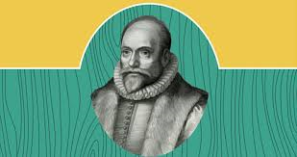
What is Arminianism?
It is a teaching regarding salvation associated with the Dutch.
One of the most important features of Arminianism is the rejection of the Doctrine created by God.
Arminianism is a reclamation of early church theological consensus (Catholic style Christianity).
All the ideas are based on Jacobus Arminius and his historic supporters are known as Remonstrants.

Slide 3
What is Protestantism?
Protestantism is a form of Christian faith and practice which originated with the Protestant Reformation (Henry VIII).
The Protestant Reformation was a movement due to its followers considering an error in the Roman Catholic Church (Martin Luther).
Protestantism is a movement that started in the 16th century as a reaction to Roman Catholic practices.
Protestantism became one of the three major forces in Christianity.

Slide 4
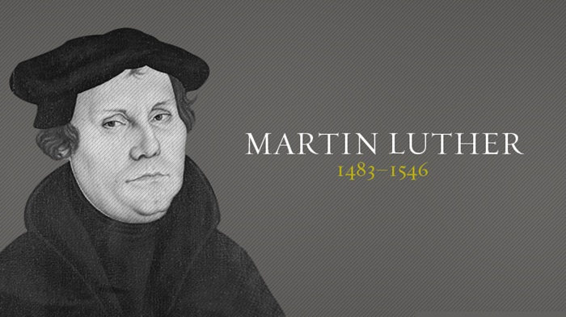
Presbyterianism
Started initially by Martin Luther’s church doctrine in Germany, but changed by John Calvin.
The Presbyterian church is governed locally by assigned ‘elders’.
These elders try to seek the will of God for the church and explain their feelings to God.

Slide 5
Anglicanism
Anglican means English Church in Latin.
The religion comes from the times of the Magna Carta in 1215.
The religion is based on the Bible and traditions of the apostolic succession, (that the churches should be succeeded through a series of bishops).
Anglicans are Protestants and their religion is closely mirrored to that of Reformed Protestantism.
During the 17th century many people referred to Anglicanism as ‘Catholic and Reformed’.

Slide 6
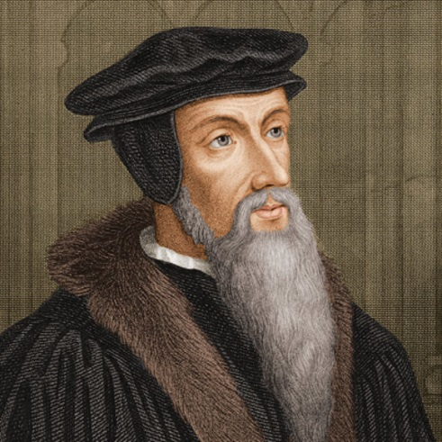
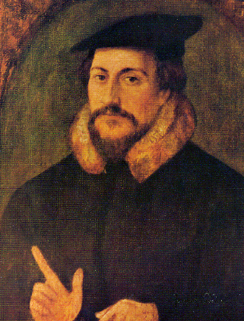
Calvinism
Calvinism was originally taught by John Calvin. Calvin lived in France in the 1500s. The five main points of Calvinism are:
Total Depravity
Unconditional Election
Limited Atonement
Irresistible Grace
Perseverance of the Saints
Inspired the Puritan movement
Total Depravity means that sin has affected all parts of man and that we are all completely sinful.
Unconditional Election means that your behaviour doesn’t matter as God has already chosen if you are going to heaven or hell (similar to the beliefs of the Puritans).
Limited Atonement means that Jesus died only for the people who have been chosen to go to heaven.
Irresistible Grace means that if you have been selected by God to go to heaven, you cannot resist.
Perseverance of the Saints means that if god has chosen you to go to heaven, then you are eternally secure.

Slide 7
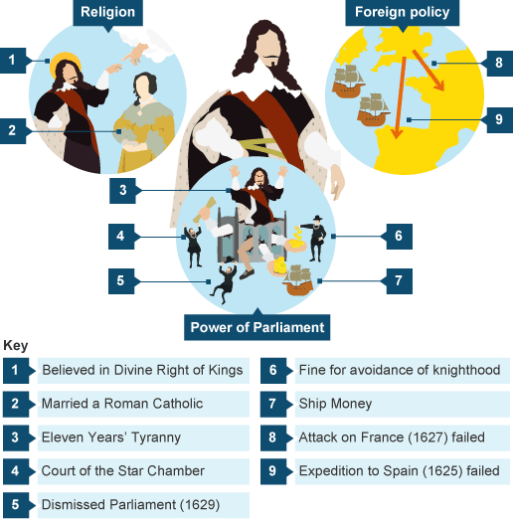
Task: Summarise the video which gives some Background on Charles’ approach to religion
http://www.bbc.co.uk/programmes/p00xcwh9 (Religious division in England in the early 1600s – 5mins)
The mindset and approach to kingship of Charles I are analysed by historians. His Catholic wife aroused suspicions among Protestants but Charles made the situation much worse by a series of actions which made it appear that he was attempting to bring back the Catholic Church. He appointed William Laud as Archbishop of Canterbury, another man who appeared to be pro-Catholic. The use of decoration, ritual and enforcing obedience all increased the worries of Puritans.

Slide 8
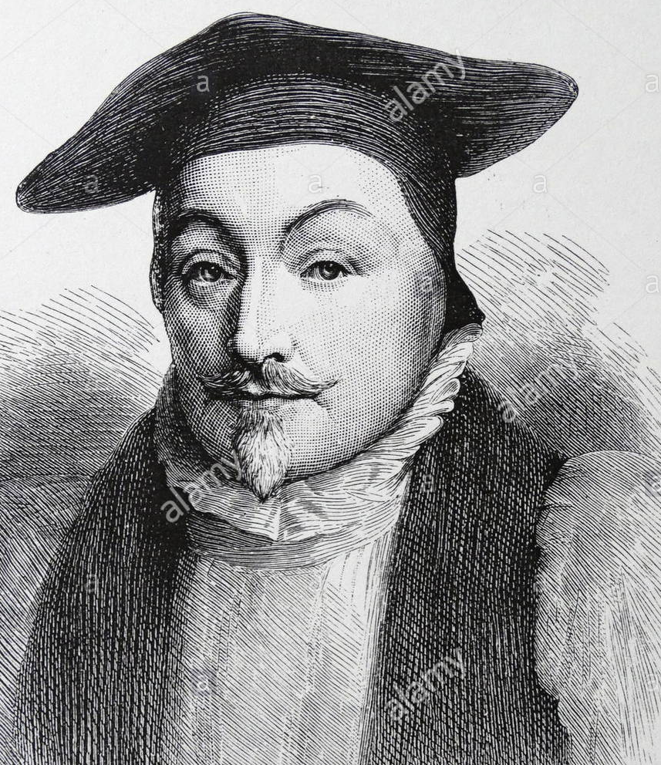
Task: Independent reading
15mins
10mins
Task Evaluate Laud – summarise your opinions on Laud in 50 words or less. Use key terms
William Laud biography
Stretch Challenge – to what extent can Laud be blamed for increasing tensions in England?
Stretch & Challenge 2: Suggest to what extent you think he contributed to Charles I’s downfall

Slide 9
William Laud Archbishop of Canterbury
William Laud, (born Oct. 7, 1573, Reading, Berkshire, Eng.—died Jan. 10, 1645, London), archbishop of Canterbury (1633–45) and religious adviser to King Charles I of Great Britain. His persecution of Puritans and other religious dissidents resulted in his trial and execution by the House of Commons.
Early life and career.
Laud was the son of a prominent clothier. From Reading Grammar School, he went on to St. John’s College, Oxford, and until he was nearly 50 combined the successful but unspectacular careers of academic and churchman. He was soon associated with the small clerical group, who, in opposition to Puritanism, stressed the continuity of the visible church and the necessity, for true inward worship, of outward uniformity, order, and ceremony. In 1608 Laud entered the service of Richard Neile, bishop of Rochester, with whose help he secured a succession of ecclesiastical appointments. From 1611 he was a royal chaplain and came gradually to the notice of King James I. His lifelong conflict with John Williams, later bishop of Lincoln and archbishop of York, began when both sought advancements through the patronage of Charles’s favourite, the Duke of Buckingham. During Buckingham’s years of power, Laud was his chaplain and confidant, and he established a dominant voice in church policies and appointments. He became a privy councillor in 1627 and, a year later, bishop of London.
In his London diocese, Laud devoted himself to combating the Puritans and to enforcing a form of service in strict accordance with the Book of Common Prayer. The wearing of surplices, the placing of the communion table—railed off from the congregation—at the east end of the chancel, and such ceremonies as bowing at the mention of the name of Jesus were imposed, though cautiously enough to avoid unmanageable opposition. Churches, from St. Paul’s Cathedral down to neglected village chapels, were repaired, beautified, and consecrated. To religious radicals, all such reforms seemed moves toward popery (too similar to Catholicism).
On the death of George Abbott in 1633, Laud became archbishop of Canterbury, but he had already, by instructions issued in the King’s name and by his ruthless energy in the royal prerogative courts of Star Chamber and High Commission, extended his authority—with varying success—over the whole country.

Slide 10
Persecution of Puritans
From 1634 to 1637 visitations of every diocese (including, after strong resistance by Williams, that of Lincoln) showed the extent of deficiencies within the Anglican Church and the strength of Puritan practices. A succession of detailed orders from the Archbishop laid down the remedies. Preaching, to Puritans the essential task of the ministry, was to Laud a most dangerous source of “differences” in religion to be curtailed and controlled. In London his attack on Puritan “lectureships” culminated in the overthrow of the “feoffees for impropriations,” the City organization for buying up tithes and church patronage for the benefit of Puritan clergy. The printed word was dangerous, too: celebrated Puritan propagandists such as Alexander Leighton and William Prynne were mutilated and imprisoned.
Occasionally, Laud was less harsh than his enemies admitted, especially to the clergy. But he rejected all conciliation of the Puritan movement, whose strength and qualities he never understood. He had, in fact, much in common with some forms of it: the unrelenting quest for the godly life, the intolerant certainty of his own righteousness, the hatred of corruption and extravagance. He could do much to diminish inefficiency, pluralism, absenteeism, and sheer idleness. But his wider efforts to overcome the poverty of clergy and parishes and restore something of the church’s position as a great and powerful landowner had extremely limited success.
To Laud, the strength of the church was inseparable from that of the state. Conflict between royal and ecclesiastical power was a possibility he never faced: under Charles I both could be exalted simultaneously. Holding no state office, he used his position on the privy council and his influence over the King to attack “the Lady Mora” (delay) in what he considered her first personification, the treasurer Richard Weston, and afterward in other ministers. His most effective direct impact on government was in the social policy he applied through the council and the courts. Exacting landlords and unscrupulous officials were attacked, and the poor were protected against everyone except the state itself.
In all this his one constant ally was Thomas Wentworth (later the earl of Strafford), from 1633 lord deputy in Ireland. Laud and Wentworth corresponded regularly and frankly on their joint struggle to establish “thorough,” as their rigorous policy came to be called. But by 1637 both began to see, dimly, the storm that was about to break upon them. The further trial of Prynne, together with other radical Puritans such as Bastwick and Burton, demonstrated not success for Laudian suppression but rather huge popular support for the opposition. The resistance of the gentry was consolidated by the extended demand for “ship money,” the most hated of Charles’s non-parliamentary levies. Attempts by Charles and Laud to impose Anglican forms of worship in Scotland provoked fierce resistance there. English forces were sent northward, and in 1639 the “Bishops’ Wars” began.

Slide 11
Trial and execution
In the spring of 1640 Parliament met for the first time in 11 years and with it the clerical assembly, the Convocation (the action of calling people together for a large formal assembly), which laid down in a new set of canons (a general law, rule, principle, or criterion by which something is judged) the principles of the Laudian church. They explained the prescribed ceremonies as “fit and convenient” rather than essential. But they added to the popular hatred of Laud shown in mass demonstrations, petitions, and leaflets. In December, formally accused of high treason, he was taken to the Tower. His trial, managed enthusiastically by Prynne, began only in 1644, in the midst of the Civil War. As with Strafford, the Commons had to abandon legal proof and resort to an ordinance of attainder, accepted hesitantly by the lords. On Jan. 10, 1645, the Archbishop was beheaded.
Laud was never much liked, even by his allies. A humourless, dwarf-like figure, uninterested in court pleasures, unmarried, tactlessly impartial in his condemnations, he could never establish a party of influential supporters. During the war and interregnum (the period in English history from the execution of Charles I in 1649 to the Restoration of Charles II in 1660), royalists and peacemakers generally preferred to forget him. At the Restoration, in 1660, outward Laudian forms were accepted but by a church less significant than ever to the community and the individual. Few in the 18th century saw Laud as a martyr. In the 19th century the historian Thomas Babington Macaulay’s fierce contempt for the “ridiculous old bigot” inspired the schoolbooks of many generations. The Oxford Movement, a movement of High Anglican reform in the 1840s, tried unconvincingly to re-establish him as a religious leader, and High Anglican clergy have remained his principal supporters. But at the turn of the 19th century, the Civil War historian Samuel Rawson Gardiner stressed Laud’s abilities and integrity and regarded the links with authoritarian politics as his “misfortune.”
In the 20th century, the eminent English historian H.R. Trevor-Roper has set against his narrow-minded methods the comprehensive idealism of his social policy, “coloured over by the accepted varnish of an appropriate religious doctrine.” Laud, as he himself was well aware, failed; but his devotion to a coherent purpose and his repudiation of hypocrisy, compromise, and corruption in allies and enemies of whatever class were rare and admirable qualities.

Slide 12
Laud’s policies and religious uniformity, 1625-40
Many Protestants saw the Catholic Church as a force of evil because they had corrupted the early ideas of Christian Church and the doctrine of salvation by faith alone
Arminians (who followed the ideas of Jacob Arminius) claimed the Anglican Church (Church of England) had the right balance because it stripped away unnecessary superstition & restored the ideas of faith & purity
BUT they retained ceremony and hierarchy in the church as they felt it kept order and respect
This idea was not accepted by many Protestants as it gave the clergy an elevated status, which is directly against the Protestant belief that all men are created equal in the eyes of God
These Arminian ideas were offensive to Puritan for 2 main reasons: it threatened the rights of the individual to a direct relationship with God AND it reeked of Catholicism
Charles protected those with Arminian beliefs from complaints by Parliament such as Richard Montagu & the Duke of Buckingham
Charles even went as far as to forbid the public discussion of sensitive religious ideas – which was seen as unfair favouritism towards the Arminian doctrine

Slide 13
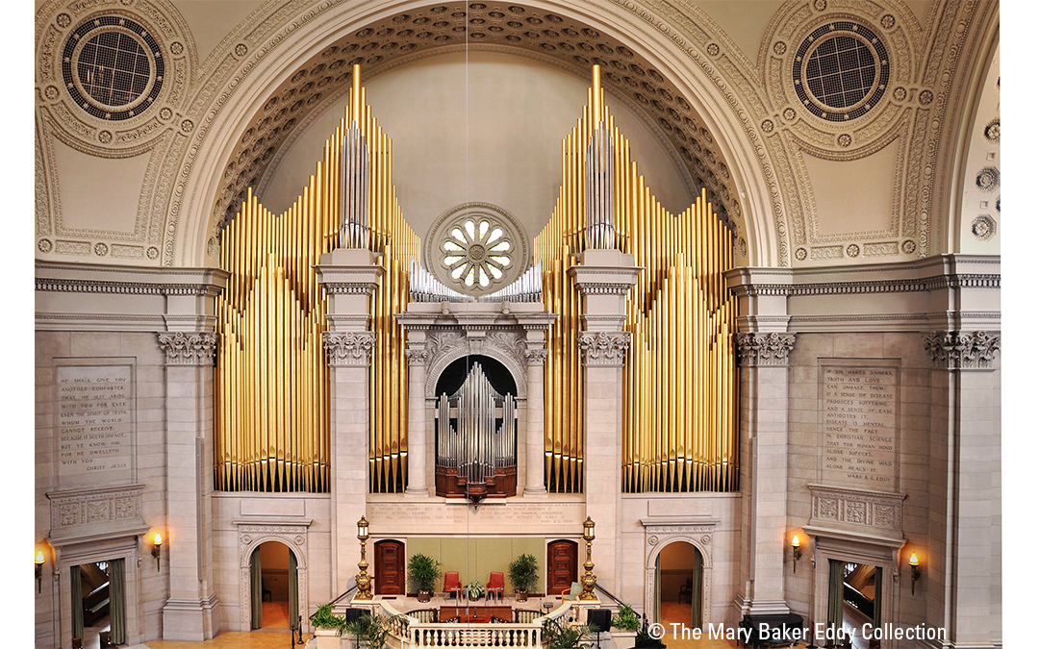
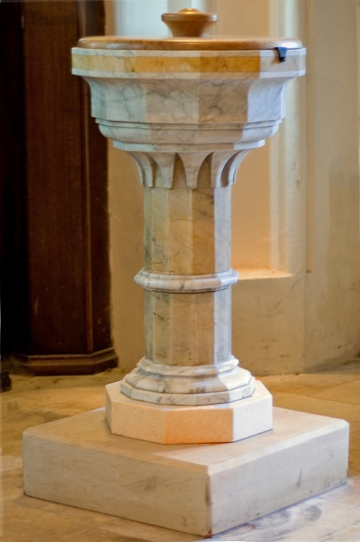
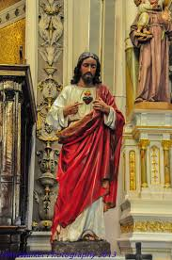
Laudian reforms, 1628-1640
Puritan MPs expressed fear of the spread of Catholicism and linked them to Arminian influence of individuals who had Charles I’s ear in court
Charles, a believer in divine right, found natural companions in Arminians who also believed in the importance of hierarchy & respect
Fears were exacerbated by the actions of the Catholic Queen and wife of Charles – the French Henrietta Maria. She appointed Catholics to important roles and jobs in government
Neither Charles nor Laud were Catholic but it raised fears among many Protestants about the return of Catholicism
Laud focused on: decorations of churches, conformity of all clergy, dissenting ministers were brought in front of the Star Chamber e.g. John Bastwick
introduction of
organs Puritans were strongly against them as they believed they distracted the congregation
Fonts
Statues
Stain glass windows
Movement of the communion table from the centre to the east (further separates the laity from the clergy - offended other Christian groups as well, not just Puritans

Slide 14
Plenary: Laud’s reforms
Write one paragraph explaining why Laud’s reforms were unpopular outside the Arminian community.

Slide 15
Extra information
https://www.youtube.com/watch?v=pR8JUQVbaEg (from 2:50

