Slide 2
Learning outcomes:
-To know how to write an effective opening and ending to a narrative.
-To be able to extend my response in narrative writing
Thursday 9th January
Narrative Writing
Do Now:
What is a better way of writing ‘he was scared’?
What do you need after an adverb to start a sentence?
What are the mistakes in this sentence: ‘the patriarchle society was bad.’
.
.

Slide 3
Learning outcomes:
-To know how to write an effective opening and ending to a narrative.
-To be able to extend my response in narrative writing
Choose a title as a class and lets plan
Write a story with the title ‘Searching for answers’
Write about a time when you refused to believe the truth
Write a story which ends: “Finally everyone knows the real me…”
Write a story beginning: ‘I couldn’t believe my eyes’.
.
.

Slide 4
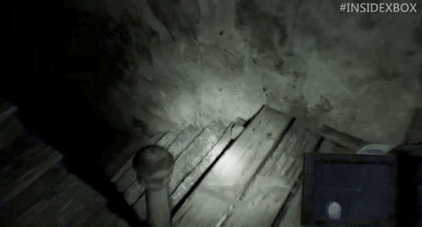
Learning outcomes:
-To know how to write an effective opening and ending to a narrative.
-To be able to extend my response in narrative writing
The so, so sentence
It was so exciting, so thrilling, I began to shake with adrenaline.
Success criteria:
Use 2 adjectives to describe an object or emotion
Place the second ‘so’ within an embedded clause
Use two commas to separate from the main clause

Slide 5
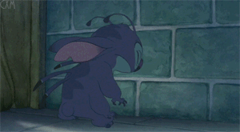
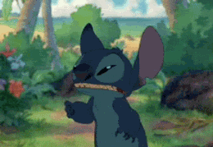
Learning outcomes:
-To know how to write an effective opening and ending to a narrative.
-To be able to extend my response in narrative writing
The triple noun colon sentences
Fear, hatred, loathing: every emotion burned into me as I recalled the betrayal.
Success criteria:
Three nouns that show emotion
Separate them with commas
Use a colon to introduce an action that would show those emotions
.

Slide 6
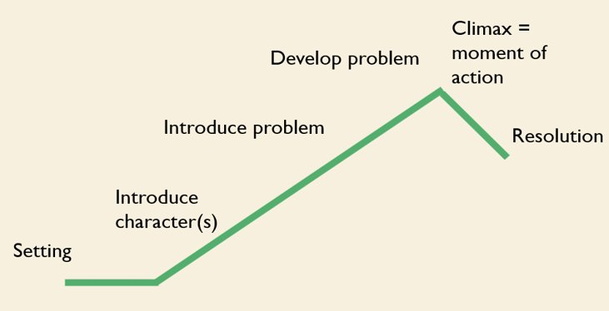
Learning outcomes:
-To know how to write an effective opening and ending to a narrative.
-To be able to extend my response in narrative writing
Narrative Writing – Paper 1
P1 – Where is it set? What is the weather like? What is the mood like? How does your character feel?
P2 –Who are they? Who else is there? What do they move/sound like? Describe their face
P3 – What are they doing? What is the issue? How do they feel? Why?
P4 – What happens to make it worse? Is anyone else there? How has the weather/surroundings got worse?
P5 – How do they make the problem better? How do they feel? What happens next?
P6 – Now where are they? What is the weather like? How has the mood changed from the beginning? How does your character feel?
.
.

Slide 7
Learning outcomes:
-To know how to write an effective opening and ending to a narrative.
-To be able to extend my response in narrative writing
Narrative Writing – A sneaky way to save time…
.
.

Slide 8
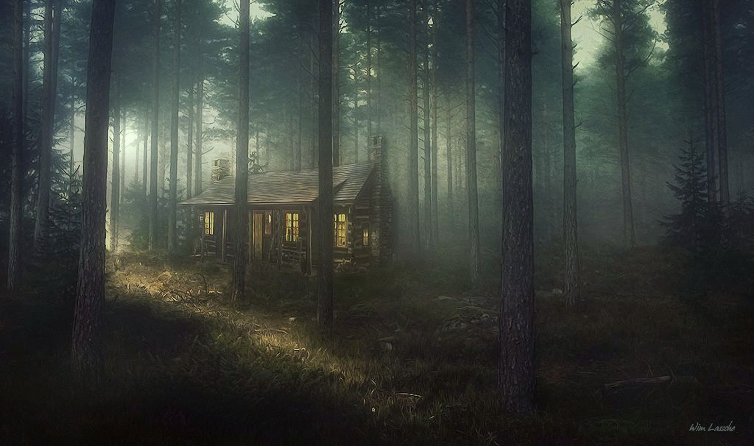
Learning outcomes:
-To know how to write an effective opening and ending to a narrative.
-To be able to extend my response in narrative writing
Narrative Writing – Slow Writing to describe the character. 1 paragraph, 10 sentences, each with a different rule
Before we begin…
What is the picture showing?
What words could we use?
Think of the senses, weather, good vocab
.
.

Slide 9
Learning outcomes:
-To know how to write an effective opening and ending to a narrative.
-To be able to extend my response in narrative writing
Thursday, 09 January 2025
Narrative Writing
Slow Writing - 1 paragraph, 10 sentences, each with a different rule
Start your sentence with an adverb to describe the light in the distance (dimly, hauntingly, eerily, barely, faintly, weakly, softly)
Now a sentence about what the cabin looks like. Start with a double adjective sentence starter (_____ and ________, the cabin…)
In your next sentence, describe the sounds all around you – make them sound threatening and scary. Start with, As I stood, all I could hear was… (whispers, squawks, screeches, chatter, chirp, buzzing)
Start with a verb to describe how you feel. (potential words: shaking, trembling, panicking, quivering, shivering…)
Use an adjective and simile to explain the isolated location. (isolated, alone, remote, secluded, abandoned, solitary)
Add in a sentence with 13 words to show that you (the narrator) have arrived late at night to the cabin and expected it to look nicer.
Write a ‘the more, the more’ sentence to show how you feel as you walk towards the cabin (walk, tread, inch, creep, step, shuffle / nerves, fear, terror, anxiety etc)
Add in a sentence where you wish you had agreed for your friend/family member/ boyfriend/girlfriend to come with you and not just meet you the next day
Add in a ‘so, so’ sentence to describe the darkness of the night or the bad weather
Describe the weather getting worse and link it to your mood
Finish with a triple noun colon sentence to say how you feel
Dimly glowing through the mist, the light did nothing but elongate the shadows.
Dreary and decrepit, the cabin looms in front of me in the darkness.
As I stood, all I could hear was the eerie chirping of crickets and the slow snapping of twigs under my feet.
Shivering, I could feel the cold invade my bones as the dread and regret seeped into my soul.
The cabin was more than just remote, it was lonelier than a grave of a forgotten man.
Add in a sentence with 13 words to show that you (the narrator) have arrived late at night to the cabin and expected it to look nicer.
The more I inched towards the door, the more my anxiety bubbled to the surface.
I regretted agreeing to go there on my own to decorate it ready for Toni’s 30th birthday.
It was so stormy, so dark, that the only thing I could do was enter the ominous building.
Through the window, the rain started to hammer harder than my tears.
Remorse, regret, sorrow: my great idea for a birthday surprise was turning into a nightmare.

Slide 10
Learning outcomes:
-To know how to write an effective opening and ending to a narrative.
-To be able to extend my response in narrative writing
Thursday, 09 January 2025
Narrative Writing
Do Now: Use the latest Spenny update to help if needed
Write a sentence starting with a verb…remember where the comma goes! ( verb , _______________.)
Write a sentence starting with an adverb…remember where the comma goes! ( adverb , _______________.)
Write a ‘the more, the more’ sentence (the more ____ , the more_______.)
Write a ‘so, so’ sentence (it/he/she was so ______ , so ______ that ________. )
.
.

Slide 11
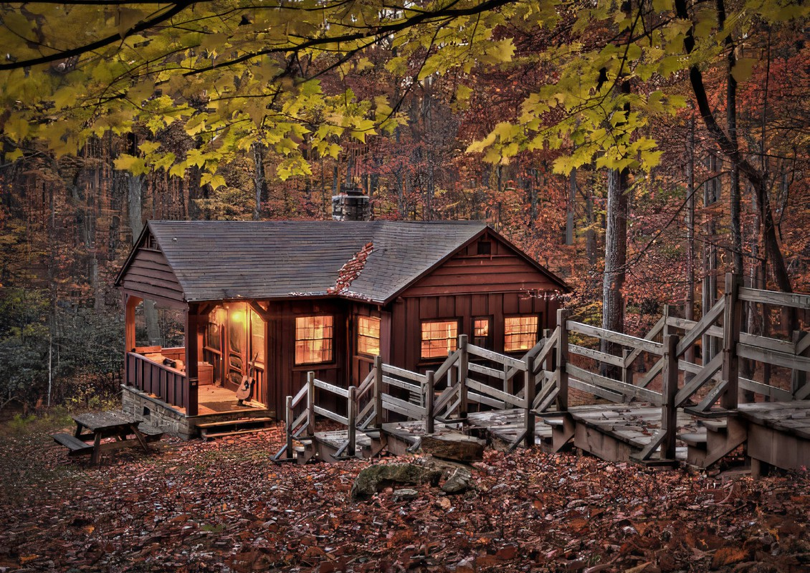
Learning outcomes:
-To know how to write an effective opening and ending to a narrative.
-To be able to extend my response in narrative writing
Thursday, 09 January 2025
Narrative Writing
Now write the same paragraph as last week but imagine it at daytime and you’re happy!
Start your sentence with an adverb or a verb to describe the sunlight through the windows (brightly, streaming, glaring, flooding, intensely)
Now a sentence about what the cabin looks like as you’re leaving. Start with a double adjective sentence starter (_____ and ________, the cabin…)
In your next sentence, describe the sounds all around you – make them sound inviting and peaceful. Start with, As I closed the door, the sounds of… (whispers, squawks, screeches, chatter, chirp, buzzing)
Start with an abstract noun to describe how you feel now . (potential words: joy, excitement, relief…)
Use an adjective and simile to explain the location in the opposite way to your first paragraph.
Add in a sentence with 13 words to show that you (the narrator) are sad to be leaving.
Write a ‘the more, the more’ sentence to show how you feel as you walk away from the cabin (walk, tread, inch, creep, step, shuffle / nerves, fear, terror, anxiety etc)
Add in a sentence where you are pleased your friend/family member had such a good trip
Add in a ‘so, so’ sentence to describe the beauty of the cabin or the nice weather
Describe the weather getting better and link it to your mood
Finish with a triple noun colon sentence to say how you now feel
Miss S will write alongside you

Slide 12
Learning outcomes:
-To know how to write an effective opening and ending to a narrative.
-To be able to extend my response in narrative writing
Thursday, 09 January 2025
Narrative Writing
Now you have your beginning and ending, all you need to do is write the middle. Think about our sentence types and use them in your middle paragraphs.
P1 – Where is it set? What is the weather like? What is the mood like? How does your character feel?
P2 –Who are they? Who else is there? What do they move/sound like? Describe their face
P3 – What are they doing? What is the issue? How do they feel? Why?
P4 – What happens to make it worse? Is anyone else there? How has the weather/surroundings got worse?
P5 – How do they make the problem better? How do they feel? What happens next?
P6 – Now where are they? What is the weather like? How has the mood changed from the beginning? How does your character feel?
.

