Slide 1
Do Now
Friday 10th January 2025
How long should a 26 year old be exercising for each day ?
What are the barriers for participation?
How to overcome access barrier ?
How to overcome cost barrier?

Slide 2
Answers
How long should a 26 year old be exercising for each day ?
150mins a week – 30 minutes x 5 days a week
2. What are the barriers for participation?
Cost,Access,Time,Personal and Cultural
3.How to overcome access barrier ?
Public transport discount, Cycle hire to access the facility, Free parking, Taster days, Staff training to support all types of participant and their needs, Increased range of provision of sports and physical activities, Ramps and Assistive technology.
4.How to overcome cost barrier?
Discounted pricing,Hiring of equipment, Free car parking

Slide 3
Read the scenario on the following slide.

Slide 4
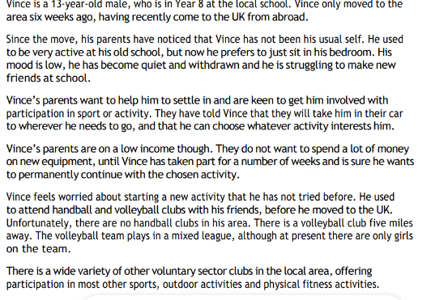

Slide 5
Analysing Task
Task 1 -Analyse the scenario
Highlight the key points in the text.
Answer the following in slide 9 or on some paper.
1)What type of participant – Age, gender?
2) Social context? What are they doing socially ? Sport?
3) What barriers are there ?
4) Why may they have these barriers ?
Complete in full sentences.
Be prepared to share with class on return.

Slide 6

Now discuss as a class – We will discuss this when you return to school.

Slide 7
Increasing Participation task
Task 2
How can you increase participation ?
Think of what activities they could do and why?
Take into consideration the barriers.
Think of how to overcome some of the barriers you have identified?
By increasing partciptation, how's it going to affect them ?
Complete this on slide 9 or on paper in full sentences. Please can you justify why you have picked your answers.
Be prepared to share with the class.

Slide 8
Extensions task- Revise the following, revise the topics you feel less confident with.
Types of Sport and Physical activities
Benefits of taking part in sport
Outdoor adventures and benefits
Provision of sport and physical activity
Advantages and disadvantages of provisions
Types of participants- age -how long each age group participates for?
Types of participants- disability and health conditions
Physical activity needs of participants
Barriers for participation
Addressing barriers for participation
Different types of clothing and equipment for sport purpose and benefits –
• Clothing
• Footwear
• Equipment needed for specific sports
• Protection and safety equipment
• Equipment for disability sports- assistive technology
• Facilities
• Performance analysis
Technologies advancement, restrictions and benefits
• Clothing
• Footwear
• Equipment needed for specific sports
• Protection and safety equipment
• Equipment for disability sports- assistive technology
• Facilities
• Performance analysis

Slide 9
Answering slide

