Slide 1





Wednesday, 08 January 2025
Introduction into new project
Learning Objective: understand the requirements of the brief
AO1 | AO2 | AO3 | AO4
Develop their ideas through sustained and focused investigations informed by contextual and other sources, demonstrating analytical and critical understanding. | Experiment with and select appropriate resources, media, materials, techniques and processes, reviewing and refining their ideas as their work develops. | Record in visual and/ or other forms, ideas, observations and insights relevant to their intentions, demonstrating an ability to reflect on their work and progress. | Present a personal, informed and meaningful response demonstrating critical understanding, realising intentions and, where appropriate, making connections between visual, written, oral and other elements.
Why are we doing this?
So we can:
Set up photoshop
Read and understand the brief
Research with purpose
Understand the marking criteria
Lucere Aude
Dare to
Shine
How could you keep your folder looking professional?
Who could be your target market and why?
How can your brief be sustainable and have a positive impact?

Slide 2


















Do Now
Wednesday, 08 January 2025
Introduction into new project
What are your interests outside of college?
Lucere Aude
Dare to
Shine
How could you keep your folder looking professional?
Who could be your target market and why?
How can your brief be sustainable and have a positive impact?

Slide 3
The Brief: Fashion
Design graphics to identify and promote a new fashion company. You might like to look at the iconic logo John McConnell designed for Biba and designs for packaging and print that Whitmore-Thomas produced for the Biba Store. Marmalade London produced brand identities, websites and designs for packaging and print for fashion designers including Sophie Hulme, Yves Piaget and Citizen Flint. Produce your own response and make reference to appropriate contextual material
The Brief
A new restaurant that specialises in using the freshest ingredients and local produce is looking to create a brand identity. The company is looking to re-brand following an ancient Nordic theme. When producing graphics for the company, you might consider approaches such as corporate identity, packaging, advertising materials, design for print and signage.
The Brief
A new beach front arcade is looking to create a new brand identity. When producing graphics for the company, you might consider approaches such as corporate identity, packaging, advertising materials, design for print and signage.
The Brief
A hotel is looking to re-brand their company. The hotel prides themselves in high level service in a rural environment. When producing graphics for the company, you might consider approaches such as corporate identity, packaging, advertising materials, design for print and signage.
The Brief
‘Jacked Up Coffee’, a boutique coffee shop is looking to re-brand their company. The coffee shop pride themselves in quality coffee in a variety of styles. When re-branding the company, you might consider approaches such as corporate identity, packaging, advertising material, design for print and signage.
Decide on a brief for your project. This will work best if it is something you have an interest in. type up your brief and then discuss with your teacher the possible outcomes.
Use past exams to inspire you.

Slide 4
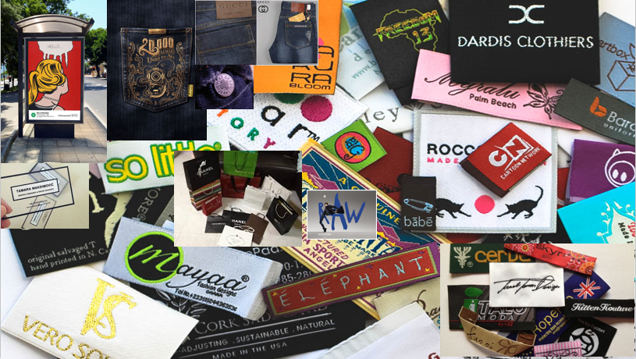
Initial Research
One page with lots of products/logos that could inspire you to meet the brief
This page does not need to be annotated.

Slide 5
Work to complete. . .
Research possible briefs and write a first draft of what you would like to do
Start gathering images for initial research
Star thinking about artists to inspire your project

