Slide 1
Set a 6-minute timer for your do now
Title: Averages
Date: 10 January, 2025
At the start of the lesson:
Greet at the classroom door
Wear your uniform with pride
Enter the classroom in silence
Books distributed calmly
Complete your do now in silence
Place your equipment on the desk
Do Now:
Sit Up & Focus - Highest Quality Work - Interruption Free - Neat Work - Equipment

Slide 2
ANSWERS
Title: Averages
Date: 10 January, 2025
At the start of the lesson:
Greet at the classroom door
Wear your uniform with pride
Enter the classroom in silence
Books distributed calmly
Complete your do now in silence
Place your equipment on the desk
Do Now:
Sit Up & Focus - Highest Quality Work - Interruption Free - Neat Work - Equipment

Slide 3
Finding the range of a list of numbers

Slide 4
The Range – practice questions (8 mins)

Slide 5
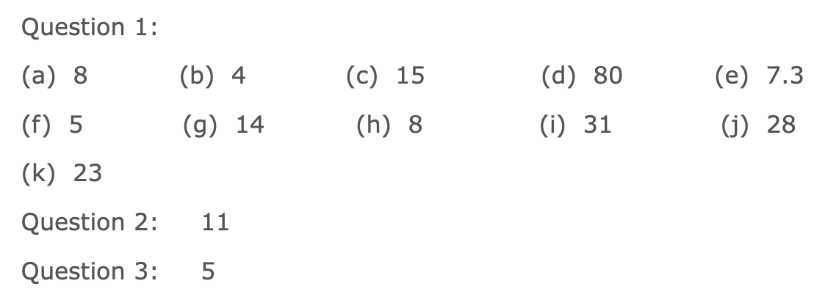
The Range – practice questions
ANSWERS

Slide 6
Finding the mode

Slide 7
The Mode – practice questions (8 mins)

Slide 8
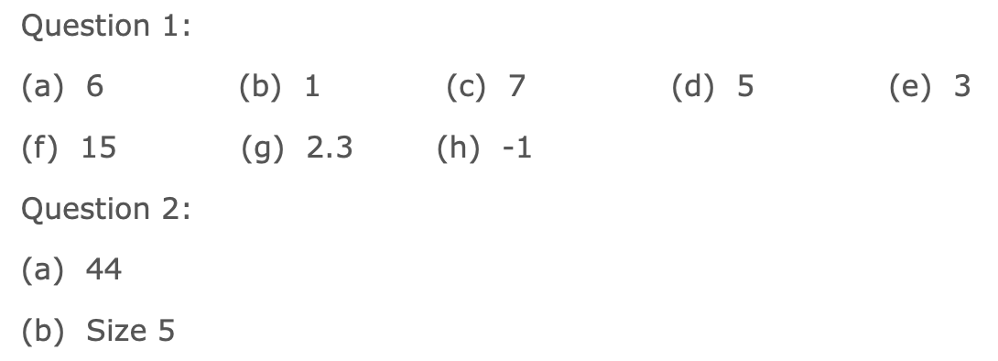
The Mode – practice questions
ANSWERS

Slide 9
Finding the median

Slide 10
The Median – practice questions (8 mins)

Slide 11
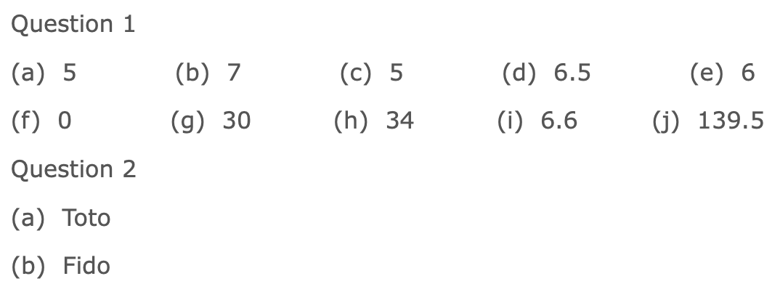
The Median – practice questions
ANSWERS

Slide 12
Finding the mean

Slide 13
The Mean – practice questions (10 mins)

Slide 14
The Mean – practice questions
ANSWERS

Slide 15
CHALLENGE Questions

Slide 16
CHALLENGE Questions - ANSWERS

