Slide 1
Set a 6-minute timer for your do now
Title: Collecting like terms to find an expression for the perimeter
Date: 9 January, 2025
At the start of the lesson:
Greet at the classroom door
Wear your uniform with pride
Enter the classroom in silence
Books distributed calmly
Complete your do now in silence
Place your equipment on the desk
Do Now:
Sit Up & Focus - Highest Quality Work - Interruption Free - Neat Work - Equipment

Slide 2
ANSWERS
Title: Perimeter and Area using Algebra
Date: 9 January, 2025
At the start of the lesson:
Greet at the classroom door
Wear your uniform with pride
Enter the classroom in silence
Books distributed calmly
Complete your do now in silence
Place your equipment on the desk
Do Now:
Sit Up & Focus - Highest Quality Work - Interruption Free - Neat Work - Equipment

Slide 3
Like terms
We learnt about like terms and unlike terms.
$$4x+3y+2x+5+6y+2$$
is like
is unlike
is like
is unlike
is like
is unlike

Slide 4
Collecting like terms

Slide 5
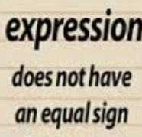
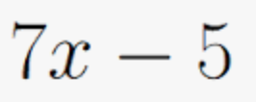
Key word: Expression

Slide 6
Collecting like terms
Example
Write as an expression in the simplest form.
Your turn
Write as an expression in the simplest form.
$$5b+4+2b+3=$$
$$4+5b−2−2b=$$

Slide 7
Collecting like terms
Example
Write as an expression in the simplest form.
Your turn - ANSWER
Write as an expression in the simplest form.
$$5b+4+2b+3=$$
$$4+5b−2−2b=$$

Slide 8
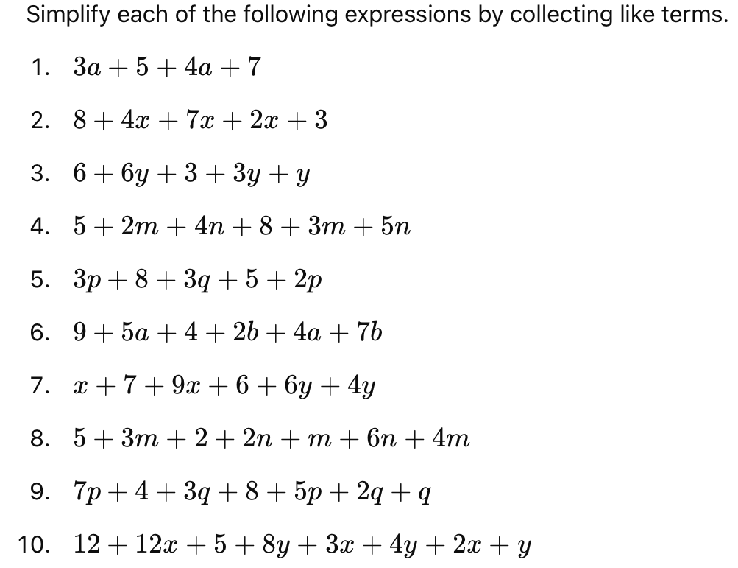
Collecting like terms – practice questions

Slide 9
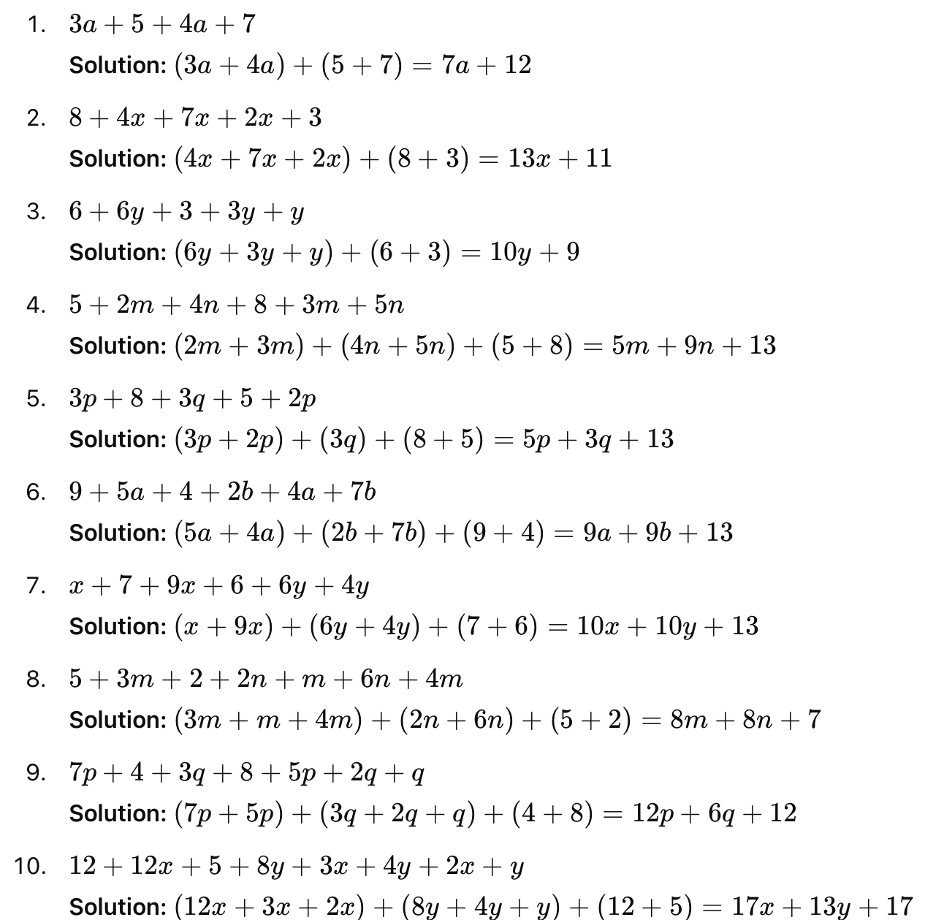
ANSWERS

Slide 10
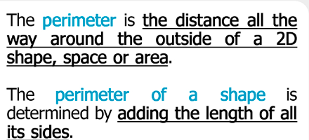
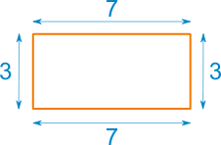
Key word: Perimeter

Slide 11
Writing expressions
We can write expressions in any part of maths where we have unknowns.
Example
Write an expression for the perimeter of this shape.
Your turn
Write an expression for the perimeter of this shape.
$$m$$
$$a$$
$$a$$
$$p$$
$$p$$
$$b$$
$$n$$
Notes:
If pupils are unsure on perimeter, use a highlighter with one colour for $a$ and one for $b$. As you move around the shape, highlight the sides and write the relevant part of the expression as you go, highlighting the term in the expression in the same colour.

Slide 12
Writing expressions
We can write expressions in any part of maths where we have unknowns.
Example
Write an expression for the perimeter of this shape.
Your turn
Write an expression for the perimeter of this shape.
$$m$$
$$a$$
$$a$$
$$p$$
$$p$$
$$b$$
$$n$$
Notes:
If pupils are unsure on perimeter, use a highlighter with one colour for $a$ and one for $b$. As you move around the shape, highlight the sides and write the relevant part of the expression as you go, highlighting the term in the expression in the same colour.

Slide 13
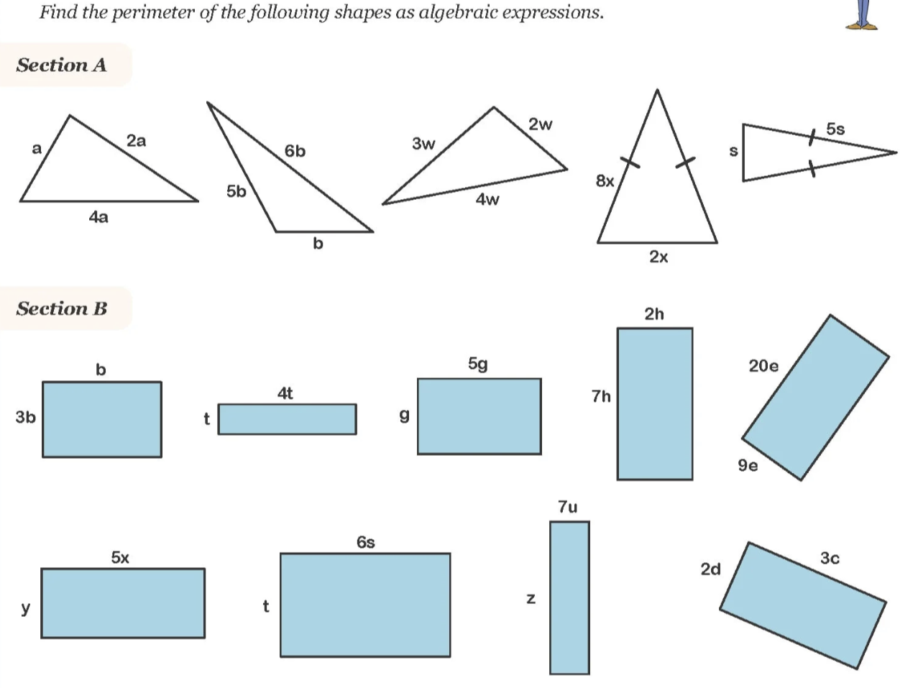
Writing expressions for the perimeter – practice questions

Slide 14
Writing expressions for the perimeter – practice questions support

Slide 15
Writing expressions for the perimeter – ANSWERS
9w
7a
12b
18x
11s
8b
18h
10t
12g
58e
10x + 2y
12s + 2t
6c+4d
14u + 2z

