Slide 1
Types of Numbers
Friday, 10 January 2025
Learning Objective: Recognise and identify types of numbers
Do Now –
Which of these expression have 2x as a factor?
Estimate the probability marked on the probability scale.
Use estimation to decide the correct answer to 3.7 x 19.6
Calculate
Is 64 a multiple of 8, explain your answer

Slide 2
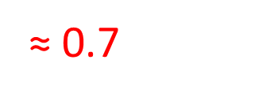
Do Now – Please mark your answers
Which of these expression have 2x as a factor?
Estimate the probability marked on the probability scale.
Use estimate to decide the correct answer to 3.7 x 19.6
Calculate
Is 64 a multiple of 8, explain your answer
Yes because 8 x 8 = 64

Slide 3
Lesson Content
Use the link below to watch the video
Sum7.5.3 - Recognise and identify prime numbers on Vimeo
Whilst watching the video complete the questions given and the worksheet on paper.
Give yourself 15 minutes to complete as much of the worksheet as you can and then mark your work using the answers provided.

Slide 5
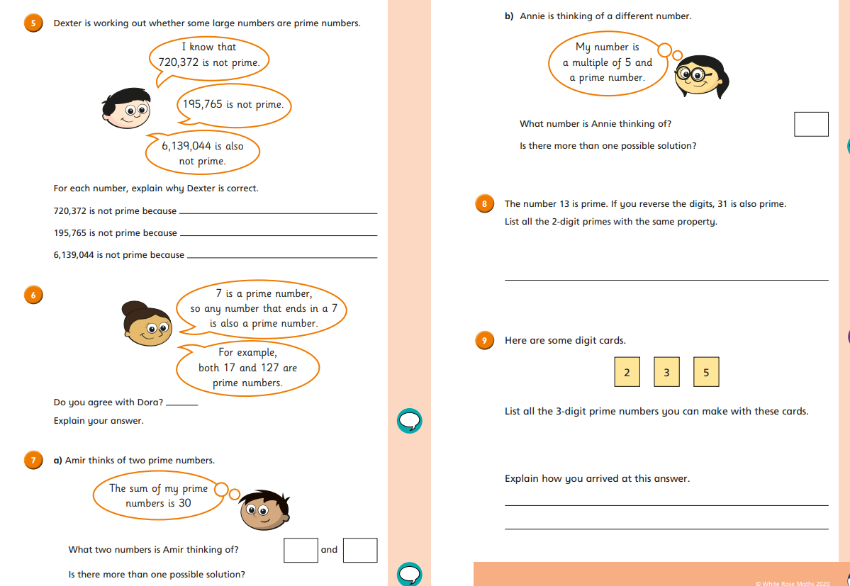

Slide 6
Answers

Slide 8
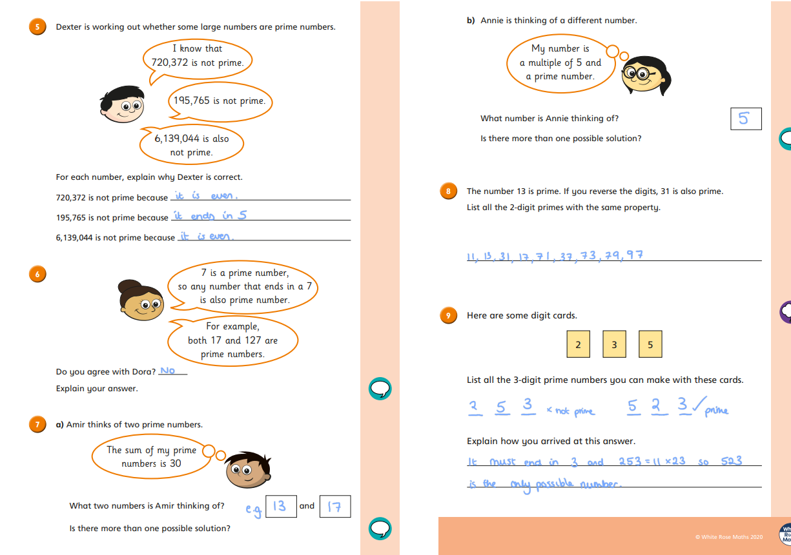

Slide 9
Lesson Content
Use the link below to watch the video
Sum7.5.4 - Recognise square and triangular numbers on Vimeo
Whilst watching the video complete the questions given and the worksheet on paper.
Give yourself 15 minutes to complete as much of the worksheet as you can and then mark your work using the answers provided.

Slide 11
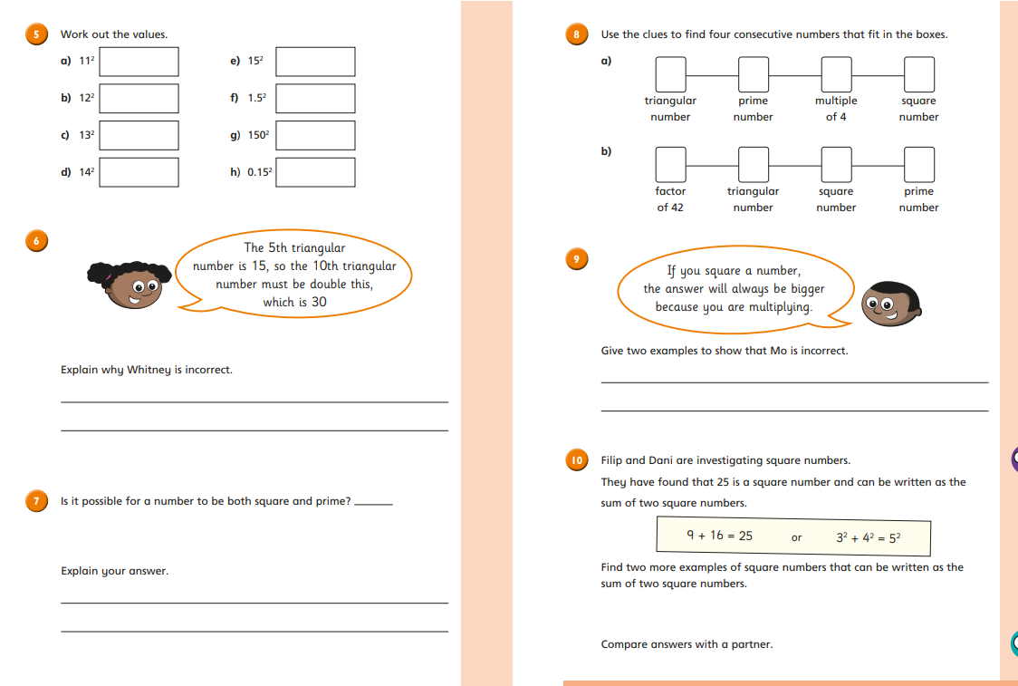

Slide 12
Answers

Slide 15
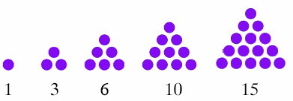
Prime Number
A prime number is a number that has only two factors of 1 and itself.
Recap
Square Number
A square number is the product you get when you multiply a number by itself.
What different types of numbers do we have?
Triangular Number

Slide 16
Lesson Content
Using the skills you’ve practiced today work through the questions below and mark your work with the answers provided (20 minutes)

Slide 17
Practice
Practice
From the list of numbers, write down:
4 7 9 12 15 21 23 30 36 45
A prime number ______
A square number _______
A triangular number _______
A multiple of 10 _______
A factor of 8 _________
From the list of numbers, write down:
1 2 4 6 10 15 21 35
A prime number ______
A square number _______
A triangular number _______
A multiple of 7 _______
A factor of 16 _________

Slide 18
Practice
Practice
From the list of numbers, write down:
4 7 9 12 15 21 23 30 36 45
A prime number _7 or 23_____
A square number ___4, 9 or 36____
A triangular number 15, 21, 36 or 45
A multiple of 10 30
A factor of 8 4
From the list of numbers, write down:
1 2 4 6 10 15 21 35
A prime number 2
A square number 1 or 4
A triangular number 1, 10 or 21
A multiple of 7 21 or 35
A factor of 16 1, 2 or 4

Slide 19
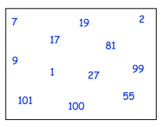
Fluency practice – independent task
Question 1: a) List the first ten prime numbers.
b) List the first ten square numbers.
c) List the first ten triangular numbers.
Question 2:
Are the following numbers prime or not prime?
Question 3:
From the box, choose:
The smallest prime number.
A prime number greater
than 10.
c) A square number.
d) A triangular number.
Question 4:
Work out each of the following:
Question 5:
From this box, list the triangular numbers.

Slide 20
Fluency answers – please mark your work in purple pen
Question 1: a) List the first ten prime numbers.
2, 3, 5, 7, 11, 13, 17, 19, 23, 29
b) List the first ten square numbers.
1, 4, 9, 16, 25, 36, 49, 64, 81, 100
c) List the first seven triangular numbers. 1, 3, 6, 10, 15, 21, 28
Question 2:
Are the following numbers prime or not prime?
yes
no
no
yes
yes
no
Question 3:
From the box, choose:
The smallest prime number. 2
A prime number greater
than 10. 17, 19, 101
c) A square number. 1, 9, 81, 100
Question 4:
Work out each of the following:
25
81
121
Question 5:
From this box, list the triangular numbers.
3, 10, 36

Slide 21
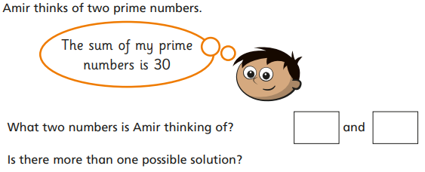
Practice
Practice
15

Slide 22
Practice
Practice
15
Prime numbers:
2, 5, 7, 9, 11, 13, 17, 19, 23, 29
Options:
23 + 7
11 + 19
13 + 17
Prime numbers:
2, 5, 7, 9, 11, 13, 17, 19, 23, 29
Option:
2 + 13

Slide 23
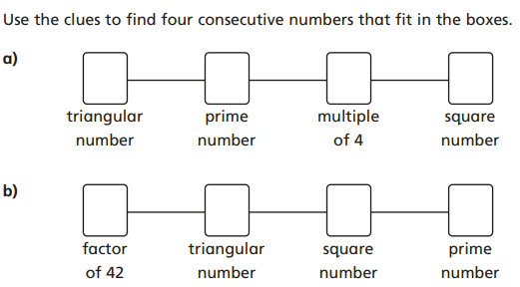
Reasoning and Problem Solving practice – independent task
Question 6:
Write two numbers that are triangular and square numbers.
Question 10:
Tom says "if you square a number, the answer is always bigger". Show that Tom is incorrect using two different examples.
Question 7:
Question 8:
Question 9:
Evie says "all prime numbers are odd". Explain why Evie is wrong.

Slide 24
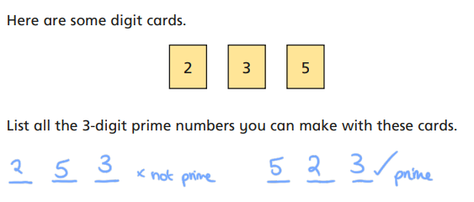
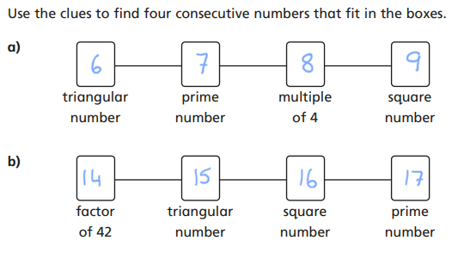
Please mark your answers
Question 9:
Evie says "all prime numbers are odd". Explain why Evie is wrong. Because 2 is a prime number and it is even.
Question 6:
Write two numbers that are triangular and square numbers. 1, 36
Question 7:
Question 10:
Tom says "if you square a number, the answer is always bigger". Show that Tom is incorrect using two different examples.
Question 8:

Slide 25
Thinking task
Task A
1 is a prime number as it has two factors of 1 and itself.
True or false?
Task B

