Slide 1

Level 3 Hospitality and Catering
Unit 1 Assignment 2
Friday 10th January

Slide 2
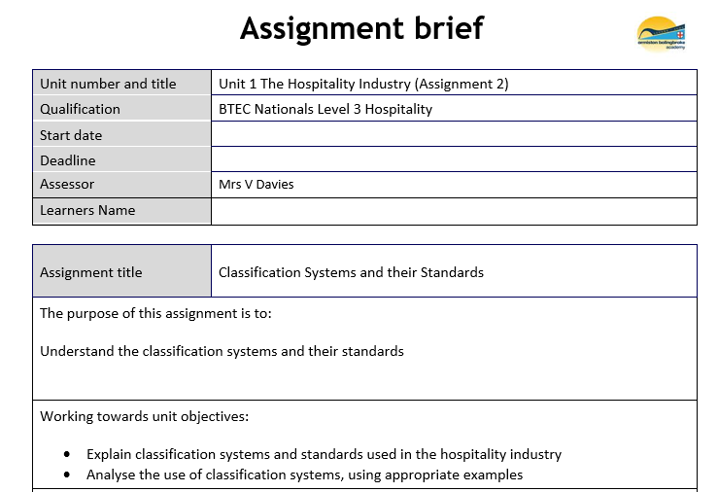

Slide 3
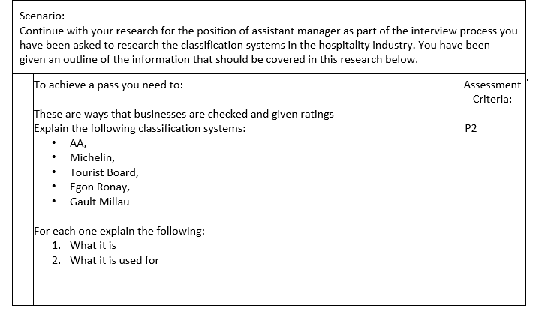

Slide 4




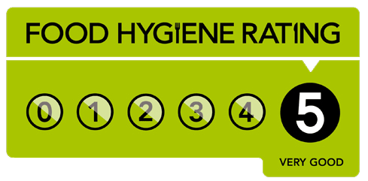

What are the benefits of ratings?
Standards, Reviews and Ratings
However …
SHARE
Food hygiene rating is a different topic altogether.
Reviews can make or break a business! A good review can increase business for establishments, as people will often try an establishment based on a recommendation.
Reviews and ratings generate publicity, awards get
you in the press!
Customers might come from further away to dine
or stay or both based on reviews.
Customers can identify less favourable establishments that they will then avoid.

Slide 5
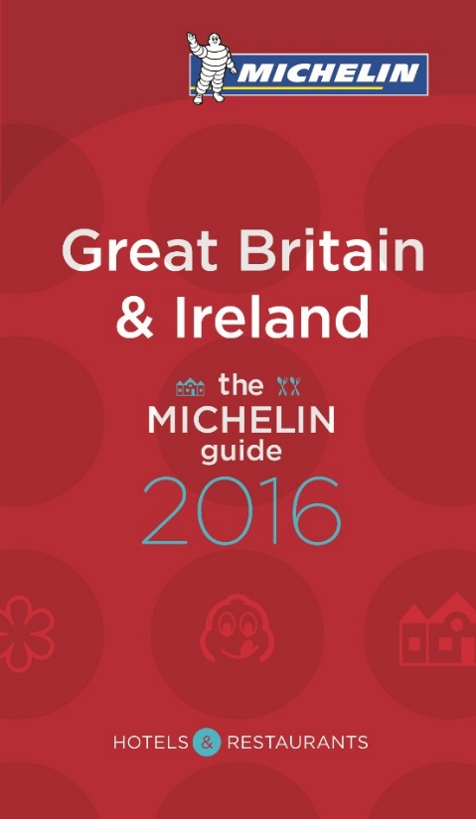


Standards, Reviews and Ratings
SHARE
Michelin Guides are a series of guide books published by the French tire company Michelin for more than a century. The term normally refers to the annually published Michelin Red Guide, the oldest European hotel and restaurant reference guide, which awards Michelin stars for excellence to a select few establishments. The acquisition or loss of a star can have dramatic effects on the success of a restaurant.
In 1926, the guide began to award stars for fine dining establishments. Initially, there was only a single star awarded. Then, in 1931, the hierarchy of zero, one, two, and three stars was introduced. Finally, in 1936, the criteria for the starred rankings were published:
A very good restaurant in its category (Une très bonne table dans sa catégorie)
Excellent cooking, worth a detour (Table excellente, mérite un détour)
Exceptional cuisine, worth a special journey (Une des meilleures tables, vaut le voyage)

Slide 6
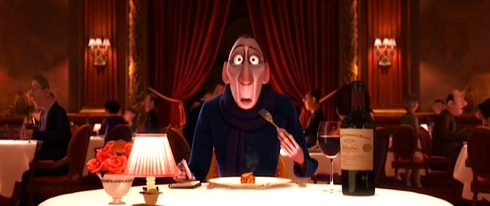
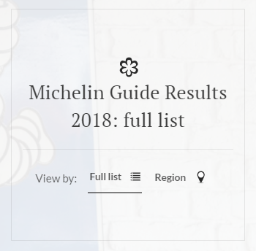

Standards, Reviews and Ratings
SHARE
Michelin has gone to extraordinary lengths to maintain the anonymity of its inspectors. Many of the company's top executives have never met an inspector; inspectors themselves are advised not to disclose their line of work, even to their parents (who might be tempted to boast about it)!
Inspectors eat a meal at the restaurant they are reviewing, paid for by the Michelin company, then write a report. Inspectors never speak to journalists.
See the 2018 results here!
https://www.eater.com/2017/10/2/16395756/michelin-stars-uk-ireland-great-britain-london
See the 2018 results here!

Slide 7



Rosette Award
Standards, Reviews and Ratings
First introduced in 1956, the AA’s Rosette Award scheme was the first UK-wide scheme for assessing the quality of food served by restaurants and hotels.
SHARE
It's all about the food!
For AA inspectors, the top and bottom line is the food. The taste of a dish is what counts, and whether it successfully delivers to the diner the promise of the menu.
A restaurant is only as good as its worst meal. Although presentation and competent service should be appropriate to the style of the restaurant and the quality of the food, they cannot affect the Rosette assessment as such, either up or down.
Suspension of multi-Rosettes (3, 4, and 5 Rosettes)
When a chef holds 3, 4 or 5 Rosettes and moves from one establishment to another, the award is suspended at that establishment and does not follow the chef automatically.
See breakdown of awards on the next slide …

Slide 8

Rosettes | Criteria
 | These restaurants will be achieving standards that standout in their local area, featuring: food prepared with care, understanding and skill good quality ingredients. The same expectations apply to hotel restaurants where guests should be able to eat in with confidence and a sense of anticipation. Around 45% of restaurants/hotels with an AA Rosette have one Rosette.
 | The best local restaurants, which aim for and achieve: higher standards better consistency greater precision is apparent in the cooking obvious attention to the selection of quality ingredients. Around 45% of restaurants/hotels with an AA Rosette have two Rosettes.
 | Outstanding restaurants that achieve standards that demand national recognition well beyond their local area. The cooking will be underpinned by: the selection and sympathetic treatment of the highest quality ingredients timing, seasoning and the judgment of flavour combinations will be consistently excellent. These virtues will tend to be supported by other elements such as intuitive service and a well-chosen wine list. Around 10% of the restaurants/hotels with an AA Rosette have three Rosettes and above.
 | Among the top restaurants in the UK where the cooking demands national recognition. These restaurants will exhibit: intense ambition, a passion for excellence, superb technical skills, remarkable consistency, an appreciation of culinary traditions combined with a passionate desire for further exploration and improvement. 42 restaurants in the Best Restaurants of Britain and Ireland guide have four Rosettes.
 | The pinnacle, where the cooking compares with the best in the world. These restaurants will have: highly individual voices exhibit breathtaking culinary skills and set the standards to which others aspire to, yet few achieve 15 restaurants in this guide have five Rosettes.
SHARE

Slide 10

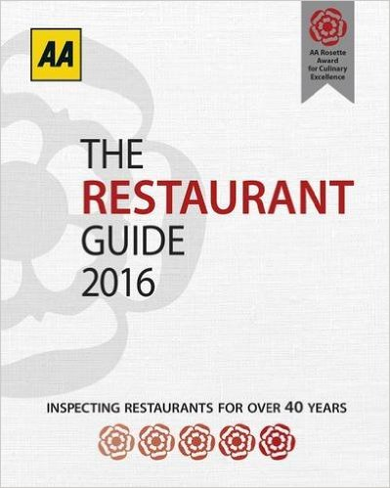
Standards, Reviews and Ratings
SHARE
Inspectors visit restaurants or hotels and write a review of the establishment. They award rosettes for restaurants and stars for hotels.
They are awards and not classifications.

Slide 11
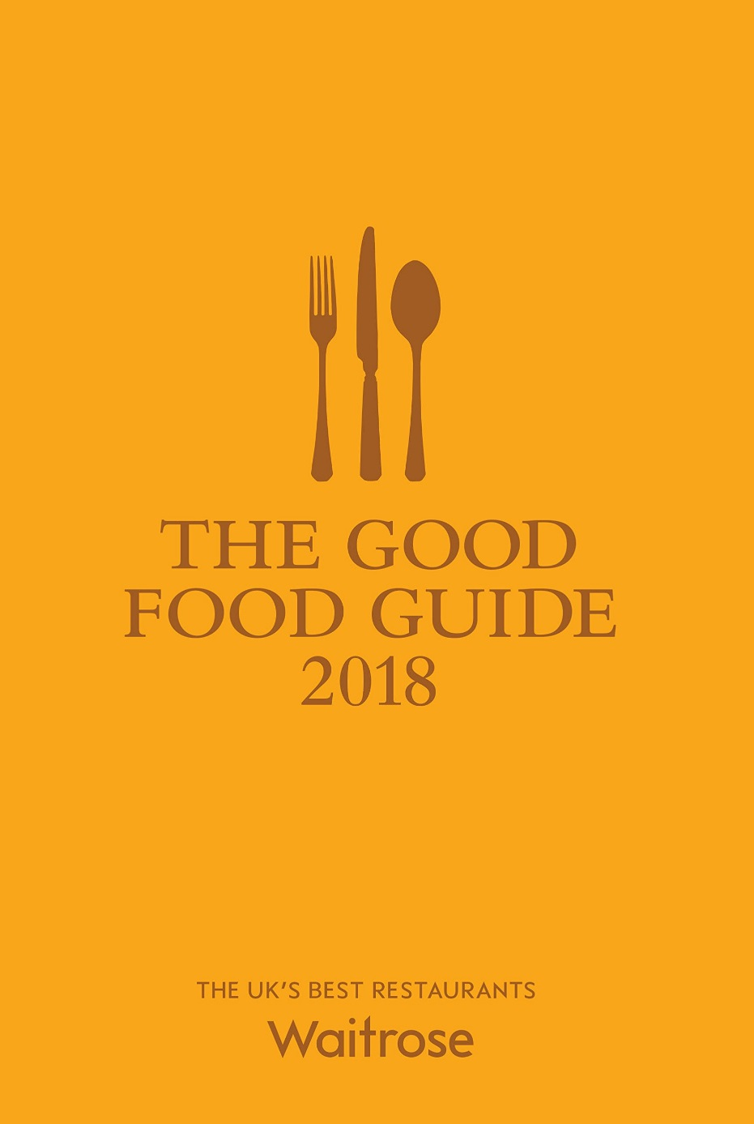
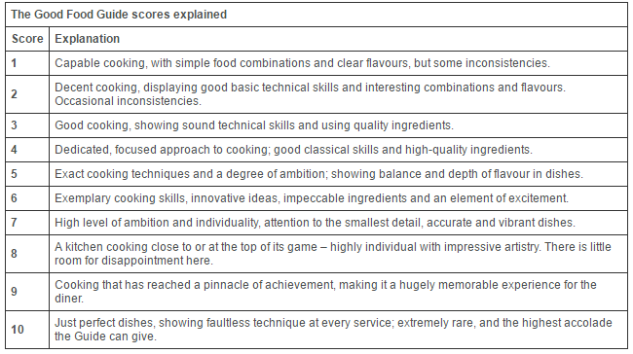
Good Food Guide
Standards, Reviews and Ratings
SHARE
Members of the general public who have visited the establishment fill
in a review which is compiled into a guide. Points are awarded for excellence.

Slide 12
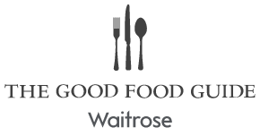
Top 10:
Standards, Reviews and Ratings
SHARE
Rank | Restaurant | Score
1 | Restaurant Nathan Outlaw, Cornwall | 10
2 | L'Enclume, Cumbria | 10
3 | Pollen Street Social, Central London | 9
4 | Restaurant Sat Bains, Nottinghamshire | 9
5 | The Fat Duck, Berkshire | 9
6 | Restaurant Gordon Ramsay, West London | 9
7 | Hedone, West London | 8
8 | Restaurant Andrew Fairlie, Perthshire & Kinross | 8
9 | Claude Bosi at Bibendum, London | 8
10 | Casamia, Bristol | 8

Slide 13



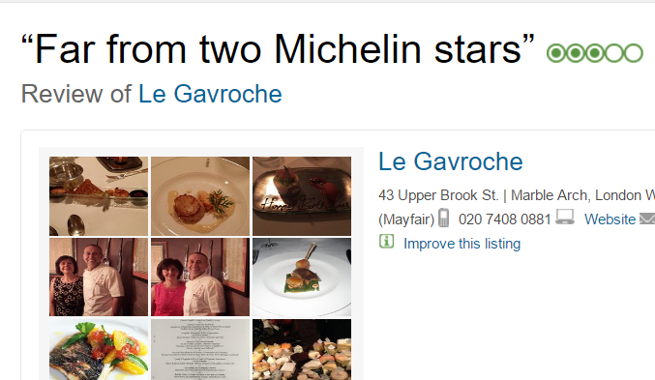

Le Gavroche - Michel Roux Jr
Standards, Reviews and Ratings
SHARE
Michelin:
AA:
Good food guide: 8
But …
Trip Advisor strikes!

Slide 14




Online Review Sites
Standards, Reviews and Ratings
SHARE
There are a number of online review sites where anyone can post their reviews of an establishment.
With a large number of reviews, a restaurant’s average score is likely to be reasonably accurate.
There are guidelines to clamp down on establishments
that give away freebies for a good review or give themselves good reviews!

Slide 15
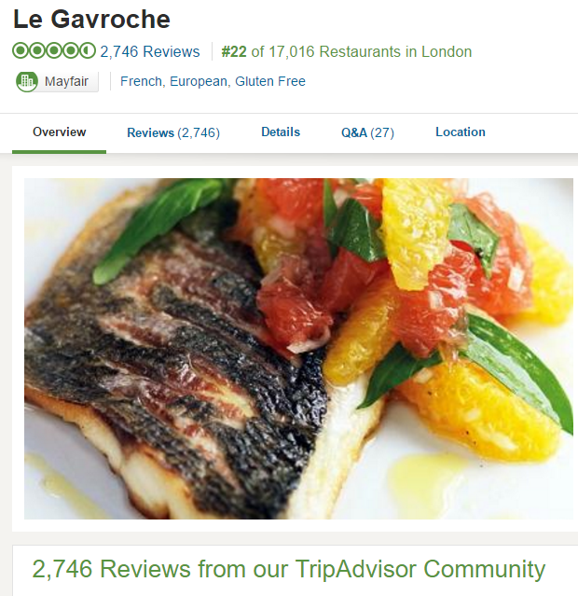


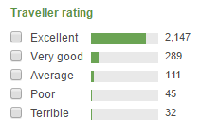
Standards, Reviews and Ratings
Back to Le Gavroche …
SHARE

Slide 16


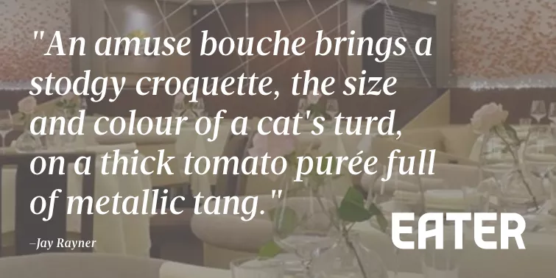

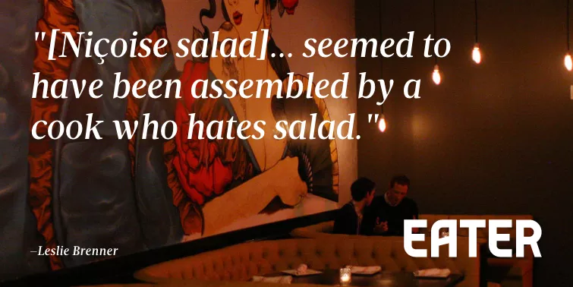
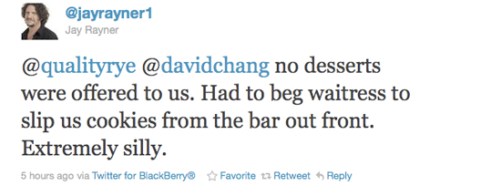
Standards, Reviews and Ratings
Poor Reviews
SHARE
What could this do to your reputation?
How could you address these reviews?
Jay Rayner – The Guardian Food Critic

