Slide 1

Improvements to Services and Customer Experience
Making improvements to services and customer experience can be very beneficial for a business.
This is because customer satisfaction and loyalty is likely to improve if customers have a better experience, which then helps to improve the brand image via positive word of mouth.
However, UK businesses are reported to be losing a staggering £12billion every year as a result of poor customer service (Survey Monkey, 2021).
Therefore, it’s crucial that businesses focus on continually improving the customer experience and one key factor that influences the experience customers receive in store is the services offered.
This is why many businesses have focused on improving the customer experience by investing in the development of services (both online and in store) by offering customers a variety of ways in which to shop so they can choose the option which is most suitable to them, thus improving the customer experience.
Notes:
https://www.surveymonkey.co.uk/mp/6-keys-improving-teams-customer-service-skills/

Slide 2
Improvements to Services and Customer Experience
Class Discussion
What changes have major supermarkets and fast food chains made in the past decade or two to improve services and customer experience?

Slide 3
Improvements to Services and Customer Experience
Supermarkets have improved their services with the aim of improving the customer experience, such as offering the following services:
- Shopping via traditional methods in store using checkouts.
- Using the scan as you go option and self serve machines.
- Ordering online via the click and collect function.
- Ordering online and having goods delivered at a time which suits them.
Fast-food restaurants have improved their services with the aim of improving the customer experience, such as offering the following services:
- Shopping via traditional methods instore and ordering from the till.
- Ordering via self serve machines.
- Ordering via apps.
- Ordering via the drive through.
- Ordering online and utilising home delivery services.
Both supermarkets and fast-food restaurants offer customers a range of services to choose from which ultimately improves their experience with the business.

Slide 4
Improvements to Services and Customer Experience
Activity 9: Improvements to Services and Customer Experience
In your opinion, what are the key characteristics of excellent customer service? Identify and explain a minimum of five.
What steps could a business take to improve its services and customer experience?
Can you think of a business which offers excellent services and customer experience? Ensure you justify why.
Have you ever had a bad customer experience? Explain what caused this and what would you recommend the business does to improve.

Slide 5

Business Growth
If a business is looking to grow, one of the most effective ways is through innovative and enterprising ideas so it can grow organically (aka internally).
But, how can a business grow organically through innovative and enterprising ideas?
Let’s watch the video on the next slide to find out (watch closely as there will be a series of tasks which follow).

Slide 6

Business Growth
Video link: Organic Business Growth
Notes:
Video link: https://www.youtube.com/watch?v=PuFtnYszmEM&t=4s

Slide 7
Business Growth
Activity 10: Business Growth Through Innovation and Enterprise
Describe what two methods a business can use to grow organically.
Explain how a business grows by introducing new products to the market.
Argue how important innovation is when growing a business.
What are the benefits and risks of a business entering new markets?
Explain why it’s important that a business amends its marketing mix when entering new markets.
Read the scenario and consult Mabel and Lewis about the advantages and disadvantages of growing organically and suggest ways they can grow their fish and chip shop business via new products and new markets.

Slide 8
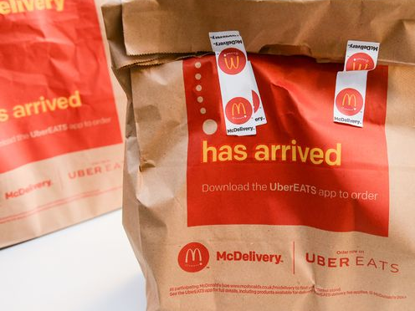
Business Growth
Class Discussion
Have you ever used UBER Eats or Deliveroo to buy McDonald’s?
If you answered ‘yes’ do you think that you eat more McDonald’s now you can get it delivered?
Based on your answers and any research you wish to do. Explain whether you think McDonald’s delivery has helped the business grow.

Slide 9
Development of New and Niche Markets
The development of new and niche markets can present both opportunities and threats to existing businesses.
For example, the rise of veganism has resulted in the market for vegan products such as food to grow rapidly alongside the demand from consumers in the past decade.
For businesses in the food industry such as McDonald’s, this presents a major threat to their current product portfolio which is predominately meat based.
However, it also presents lots of opportunities and areas for business growth as they are able to develop new vegan based products for this growing market.
Therefore, it’s crucial that McDonald’s invests in research and development to increase the range of vegan options available in their restaurants to not only increase profitability but to ensure they survive long term and meet consumer wants and needs.

Slide 10

Offering Unique Selling Points
A ‘Unique Selling Point’ aka ‘USP’ is something that sets the business apart from its competitors, usually in the form of a product or service but it can be anything that the business offers which is different to that of its competitors to the benefit of its customers.
Businesses can have multiple USPs which can help focus their marketing strategy and influence messaging, branding, copywriting, and other marketing decisions.

Slide 11
Offering Unique Selling Points
Activity 11: What’s the USP?
In your workbook you will find 5 different businesses, your task is to identify the USPs for each business and justify what sets each business apart from its competitors.

Slide 12
Offering Unique Selling Points
Activity 12: The Impact of a Strong USP
Of the businesses you have just identified the USPs for in the previous activity, which one do you believe has the strongest USP and why?
What impact do you believe this has on the business? Provide clear examples.

