Slide 1
Year 12 Food Science Friday 10th January

Slide 3
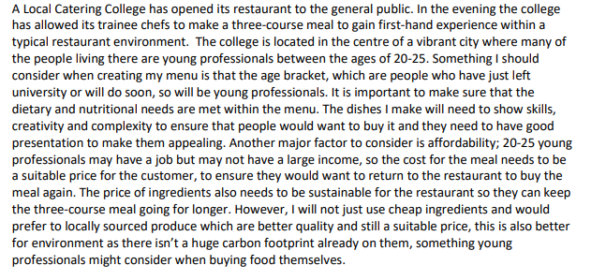
Here is an example of an ANALYSIS of the brief
You will need to complete your own version.

Slide 4
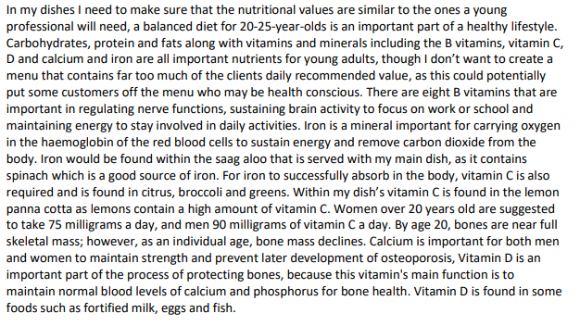

Slide 5
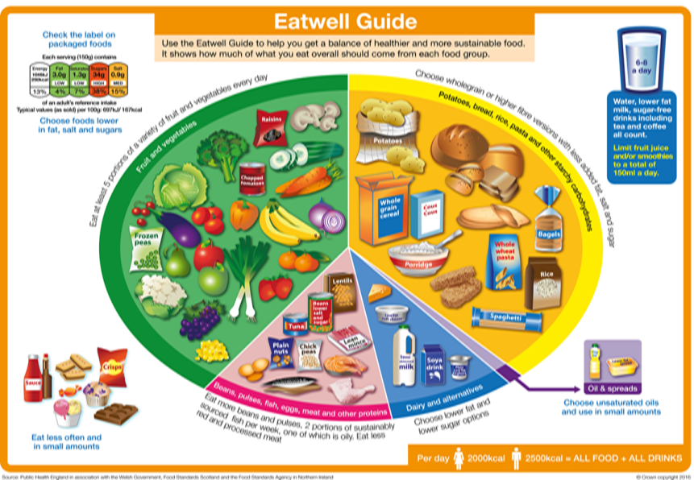
Nutrition: Functions of nutrients in the human body.
Portion Control!
Healthy diets not only have the correct balance, but have the right portion sizes. Here is a ‘handy’ guide… Vegetables = double cupped palm. Grains/Starches = clenched fist. Protein = palm of hand. Fruits = clenched fist. Thumb = fats.
38%
Fruits & Vegetables
Eat 5 portions s a day!
Choose a variety
Provides fibre for healthy digestion
Provides vitamins and minerals for healthy body functions and immune system
Starchy Foods
Provide slow release carbohydrate used by the body for energy
Choose wholegrains for increased fibre (good digestion, reduced risk of heart disease)
40%
0%
Fatty and Sugary Foods
These are the danger foods!
They are not part of a healthy diet
Eat them only occasionally
Eating too much fatty and sugary processed food is linked to increased risk of weight gain/obesity, diabetes , tooth decay and cardiovascular disease
Water Intake
A balanced diet must include water, it is required for nearly all brain and other bodily functions
See slide 2 for more details on water
Oils & Spreads
Provide fat soluble vitamins A,D,E & K
Are high in calories & energy so keep use to a minimum
It is recommended to choose unsaturated oils like olive oil
1%
12%
8%
Beans, Pulses, Eggs, Meat, Fish
Provide protein for growth, repair and maintenance of body cells
Choose a combination of plant proteins
Avoid eating too much processed meat like bacon and sausages as these are linked with increased risk of bowel and stomach cancer
Dairy Foods
Provide calcium for healthy bones, teeth and nails
The body needs Vitamin D to absorb calcium effectively
The Eatwell Guide is the UK Healthy Eating Model. It shows what we should eat as a balanced diet. The size of the sections represents the proportion of our diet that particular food group should make up. The Eatwell Guide was updated in 2016 to take into account scientific opinion and public opinion. The main change was that sugary and fatty foods are shown off the plate as they are not part of a healthy diet.
Notes:
Portion control, water intake, fibre, RI/GDAs etc

Slide 6
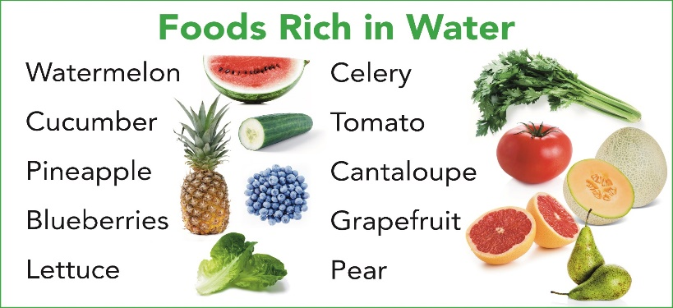
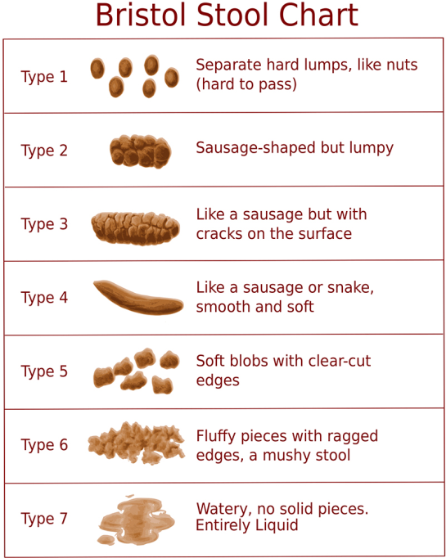
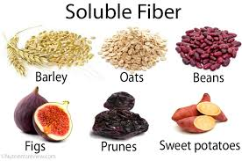
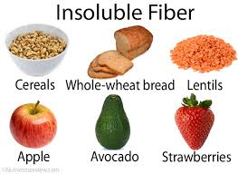
Nutrition: Functions of nutrients in the human body.
FIBRE
What is it? Fibre is found in fruits and vegetables, nuts, seeds, wholegrain cereal flours and products. It is not digestible and passes through the digestive system, forming the bulk of our stools (poo). Dietary fibre has many health benefits: It can reduce your risk of heart disease, diabetes and some cancers, and also help weight control. Fibre is also important for digestive health - fibre bulks up stools and holds water in them, making them softer and easier to pass. It also makes waste move through the digestive tract more quickly, which is better for the gut and can help to prevent constipation. Some types of fibre can be fermented by gut bacteria, producing substances that appear to be good for gut health. Providing ‘food’ for gut bacteria can also help increase the number of healthy bacteria in the gut.
How FIBRE Much do we Need? 30g a day for adults 2-5 years 15g per day, 5-11 years 20g per day, 11-16 years 25g per day, 16-18 years 30g per day
To increase your fibre intake you could: Choose a high fibre breakfast cereal e.g. bran flakes, or porridge Choose wholegrains like whole-wheat pasta, bulgur wheat or brown rice, wholemeal bread Go for potatoes with skins For snacks try fruit, vegetable sticks, rye crackers, oatcakes, unsalted nuts or seeds Include plenty of vegetables with meals – either as a side dish or added to sauces, stews or curries Add pulses like beans, lentils or chickpeas to stews, curries and salads Eat fruit! Add nuts and seeds to recipes
Fibre intake
Water intake
Click here to watch video on water
The Bristol Stool Chart
The Bristol stool chart shows how the shape of different stools (poos) on a continuum. Both dietary fibre and water play a HUGE role in keeping the digestive system functioning properly. Too little water and/or fibre can result in constipation (the Type 1 and 2 stools)
Water makes up just over 2/3 of the human body and is required for:
Maintain body temperature
Metabolise fat
Aid digestion
Lubricate organs
Transport nutrients
Flushes out waste and toxins
FIND OUT MORE HERE: https://www.nhs.uk/live-well/eat-well/water-drinks-nutrition/
Keeping hydrated is important. It is recommended that 6-8 glasses of water or other fluid are consumed everyday to replace normal water loss, rather than to obtain any broader health benefits.
Soluble fibre dissolves in water and the insoluble kind doesn’t.
Insoluble helps absorb water and bulk up stools. Soluble helps reduce blood cholesterol and sugar.

Slide 7
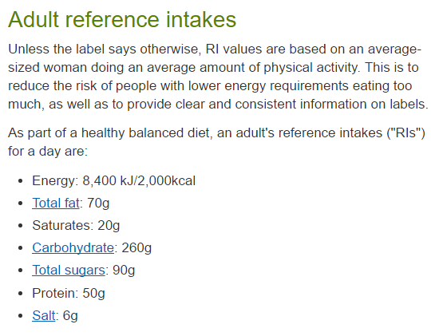
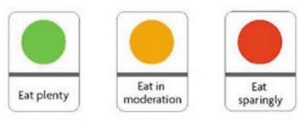
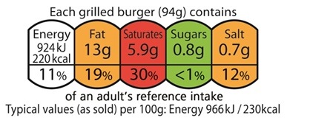
Reference Intake
The NHS recommends the following intake of each nutrient per day:
What are Calories click here
Nutrient | Amount | Calories per gram
Energy (calories) | 2,000kcal
Carbohydrate of which sugars | At least 260g 90g | 4kcal
Protein | 50g | 4kcal
Fat of which saturates | Less than 70g Less than 20g | 9kcal
Click here to find out more about food labels
Red colour coding means the food or drink is high in this nutrient and we should try to have these foods less often or eat them in small amounts.
Amber means medium, and if a food contains mostly amber you can eat it most of the time.
Green means low, and the more green lights a label displays the healthier the choice.
As you can see below we need much less of the micronutrient: Vitamins and minerals. There are slight differences between males and females.
Nutrient | Males |  | Females
Vitamin A | 0.7mcg |  | 0.6mcg
Vitamin D | 10mcg
Vitamin E | 4mg |  | 3mg
Vitamin K | 1mcg per kg of body weight
Vitamin B | Thiamin: 1mg Riboflavin: 1.3mg Vitamin B12: 1.5mcg |  | Thiamin: 0.8mg Riboflavin: 1.1mg Vitamin B12: 1.5mcg
Vitamin C | 40mg
Sodium (Salt) | Less than 6g
Iron | All (M) 8.7mg | (F) 19-50yrs 14.8mg / 50yrs+ 8.7mg
Calcium | 700mg
Front of Pack label
Portion/Serving size is indicated on the label.
This is NOT always the whole pack!
Front of pack nutrition labelling is optional
Traffic light system indicates with colour how much of intake is needed.
Easy to see, quick to take in
Energy intake as a percentage of RI

Slide 8
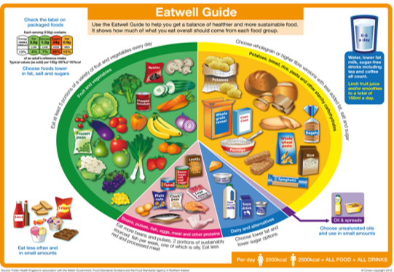
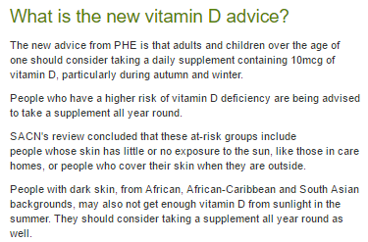
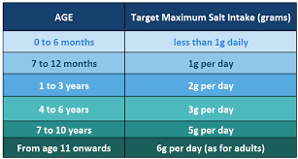
Current Healthy Eating Advice
8 Tips for Healthy Eating!
Eat more fibre Eat more fruits and Vegetables Eat more oily fish Eat less salt Eat less fat Eat less sugar Choose wholegrains Drink 6-8 glasses of water per day
Healthy Eating Guidelines in the UK are set by Public Health England
Fat intake
Click here to find out more about Fat
Sugar intake
What counts as 5 A Day?
For kids, the amount they should eat depends on their size and age. As a rough guide, one portion is the amount they can fit in the palm of their hand.
For adults, a portion is 80g fruit of vegetables or 30g of dried fruit.
Click here to find out more about sugar
2016 Update from Public Health England - The latest advice on Vitamin D intake
Salt intake
Click here to find out more about salt

Slide 9
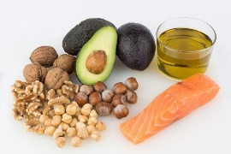
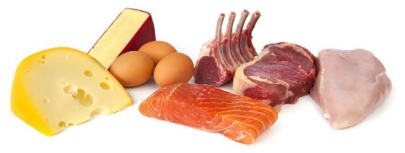
Nutrition: Functions of nutrients in the human body.
 | Nutrient | Source | Function | Effects too little (deficiency) | Effect of too much (access)
MACRONUTRIENTS | Carbohydrates Click here to see a video. | Starches – found in cereal grains such as rice, wheat, oats, plus starchy tubers (potatoes and sweet potatoes) and vegetables (carrots, beets, corn) Sugars – lactose found in milk and dairy, fructose found in honey, fruits and some vegetables (peppers, tomatoes etc.) | Two types: 1. Starchy (complex) provide energy when broken down – slow release energy to the body (wholegrain provide slower release carbohydrates) 2. Sugary (simple) provide quick release energy to the body's’ cells. | Deficiency of carbohydrates is extremely rare in the UK. Long term lack of carbohydrates in the diet can cause Ketosis – a condition where the body switches to using protein as an energy source. Visible symptoms- lack of energy and weight loss. Non- visible symptoms- Not enough fibre from wholegrains foods leads to constipation and other intestinal problems. | If not used for energy it becomes stored as fat. Visible symptoms weight gain and obesity. Non- visible- eating too much non refined(white carbs) leads to tooth decay, raising blood sugar levels and type 2 diabetes.
 | Proteins Click here for video | High Biological Value (HBV) protein: Meat, fish, poultry, eggs, Low Biological Value (LBV) protein: Tofu, beans, nuts. | Protein is digested by the body into its component parts – called amino acids. There are 8 which are essential for adults and 12 for children. HBV protein foods contain all the essential amino acids. | Visible symptoms- Wasting of muscle & muscle loss Oedema – build up of fluids in the body Slow growth in children Severe deficiency leads to kwashiorkor (bloating of the stomach) Non-visible symptoms- weaker immune system which needs protein to function properly. | Visible symptoms excess stored as fat, lead to weight gain and obesity. Non-visible symptoms- Puts a strain on how well the kidneys work.
 | Fats Click here for video Click here for more info | Butter, cheese, dairy foods including yogurt, crème fraiche, milk Oils, lard, suet, dripping. | Fat is a term used to describe lipids – this can refer to solid fats and oils. Fat is broken down by the body and used for energy, Also used to provide warmth when stored under the skin. Is a dietary carrier of fat soluble vitamins A, D, E & K. Two types of fats: Unsaturated and saturated. | Visible symptoms- Weight loss over time as the body uses stores of fat. Person feels cold as fat under skin acts as insulator. Non-visible symptoms- Bruising of the bones as they are not protected. Lack of fat in the diet can lead to deficiencies of fat soluble vitamins A, D, E & K. | Common issue in the UK Visible symptoms- Stored under the skin in adipose tissue cells, which leads to disease such as type 2 diabetes, obesity and heart disease and high bloody pressure. Non-visible symptoms- Internal organs store fat which prevents them working properly. Fat blocks arteries.
Unsaturated Fat:
Liquid at room temperature.
Mainly from non-animal (plant) sources.
Can lower blood cholesterol.
Saturated Fat:
Solid at room temperature.
Mainly from animal sources. *With the exception of palm and coconut oil.
Causes high blood cholesterol.

Slide 10
Nutrition: Functions of nutrients in the human body.
Click here to watch a video on Vitamins and minerals
Vitamins and Minerals are chemicals found naturally in food. With the exception of Vitamin D, which can be manufactured through the action of sunlight on the skin, vitamins cannot be made by the body, and must be provided by the diet. They are needed in minute (tiny) amounts to perform specific functions and fall into two different classes:
Water Soluble | Needed For | Found In | Deficiency/ Excess
C Antioxidant | Normal structure and function of connective tissue e.g. collagen. Helps healing process. Antioxidant (protects from free radicals). Helps absorb iron in the body. Improves immune system. | Main sources from plants – fruits and vegetables. Milk and liver contain small amounts. | Deficiency- Scurvy, very rare symptoms include bleeding gums, wounds not healing properly, tiredness. Lack of vitamin C effects absorption of iron. Excess is eliminated from the body within 24 hours so not a problem.
B1 Thiamin | Normal function of the nervous system and heart | Whole grains, meat, flour and breakfast cereals. | Deficiency-Beri-beri (disorder of the nervous system). Excess-body excretes it.
B2 Riboflavin | Release of energy from food. | Milk, eggs, green vegetables, cererals. | Deficiency- Dry cracked skin around the mouth and nose. Excess-body excretes it.
B3 Niacin | Energy release, skin and membranes. | Milk, eggs, cheese, meat. | Deficiency- disease pellagra. Symptoms can include dermatitis, dementia and diarrhoea. Excess-body excretes it.
B9 Folate | Red blood cells and nervous system. | Green leafy vegetables. | Deficiency- can lead to anaemia. Symptoms can include insomnia, depression and forgetfulness. Excess-body excretes it.
B12 Colbalbumin | Cell division and blood formation. Normal structure of nerves. | Animal sources – milk, meat and eggs. Some algae and bacteria can produce B12. | Deficiency- Anemia (rare), may be found in vegetarians. Excess-body excretes it.
AC1.3 Explain characteristics of unsatisfactory nutritional intake.
Water Soluble | Fat Soluble
C | A
B group | D
 | E
 | K
Free Radicals
Essentially, damaged oxygen molecules with an extremely unstable atomic structure. They attack fats and proteins all over the body, especially those in membranes that line the blood vessels, the skin and other connective tissue. They can make you age a lot quicker! Anything we do to raise our metabolic rate (like exercise) accelerates the production of free radicals.

Slide 11
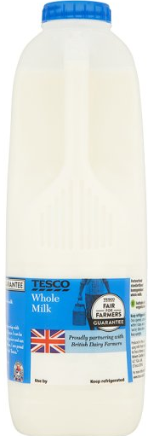
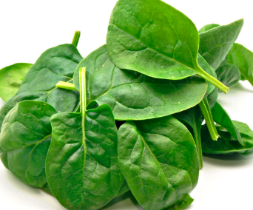
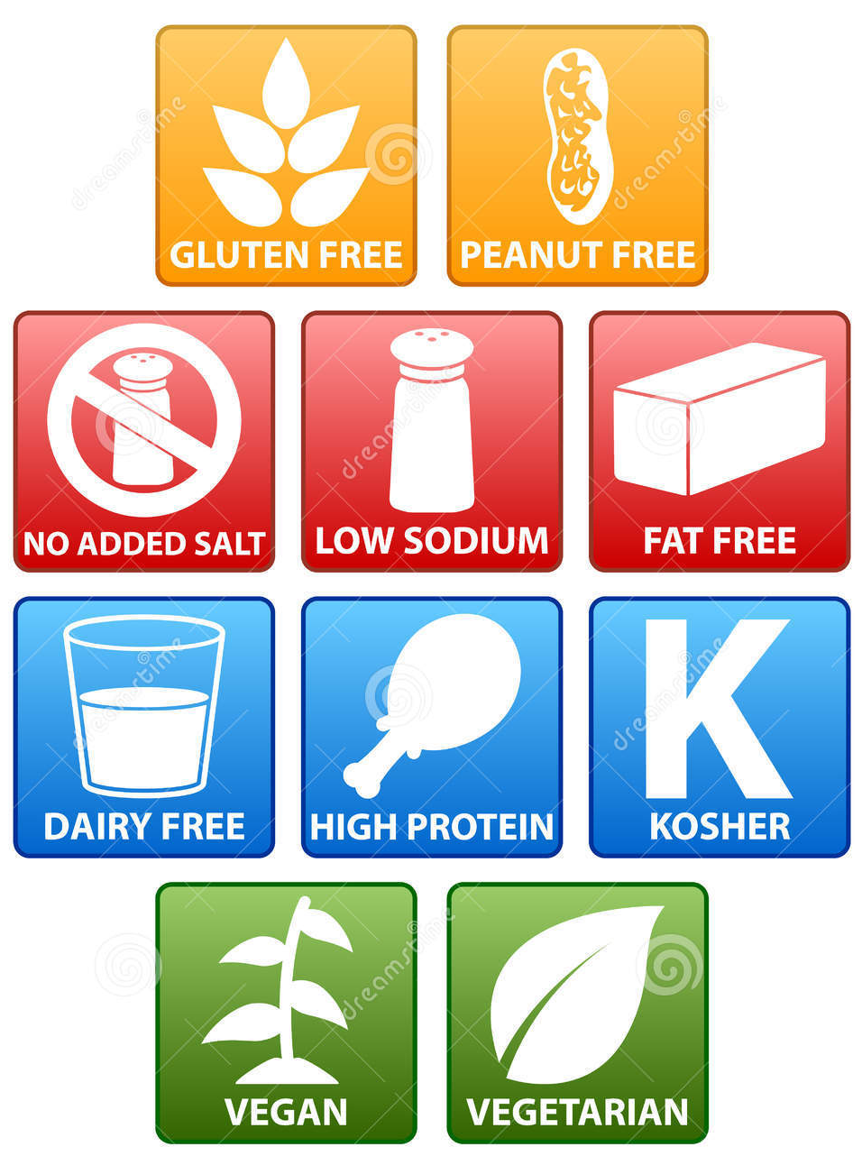
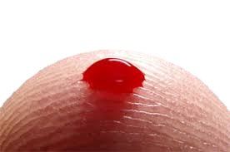
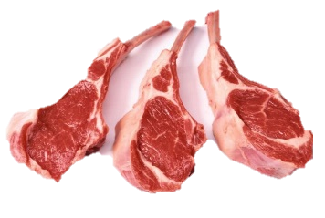
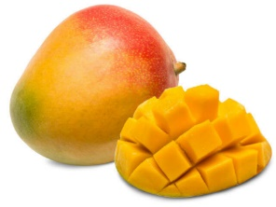
Nutrition: Functions of nutrients in the human body.
Fat Soluble | Needed For | Found In | Deficiency/ Excess
A Antioxidant | Needed for structure and functioning of the skin and mucous membranes, Cell differentiation Helps with vision in dim light and colour vision Keeping the immune system healthy. | Dairy Products Dark Green Veg Orange coloured fruit and veg Fish Oils and Liver | Deficiency-Poor vision, night blindness. Excess- stored in the liver and too much can be toxic.
D | Needed for the absorption of calcium and phosphorus from foods, to keep bones healthy. | Fish Oils Dairy Products Sun Light Absorption. Often added to cereal and margarine. | Deficiency-Rickets (soft deformed) Osteomalacia (weak bones) Excess: build up of calcium, poor appetite, vomiting
E Antioxidant | Helps maintain healthy skin and eyes and strengthen the body's natural defence against illness and infection. | Dairy Products Dark Green veg Nuts | Deficiency- Rare- Age quickly, Wrinkles Skin loses elasticity. Excess- In very large doses may interfere with absorption of vitamin A
K | Needed for clotting of blood and is also required for normal bone structure. Infants are given vitamin K at birth. | Dark Green Veg Fish, liver, fruit | Deficiency- Hemorrhages- ruptured blood vessels. Excess- Unknown

Slide 12
Nutrition: Functions of nutrients in the human body - MICRONUTRIENTS
Click here to watch a video on Vitamins and minerals
AC1.3 Explain characteristics of unsatisfactory nutritional intake.
 | Nutrient | Function | Source | Effects too little (deficiency) | Effect of too much (access)
MINERALS | Iron | Needed to make haemoglobin in red blood cells which transports oxygen around the body. Also removing waste substances from the body. | Haem iron found in meat, offal Non-haem iron found in wholegrain foods, leafy green vegetables, fortified breakfast cereals Iron is only absorbed in the presence of vitamin C. | Iron deficiency anaemia is the most common dietary deficiency in the UK. Visible Symptoms include tiredness, paleness, lethargy. Weak and splitting nails. | Side effects of taking high doses (over 20mg) of iron include constipation, vomiting. Very high doses of iron can be fatal, particularly if taken by children, so always keep iron supplements out of the reach of children
 | Calcium | Needed by the body to build strong bones and teeth. Essential for blood clotting process and blood pressure. Essential for nerve signal transmission and muscle contraction. The skeleton contains about 99% of the body’s calcium | Dairy foods including milk, yogurt, cheese, butter Dark leafy green vegetables, Fish with edible bones including sardines and pilchards Non-dairy milks fortified with added calcium | Visible symptoms Lack of calcium in children can cause rickets Osteoporosis (brittle bones) in adults later on in life when bone density is less. Rickets wear children’s bones are weak and soft causing them to be deformed. To find out more click here Non-visible symptoms Bones and teeth weaken, Nerves and muscles don’t work properly. Blood will not clot and form a scrap after an injury. | Hypercalcemia is a condition in which you have too high a concentration of calcium in your blood.
 | Sodium | Controls the amount of water in the body Makes nerves and muscles work properly | Salted foods, yeast extract, stock cubes, gravies, seasonings, snack foods, canned fish, bacon, ham, fast foods, ready meals, baking powder and takeaway foods. | Visible symptoms: Unlikely, but can be caused by excessive sweating or vomiting and diarrhoea Muscle cramps, weakness | Water retention and swelling High blood pressure Heart problems Headaches Guideline is 6g for adults 4g for teenagers

Slide 13
Special Diets.
Nutrition through life differs mainly due to the need for energy and protein for growth and development – in younger age groups, growth and development occurs, in older age groups only maintenance of the body is required, therefore protein and energy requirements are reduced.
GENDER affects nutritional requirements after puberty – before puberty male and female requirements are the same. Puberty causes girls to begin menstruation, increasing their iron needs, which remain higher than men until the menopause which occurs around 50 years of age. Generally males are physically larger than females and therefore need to consumer more energy and protein on a daily basis.
PHYSICAL ACTIVITY LEVEL affects a person's’ energy requirements. The more active a person is, the more energy they need. It is recommended that extra energy requirements come from extra starchy carbohydrate in the diet,. Increased PAL could be from having an active job or from playing lots of sport.
Babies and Toddlers Milk only for first 4-6 months Weaning occurs from 6 months – introduce a wide variety of textures and colours Avoid nuts (choking hazard), salt and sugar. Pre-school children Balanced diet needed – in line with Eatwell Guide from 12 months High needs for energy and protein due to rapid growth and constant movement Full fat dairy products should be consumed Salt and sugar should be avoided | Children Balanced diet needed – in line with Eatwell Guide from 12 months High needs for energy and protein due to rapid growth and constant movement 5-a-day is recommended. Energy requirements increase because they grow quickly and become active. Good supply of protein, calcium, iron, vitamin A and D, as part of a healthy, balanced diet Calcium and vit D for healthy tooth development, and strong bones. Limit sugary carbohydrates such as sweets -tooth decay. Fat: small amounts for energy and insulation. Young children small stomachs, small and frequent meals. No room for junk food Children cannot cut food and chew as easily so need easy to eat foods Avoid nuts- choking and allergy risks. Children need plenty of fluid and they should be encouraged to drink regularly, especially if they are very active.
Teenagers Increased needs for iron in teenage girls due to menstruation Calcium intake & vitamin D are really important to ensure Peak Bone Mass is reached – setting up bone health for life. Boys need extra iron initially for growth and muscles but this need decreases after age 19. Boys need more protein and energy than girls due to their later growth spurt Many UK teenagers are lacking in calcium, iron and vitamin A. | Adults Requirements do not change much between the ages of 19 to 50, except during pregnancy and lactation. Well balanced diet modelled on the Eatwell Guide essential. Many UK adults eat too much fat, too much salt and not enough fruit and vegetables. | Elderly Older adults need protein to repair worn out body cells. They need a good supply of calcium and Vitamin D in order to maintain healthy bones and teeth and iron to keep bloody healthy. In winter time, they may need a little more fat in their diet to provide body warmth. Fresh fruit and Vegetables are important for a good supply of vitamins and minerals. Old people may have digestive problems or may have difficulty cutting food (because of arthritis) or chewing food (because of false teeth). Examples of food suitable for the elderly = Soft foods – boiled potatoes, stew, soup, casseroles, one pot meals. A good supply of fibre is needed to prevent constipation in the elderly who may be less active Older adults may have a weaker sense of thirst. If necessary they should be helped and encouraged to drink regularly.
Pregnancy & Lactation Because the body becomes more efficient at absorption during pregnancy, normal nutritional requirements apply until the last third of pregnancy, when some extra energy and calcium is required. Pregnant and lactating ladies should eat a varied diet rich in fresh fruit and vegetables and wholegrains (in line with the Eatwell Guide). There are some foods to avoid: Unpasteurised milk products and undercooked meats/cured meat products – they may contain listeria which is harmful to unborn babies Pate, liver and liver products – due to high vitamin A content (Vitamin A is harmful to unborn babies if eaten in large quantities) Swordfish, marlin and shark as they are high in mercury which can be harmful to unborn baby
Click here to find out more life stages and diets

Slide 14
Special Diets
Medical Diets | Religious Diets | Ethical Diets
Nut & other allergies Must avoid particular allergen, otherwise an allergic reaction may occur. Serious allergic reactions can result in anaphylaxis and even death. The 14 common allergens which must be declared on menus and food packaging are: Celery, Gluten, Crustaceans, Eggs, Fish, Lupin, Milk, Molluscs, Mustard, Nuts, Peanuts, Sesame, Soya, Sulphites. | Halal (Muslim) Halal is Arabic for permissible. Halal food is that which adheres to Islamic law, as defined in the Koran. Haram is the opposite to Halal and describes food which is not permitted under Islamic law. Haram items that Muslims will not consumer include pork and all pork products as well a alcohol. | Vegetarian Vegetarians do not eat any flesh – they do not eat meat, poultry or fish/shellfish. Vegetarians do eat dairy products and eggs (lacto-ovo-vegetarian).
Lactose intolerance - Link to website here People who are lactose intolerant do not make the digestive enzyme which is needed to digest lactose (a milk sugar found in dairy products). If they consume lactose, they will experience digestive discomfort including cramps, excess wind and diarrhoea. Lactose intolerant people can consumer lactose free milk and dairy products or dairy alternatives. They must be careful to ensure they get enough calcium in their diet. | Kosher (Judaism) Judaism instructs its followers to observe a kosher diet, this means no pork. Kosher food also does not mix dairy products and meat in the same meal/course. Foe example, a burger must be served without cheese. | Vegan Vegans avoid consuming any animal products – including milk and dairy products, Protein is a nutrient which can be lacking in a badly planned vegan diet – vegans can eat wholegrain cereals, nuts, beans, lentils and tofu. Calcium may be lacking in a vegan diet – some vegans replace dairy with calcium fortified alternatives such as soya milk or almond milk.
Coeliac - Link to website here Coeliac disease sufferers react to the presence of gluten, a protein found in wheat flour and wheat flour products. They must avoid consuming gluten. Gluten is present in any wheat flour – alternatives such as | Hindu Followers of the Hindu religion do not eat Beef, as they believe it is a sacred animal. | Pescetarian Pescetarians do not eat meat, but will eat fish and shellfish.
Coronary Heart Disease - Find out more click here People who are diagnosed or at risk of Coronary Heart Disease are currently recommended to adopt a low sugar, low saturated fat, high fibre and fruit and vegetable Mediterranean style diet. | Buddhist Buddhists are usually vegetarian and do not consume meat or fish. | Flexitarian This is a new concept – followers of a flexitarian diet choose vegetarian or vegan diet meal choices for some parts of the week, in order to reduce their carbon foot print. Meat-Free Mondays campaign spearheaded this movement.

