Slide 1
Learning outcomes:
To know how to approach a poetry comparison question
To be able to write an exam response
Thursday, January 9, 2025
Poetry Comparison: Power of Nature
Do Now:
Name one piece of context about Storm on the Island.
What is onomatopoeia?
What is a pronoun?

Slide 2
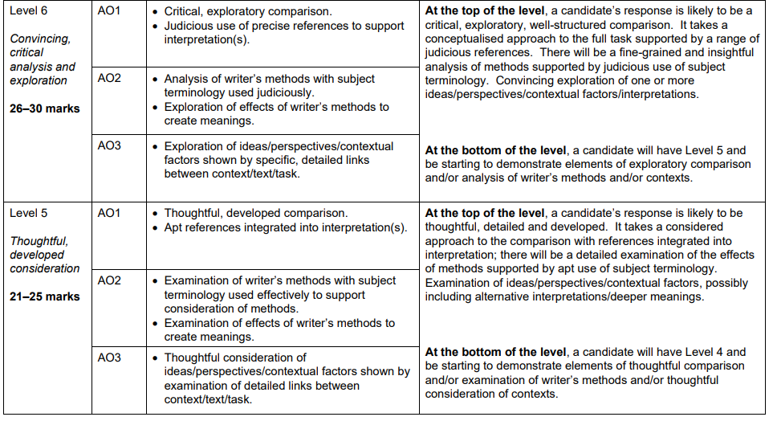
Let's recap the mark scheme
Using our flash codes the AOs would be:
AO1 – Thesis Statement, CF and EQ
AO2 – AQ, WT, Z
AO3 – CON and WM

Slide 3
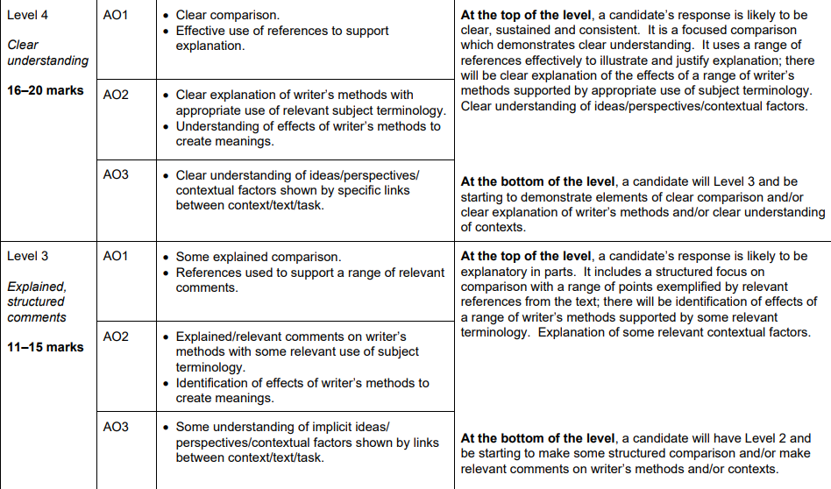
Let's recap the mark scheme
Using our flash codes the AOs would be:
AO1 – Thesis Statement, CF and EQ
AO2 – AQ, WT, Z
AO3 – CON and WM

Slide 4
Learning outcomes:
To know how to approach a poetry comparison question
To be able to write an exam response
Thursday, January 9, 2025
Poetry Comparison: Power of Nature
Use your notes and plan from yesterday to answer exam question on the next slide

Slide 6
If you're struggling to structure your answer, don't forget to use PETAL
P – state your Point (what the writer is doing)
Heaney highlights the...
E – use Evidence from the poem (what quote shows this?)
This is demonstrated when '__________________'
T – what Technique is being used in the quote (metaphor, caesura, imagery)
The use of the ______ implies...
A – Analyse the impact of this quote and what it makes you think (connotations of the word)
In particular, the word '_______' has connotations of __________ and makes the reader think...
L – Link your analysis back to your point
This shows the ________ that Heaney wanted to highlight because of ______________.

