Slide 1
Learning outcomes:
To know how to approach a poetry comparison question
To be able to plan for a timed write lesson
Wednesday, January 8, 2025
Poetry Comparison: Power of Nature
Do Now:
How many poetic techniques can you recall?

Slide 2
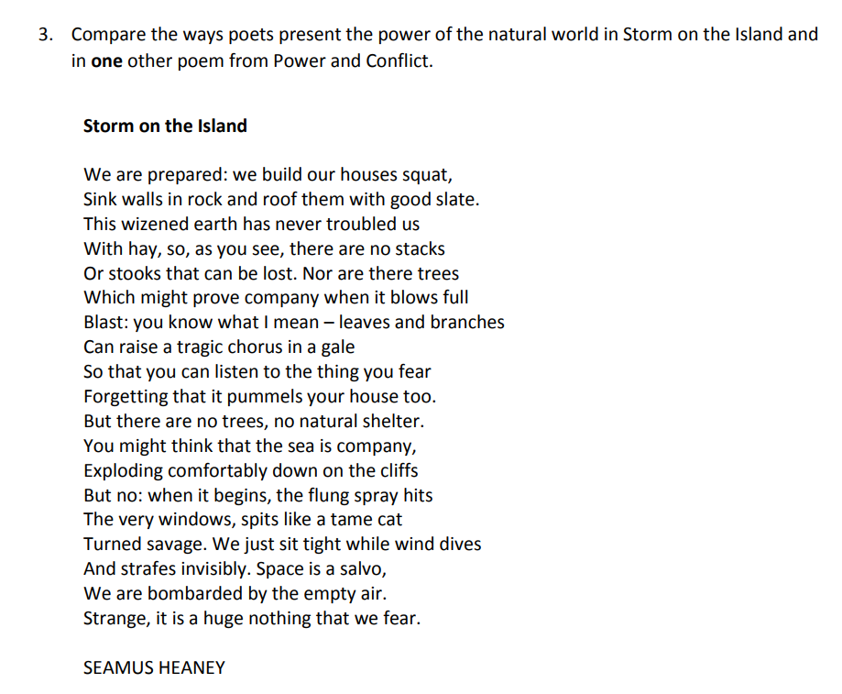
What are the key words in the question?
Use the below video to make notes on the poem Storm on the Island and choose a suggested poem to compare it to:
https://www.youtube.com/watch?v=Sgsu_WgO9GY
Suggested other poem:
Ozymandias

Slide 3
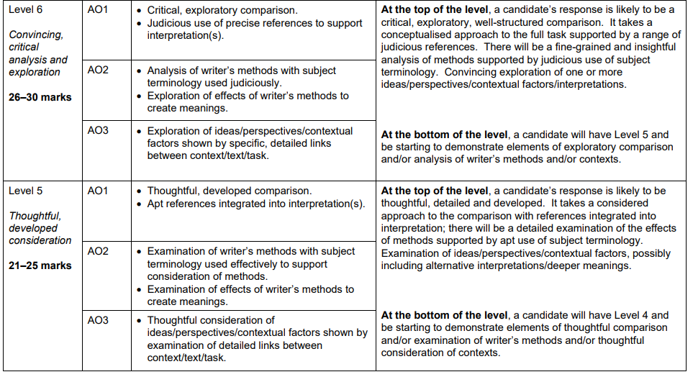
Let's recap the mark scheme
Using our flash codes the AOs would be:
AO1 – Thesis Statement, CF and EQ
AO2 – AQ, WT, Z
AO3 – CON and WM

Slide 4
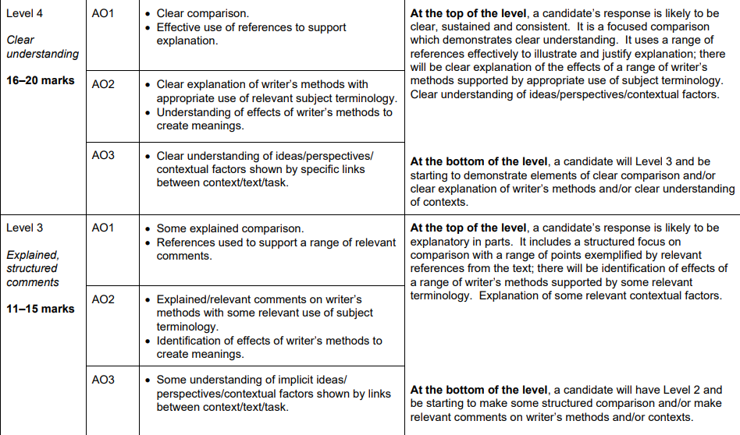
Let's recap the mark scheme
Using our flash codes the AOs would be:
AO1 – Thesis Statement, CF and EQ
AO2 – AQ, WT, Z
AO3 – CON and WM

Slide 5
Learning outcomes:
To know how to approach a poetry comparison question
To be able to plan for a timed write lesson
Wednesday, January 8, 2025
Poetry Comparison: Power of Nature
Use the following structure to help plan your answer:
P – state your Point (what the writer is doing)
Heaney highlights the...
E – use Evidence from the poem (what quote shows this?)
This is demonstrated when '__________________'
T – what Technique is being used in the quote (metaphor, caesura, imagery)
The use of the ______ implies...
A – Analyse the impact of this quote and what it makes you think (connotations of the word)
In particular, the word '_______' has connotations of __________ and makes the reader think...
L – Link your analysis back to your point
This shows the ________ that Dharker wanted to highlight because of ______________.

Slide 6
Today we will be comparing how the power of nature is presented in Storm on the Island and one other poem
London | Link | Ozymandias or other poem
P E T A L | What is similar/different? | P E T A L
P E T A L |  | P E T A L
P E T A L |  | P E T A L

