Slide 1

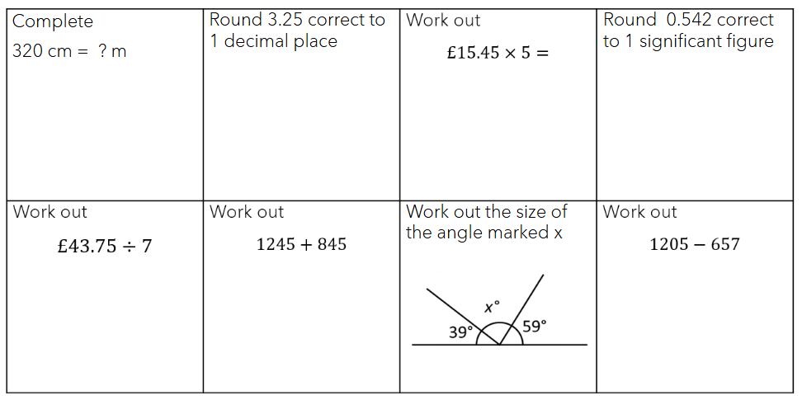
Threshold – Entrance - Teacher to stand on door threshold
Title: Probability Expected Outcomes
Date: Friday 10th January 2025
At the start of the lesson:
Greet at the classroom door
Wear your uniform with pride
Enter the classroom in silence
Books distributed calmly
Complete your do now in silence
Place your equipment on the desk
Do Now:
Sit Up & Focus - Highest Quality Work - Interruption Free - Neat Work - Equipment

Slide 2
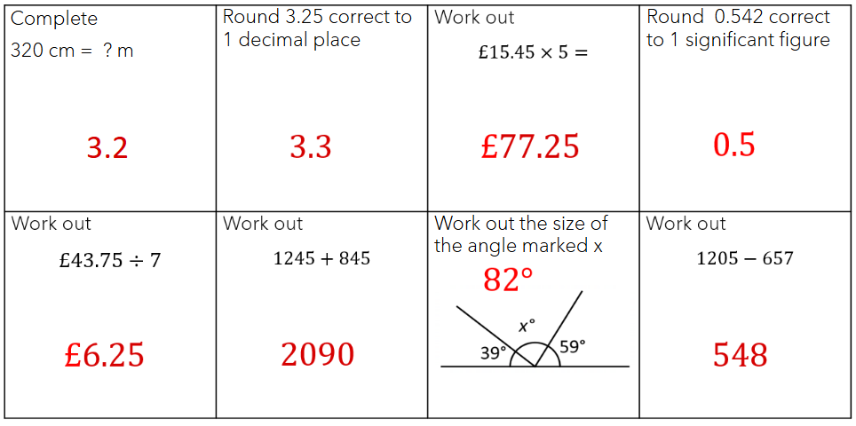
Do Now Answers

Slide 3
RECAP FROM YESTERDAY

Slide 4
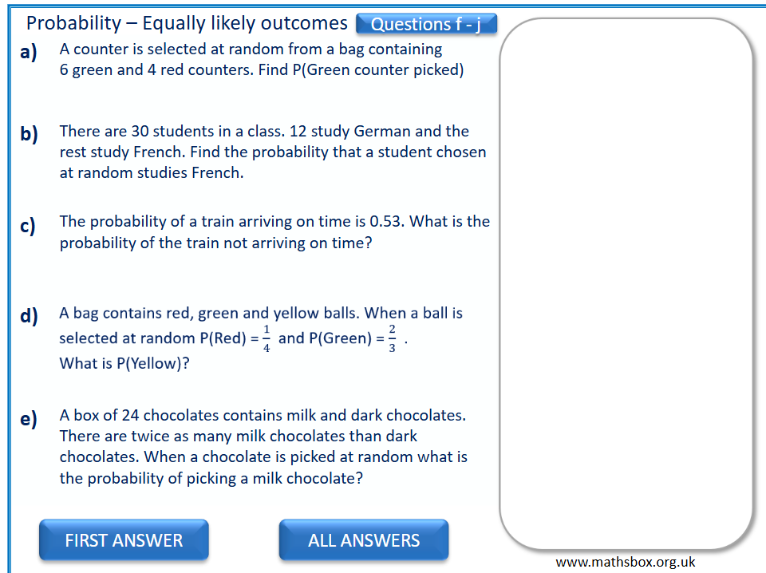

Click on this audio file to listen
to a description of how each
answer is calculated.

Slide 5
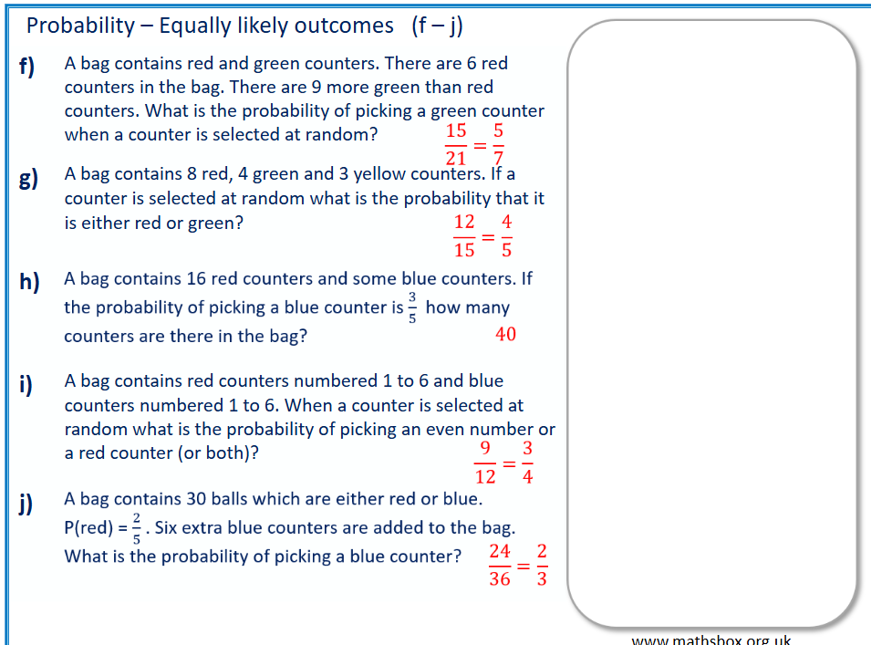
Click on this audio file to listen
to a description of how each
answer is calculated.

Slide 6
VIDEO CLIP TO WATCH
https://corbettmaths.com/2013/06/20/relative-frequency/

Slide 7
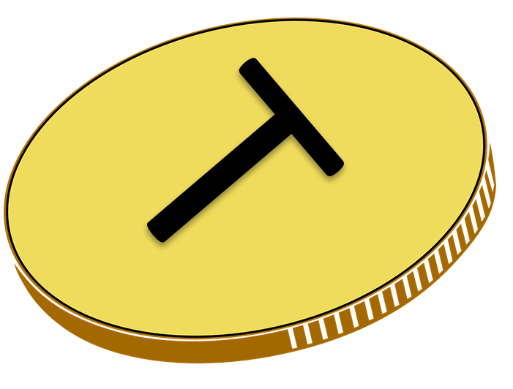

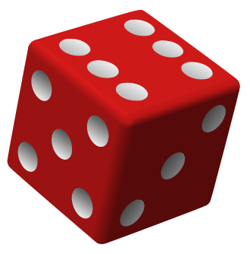

Do you agree?
If I flip a coin twice I must get
one tails & one heads.
If I roll a dice 6 times, I will definitely get a 5.

Slide 8

Do you agree?
If I flip a coin twice I must get
one tails & one heads.
Possible outcomes:
Tails then Tails
There are 4 equally likely outcomes.
Tails then Heads
The probability of 1 tails & 1 heads
is 2 out of 4.
Heads then Tails
$$\frac{2}{4} = \frac{1}{2}$$
Heads then Heads

Slide 9

Do you agree?
If I roll a dice 6 times, I will definitely get a 5.
$$\frac{1}{6}$$
The probability of rolling a 5 is
A sixth of the times we roll the dice we expect a 5.
After 6 rolls, we expect to roll a 5,
but Peter might be unlucky and roll 1, 1, 1, 1, 1, 1, or 6, 3, 4, 6, 2, 2.
Expecting something to happen does not mean it actually will!

Slide 10

Jackie recorded flips of a coin
Tails
Heads
To even it up,
the next flip must be tails.
Do you agree?
The next flip of the coin is an independent event:
the probability it is tails, is not changed by what happened before.

Slide 11





In a competition, 5 students flip a coin 6 times. They get one point for each tails.
Ash
Tom
Mae
Bob
Lucy
TTTHTT
HTHTHT
HHTHTH
HHHHHH
TTTHHT
5 points
3 points
2 points
0 points
4 points
Who was the luckiest/unluckiest?
Ash
Bob
What is the expected number of points for each player?
3
Who scored below average?
Mae
Bob
below expectation,
unlucky
Was the group lucky on average?
(5 + 3 + 2 + 0 + 4) ÷ 5 = 2.8
What would happen to the average if we had a competition
between 50 students?
Individual students can be lucky or unlucky,
but by combining more results the average
gets closer to the expectation.
The expectation is the mean theoretical result.

Slide 12

Max flips a coin…. lots
He records the percentage of tails after 1 flip, 10 flips, 50 flips, 100 flips & 1000 flips.
The first flip is a tails.
(100% Tails)
4 of the first 10 are tails.
(40% Tails)
28 of the first 50 are tails.
(56% Tails)
100%
As we increase the number of trials,
the results tend towards the expectation, the mean result.
% tails
50%
0%
Number of Flips

Slide 13
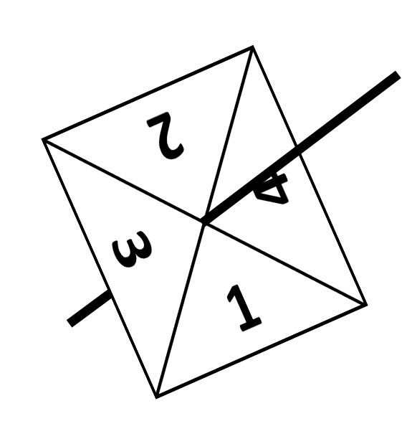



This is a fair spinner.
How often will it land on 3?
$$\frac{1}{4}$$
For every 4 spins,
we expect one of the spins to land on 3.
If we spin the spinner 40 times,
how many times do we expect it to land on 3?
$$\frac{40}{4}=10$$
A quarter of the spins:
times
$$\frac{1}{4}×40 =10$$
times
Expected number of outcomes =
probability of the outcome × number of trails

Slide 14
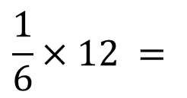


DEMO
Expectation
If we roll the dice 12 times,
how many times do we expect to score a 2?
$$\frac{1}{6}$$
P(2) =
Number of trials = 12
$$\frac{1}{6}×12 =$$
$$2$$
times

Slide 15
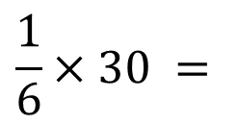

DEMO
Expectation
If we roll the dice 30 times,
how many times do we expect to score a 4?
$$\frac{1}{6}$$
P(4) =
Number of trials = 30
$$\frac{1}{6}×30 =$$
$$5$$
times

Slide 16
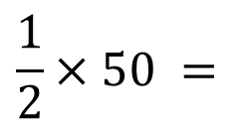


DEMO
Expectation
If we flip the coin 50 times,
how many times do we expect to get tails?
$$\frac{1}{2}$$
P(Tails) =
Number of trials = 50
$$\frac{1}{2}×50 =$$
$$25$$
times

Slide 17
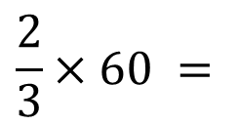


DEMO
Expectation
We randomly pick a cube then replace it.
If we make 60 picks,
how many times do we expect to pick a red cube?
$$\frac{2}{3}$$
P(Red) =
Number of trials = 60
$$\frac{2}{3}×60 =$$
$$40$$
times

Slide 18

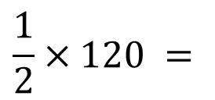

DEMO
Expectation
YOUR TURN
We randomly pick a cube then replace it.
If we make 60 picks,
how many times do we expect to pick a red cube?
If we flip the coin 120 times,
how many times do we expect to get tails?
$$\frac{2}{3}$$
$$\frac{1}{2}$$
P(Red) =
P(Tails) =
Number of trials = 60
Number of trials = 120
$$\frac{2}{3}×60 =$$
$$\frac{1}{2}×120 =$$
$$40$$
times
$$60$$
times

Slide 19

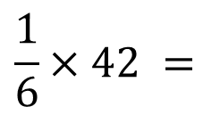

DEMO
Expectation
YOUR TURN
We randomly pick a cube then replace it.
If we make 60 picks,
how many times do we expect to pick a red cube?
If we roll the dice 42 times,
how many times do we expect to score a 1?
$$\frac{2}{3}$$
$$\frac{1}{6}$$
P(Red) =
P(1) =
Number of trials = 60
Number of trials = 42
$$\frac{2}{3}×60 =$$
$$\frac{1}{6}×42 =$$
$$40$$
times
$$7$$
times

Slide 20

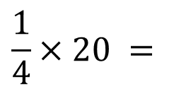

DEMO
Expectation
YOUR TURN
We randomly pick a cube then replace it.
If we make 60 picks,
how many times do we expect to pick a red cube?
We randomly pick a cube then replace it.
If we make 20 picks,
how many times do we expect to pick a red cube?
$$\frac{2}{3}$$
$$\frac{1}{4}$$
P(Red) =
P(Red) =
Number of trials = 60
Number of trials = 20
$$\frac{2}{3}×60 =$$
$$\frac{1}{4}×20 =$$
$$40$$
times
$$5$$
times

Slide 21

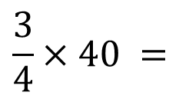

DEMO
Expectation
YOUR TURN
We randomly pick a cube then replace it.
If we make 60 picks,
how many times do we expect to pick a red cube?
We randomly pick a cube then replace it.
If we make 40 picks,
how many times do we expect to pick a blue cube?
$$\frac{2}{3}$$
$$\frac{3}{4}$$
P(Red) =
P(Blue) =
Number of trials = 60
Number of trials = 40
$$\frac{2}{3}×60 =$$
$$\frac{3}{4}×40 =$$
$$40$$
times
$$30$$
times

Slide 22

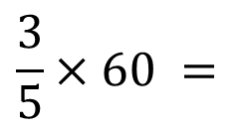

DEMO
Expectation
YOUR TURN
We randomly pick a cube then replace it.
If we make 60 picks,
how many times do we expect to pick a red cube?
We randomly pick a cube then replace it.
If we make 60 picks,
how many times do we expect to pick a red cube?
$$\frac{2}{3}$$
$$\frac{3}{5}$$
P(Red) =
P(Red) =
Number of trials = 60
Number of trials = 60
$$\frac{2}{3}×60 =$$
$$\frac{3}{5}×60 =$$
$$40$$
times
$$36$$
times

Slide 23
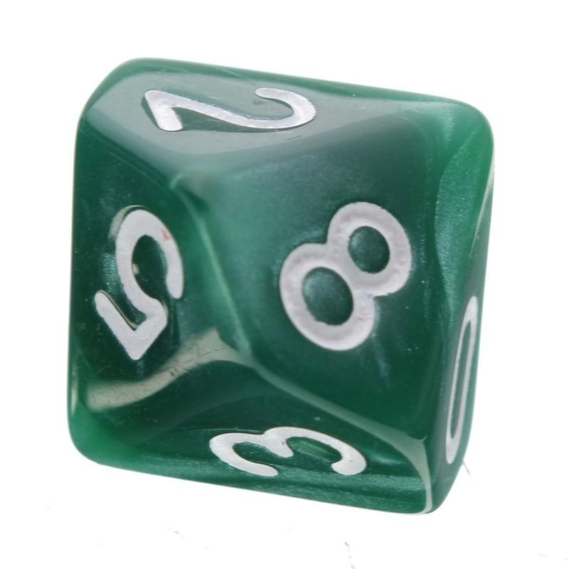
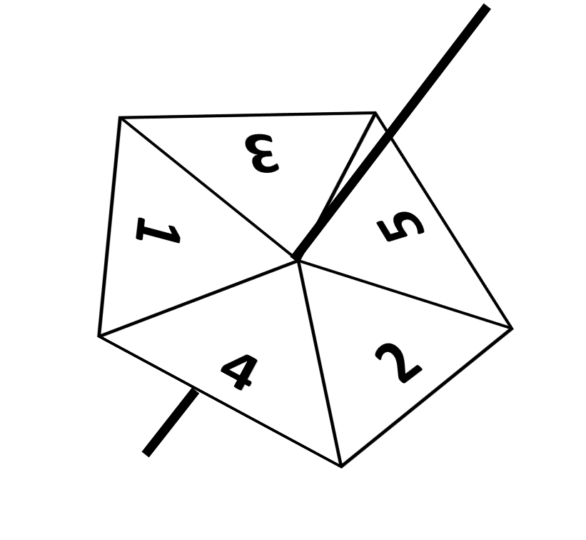
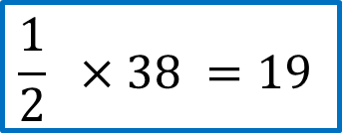
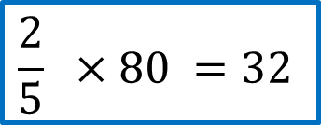
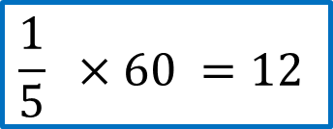
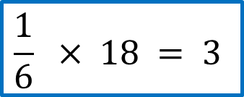
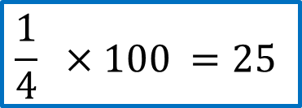
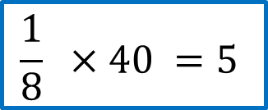
The dice is rolled 18 times.
How many 5s do we expect?
The coin if flipped 38 times.
How many tails do we expect?
$$\frac{1}{6} × 18 = 3$$
$$\frac{1}{2} ×38 =19$$
The dice is rolled 40 times.
How many 7s do we expect?
The spinner is spun 100 times.
How many 2s do we expect?
$$\frac{1}{8} ×40 =5$$
$$\frac{1}{4} ×100 =25$$
We randomly pick a cube &
replace it.
We do this 80 times.
How many red cubes
do we expect to pick?
The spinner is spun 60 times.
How many 1s do we expect?
$$\frac{1}{5} ×60 =12$$
$$\frac{2}{5} ×80 =32$$

Slide 24


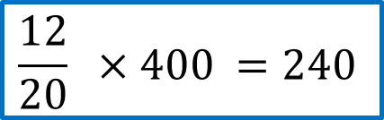

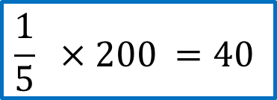
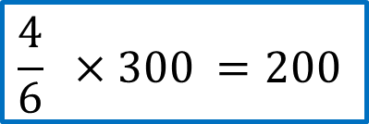


We randomly pick a cube &
replace it.
We do this 200 times.
How many blue cubes
do we expect to pick?
We randomly pick a cube &
replace it.
We do this 300 times.
How many white cubes
do we expect to pick?
$$\frac{1}{5} ×200 =40$$
$$\frac{4}{6} ×300 =200$$
Dane is practising taking penalties.
The probability he scores is 0.2
If he takes 65 penalties,
how many does he expect to score?
70% of the shoes in the UK are made abroad.
If you survey 120 people about the shoes
they are wearing, how many do we
expect to have UK-made shoes?
$$0.2×65 =13$$
$$0.3×120 =36$$
A bag contains 12 red cubes,
6 black cubes & 2 green cubes.
We pick and replace a cube.
If we do this 400 times,
how many red cubes do we expect to pick?
Jamie rolls a dice 30 times.
1 = 1 point, 2 = 2 points etc
He totals his score.
What is his expected mean score?
$$\frac{12}{20} ×400 =240$$
$$\left(1+2+3+4+5+6\right)÷ 6=3.5$$

Slide 25
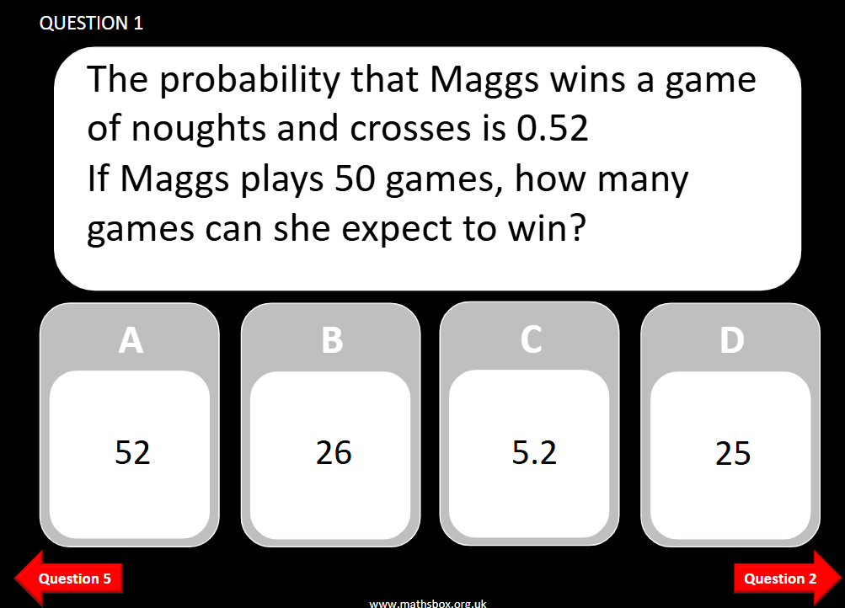

Slide 26
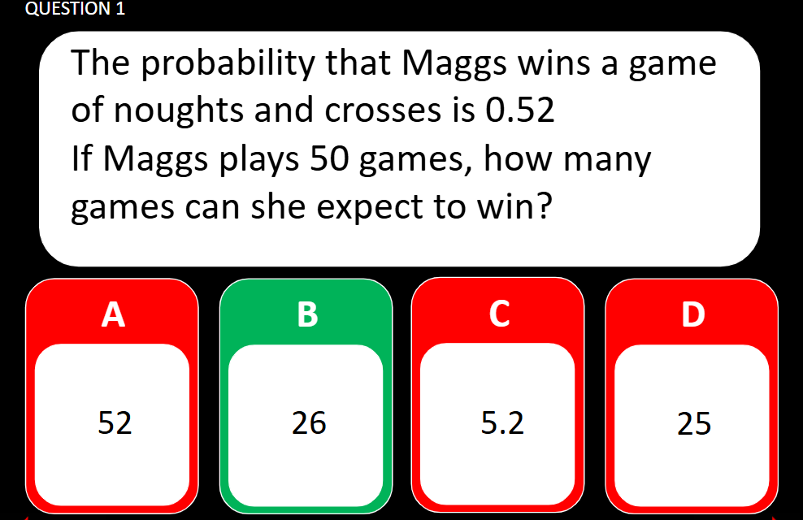

Slide 27
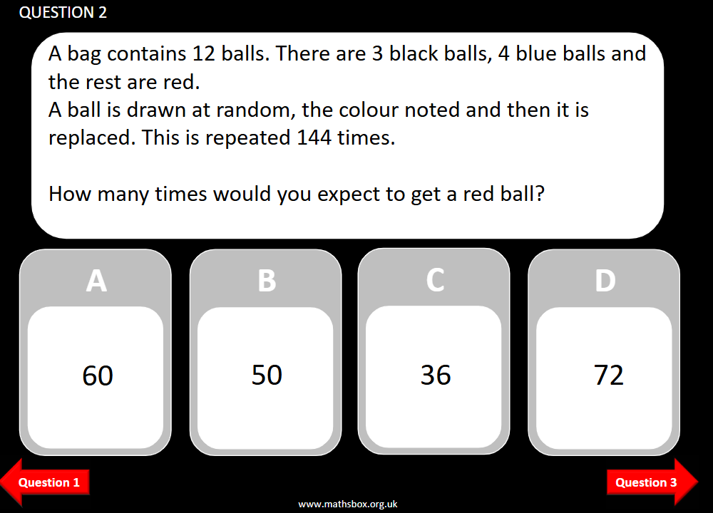

Slide 28
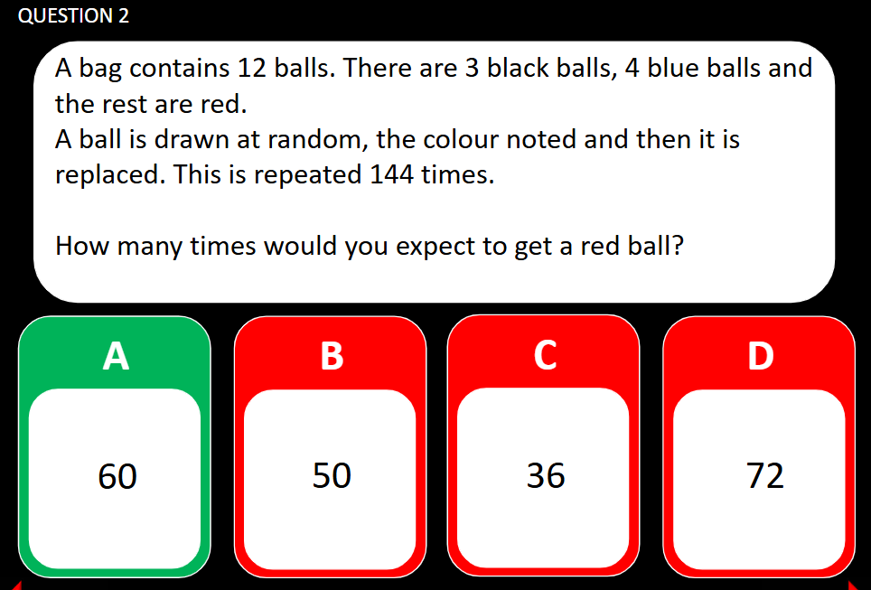

Slide 29
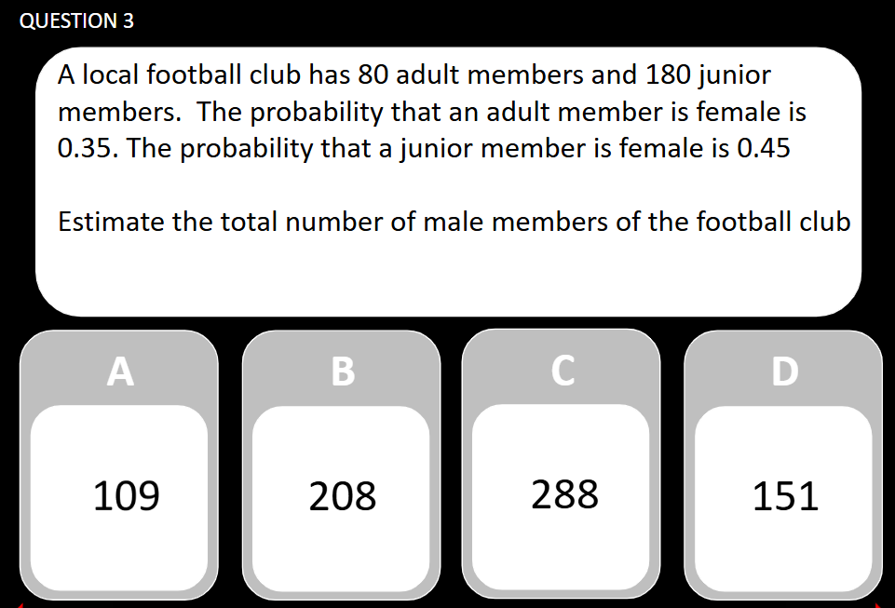

Slide 30
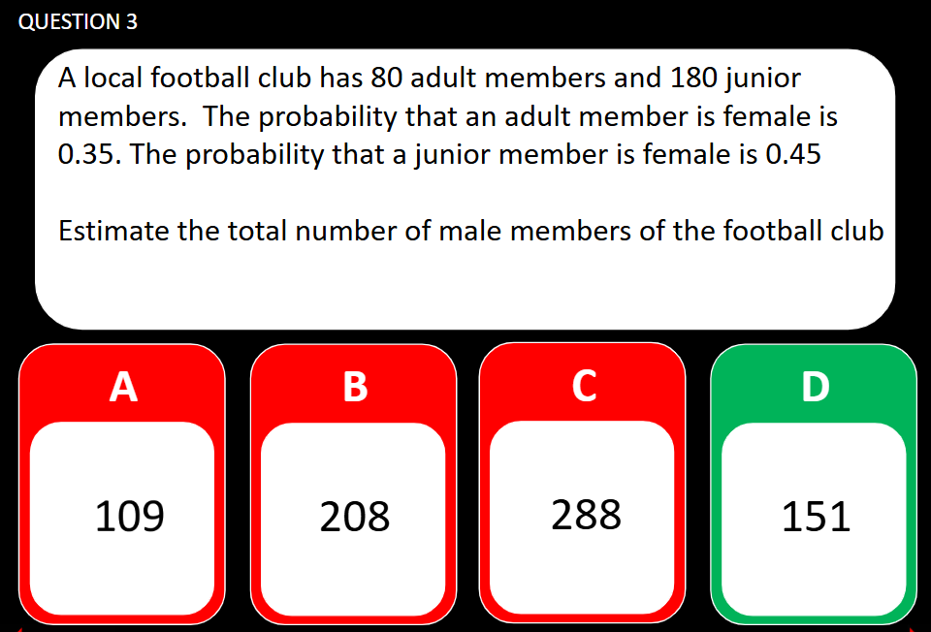

Slide 31
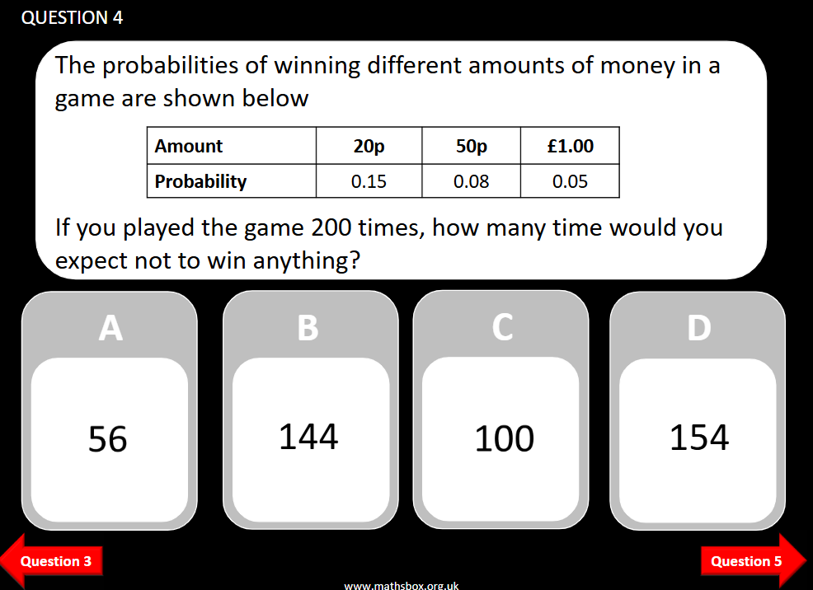

Slide 32
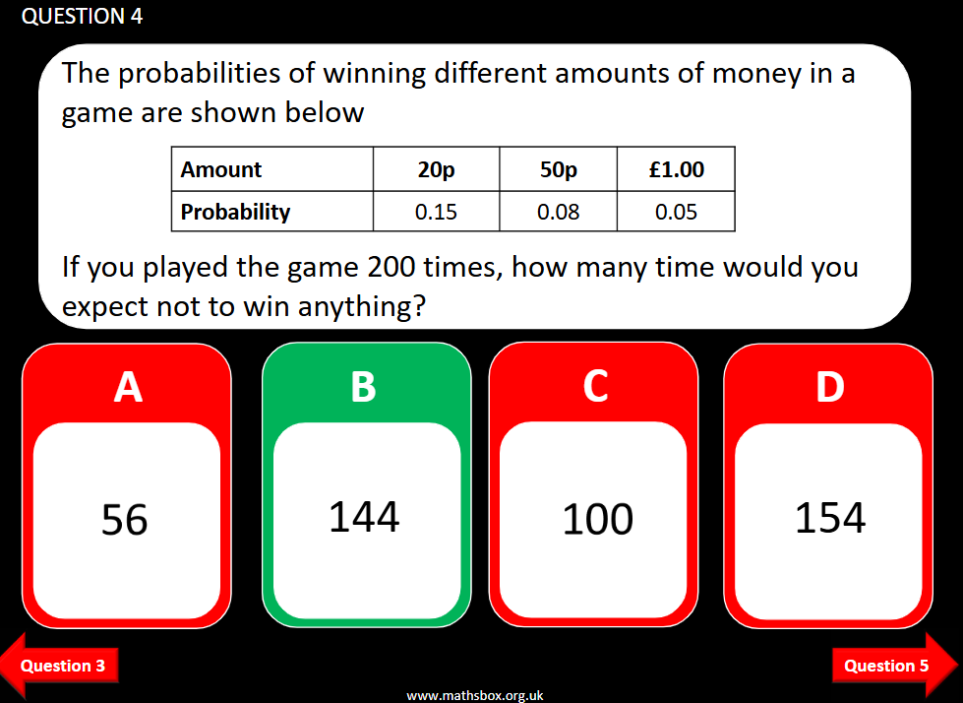

Slide 33
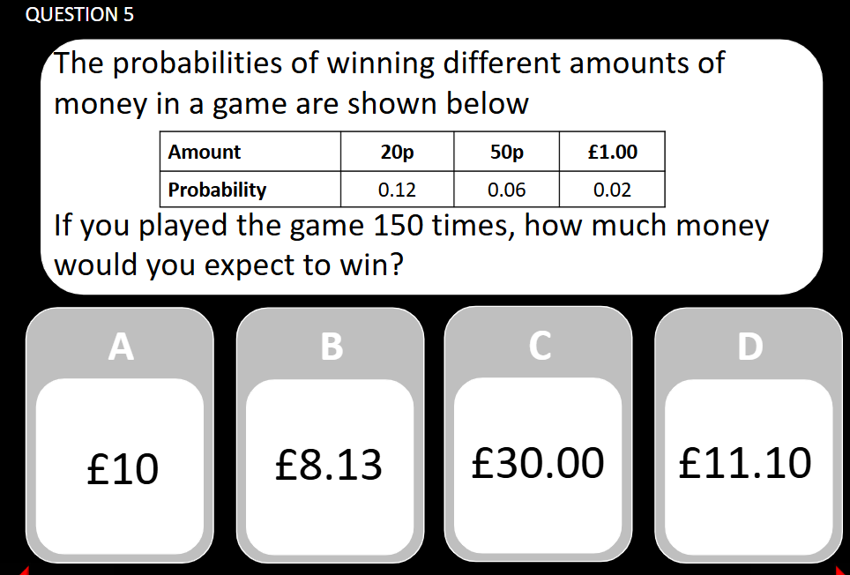

Slide 34
