Slide 1
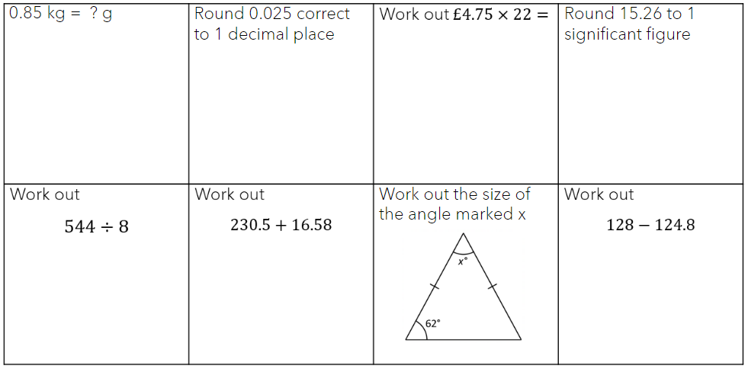
Threshold – Entrance - Teacher to stand on door threshold
Title: Probability Introduction
Date: Thursday 9th January 2025
At the start of the lesson:
Greet at the classroom door
Wear your uniform with pride
Enter the classroom in silence
Books distributed calmly
Complete your do now in silence
Place your equipment on the desk
Do Now:
Sit Up & Focus - Highest Quality Work - Interruption Free - Neat Work - Equipment

Slide 2
Do Now Answers

Slide 3
The Probability Scale
Impossible
Unlikely
Likely
Certain
Very Unlikely
Even Chance
Very Likely
0
0.5
1
Likely
Unlikely
Very Likely
Even Chance
Very Unlikely

Slide 4
The Probability Scale
We can use decimals, percentages or fractions
to describe probabilities.
Impossible
Certain
0
0.25
0.5
0.75
1
0
25%
50%
75%
100%
$$\frac{1}{4}$$
$$\frac{1}{2}$$
$$\frac{3}{4}$$
$$0$$
$$1$$

Slide 5
Mark these events on the probability scale.
A baby is born male.
(51%)
It will rain in the amazon tomorrow.
(15/20)
Twins are born.
(0.05)
A dice will land on a 6.
(1/6)
0
0.25
0.5
0.75
1
0
25%
50%
75%
100%
$$\frac{1}{4}$$
$$\frac{1}{2}$$
$$\frac{3}{4}$$
$$0$$
$$1$$

Slide 6
Video Clip to Watch
https://www.youtube.com/watch?v=ur_hHjLrBNo

Slide 7
Mark these events on the probability scale.
a) It will rain tomorrow
P = 0.5
e) Mary will pass her driving exam.
P = 7/10
b) There will be a test on Monday.
P = 0.1
f) United will win their next match.
P = 25%
c) Jack will eat pasta for dinner.
P = 60%
g) It will snow at Christmas
P = 4/5
d) Dan will fly home from school.
P = 0/10
h) There will be homework today.
P = 0.92
d
b
f
a
c
e
g
h
0
1

Slide 8
5 cards numbered 1 to 5 are put face down and mixed up.
1
2
3
4
5
$$\frac{1}{5}$$
What is the probability of picking…
…the 5 card?
$$0.2$$
$$20\%$$
$$\frac{1}{5}$$
…the 1 card?
$$0.2$$
$$20\%$$
$$\frac{2}{5}$$
…an even card?
$$0.4$$
$$40\%$$

Slide 9
To express the probability of an event happening we can use a formula:
P(outcome) = $\frac{number of ways the outcome can happen}{total number of possible outcomes}$
Tom picks a counter randomly from the bag.
$$\frac{3}{5}$$
What is P(blue counter)?
$$0.6$$
$$60\%$$
$$\frac{2}{5}$$
What is P(yellow counter)?
$$0.4$$
$$40\%$$
$$\frac{0}{5}$$
What is P(green counter)?
$$0$$
$$0\%$$

Slide 10
To express the probability of an event happening we can use a formula:
P(outcome) = $\frac{number of ways the outcome can happen}{total number of possible outcomes}$
Jem picks a counter randomly from the bag.
$$\frac{7}{10}$$
What is P(blue counter)?
$$0.7$$
$$70\%$$
$$\frac{3}{10}$$
What is P(yellow counter)?
$$0.3$$
$$30\%$$
What do the two probabilities total?
$$1$$
It is certain the counter is blue or yellow.

Slide 11
Jem picks a counter randomly from the bag.
What does random mean?
How could we make the event non-random?

Slide 12
Example
Calculating Probabilities
P(outcome) = $\frac{number of ways the outcome can happen}{total number of possible outcomes}$
At random a counter is picked from the bag.
What is P(yellow counter)?
$$\frac{6}{8}=\frac{3}{4}$$
$$0.75$$
$$75\%$$

Slide 13
Example
Calculating Probabilities
YOUR TURN
P(outcome) = $\frac{number of ways the outcome can happen}{total number of possible outcomes}$
At random a counter is picked from the bag.
At random a counter is picked from the bag.
What is P(yellow counter)?
What is P(yellow counter)?
$$\frac{6}{8}=\frac{3}{4}$$
$$\frac{2}{5}$$
$$0.75$$
$$75\%$$
$$0.4$$
$$40\%$$

Slide 14
Your turn 2
P(outcome) = $\frac{number of ways the outcome can happen}{total number of possible outcomes}$
At random a counter is picked from the bag.
What is P(blue counter)?
$$\frac{5}{10}=\frac{1}{2}$$
$$0.5$$
$$50\%$$

Slide 15
A counter is picked at random.
Calculate the probability of each event and give your answer as a fraction.
$$\frac{2}{8}=\frac{1}{4}$$
P(white counter) =
$$\frac{4}{8}=\frac{1}{2}$$
P(black counter) =
P(green counter) =
$$0$$
$$\frac{4}{10}=\frac{2}{5}$$
P(pink counter) =
$$\frac{3}{10}$$
P(white counter) =
$$\frac{7}{10}$$
P(yellow or pink counter) =

Slide 16
A counter is picked at random.
Calculate the probabilities as fractions.
$$\frac{4}{12}=\frac{1}{3}$$
$$\frac{3}{18}=\frac{1}{6}$$
P(pink) =
P(yellow) =
$$\frac{3}{12}=\frac{1}{4}$$
$$\frac{15}{18}=\frac{5}{6}$$
5 white
3 black
4 pink
P(black) =
6 white
9 black
3 yellow
P(white or black) =
$$\frac{7}{12}$$
$$\frac{9}{18}=\frac{1}{2}$$
P(not white) =
P(not black) =
A fair dice is rolled.
Calculate the probabilities as fractions.
10 cards are numbered 1-10 &
one card is picked at random.
What is…
$$\frac{1}{6}$$
$$\frac{5}{10}=\frac{1}{2}$$
P(5) =
P(odd) =
1
2
2
10
$$\frac{3}{6}=\frac{1}{2}$$
$$\frac{4}{10}=\frac{2}{5}$$
P(even) =
P(prime) =
$$\frac{4}{6}=\frac{2}{3}$$
$$\frac{3}{10}$$
P(more than 2) =
P(multiple of 3) =
If you rolled the dice 60 times,
how many 6s would you expect?
$$\frac{6}{10}=\frac{3}{5}$$
10
P(even or 7) =

