Slide 1
GCSE Drama
Comp 3 – Exam Preparation

Slide 2
Describe puritan life in Salem 1692.
List the costume a Puritan woman would wear below:
Do Now Task
Communism – what does it mean?
The Crucible has lots of parallels with McCarthyism . . . . List them below.
America carried out real life ‘witch-hunts’. Explain what happened.
What is the name of the senator who was in charge of finding communists in America?

Slide 3
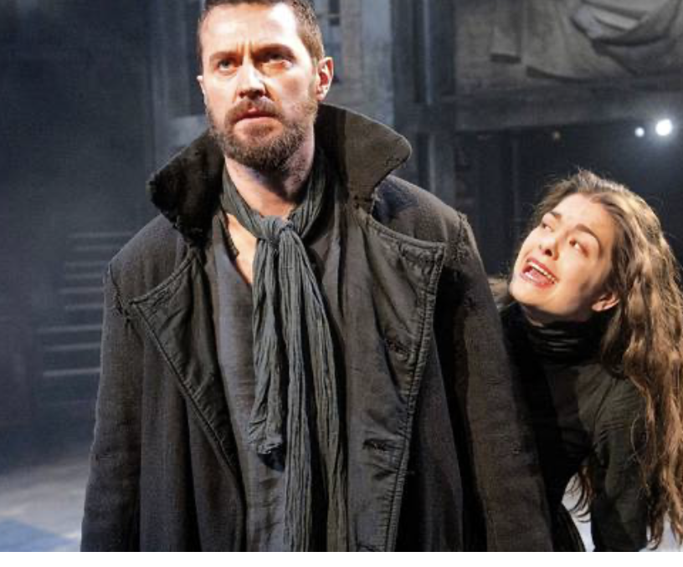
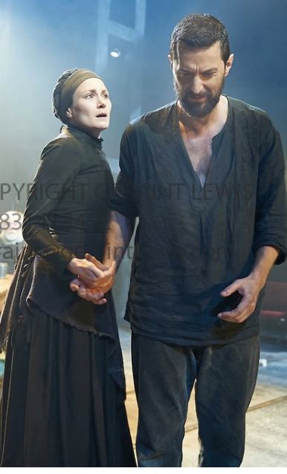
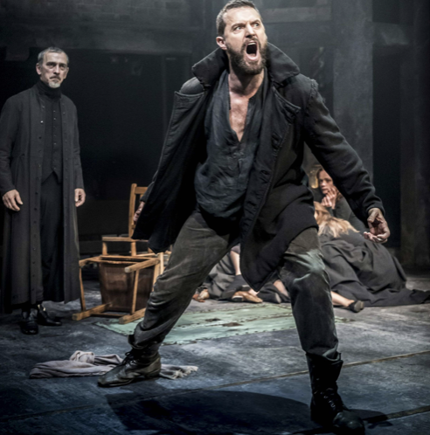
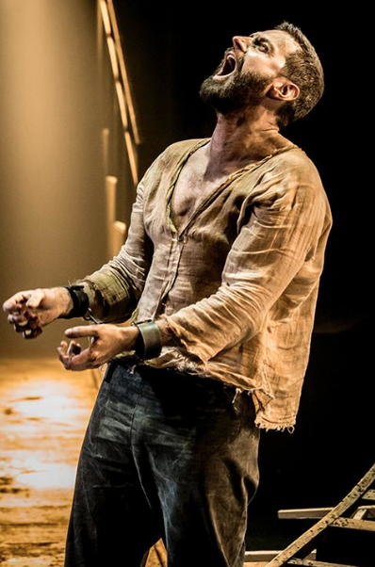
John Proctor – Costume
John’s costume will be similar in each act Trousers – black/brown loose fitting Boots – outdoor boots to show he works on the land, laced up to his ankle, and made from leather. Scuffed and dirty to reflect his work on the farm. Shirt | Act One (Parris household) – John could wear a heavy outdoor overcoat and a scarf around his neck. Coat could be made from felt, and have patches stitched on to show it has been mended. This could help communicate John’s flaws. He visits Parris over Betty’s condition.
 | Act Two (Proctor household) - he would remove his coat to reveal a cotton shirt, loose fitting and with a v-neck revealing his chest. It could be dirty/stained to communicate he has been working on the fields.
 | Act Three – (Courthouse) –John could wear a heavy outdoor overcoat and a scarf around his neck. Coat could be made from felt, and have patches stitched on to show it has been mended.
 | Act Four – Jail cell – Proctor would be barefoot, trousers and shirt. He would be dirty all over his face, arms and feet. The shirt would be ripped with tones of brown and dark brown stains on it.

Slide 4
How would John’s costume change throughout the play?
John Proctor – Costume
Act One – Parris Household | Act Two – Proctor Household
Act Three – Courthouse | Act Four – Jail

Slide 5
Elizabeth Proctor – Costume
Elizabeth’s costume will be similar in each act Dress Bonnet Shoes Shawl | Act One - we do not see Elizabeth Proctor in Act One
 | Act Two (Proctor household) - ankle length dress, long sleeved, nipped in at the waist and A-line in shape. Muted tones of browns, beiges to reflect the simplistic life led by puritan woman. The dress would be made from cotton as this was readily available during the 17th century. She would also wear an apron around her waist as she is at home and has been cooking. The apron would be white cotton with stains on it to look well worn as she is a housewife. Elizabeth would not be wearing a bonnet at the beginning of the act but when Hale enters the house, she would tie her hair back and put the bonnet on. Elizabeth would wear a necklace with a crucifix on it, made from wood to show her belief in God and to reinforce her being a covenanted Christian woman. Elizabeth might also wear a shawl around her shoulders. This would be knitted in wool and would be white or beige in colour. Elizabeth might rub the necklace whilst she and John are being questioned by Hale or she might fiddle with the shawl around her shoulders, pulling it tighter on her during the questioning about the commandments.
 | Act Three – (Courthouse) – she would wear the same dress but without the apron as she is not home. She should look a little worn down here and disheveled as she has been imprisoned since she was arrested at the end of Act Two. Her hair could look untidy, she could have dark circles under eyes and the skirt of her dress could be dirty.
 | Act Four – Jail cell – How would she look from being kept in a jail cell?

Slide 6
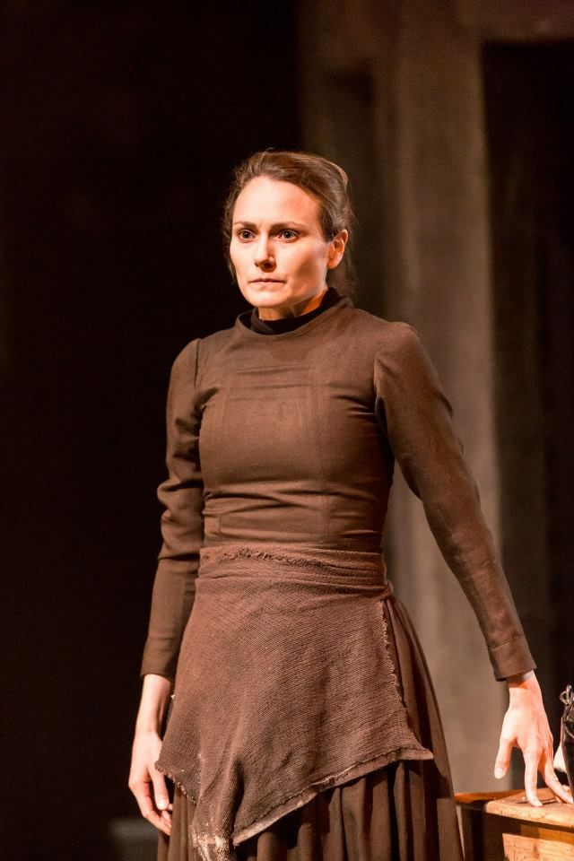
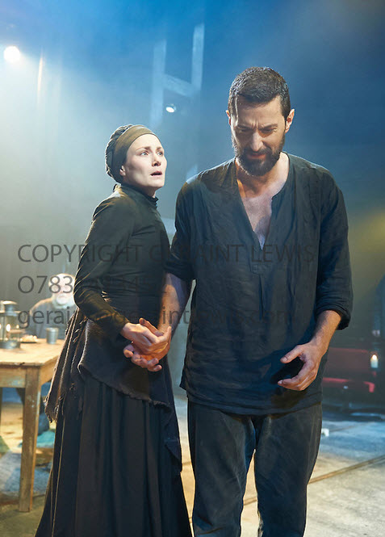
How would Elizabeth’s costume change throughout the play?
Elizabeth Proctor – Costume
Act One – Parris Household | Act Two – Proctor Household
Act Three – Courthouse | Act Four – Jail

Slide 7
How would Parris’ costume change throughout the play?
Parris– Costume
Act One – Parris Household | Act Two – Proctor Household – he is not in this scene.
Act Three – Courthouse | Act Four – Jail

Slide 8
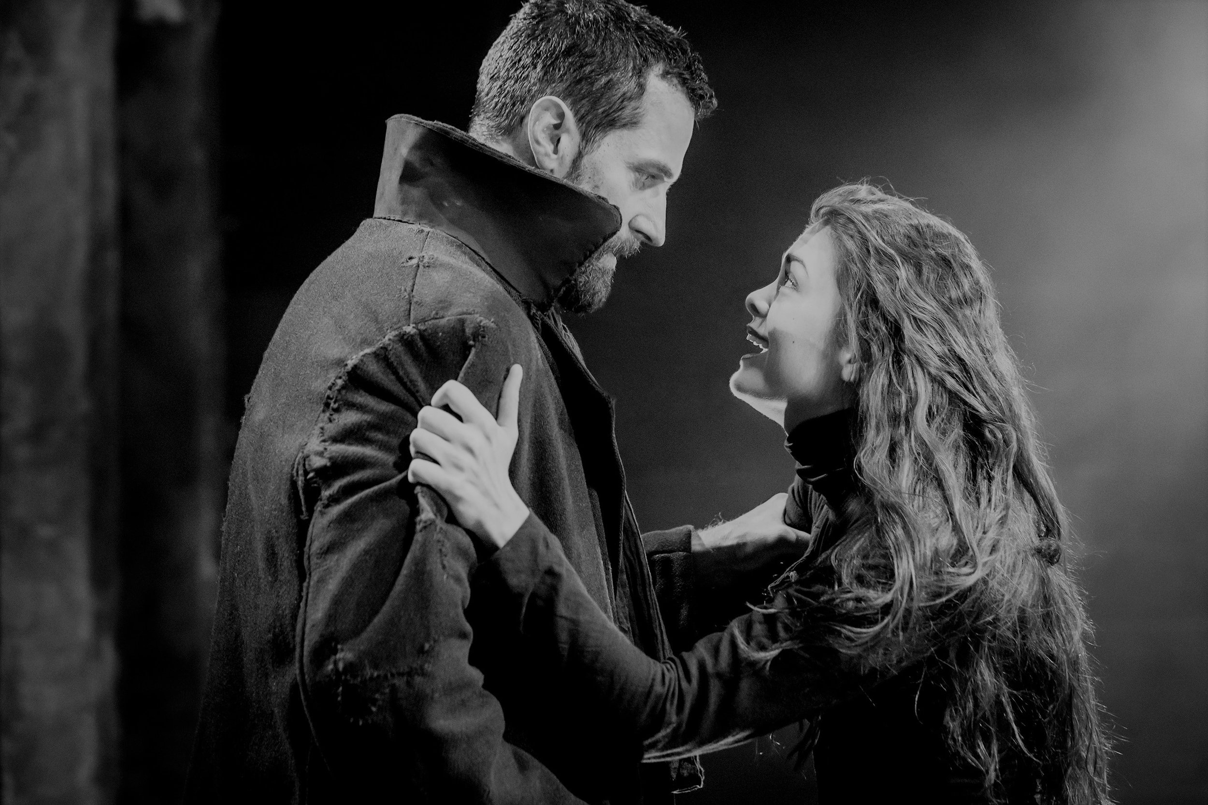
How would Abigail’s costume change throughout the play?
Abigail Williams – Costume
Act One – Parris Household | Act Two – Proctor Household
Act Three – Courthouse | Act Four – Jail

