Slide 1

Year 11 Hospitality and Catering

Slide 2
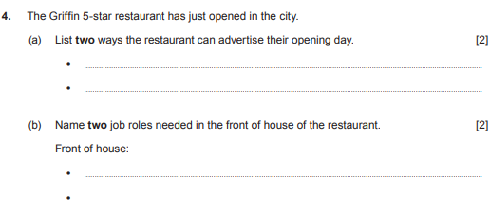

Slide 3
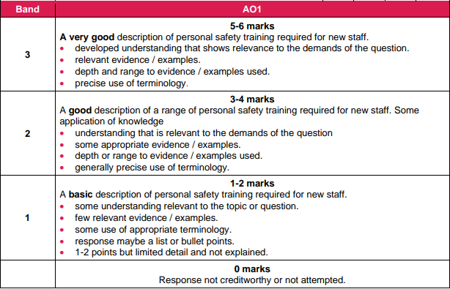
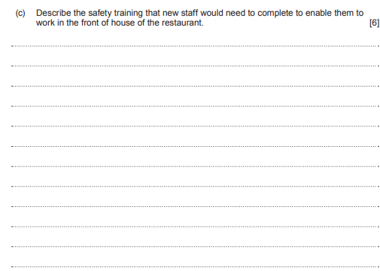
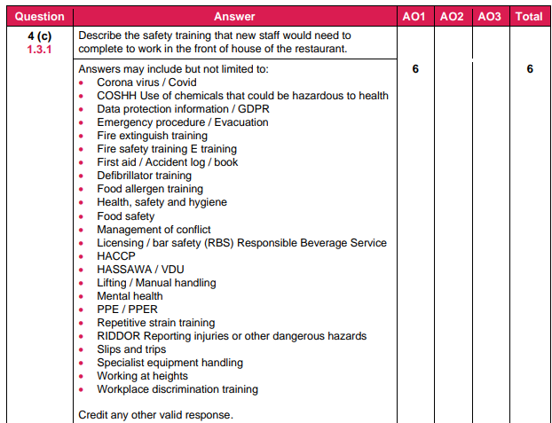

Slide 4















7. HEALTH AND SAFETY
RISK | CONTROL
Cuts | Carry blade down Use the right knife for the job Safe cutting techniques
Fire | Staff training No smoking signs Fire extinguishers
Burns | Deep fat fryer safety rules Use a basket Do not overfill Oven safety rules Wear an apron Use an oven glove
Slips, trips and falls | Keep floors clutter free Clear up spills
Electrocution | Replace damaged equipment Get PAT testing
Chemical hazards | Labels and signs Store safely
Stress & fatigue | Monitor employees
Bullying & harassment | Open culture for reporting Bullying and harassment policies
Assault | Training on diffusing anger
HASAWA Health and Safety at Work Act:
RIDDOR
Reporting of Injuries, Diseases and
Dangerous Occurrences Reg.s
Claw hold
Bridge hold
Serious injuries
Work related disease
Gas leaks
Keep grills/ovens grease​ free
No cloths by ovens
Store flammable stuff safely
MHOR
Manual Handling Operations Reg.s
Open flames safety rules
Keep cloths away
Keep clothes away
Steam and hot water burns
Use oven glove
Lift lid carefully
Keep back straight
Bend knees
Feet apart
Get help
Use a trolley
PPER
Personal Protective Equipment Regulations
Wet floor signs
Use a step ladder
Gloves
Goggles
Face masks
Do not have wet hands
Unplug before cleaning
COSHH
Control of Substance Hazardous to Health
Chemicals
Dust
Gases
Rest breaks
Security guards
EMPLOYERS MUST:
Train employees
Provide PPE
Provide safety equipment
Do a risk assessment
Test and maintain equipment
Put up signs and label
EMPLOYEES MUST:
Follow training
Wear PPE
Use safety equipment
Work safely
Follow H&S rules
Report any accidents
Keeping customers safe
Food poisoning | HACCP, avoid cross contamination, check use-by dates
Allergic reactions | Labelling on menus Avoiding cross contamination
Burns | Well fitting lids
Fire | Emergency exit signs
Slips, trips and falls | Wet floor signs No trailing wires
Assault
Not serving boiling hot food
RISK ASSESSMENTS
How high is the level of hazard (1-5)?
Multiplied by how likely is it to happen (1-5)?
Who is at risk?
What can be done to minimise it?
l
Nonslip stairs
Training on diffusing anger​
Security guards and cameras

Slide 5
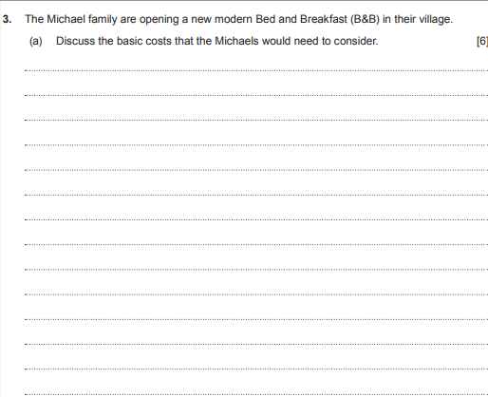
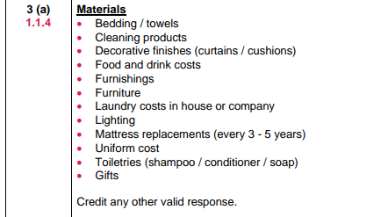
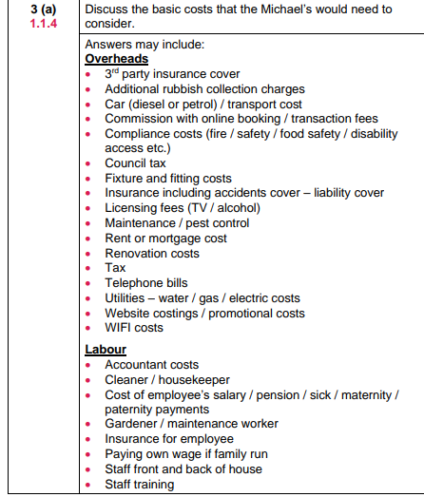
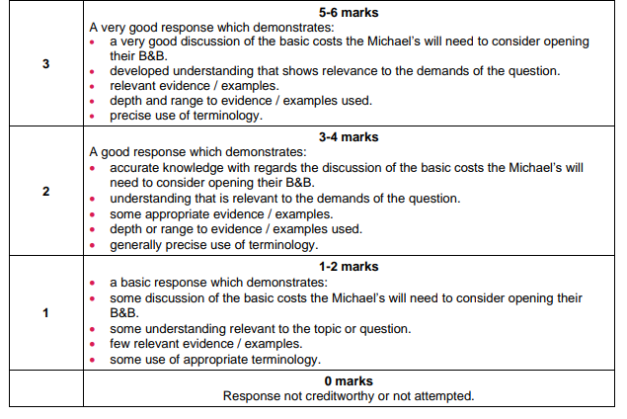

Slide 6
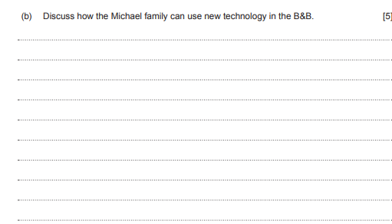
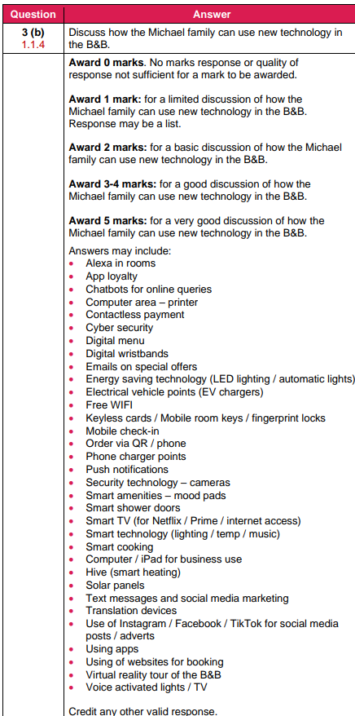

Slide 7









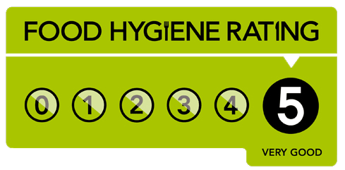





8. FOOD RELATED
ILL HEALTH
BACTERIA -keep food out of the danger zone (5-63 c)
NAME FROM SYMPTOMS
Bacillus cereus
Campylobacter
Clostridium perfringens
E-Coli
Listeria
Salmonella
Staphylococcus aureus
BACTERIA: NEEDS AND CONTROLS
Warmth- usually 37°c
Chill to less than 5°c
CHEMICAL
Bleach- store safely
Cleaners-label
Pesticide- wash fruit and veg.
Nausea Vomiting
Water
Dried food
Add sugar or salt
Stomach pain Diarrhoea
Diarrhoea Vomiting Fever
Food- mostly animal sources
Cook meat well
PHYSICAL
Anything solid that shouldn’t be in the food e.g:
Sticks, screws
Bloody diarrhoea Sometimes death
Time
Use by use -by-date
Cook & chill quickly
Flu-like symptoms Miscarriage
ALLERGY
Immune reaction causes rashes, swollen lips and throat, and death from anaphylactic shock
Eggs
Fish & shellfish
Dairy
Gluten
Nuts & peanuts
Soya
Mustard
Fruit & vegetables
MSG
Aspartame
Anaphylactic shock
Call 999
Treat with EpiPen
Avoid contamination
Labels
Hand washing
Colour coded equipment
Vomiting, fever Sometimes death
Food safety plan showing
due diligence-
Hazard
Analysis
Critical
Control
Points
How?
Create a flow chart showing each stage in the preparation
Identify hazards (physical, chemical, biological)
Say what can be done do control or prevent hazard
HACCP
Severe vomiting Diarrhoea
SYMPTOMS
KEEPING FOOD SAFE
Clean hands, clothes and nails
Don’t’ work if sick
Clean as you go
Separate raw and cooked food
Chill to below 5°c
Cook to over 75°c
Hot hold above 63°c
Freeze to below -18°c
Dispose of waste
Use pest control
Use HACCP
Non-visible
Nausea
Stomach ache
Constipation
Painful joints
Visible
Vomiting
Diarrhoea
Weight loss
Death
Sweating
Reheat food to 75°c
THE ENVIRONMENTAL HEALTH OFFICER
p
Actions thay can take
Can enter any premises without warning
Formal inspection letter
Hygiene improvement notice
Emergency prohibition notice
Seize of food
Take enforcement action (court)
Responsibilities
Enforcing the Food Safety Act
Inspecting businesses and giving ratings
Giving feedback to businesses
Investigating complaints
Following up outbreaks of food poisoning
Taking photos and samples
Giving evidence in court
FOOD LABELLING REG.S
Use-by /best-before date
Ingredients list
Allergen information
Nutritional information
Manufacturer
Storing and cooking instructions
Country of origin
Red- high calorie/fat/sat /sugar
Amber- medium. calorie/fat/sat /sugar
Green- low in calories/fat/salt/sugar
% recommended intake and serving size
INTOLLERANCE
Problems with digestion causes stomach-ache, sore joints etc.
Coelliac- gluten
Lactose- dairy

Slide 8
