Slide 1
Year 11 Hospitality and Catering Friday 10th January

Slide 2
7. HEALTH AND SAFETY
RISK | CONTROL
Cuts | Carry blade down Use the right knife for the job Safe cutting techniques
Fire | Staff training No smoking signs Fire extinguishers
Burns | Deep fat fryer safety rules Use a basket Do not overfill Oven safety rules Wear an apron Use an oven glove
Slips, trips and falls | Keep floors clutter free Clear up spills
Electrocution | Replace damaged equipment Get PAT testing
Chemical hazards | Labels and signs Store safely
Stress & fatigue | Monitor employees
Bullying & harassment | Open culture for reporting Bullying and harassment policies
Assault | Training on diffusing anger
HASAWA Health and Safety at Work Act:
RIDDOR
Reporting of Injuries, Diseases and
Dangerous Occurrences Reg.s
Claw hold
Serious injuries
Work related disease
Gas leaks
Keep grills/ovens grease​ free
No cloths by ovens
Store flammable stuff safely
MHOR
Manual Handling Operations Reg.s
Open flames safety rules
Keep cloths away
Keep clothes away
Steam and hot water burns
Use oven glove
Lift lid carefully
Keep back straight
Bend knees
Feet apart
Get help
Use a trolley
PPER
Personal Protective Equipment Regulations
Wet floor signs
Use a step ladder
Gloves
Goggles
Face masks
Do not have wet hands
Unplug before cleaning
COSHH
Control of Substance Hazardous to Health
Chemicals
Dust
Gases
Rest breaks
Security guards
EMPLOYERS MUST:
Train employees
Provide PPE
Provide safety equipment
Do a risk assessment
Test and maintain equipment
Put up signs and label
EMPLOYEES MUST:
Follow training
Wear PPE
Use safety equipment
Work safely
Follow H&S rules
Report any accidents
Keeping customers safe
Food poisoning | HACCP, avoid cross contamination, check use-by dates
Allergic reactions | Labelling on menus Avoiding cross contamination
Burns | Well fitting lids
Fire | Emergency exit signs
Slips, trips and falls | Wet floor signs No trailing wires
Assault
Not serving boiling hot food
RISK ASSESSMENTS
How high is the level of hazard (1-5)?
Multiplied by how likely is it to happen (1-5)?
Who is at risk?
What can be done to minimise it?
l
Nonslip stairs
Training on diffusing anger​
Security guards and cameras

Slide 3
Regulations
What does HASAWA stand for?
What does RIDDOR stand for?
What does MOHR stand for?
Give 4 rules for lifting
What does PPER stand for?
Give 3 examples of PPE
What does COSHH stand for?
Give 2 things covered by COSHH
Name the symbols
Give 4 things an employer must do
Give 4 things an employee must do
Name the COSHH symbols
Risks and controls
How is a risk worked out?
Give 2 controls against cuts
Name 2 safe cutting techniques
Give 2 controls against fire
Give 2 controls against burns from deep fat fryers
Give 2 controls against slips, trips and falls
Give 2 controls against chemical hazards
Give 2 controls against stress and fatigue
Give 2 controls against bullying and harassment
Give 1 control against assault
Give 1 control against food poisoning of customers
Give 1 control against allergic reaction occurring in customers
Give 1 control against customers burning themselves
Give 1 control against customers burning to death in a fire
Give 1 control against customers being assaulted
0
…........................
…........................
…........................
…........................
…........................
…........................
…........................
…........................
…........................

Slide 4
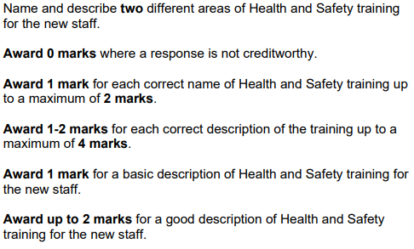
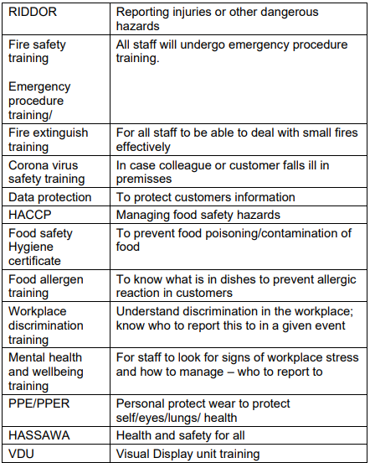
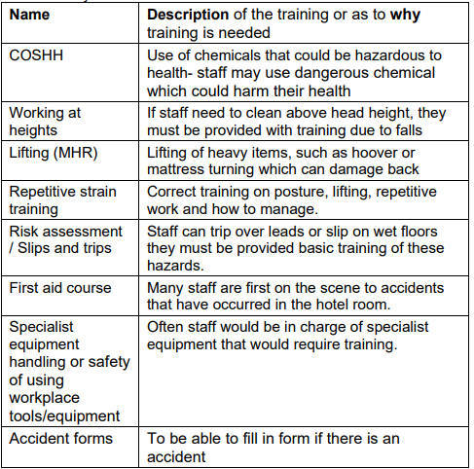

Slide 5
