Slide 1
Learning Objective:
To be able to analyse how language is used to communicate Shylock’s feelings about the way he is treated.
Friday 10th January
Title: The treatment of Shylock
Do Now:
Answer in full sentences
’I am daughter to his ______, but not to his ______.’ - Jessica
‘I will have my _____.’ - Shylock
‘Oh my Christian ______!’ – Shylock
‘To you Antonio, I owe the most in ______ and in _____.’ - Bassanio
‘Hung on her ______ like a ______ / fleece’ - Bassanio
Dare to Shine: Choose a Quote to Explode

Slide 2
Learning Objective:
To be able to analyse how language is used to communicate Shylock’s feelings about the way he is treated.
Friday 10th January
Title: The treatment of Shylock
Starting with this speech, how does Shakespeare present Shylock’s feelings about the way he is treated?
Write about:
• how Shakespeare presents Shylock in this speech
• how Shakespeare presents Shylock in the play as a whole.
[30 marks]
AO4 [4 marks

Slide 3
Learning Objective:
To be able to analyse how language is used to communicate Shylock’s feelings about the way he is treated.
Friday 10th January
Title: The treatment of Shylock
Your planned response
What points will you make about the treatment of Shylock
What characters will you focus on – how did they treat Shylock?
What quotes will you use?
Quote analysis – can you identify a number of points about this quote and how it shows the treatment of Shylock?
Can you pick out writers methods and how they are used to show the treatment of Shylock?

Slide 4
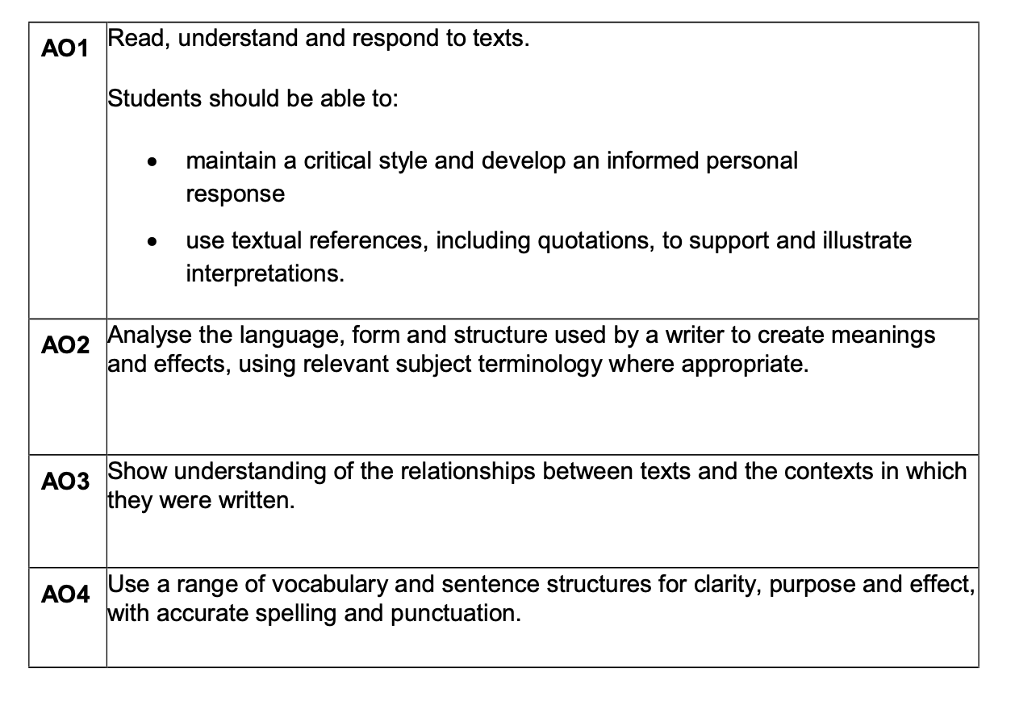
Learning Objective:
To be able to analyse how language is used to communicate Shylock’s feelings about the way he is treated.
Friday 10th January
Title: The treatment of Shylock
Assessment
Objectives
This is what you get
awarded marks for
in the exam

Slide 5
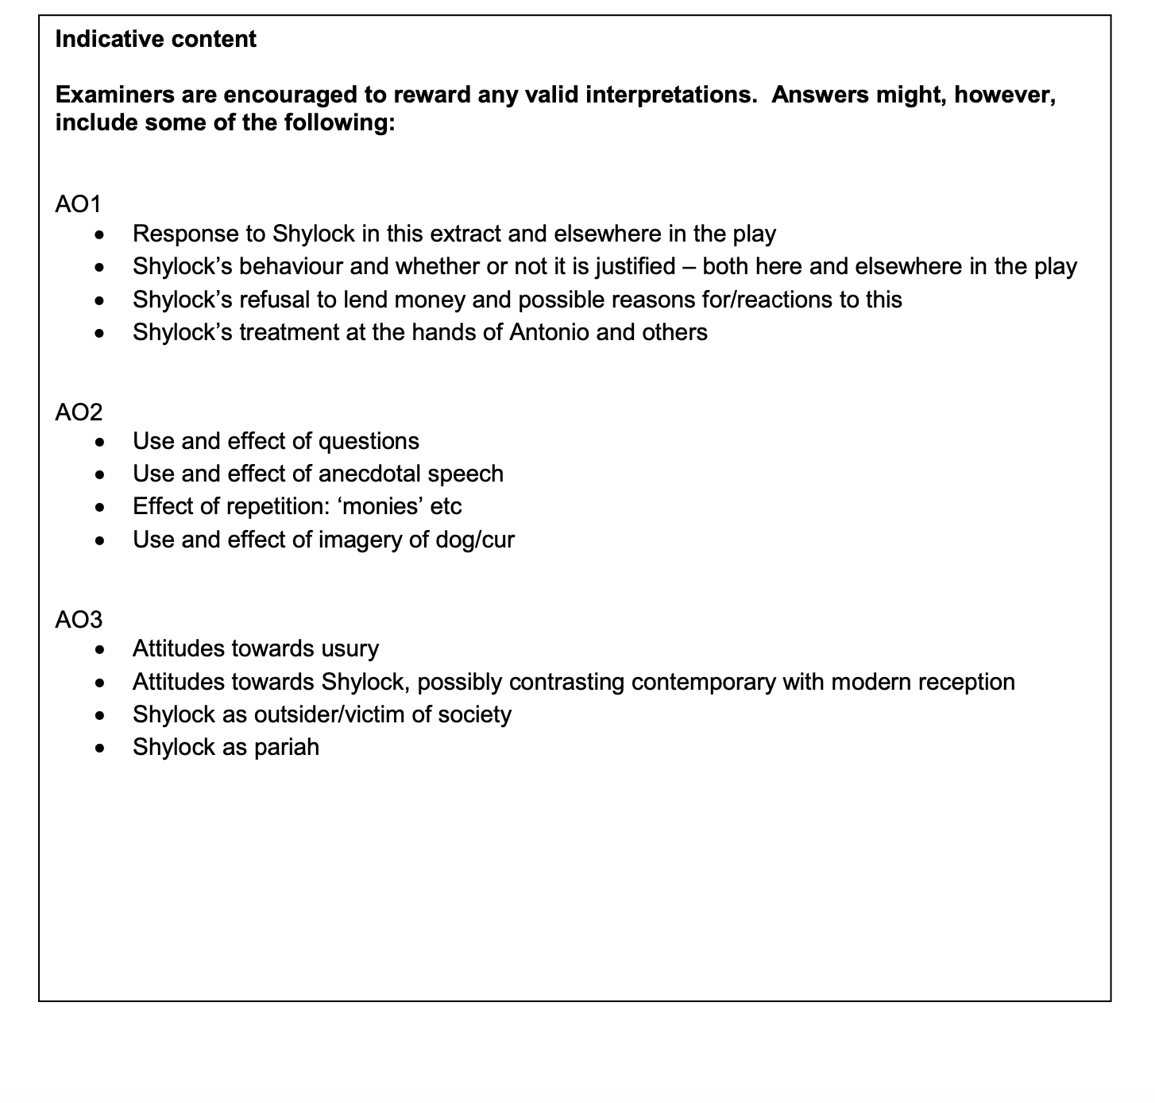
Learning Objective:
To be able to analyse how language is used to communicate Shylock’s feelings about the way he is treated.
Friday 10th January
Title: The treatment of Shylock
Exam board
mark scheme

Slide 6
Learning Objective:
To be able to analyse how language is used to communicate Shylock’s feelings about the way he is treated.
Friday 10th January
Title: The treatment of Shylock
Essay Plan
Thesis Statement:
Reference the question ‘Shakespeare presents Shylock’s feelings about the way he is treated . . .’
One surface meaning – Shakespeare used something . . .
One deeper meaning – Shakespeare crafted a character to highlight/celebrate/criticise

Slide 7
Learning Objective:
To be able to analyse how language is used to communicate Shylock’s feelings about the way he is treated.
Friday 10th January
Title: The treatment of Shylock
Paragraph structure – you should use this model for each paragraph you write
CF: Shakespeare presents Shylock’s feelings about the way he is treated …
EQ: When it says, ‘….’ Shakespeare is suggesting…
AQ: Shakespeare is showing that… because…
ZOOM: The word ….’ tells us that…. Because…
ZOOM: Also, the word ‘….’ shows us… because…
CON: In Elizabethan England,…
LINK: Therefore, Shylock’s feelings about the way he is treated is shown when…

Slide 8
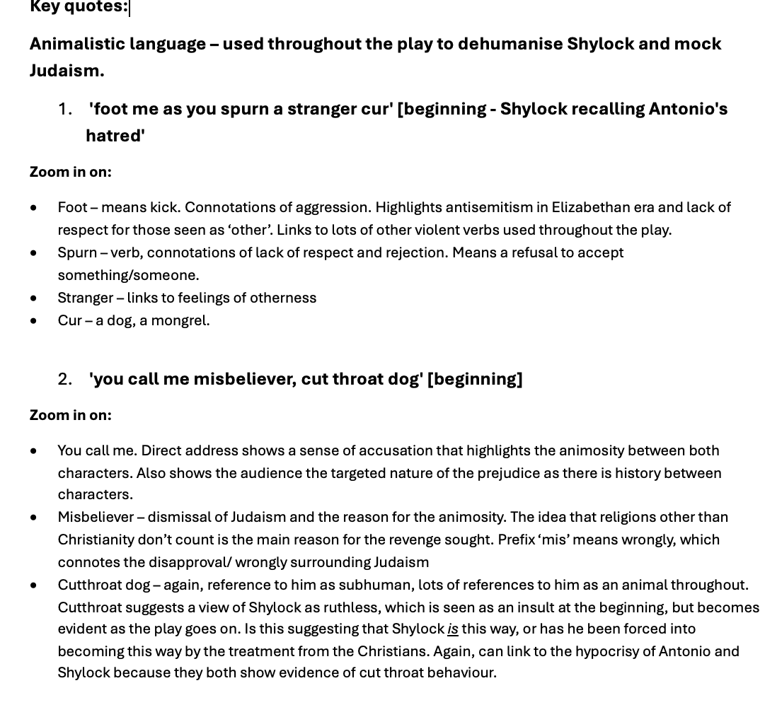
Learning Objective:
To be able to analyse how language is used to communicate Shylock’s feelings about the way he is treated.
Friday 10th January
Title: The treatment of Shylock

Slide 9
Learning Objective:
To be able to analyse how language is used to communicate Shylock’s feelings about the way he is treated.
Friday 10th January
Title: The treatment of Shylock

Slide 10
Learning Objective:
To be able to analyse how language is used to communicate Shylock’s feelings about the way he is treated.
Friday 10th January
Title: The treatment of Shylock
Write up your essay
At least 2 sides

