Slide 1
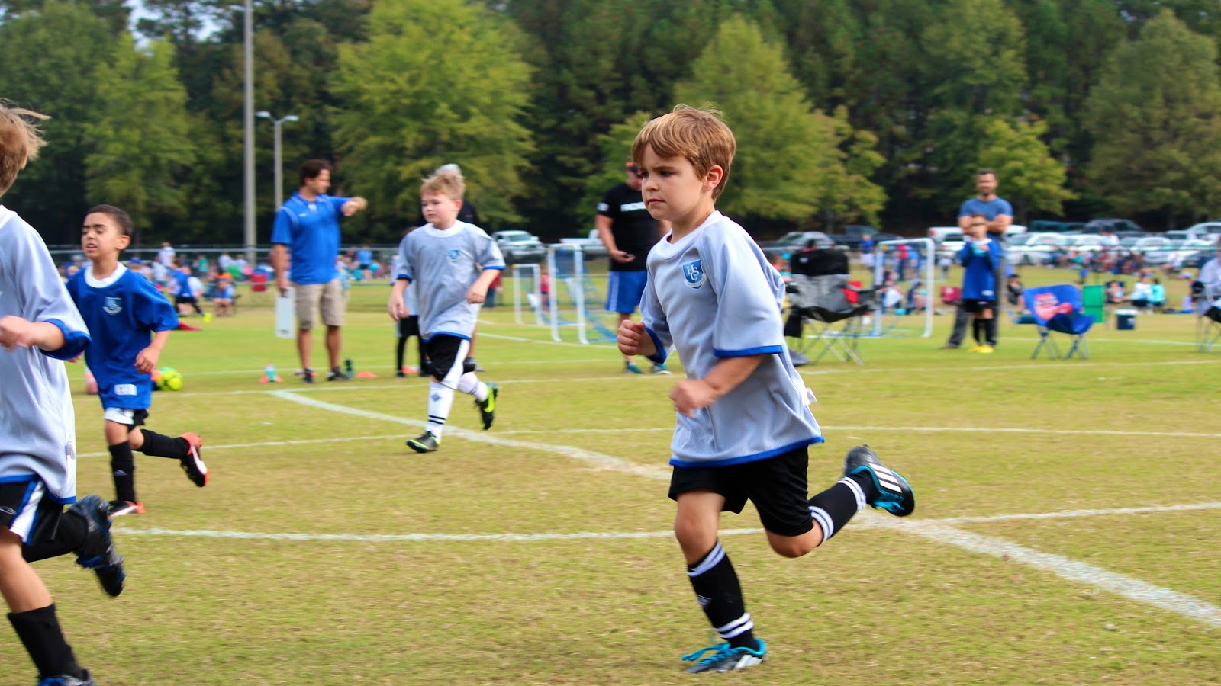
BTEC Sport
LEVEL 3 – Unit 4

Slide 2
Unit 4 – Sports Leadership
A Understand the roles, qualities and characteristics of an effective sports leader.
B Examine the importance of psychological factors and their link with effective leadership.
C Explore an effective leadership style when leading a team during sport and exercise activities.

Slide 3
Psychological factors that impact on leadership
The Ringlemann Effect: Ringlemann measured the amount of effort exerted by individuals participating in tug of war events with increasingly large numbers of team members (up to 8 in a team)
As the group/teams increased in size, the individual effort of each team deteriorated.
Think. Pair. Share – Why does the Ringlemann effect occur?

Slide 4
Psychological factors that impact on leadership
Ringlemann attributed this phenomenon to reduced co-ordination and decreased motivation. The tendency for some individuals was to put in less than maximum effort when working as part of a group.

Slide 5
Psychological factors that impact on leadership
Personality affects how we interact with others around us. No personalities are the same and leaders must manage a range of styles to unify a group.
Personalities are often described by how introverted or extroverted the individual is.
Introverted people tend to be quiet, shy, thoughtful and enjoy own company.
Extroverted people are more loud, sociable, talkative and excitable.

Slide 6
Psychological factors that impact on leadership
Social Loafing: This is a phenomenon of a person exerting less effort to achieve a goal when they work in a group than when they work alone. Often the player will ‘coast’ through the game and not performing to their maximum potential.

Slide 7
Psychological factors that impact on leadership
Think. Pair. Share – What type of motivation exist?

Slide 8
Psychological factors that impact on leadership
Motivation is thought to be a combination of the drive within us to achieve our aims and the outside factors which affect it. With this in mind, motivation has the following two forms, intrinsic motivation and extrinsic motivation.
Players who are motivated will persist with the task, even when the odds are against them.

Slide 9
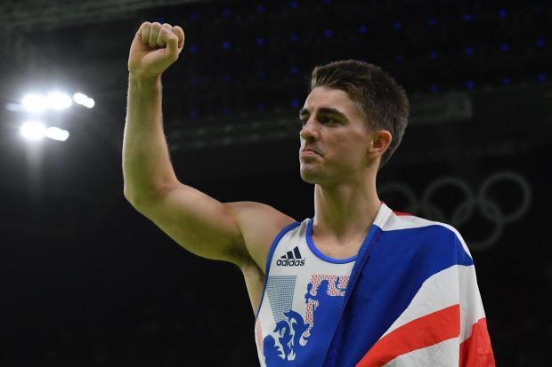
Psychological factors that impact on leadership
Intrinsic motivation comes from within the performer and is characterised by feelings of pride, self satisfaction and accomplishment from completing or succeeding in a task.

Slide 10
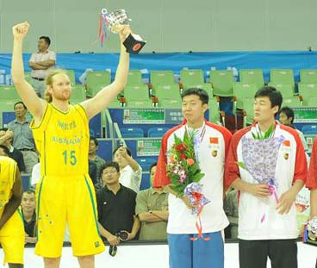
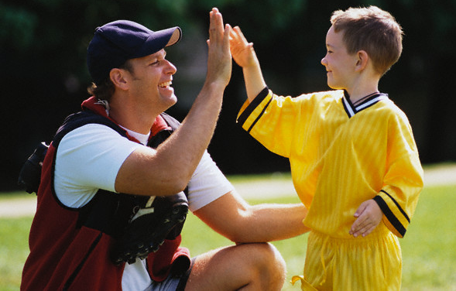
Psychological factors that impact on leadership
Extrinsic motivation is more temporary and comes from a source outside of the performer. These are things which can encourage the athlete to perform and are either physical rewards such as medals, certificates and money or intangible such as praise, recognition and applause from leaders.

Slide 11
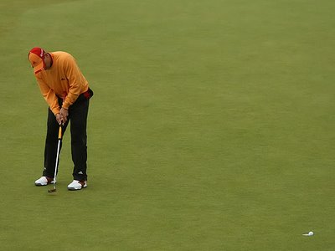
Psychological factors that impact on leadership
The effects of arousal can be positive or negative and affects performers differently. It affects the body both physiologically and psychologically.
Definition:
“An energised state of readiness before performing a task”
Think. Pair. Share – What situations can be affected by arousal?

Slide 12
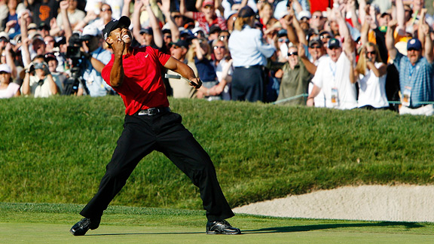
Psychological factors that impact on leadership
What is the inverted U theory all about?

Slide 13
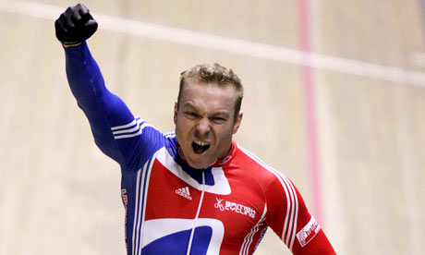
Psychological factors that impact on leadership
Arousal can help focus attention on a set goal. As arousal increases so does performance, up to an optimal point. This optimal zone varies depending on activity and personality of performers.
Leaders should be aware of how arousal and anxiety affect performance and work with individuals to minimise the impact.

Slide 14
Learning Aim B – Assignment task
Task B:
Develop a presentation on the psychological factors that could impact on the leadership of a team within different sport and exercise activities or environments.
Check your assignment booklet for the assessment criteria

