Slide 2
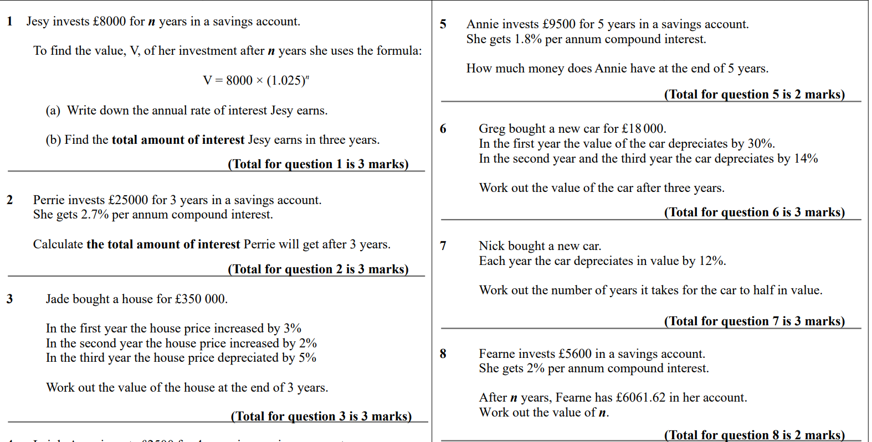

Slide 4
Guess the topic
3.12% APR

Slide 5
Mortgages
What do you know?

Slide 6
Mortgages
What do you know?
What is a mortgage?
How long do mortgages last for?
Are there any charges associated with mortgages?
Do you pay interest on a mortgage?
What rate of interest do you pay?
Does anything affect the interest rate?
Is the interest rate fixed?
Does anything affect your ability to get a mortgage?

Slide 7
A mortgage is…
A loan from a bank, given so that you are able to own a house without needing to pay the full cost upfront. However, the home is at risk if repayments are not paid.

Slide 8
In this context, interest is…
A fee charged monthly for the use of money borrowed or applied to a repayment schedule i.e. a mortgage

Slide 9
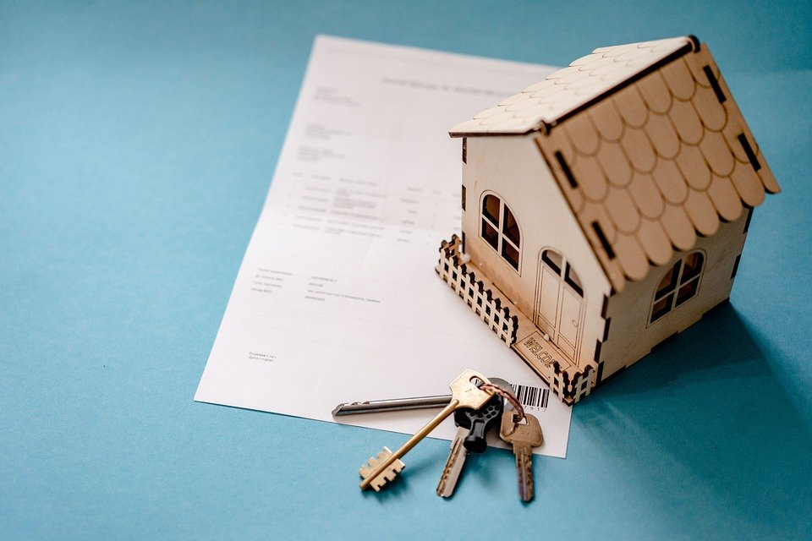
APR is…
APR, which stands for Annual Percentage Rate, is the annual rate of interest that is charged for borrowing.
APR includes any fee charged to arrange the loan.
It is expressed as a percentage.

Slide 10
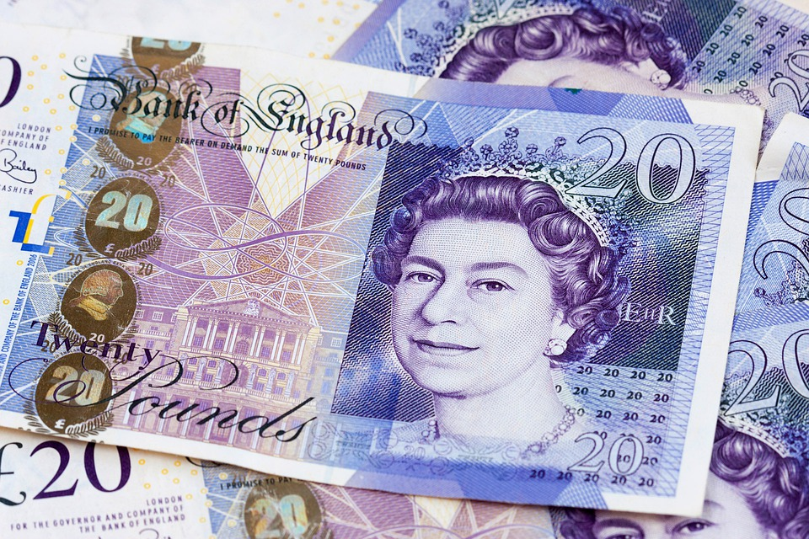
A repayment is…
An amount of money paid back to cover a loan, and any additional interest accrued. Repayments for mortgages are normally paid monthly, however repayments for other loans can be paid according to a different schedule.

Slide 12
How much do you repay?
The amount you repay depends the interest rate, and the term of your mortgage.
The loan-to-value (LTV) ratio also affects how much you repay. This is the mortgage size as a percentage of the value of the property.
For some mortgages, the interest rate is fixed for a certain number of years, and then changes to a variable interest rate. Normally, a new mortgage agreement with a new fixed interest rate would then be sought.
We will focus on mortgages with a fixed interest rate.

Slide 13
Calculating repayments
To calculate repayments, you can use the following formula:
$$Mortgage repayment=A×\frac{r}{n}×\frac{{(1+\frac{r}{n})}^{nt}}{{(1+\frac{r}{n})}^{nt}−1}$$
Where
A = amount of the mortgage
r = mortgage interest rate as a decimal
n = number of payments per year
t = loan term in years
Notes:
Formula taken from https://www.mortgagecalculator.uk/amortisation/

Slide 14
Example 1
Liz takes out a mortgage for £229,995.00 with a fixed interest rate of 3.6% APR for the first 5 years. The duration of the loan will be 25 years. Liz will repay the loan in monthly instalments.
How much will each monthly repayment be in the first 5 years?

Slide 15
Example 1
$$Mortgage repayment=A×\frac{r}{n}×\frac{{(1+\frac{r}{n})}^{nt}}{{(1+\frac{r}{n})}^{nt}−1}$$
A =
r =
229,995
n =
t =
12
A = amount of the mortgage
r = mortgage interest rate as a decimal
n = number of payments per year
t = loan term in years
0.036
25
$${Liz}^{′}s monthly mortgage repayment=229,995×\frac{0.036}{12}×\frac{{(1+\frac{0.036}{12})}^{12×25}}{{(1+\frac{0.036}{12})}^{12×25}−1}$$
$$=1163.780938$$
So, Liz will pay £1163.78 each month in the first 5 years.
Notes:
Follow up question – why would the amount be rounded down rather than up? Normally in situations where payment is being made, amounts would be rounded up so that there is no loss to the seller. However, in this instance, the amount unpaid each month will have further interest accrued, thus making it more profitable for the lender.

Slide 16
Example 2
Dante wants to buy a house for £200,000. Dante will pay a 10% deposit, and has been offered an interest rate of 2.29% APR. The mortgage term will be 30 years.
a) How much will Dante repay monthly?
b) How much will Dante repay in total for the loan?
c) How much will Dante have paid in total to buy the house?

Slide 17
Example 2a)
$$Mortgage repayment=A×\frac{r}{n}×\frac{{(1+\frac{r}{n})}^{nt}}{{(1+\frac{r}{n})}^{nt}−1}$$
A =
r =
?
n =
t =
12
A = amount of the mortgage
r = mortgage interest rate as a decimal
n = number of payments per year
t = loan term in years
0.0229
30
First, we need to calculate the amount of the mortgage.
This is the price of the house, less the value of the deposit.
Deposit = 0.1×200 000 = 20 000
A = 200 000 – 20 000 = 180 000

Slide 18
Example 2a)
$$Mortgage repayment=A×\frac{r}{n}×\frac{{(1+\frac{r}{n})}^{nt}}{{(1+\frac{r}{n})}^{nt}−1}$$
A =
r =
?
n =
t =
12
A = amount of the mortgage
r = mortgage interest rate as a decimal
n = number of payments per year
t = loan term in years
0.0229
30
Dante’s monthly mortgage repayment
$$=180,000×\frac{0.0229}{12}×\frac{{(1+\frac{0.0229}{12})}^{12×30}}{{(1+\frac{0.0229}{12})}^{12×30}−1}$$
$$=691.7210275$$
So, Dante will pay £691.72 each month.
Notes:
Follow up question – why would the amount be rounded down rather than up? Normally in situations where payment is being made, amounts would be rounded up so that there is no loss to the seller. However, in this instance, the amount unpaid each month will have further interest accrued, thus making it more profitable for the lender.

Slide 19
Example 2b)
How much will Dante repay in total for the loan?
Dante has taken the loan out for 30 years, so he will make 12×30 = 360 repayments.
Remember, the monthly payment was rounded down, so we should use the unrounded figure.
Total to be repaid = 691.721… ×360
= 249 019.5699
Dante will repay £249,019.57 in total.

Slide 20
Example 2c)
How much will Dante have paid in total to buy the house?
This will include the deposit that Dante initially paid.
£249,019.57 + £20,000 = £269,019.57
Notes:
Follow up questions:
How would changing the deposit amount affect how much Dante will have paid overall?
How would changing the interest rate affect the amount Dante is to pay overall?
What else could Dante do to decrease the amount he pays overall? (Early repayments)

Slide 21
Questions to be completed
Link to worksheet
5 Student questions Mortgages.docx
Link to answers
6 Teacher sheet quetions Mortgages.docx

Slide 22
Exam-style question: AQA
George is buying a house for £200 000, with a deposit of £20 000. He takes out a mortgage for the remainder of the house price.
The interest rate on the mortgage is 0.3% per month, and the repayments are £850 per month.
At the end of the $n$th month, the amount of mortgage outstanding, £$A_{n}$, is given by the formula
$$A_{n}=(1+r)A_{n−1}−M$$
Where
$A_{0}=$ initial mortgage amount
$r=$ interest rate as a decimal
$M=$ monthly repayment amount

Slide 23
a) Create a table which shows the amount of mortgage outstanding at the end of each month for the first 5 months.
b) George says,
“For the first 5 months, the total amount of interest is about £2500”
Is he correct? Justify your answer.
Notes:
The answers for this question can be reviewed in the teacher notes

Slide 24
Exam Question - answer

Slide 25
Exam Question - answer
b) £180 000 - £178 440.67 = £1559.33, £850 × 5 = £4250, £4250 - £1559.33 = £2690.67
The total amount of interest is around £2700, not £2500 for the first 5 months. So, George is incorrect. OR £2690.67 is closer to £3000, so if George is rounding to the nearest £500 he is correct.

Slide 26
Repaying a mortgage
When applying for a mortgage, you will need to provide the following information:
the value of the property you are buying
the size of the deposit you are putting down on the property
the period of time over which you want to repay
Notes:
Adapted from CMSP resource at https://www.stem.org.uk/resources/elibrary/resource/282547/mortgages-and-spreadsheets

Slide 27
Repaying a mortgage
With this information, the mortgage lender will offer you different types of mortgage with the following details:
the total loan value (including fees)
the monthly repayment amount
the Annual Percentage Rate (APR).
Now, we will consider how much of our monthly payment is going towards paying off the loan, and how much is paying interest.
We can use a spreadsheet to do this.

Slide 28
Mortgage example
Let us say we want to buy a house for £286,000 (national average in June 2022) and we have £57,200 deposit (20% of the house value).
So, we require a £228,800 mortgage.
The ‘Too Good To Be True’ building society offers to lend us the money at a fixed APR of 3% with no fees included.
We wish to pay the mortgage off over 25 years and so the lender tells us that the monthly repayments will be £1084.99.
Notes:
National average statistics taken from https://www.ons.gov.uk/economy/inflationandpriceindices/bulletins/housepriceindex/june2022

Slide 29
Repayment schedule
In an Excel file, put together a monthly repayment schedule, detailing your monthly opening and closing balances, the monthly interest charged, the monthly repayment, and the current loan balance.
The handout will help you set up your schedule.
Remember:
The opening loan balance is £228,800.
Annual interest is charged at 3%.
The mortgage will be paid back monthly over 25 years.
A repayment of £1084.99 will be paid each month.

Slide 30
Graphical representation
Using the values you have calculated, construct graphs to show:
the outstanding (closing) loan balance changing over time
a comparison of how much of each monthly repayment is actually paying off the loan (the principal) and how much is interest.
Analyse these graphs, reporting your findings.

Slide 31
Outstanding Balance

Slide 32
Repayment breakdown

Slide 33
Repayment breakdown
Create a repayment schedule for the below mortgage offers.
Take note of the change in rate after a certain number of years and the product fees.
Bank | Initial monthly cost | Interest rate | Total upfront fees | Initial term cost | APRC
Carblays PLC | £1,145.43 | Fixed initial rate for 2 years: 3.5% Then 5.24% | £1,034.00 | £28,524.24 | 5.0%
CashCapita UK | £1,176.33 | Fixed initial rate for 5 years: 3.75% Then 5.04% | £1,516.00 | £72,095.93 | 4.6%
Then 5.24%
Notes:
You should replace these examples with current ones. Students could also be asked to find their own examples online using mortgage comparison sites.

Slide 34
Bank | Initial monthly cost | Interest rate | Total upfront fees | Initial term cost | APRC
Carblays PLC | £1,145.43 | Fixed initial rate for 2 years: 3.5% Then 5.24% | £1,034.00 | £28,524.24 | 5.0%
Representative example
Borrowing £228,8000 over 25 years, representative APRC 5.0%:
Upfront fees breakdown
Initial term | 26 payments of £1,145.43 at 3.5% (fixed)
End rate | 274 payments of £1,352.74 at 5.24% (variable)
Total interest | £171,629.46
Total upfront fees | £1,034.000
Total amount payable | £401,463.46
Application fee | £0
Arrangement fee | £999
Bank transfer fee | £35
Valuation fee | £0
Other fees | £0
Notes:
Possibilities for teacher discussion around the number of payments in the initial term and end rate

Slide 35
Bank | Initial monthly cost | Interest rate | Total upfront fees | Initial term cost | APRC
CashCapita UK | £1,176.33 | Fixed initial rate for 5 years: 3.75% Then 5.04% | £1,516.00 | £72,095.93 | 4.6%
Representative example
Borrowing £228,8000 over 25 years, representative APRC 4.6%:
Upfront fees breakdown
Initial term | 61 payments of £1,176.33 at 3.75% (fixed)
End rate | 239 payments of £1,313.28 at 5.04% (variable)
Total interest | £156,831.01
Total upfront fees | £1,516.00
Total amount payable | £387,147.01
Application fee | £0
Arrangement fee | £1,499
Bank transfer fee | £17
Valuation fee | £0
Other fees | £0

