Slide 1
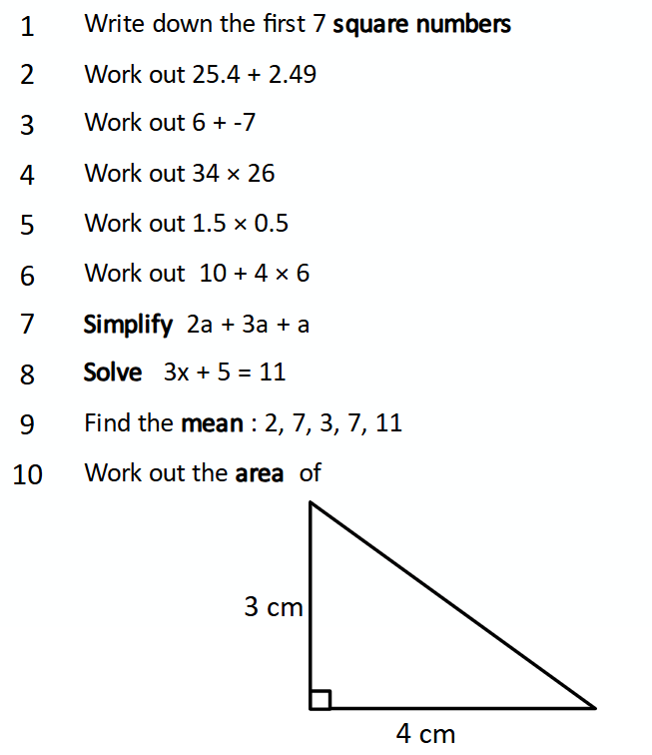
Friday 10th January 2025
Algebra
L.O. To be able to solve linear equations
Do Now:

Slide 2
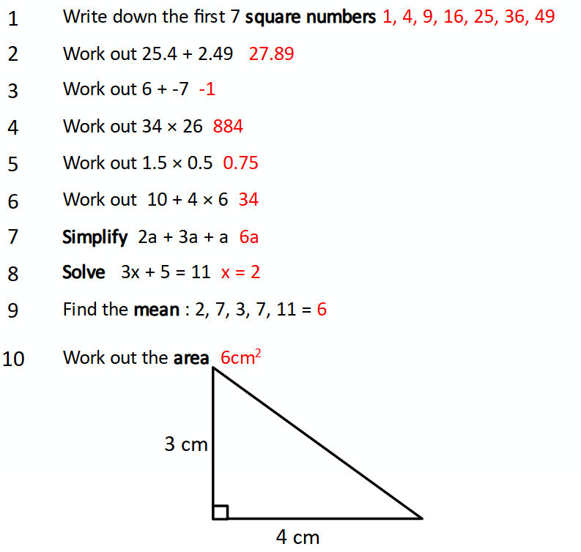

Slide 3
Please watch the video below up to 5 mins 20 seconds

Slide 4
Examples – Solve:
a + 3 = 10
- 3 -3
a = 7
b - 9 = 15
+9 +9
b = 24
3y = -15
÷3 ÷3
y = -5
x = 10
3
x3 x3
x = 30
Your turn – Solve:
a + 7 = 10
b - 9 = 8
4y = -24
x = 7
5

Slide 5
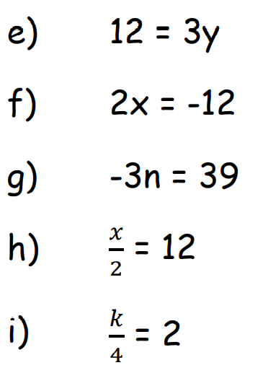
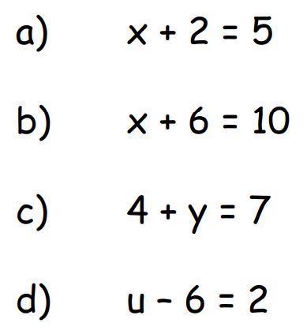
Task - Solve the following equations:

Slide 6
Answers:
3
4
3
8
4
-6
-13
24
8

Slide 7
Example – Solve:
7x – 6 = 29
+ 6 + 6
7x = 35
÷7 ÷7
x = 5
3x + 5 = 19
-5 -5
3x = 14
÷3 ÷3
x = 14/3 or 4.666...
Your turn – Solve:
6x – 5 = 19
4x + 5 = 30

Slide 8
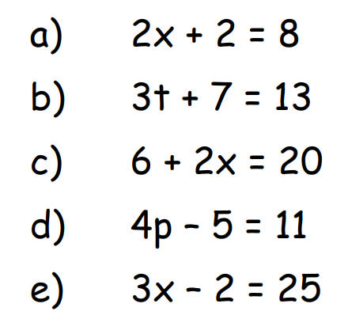
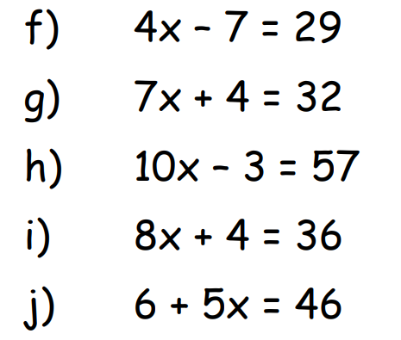
Task - Solve the following equations:

Slide 9
Answers:
6
2
7
4
9
9
4
6
4
8

Slide 10
Please watch the video below from 5 minutes 20 seconds up to 6 minutes 20 seconds

Slide 11
Example – Solve:
2x + 3 = 12
4
- 3 -3
2x = 9
4
x4 x4
2x = 36
÷2 ÷2
x = 18
Your turn – Solve:
3x - 3 = 3
6

Slide 12
Task - Solve the following:

Slide 13
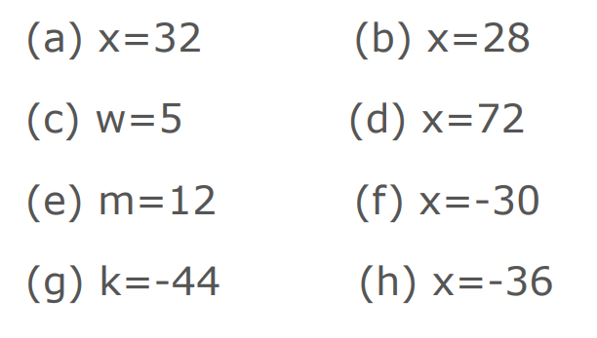
Answers:

Slide 14
Please watch the video below up to 1 minute 20 seconds

Slide 15
Example – Solve:
Your turn – Solve:
2x + 3 = 12
4
3x - 3 = 3
6
x 4 x 4
2x + 3 = 48
-3 -3
2x = 45
÷2 ÷2
x = 22.5

Slide 16
Task - Solve the following:

Slide 17
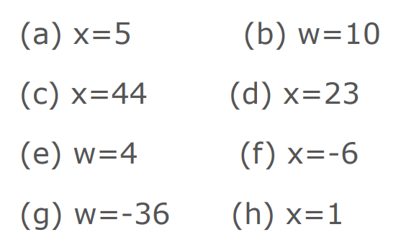
Answers:

Slide 18
Task - Solve the following:

Slide 19
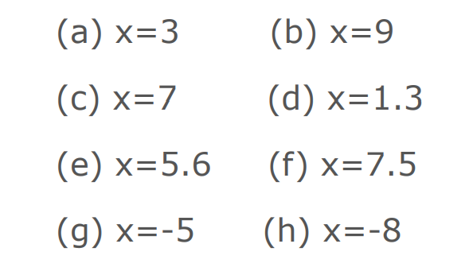
Answers:

Slide 20
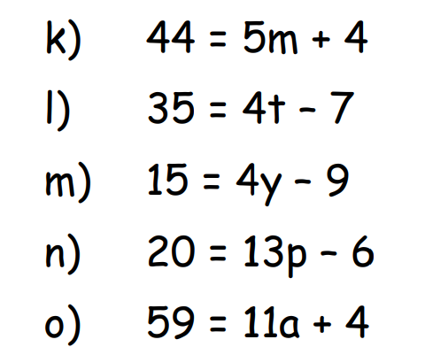
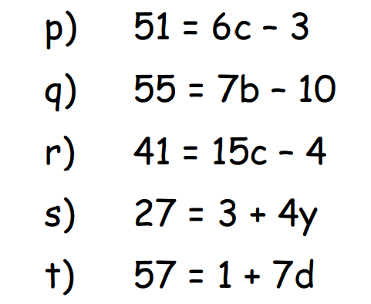
Task - Solve the following equations:

