Slide 1

Writing a Specification

Slide 2


Writing a specification...
The specification is probably the easiest section of a design project, if all the research has been carried out. The specification draws on the information collected and presented during the research section. The specification is a number of straightforward statements, made clearly outlining the nature of the project to be designed and manufactured. If the research section has not been completed fully, the specification will also be lacking.
1. The specification should be composed of simple, clear statements. Keep the statements as short as possible. 2. If possible, always refer to the research you have carried out. For example, “The colour scheme will be based on blue and red as these colours are the most popular - as seen in my questionnaire”. 3. Look at each page of your research and try to write a statement based on each one. Most of the statements in the specification should refer to your research section. 4. Keep the number of statements to between 7 to 8 in total. Specifications should be short and precise in what they state. 5. Each of the statements should help determine the final design of the product. For example, there may be a statement concerning the overall size or weight of the product. This clearly places limits on the design of the product. 6. Ask another pupil or a teacher to read your draft specification. It should be easy for them to form a view of your final product, and describe it back to you. If this description is similar to what you intend for your final product, then your specification is correctly written. 7. Look at the specification written by another pupil attempting the same project. This will help you formulate further statements for your project. 8. The specification should take you no longer than an hour to write, if you have carried out a detailed research.
Beginning
Knowledge
Student Practice
Review

Slide 3
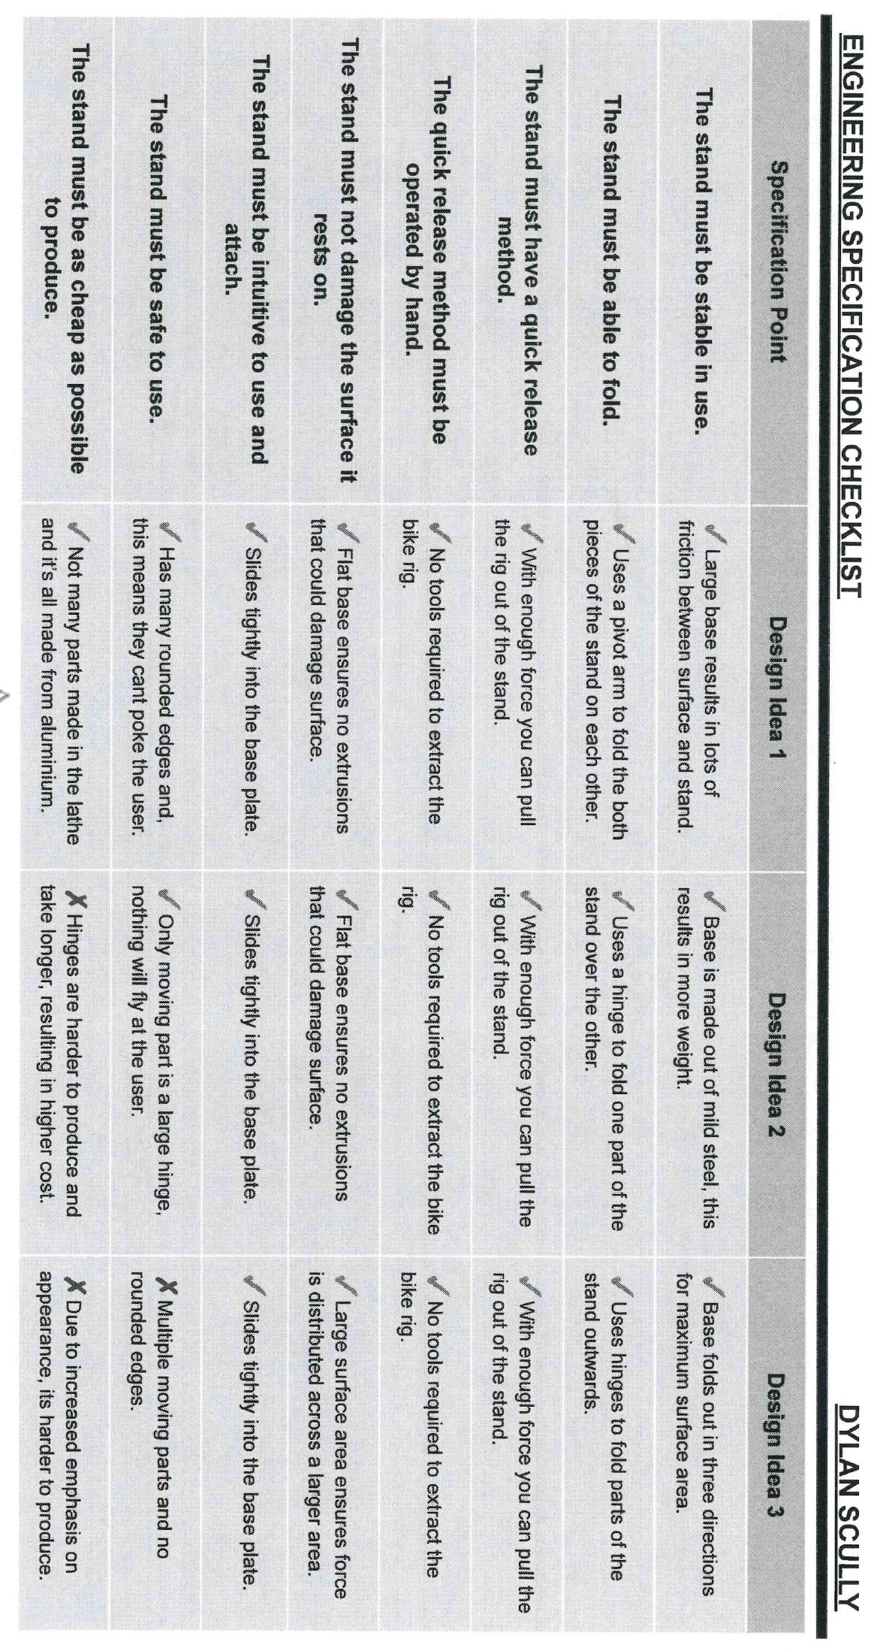
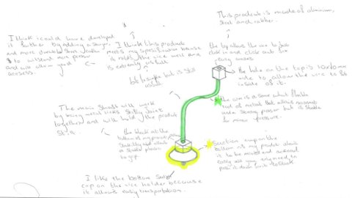
Why do we need a specification for our coursework?​
To help us understand what we need to actually design!
To support or annotation writing!
To help us evaluate designs and measure them against each other!
Beginning
Knowledge
Student Practice
Review

Slide 4
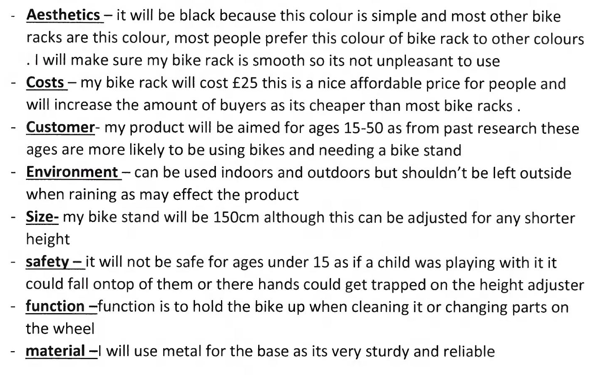
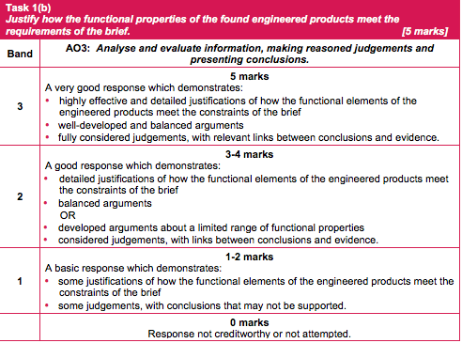

Examples against the mark scheme...
Limited to two areas as the remaining statements are not functional in nature. The student hasn’t thought about the requirements of the assignment brief
Beginning
Knowledge
Student Practice
Review

Slide 5
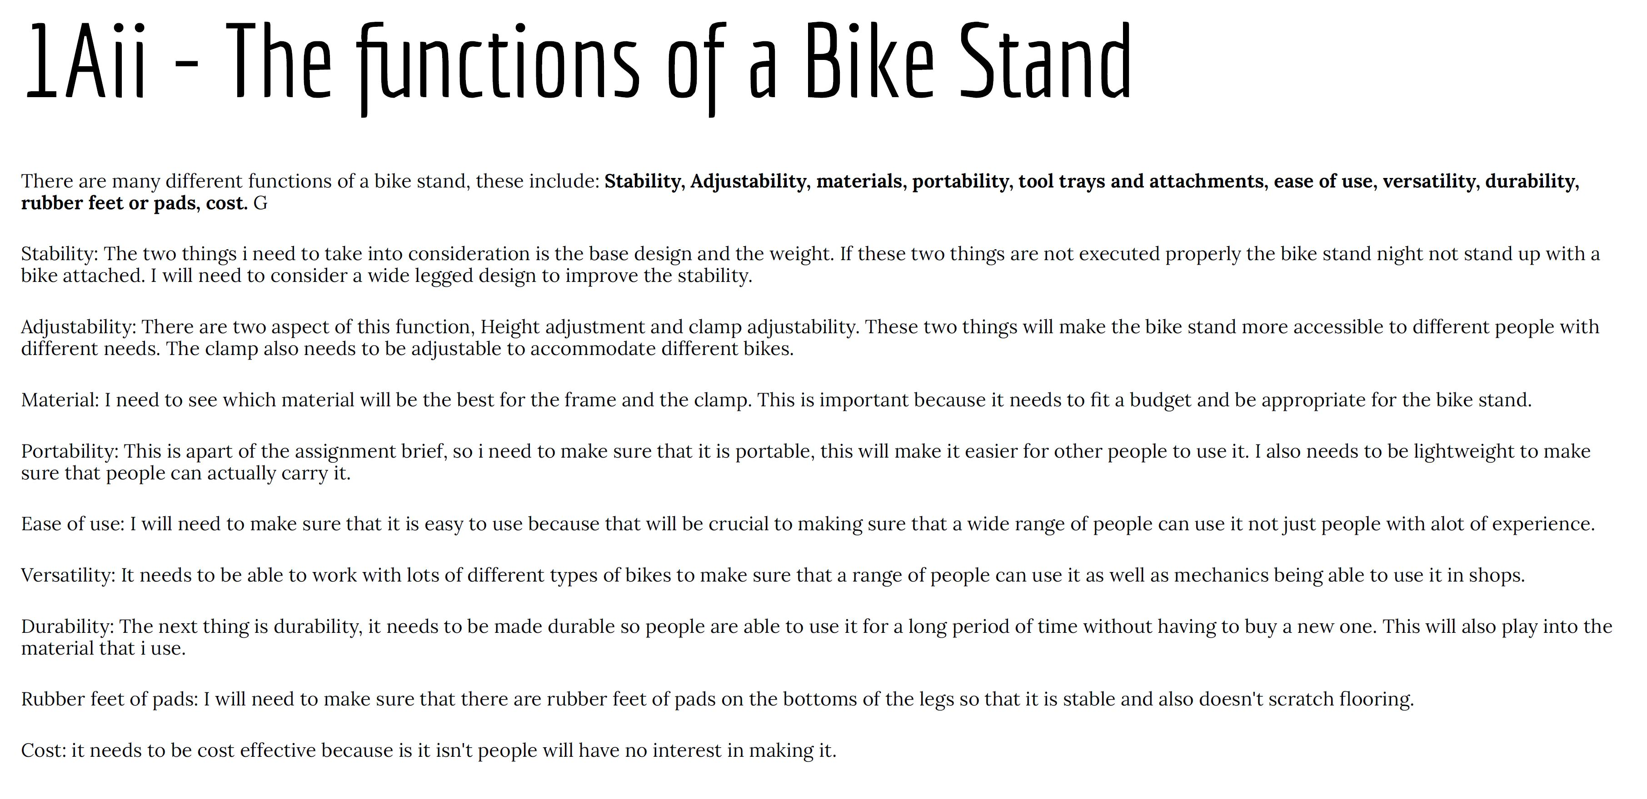
Examples against the mark scheme...​
Better links to the brief and specification but still lacking in detailed functional properties.
Beginning
Knowledge
Student Practice
Review

Slide 6
Recapping our assignment brief...​
Modifications to be included into the existing design.
A method of clamping a range of seat posts between Ø22mm to Ø35mm without the need to change inserts of various sizes. This will allow the maintenance rig to cater for leisure and competitive cyclists.
Existing users have also asked for a method of adjustment to allow the bike to be rotated and locked into position whilst being held in the rig.
This is a design task. There is no requirement for modifying or manufacturing the engineered design solution. Do not develop any of the existing maintenance rig apart from a method of clamping a range of seat posts and a method of adjustment to allow the bike to rotate whilst being held in the rig.
Design Specification
· The modified design must include a method of adjustment to allow the bike to be rotated whilst being held in the rig.
· There must be a method of clamping a range of seat posts between Ø22mm to Ø35mm without the need to change inserts of various sizes.
· The bicycle should be able to be locked at any set angle.
· The maintenance rig’s rotational feature should be able to be operated with one hand only.
· The clamp must not damage the seat post when in use.
Beginning
Knowledge
Student Practice
Review

Slide 7

Over to you...
Specification task...
From understanding the design brief and following on from my initial research I have created an initial specification to help me create some design ideas.
The product should/could... | Justification
method of clamping a range of seat posts between Ø22mm to Ø35mm
 | cater for leisure and competitive cyclists.
adjustment to allow the bike to be rotated
The rotational element to be locked into position whilst being held in the rig.
rotational feature should be able to be operated with one hand only.
 | must not damage the seat post when in use.
Beginning
Knowledge
Student Practice
Review

Slide 8
Design Specification
From understanding the design brief and following on from my initial research I have created an initial specification to help me create some design ideas.
The product should/could... | Justification
Analysis & Reflection Box

