Slide 1
Threshold – Entrance - Teacher to stand on door threshold
Title: Tissues, organs and organ systems
Date: Friday 10th January
At the start of the lesson:
Greet at the classroom door
Wear your uniform with pride
Enter the classroom in silence
Books distributed calmly
Complete your do now in silence
Place your equipment on the desk
Do Now:
State the function of the nucleus
State the function of the cell membrane
What is different about a plant cell and an animal cell?
Sit Up & Focus - Highest Quality Work - Interruption Free - Neat Work - Equipment

Slide 2
Year 7: Cells
Prior Learning:
This Topic covers:
Future learning links:
KS1/2 – Identifying animals and plants
Describing the basic needs of plants and animals
Comparing the differences between things that are alive, dead of have never been living
Animal and plant cells
Specialised cells
Unicellular organisms
Microscopes
Onion cell practical
Tissues, organs and organ systems
Organ dissection and transplants
Year 9 – Recap of microscopes with deep dive into looking a cells. Bacteria cells linking to knowledge of plant and animal cells.
KS4 – The heart and the circulatory system linking to organs and organ systems.
Careers:
Cellular biologist, microbiologist, doctor, nurse, vet

Slide 3
Keywords:
Tissues:
Organs:
Notes:
Cell recap

Slide 4
Multicellular organisms are organised into increasingly complex parts. In order, from least complex to most complex:
• cells
• tissues
• organs
• organ systems
• organism
Notes:
Cell recap

Slide 5
Animal cells and plant cells can form tissues, such as muscle tissue in animals.
A living tissue is made from a group of cells with a similar structure and function, which all work together to do a particular job.
Notes:
Discuss examples

Slide 6
An organ system is made from a group of different organs, which all work together to do a particular job.
Why do we need multiple organ systems?
Notes:
Discuss examples

Slide 7
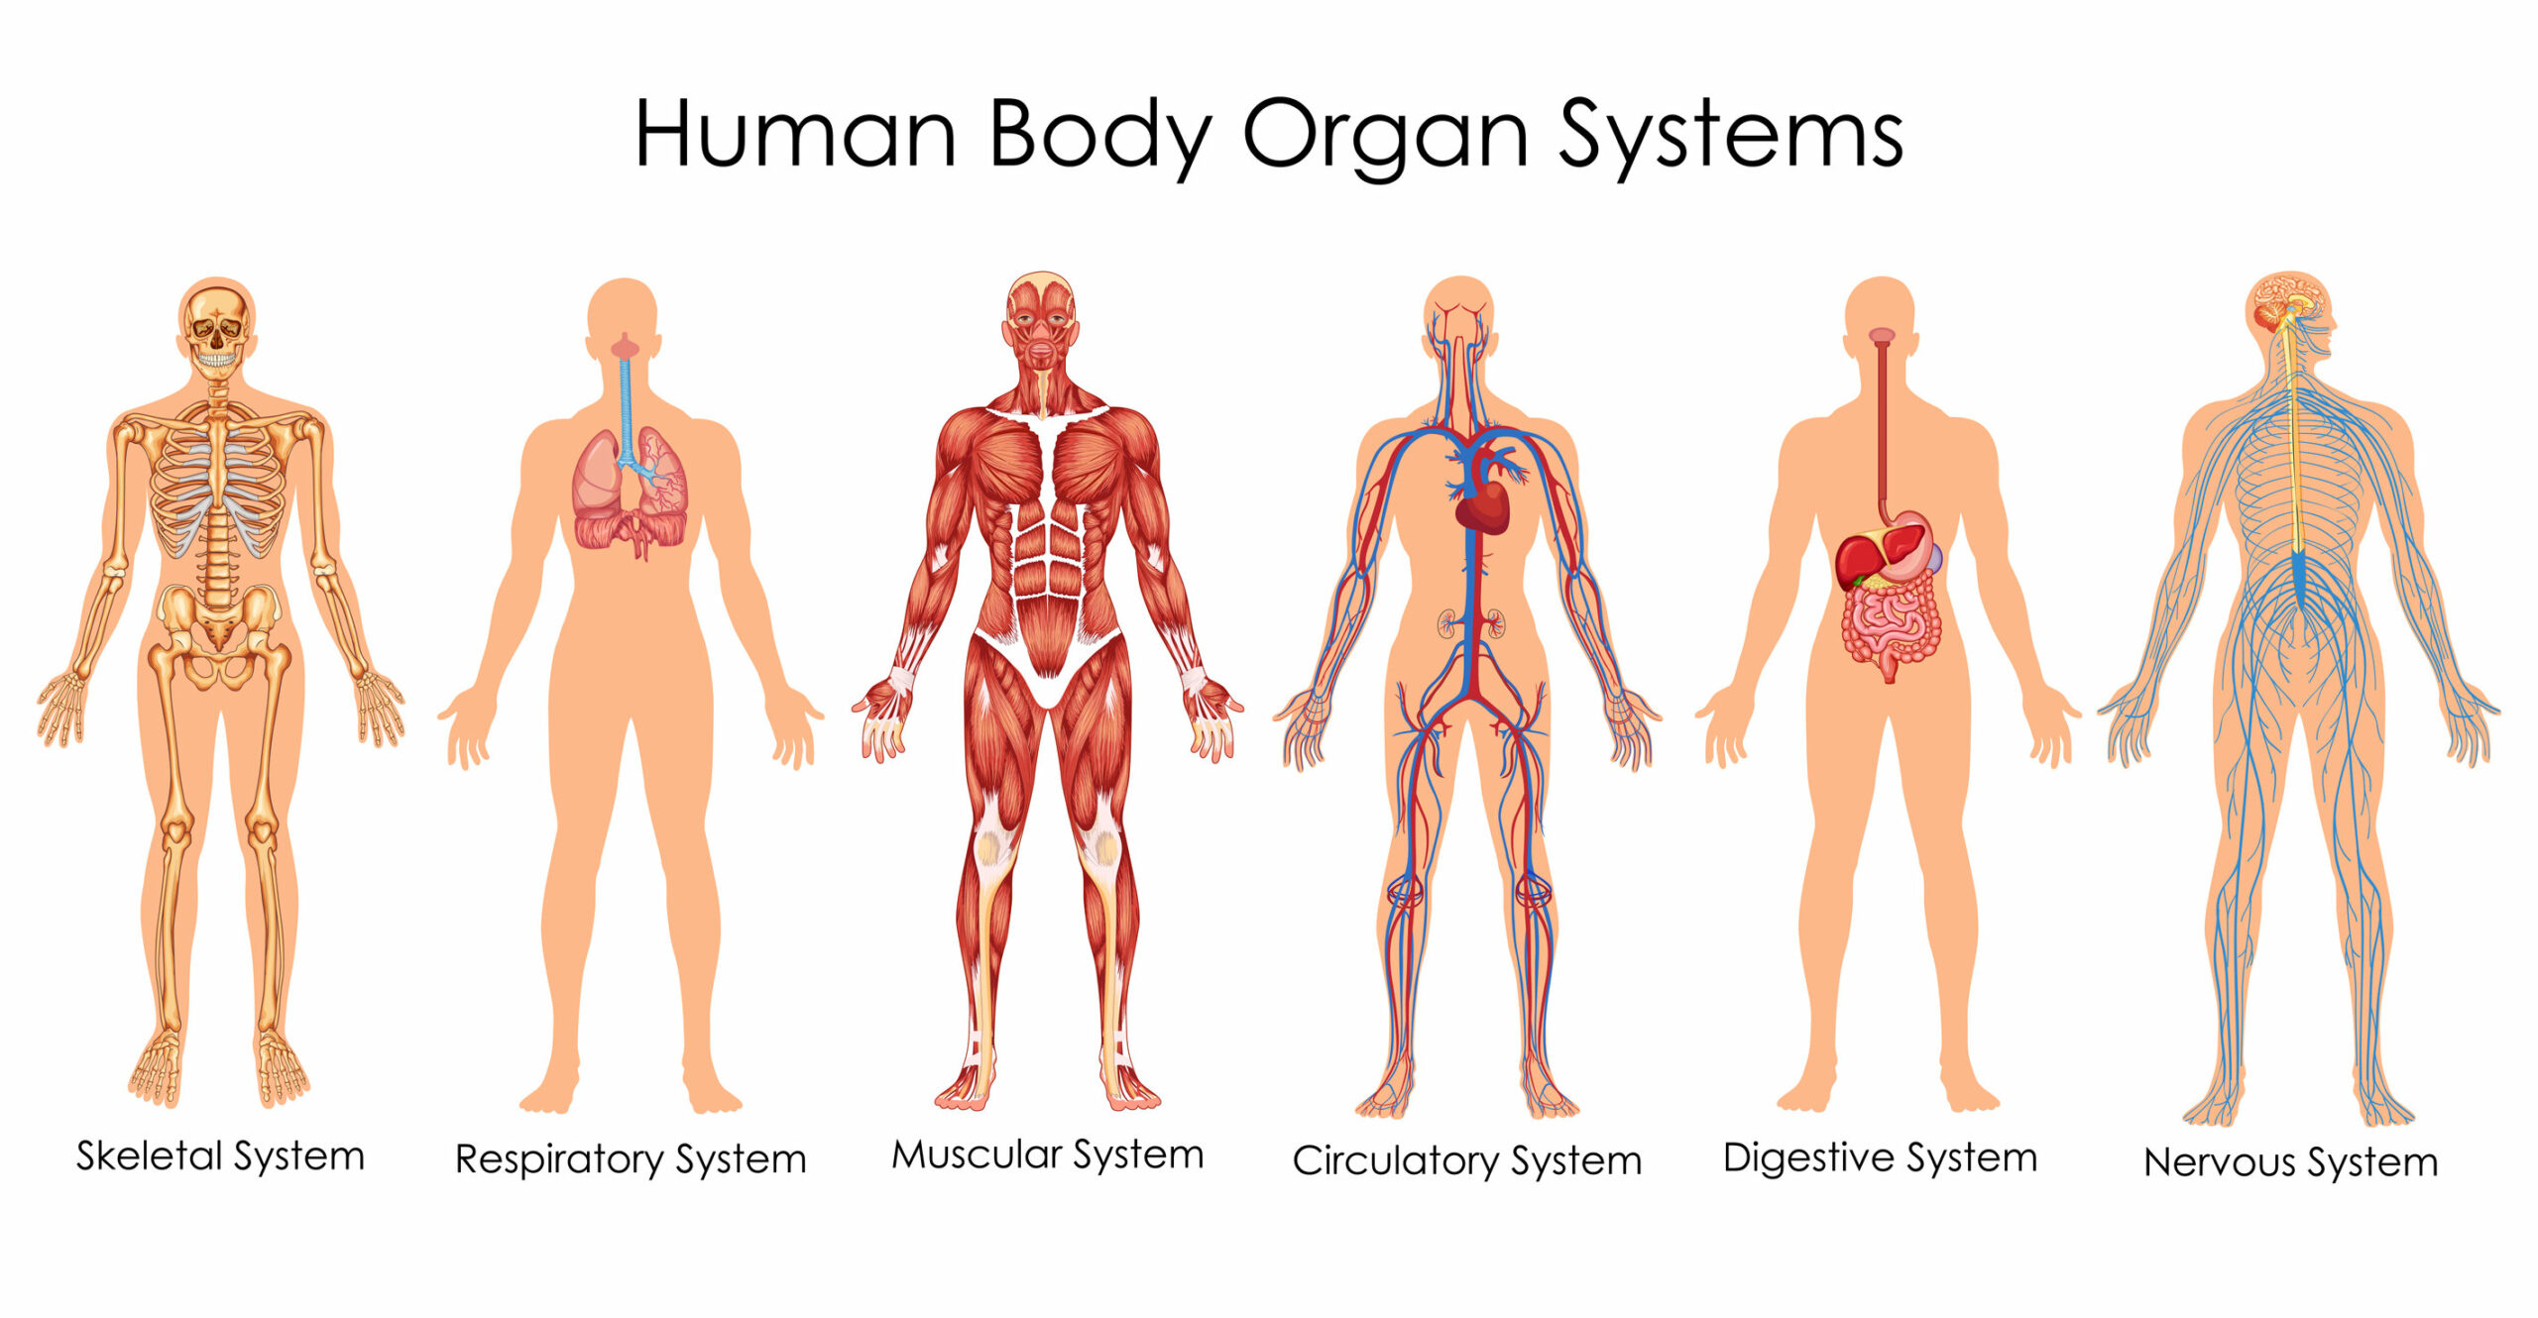
Notes:
Discuss examples

Slide 8
Suggest why it is important that cells can communicate
Notes:
Discuss examples

Slide 9
Define tissue
Hinge questions
A) A few cells
B) A group of cells working together to do the same job
C) Lots of cells doing different jobs
D) A group of organs working together to do the same job

Slide 10
Give an example of an organ in the digestive system
Hinge questions
A) Heart
B) Brain
C) Stomach
D) Lungs

Slide 11
1. What is a tissue?
2. Name one type of animal tissue.
3. What does muscle tissue do?
4. What does skin tissue do?
5. What is an organ?
6. Can you name an organ in the body?
7. What does the heart do?
8. What is the job of the lungs?
9. What does the stomach do?
10. What is the brain's job?
11. What is the job of the bones in the body?
12. What is an example of a plant tissue?
13. What do leaves do in plants?
14. What does the circulatory system do?
15. What does the digestive system do?
16. What is the job of the kidneys?
17. What does the respiratory system do?
18. What is an example of a connective tissue?
19. What does the nervous system do?
20. What is the job of the muscles?

Slide 12
1. What is a tissue?
Answer: A tissue is a group of cells that work together to do a job.
2. Name one type of animal tissue.
Answer: Muscle tissue.
3. What does muscle tissue do?
Answer: Muscle tissue helps the body move.
4. What does skin tissue do?
Answer: Skin tissue protects the body and covers it.
5. What is an organ?
Answer: An organ is a part of the body made of different tissues that work together.
6. Can you name an organ in the body?
Answer: The heart.
7. What does the heart do?
Answer: The heart pumps blood around the body.
8. What is the job of the lungs?
Answer: The lungs help us breathe by taking in oxygen and getting rid of carbon dioxide.
9. What does the stomach do?
Answer: The stomach breaks down food.
10. What is the brain's job?
Answer: The brain controls the body and helps us think.

Slide 13
11. What is the job of the bones in the body?
Answer: Bones support the body and protect organs.
12. What is an example of a plant tissue?
Answer: Leaf tissue.
13. What do leaves do in plants?
Answer: Leaves make food for the plant using sunlight.
14. What does the circulatory system do?
Answer: The circulatory system moves blood around the body.
15. What does the digestive system do?
Answer: The digestive system helps break down food to give energy.
16. What is the job of the kidneys?
Answer: The kidneys help remove waste from the body.
17. What does the respiratory system do?
Answer: The respiratory system helps us breathe.
18. What is an example of a connective tissue?
Answer: Bone tissue.
19. What does the nervous system do?
Answer: The nervous system sends messages between the brain and the body.
20. What is the job of the muscles?
Answer: Muscles help the body move.

