Slide 1
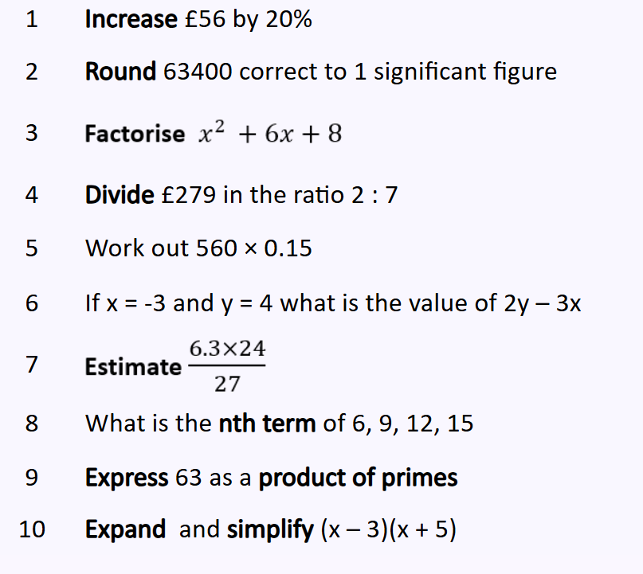
Retrieval – Do Now

Slide 2
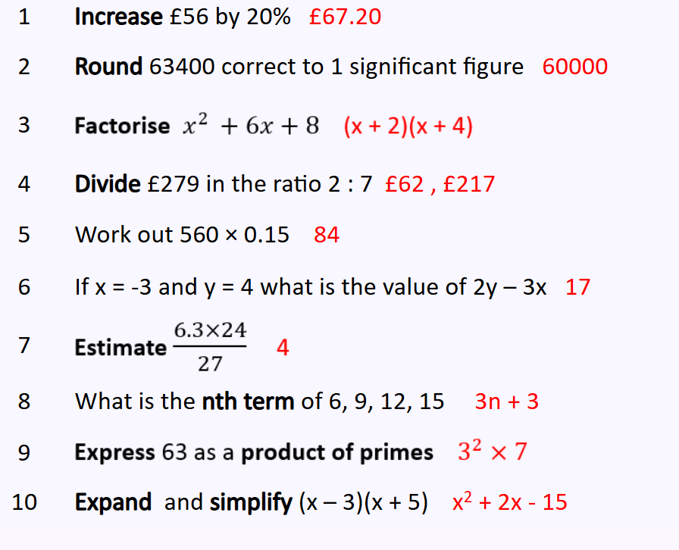
Retrieval – Do Now

Slide 3
Unit 9: Equations & Inequalities
Solving and representing Inequalities

Slide 4
Retrieval – Do Now
Aut10.3.3 - Form and solve one step and two step inequalities on Vimeo Use the link above to watch the video and complete the questions on the following slides

Slide 5
Solve 5$a$ $−$ 14 $=$ 3
True or False? 3 $+$ 5 $>$ 4 $×$ 2
3) Match each symbol to the correct definition.
$$>$$
Less than or equal to
$$≥$$
Greater than or equal to
$$≤$$
Greater than
$$<$$
Less than

Slide 6
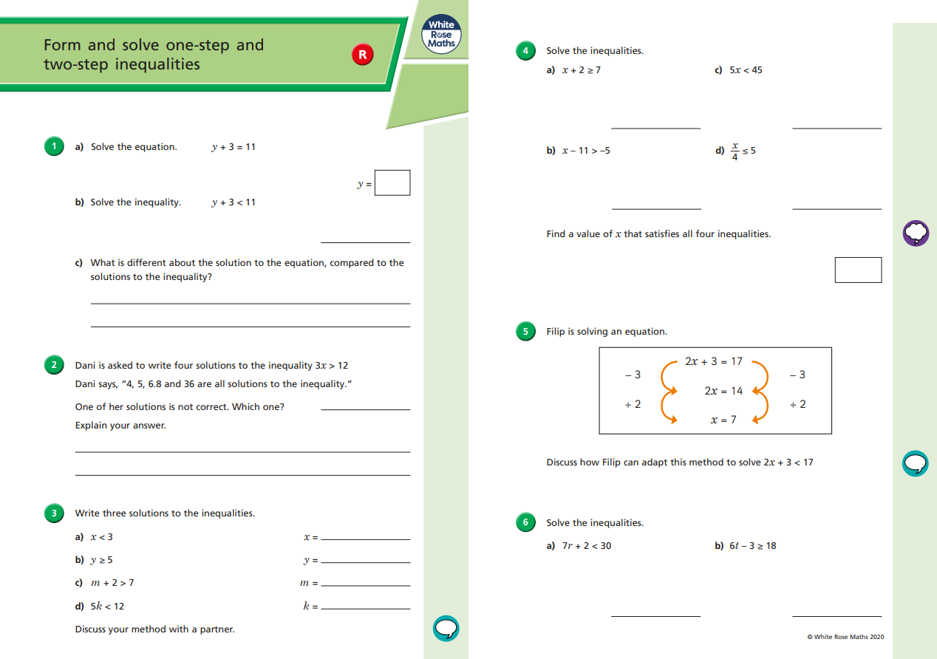

Slide 8
ANSWERS

Slide 9
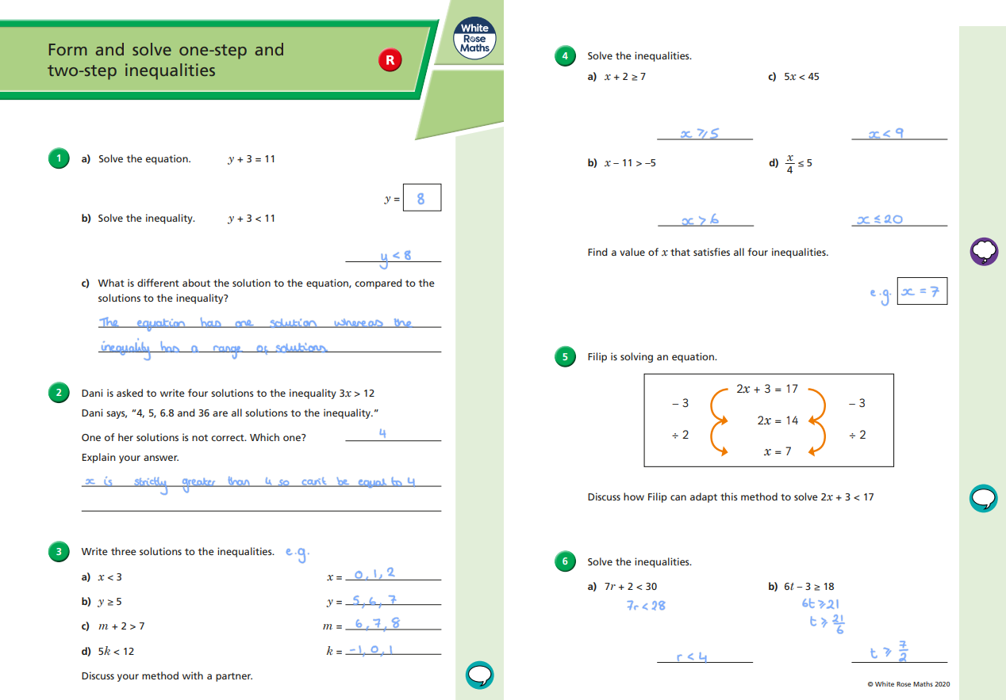

Slide 11
Practice
3(2x - 3) > 9 | 18 ≤ 2(2x + 3)
$\frac{x}{4}$ + 2 < 3 | 7 ≤ 3 + $\frac{x}{5}$

Slide 12
ANSWERS
3(2x - 3) > 9 6x - 9 > 9 6x > 18 x > 3 | 18 ≤ 2(2x + 3) 18 ≤ 4x - 6 24 ≤ 4x 6 ≤ x x ≥ 6
$\frac{x}{4}$ + 2 < 3 $\frac{x}{4}$ < 1 x < 4 | 7 ≤ 3 + $\frac{x}{5}$ 1 ≤ $\frac{x}{5}$ 20 ≤ x x ≥ 20

Slide 13
Fluency Skills
$\frac{x}{2}$ + 3 < 5
4(3x - 2) < 28
6 + $\frac{y}{4}$ > 7
9x - 6 > 48
46 ≤ 2(3 + 2x)
$\frac{r}{6}$ - 7 < 2
50 < 5(4 + 3x)
⁻58 > 8x + 6
9. $\frac{e}{5}$ + 6 ≥ 8
10. 9 > 5x - 11
11. 2(4f + 6) ≤ 28
12. $\frac{r}{4}$ - 2 ≤ 7
13. 35 > 5x - 5
14. 2 ≥ 8 + $\frac{b}{2}$
15. 33 ≥ 3(2 + 3t)
16. -2 < $\frac{k}{7}$ + 6

Slide 14
ANSWERS
$\frac{x}{2}$ + 3 < 5
4(3x - 2) < 28
6 + $\frac{y}{4}$ > 7
9x - 6 > 48
46 ≤ 2(3 + 2x)
$\frac{r}{6}$ - 7 < 2
50 < 5(4 + 3x)
⁻58 > 8x + 6
x < 4
x < 3
y > 4
x > 6
x ≥10
r < 54
x > 2
x < ⁻8
9. $\frac{e}{5}$ + 6 ≥ 8
10. 9 > 5x - 11
11. 2(4f + 6) ≤ 28
12. $\frac{r}{4}$ - 2 ≤ 7
13. 35 > 5x - 5
14. 2 ≥ 8 + $\frac{b}{2}$
15. 33 ≥ 3(2 + 3t)
16. -2 < $\frac{k}{7}$ + 6
e ≥ 10
x < 4
f ≤ 2
r ≤ 36
x < 8
b ≤ ⁻12
t ≤ 3
k > ⁻56

Slide 15
Part 2
Aut10.3.4 - Show solutions to inequalities on a number line on Vimeo Use the link above to watch the video and complete the questions on the following slides

Slide 16
I Do / We Do
< means “is less than”
≤ means “is less than or equal to”
> means “is greater than”
≥ means ”is greater than or equal to”

Slide 17
Solve 7$a$ $+$ 12 $<$ 103
Find three values of $x$ for which $x$ $>$ 4
What does the symbol $≥$ mean?
True or False?
“When $w$ $≤$ 19, 19 is the greatest solution.”

Slide 18
Solve 7$a$ $+$ 12 $<$ 103
Find three values of $x$ for which $x$ $>$ 4
What does the symbol $≥$ mean?
True or False?
“When $w$ $≤$ 19, 19 is the greatest solution.”
$a <$ 13
Any solutions greater than 4
4 is NOT a solution
Greater than or equal to
True

Slide 20
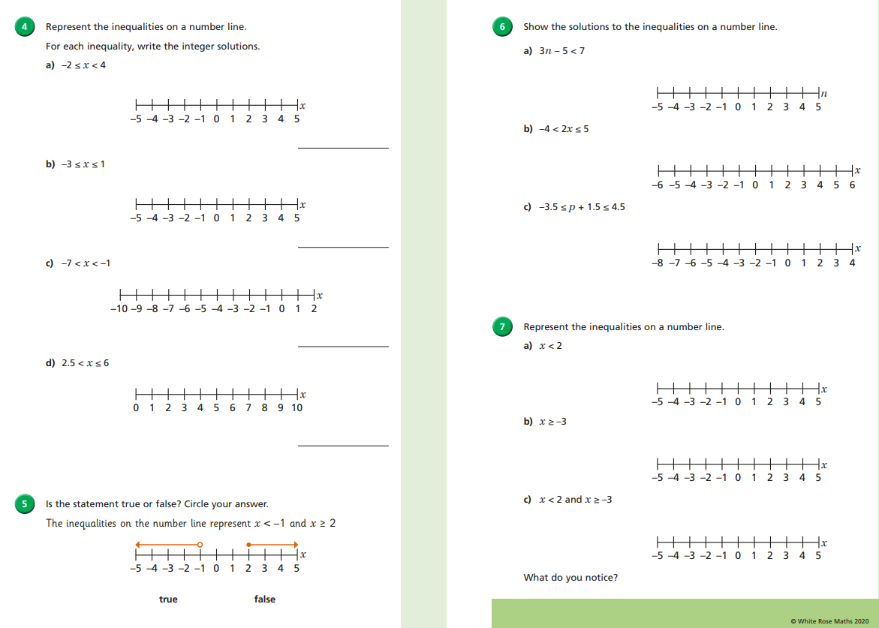

Slide 21
ANSWERS

Slide 23
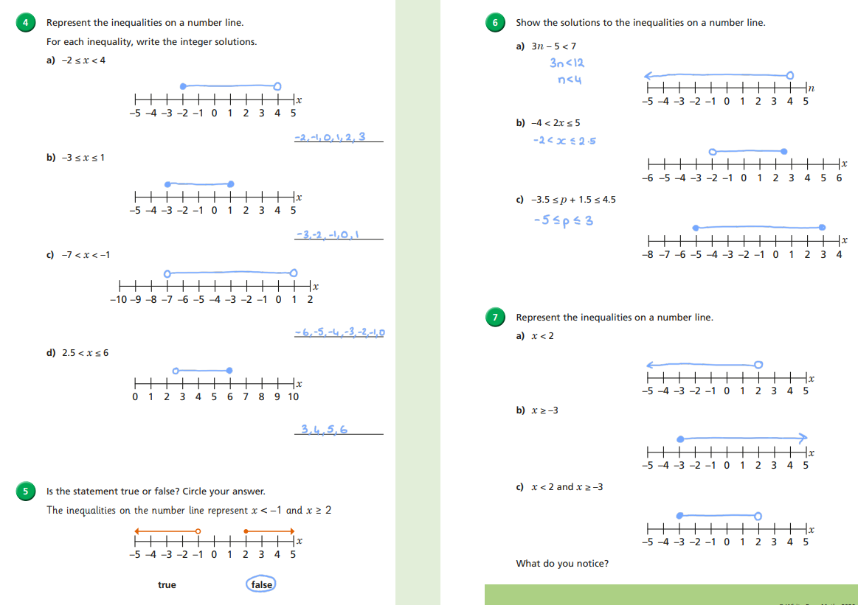

Slide 24
Additional Practice
Link to an additional worksheet that contains both practice and problem solving questions
Additional questions: Solving Inequalities
Additional video for students who want a different explanation: https://youtu.be/-YcE_D78fGE
Answers: Microsoft Word - Solving Inequalities Answers.docx

Slide 25
Exit Question(s)
$\frac{x}{2}$ + 3 < 7
Show on a number line the solution of: 21 > 3(2x - 5)
Look up solving inequalities (K341-3) on drfrostmaths.com for more practice

Slide 26
Exit Question(s)
$\frac{x}{2}$ + 3 < 7
Show on a number line the solution of: 21 > 3(2x - 5)
$\frac{x}{2}$ < 4
x < 8
6x - 15 < 21
6x < 36 x < 6
2
3
4
5
6
7
Look up solving inequalities (K341-3) on drfrostmaths.com for more practice

