Slide 1
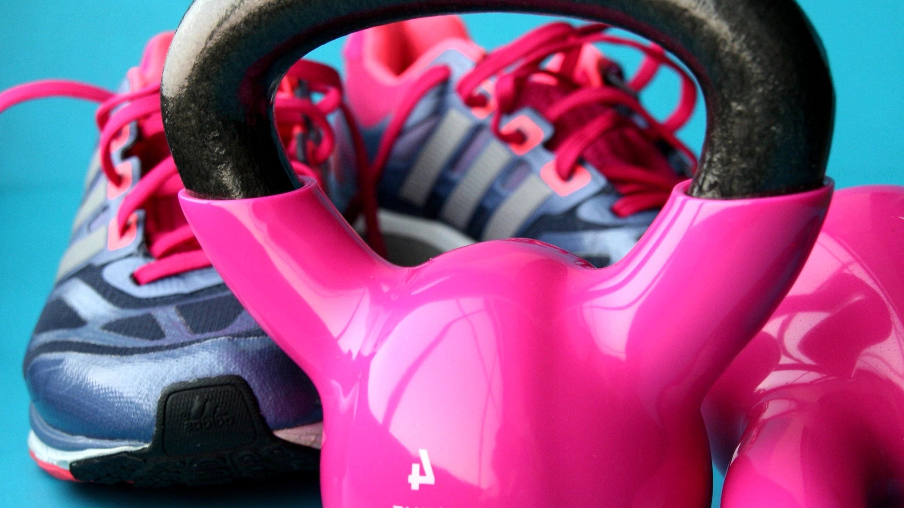
BTEC Sport
LEVEL 3 – Unit 1

Slide 2
Unit 1 - Anatomy and Physiology
AO1 – Demonstrate knowledge of body systems, structures, functions, characteristics, definitions and other additional factors affecting each body system.
AO2 – Demonstrate understanding of each body system, the short- and long-term effects of sport and exercise on each system and additional factors that can affect body systems in relation to exercise and sporting performance.
AO3 – Analyse exercise and sports movements, how the body responds to short-term and long-term exercise and other additional factors affecting each body system.
AO4 – Evaluate how body systems are used and how they interrelate in order to carry out exercise and sporting movements
AO5 – Make connections between body systems in response to short-term and long-term exercise and sport participation. Make connections between muscular and all other systems, cardiovascular and respiratory systems, energy and cardiovascular systems.

Slide 3
Learning Aim E – The effect of exercise & sports performance on the energy system
E1 – To understand the role of adenosine triphosphate (ATP) for muscle contraction during exercise.
E2 – To be able to describe the ATP-PC (alactic) system in exercise and sports performance.
E3 – To understand the lactate system in exercise and sports performance.
E4 – To identify the components of the aerobic system in exercise.
E5 + E6 – To understand the adaptations and additional factors of the energy system in response to exercise.

Slide 4
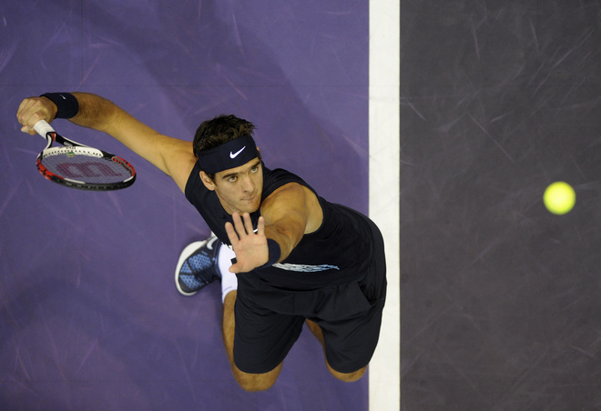
Energy for exercise
How does the body continually provide energy for exercise?

Slide 5
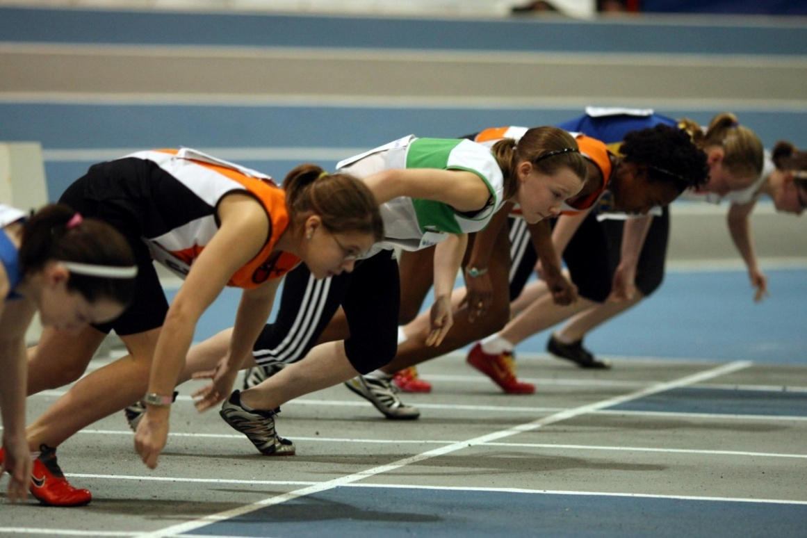
Energy for exercise
We need a constant supply of energy so that we can perform everyday tasks. The more exercise we do the more energy is required.
The intensity and duration of an activity play an important role in the way in which energy is provided.

Slide 6
The role of ATP in exercise
Adenosine Triphosphate (ATP) is the usable form of energy in the body.
The energy from foods that we eat, such as carbohydrates, has to be converted into ATP before the potential energy in them can be used.
An ATP molecule consists of adenosine and 3 Phosphates
Adenosine
P
P
P

Slide 7
The role of ATP in exercise
Energy is released from ATP by breaking down the bonds that hold this compound together.
Enzymes are used to break down ATP.
ATP-ase is the enzyme used to break down ATP into ADP (adenosine diphosphate) and a single phosphate.
Adenosine
ENERGY
P
P
P
This type of reaction is an exothermic reaction.
Think. Pair. Share – What is meant by an exothermic reaction?

Slide 8
The role of ATP in exercise
ATP within muscle fibres are used up very quickly (2-3 seconds) and therefore needs to be replenished (resynthesized) immediately.
For ATP to be rebuilt an endothermic reaction has to occur. This is a chemical reaction which absorbs energy.
ADP
P
P
P
Resynthesis of ATP is done through the joining of ADP and a single phosphate. This energy regeneration is only possible through one of three energy systems.

Slide 9
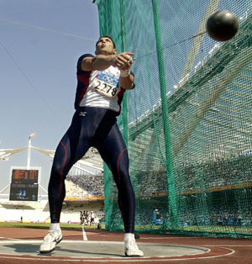
The role of ATP in exercise
ATP can provide several powerful contractions lasting only 2-3 seconds. This can be shown on a graph similar to the one below.
ATP STORE
CONCENTRATION OF ATP
TIME
3 SECS
10 SECS
60 SECS
2 HRS

Slide 10
Energy systems
There are three energy systems that regenerate ATP:
The ATP-PC (alactic) system
The lactate (anaerobic) system
The aerobic system
Each energy system is suited to a particular type of exercise depending on the intensity and duration and whether oxygen is present.

Slide 11
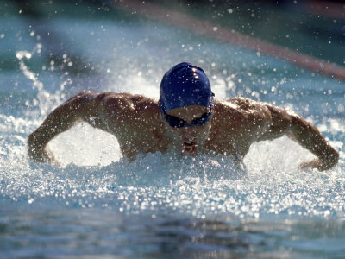
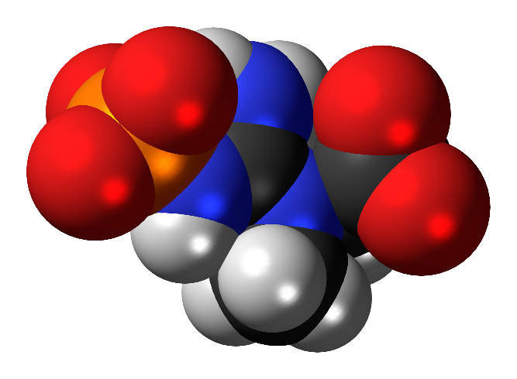
ATP-PC (alactic) system
Depleted ATP stores trigger the release of creatine kinase which causes phosphocreatine (PC) to be broken down anaerobically.
Phosphocreatine is an energy-rich chemical produced naturally by the body. This compound found in the sarcoplasm of the muscles.

Slide 12
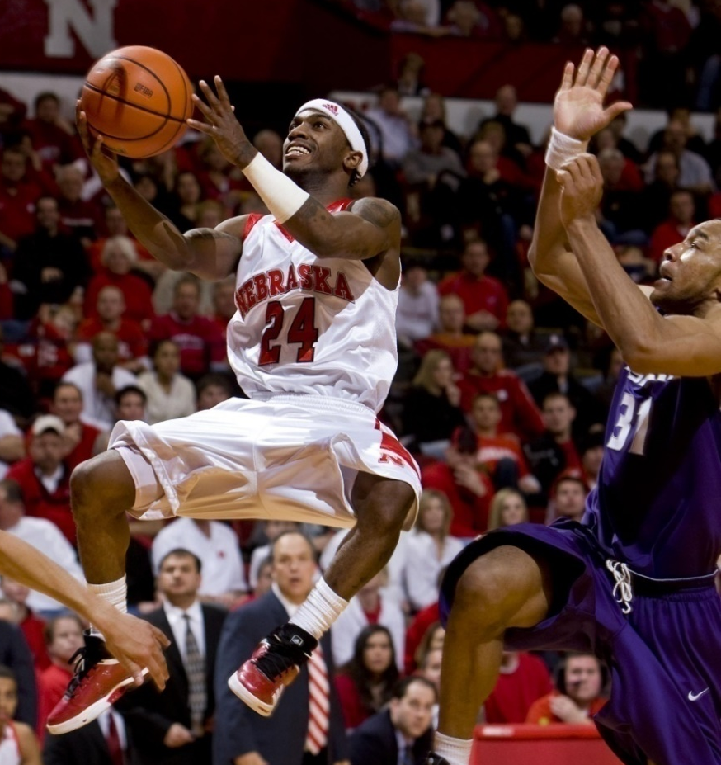
ATP-PC (alactic) system
Phosphocreatine’s (PC) rapid availability is important for providing contractions of high power, such as in the 100 m or in a short burst of intense activity during a longer game (e.g. a fast break in basketball)
However, there is only enough PC to last for up to 10 seconds and it can only be replenished when the intensity of the activity is sub-maximal.

Slide 13
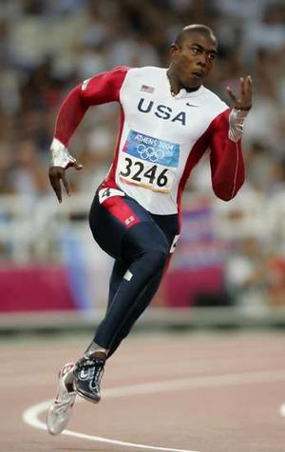
ATP-PC (alactic) system
The ATP-PC system energy production peaks at 3-5 seconds and can be shown on a graph similar to the one below.
CONCENTRATION OF ATP
ATP-PC SYSTEM
TIME
3 SECS
10 SECS
60 SECS
2 HRS

Slide 14
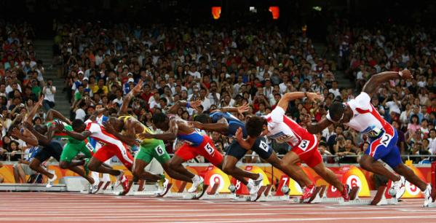
ATP-PC (alactic) system
For every one molecule of PC broken down there is enough energy released to create one molecule of ATP.
This is not very efficient system but it does have the advantage of not producing by-products and its use is important in delaying the onset of the lactic anaerobic system.
This breaking down of PC to release energy is a coupled reaction.

Slide 15
Practise it!
Exam questions
1. Abi is a competitive sprinter who regularly competes in 100m and 200m races. Some of her rivals are using a creatine supplement to enhance their performance. Abi also decides to use a creatine supplement. Figure 1 shows Abi’s 200m personal best sprint times before and after creatine supplementation.
Explain why increasing creatine stores may have an impact on Abi’s sprint time. (3)

Slide 16
Practise it!
Marks Scheme:
1. Storage of Phosphocreatine (PC) is limited, thus limiting the capacity of the PC system (1) PC system only lasts for around 8-10 seconds and the 200m lasts longer (1) PC supplementation increases the capacity of the ATP-PC system (1)

