Slide 1
Confidence Intervals REVISION

Slide 2
Revision materials on Teams
Revision
Use the revision area on teams to access the word document and watch the videos on Confidence Intervals then complete the questions on page 36-37 of the workbook (link below)
Revision document Revision videos and links.docx
Workbook AQA Core Maths OUP Workbook.pdf

Slide 3
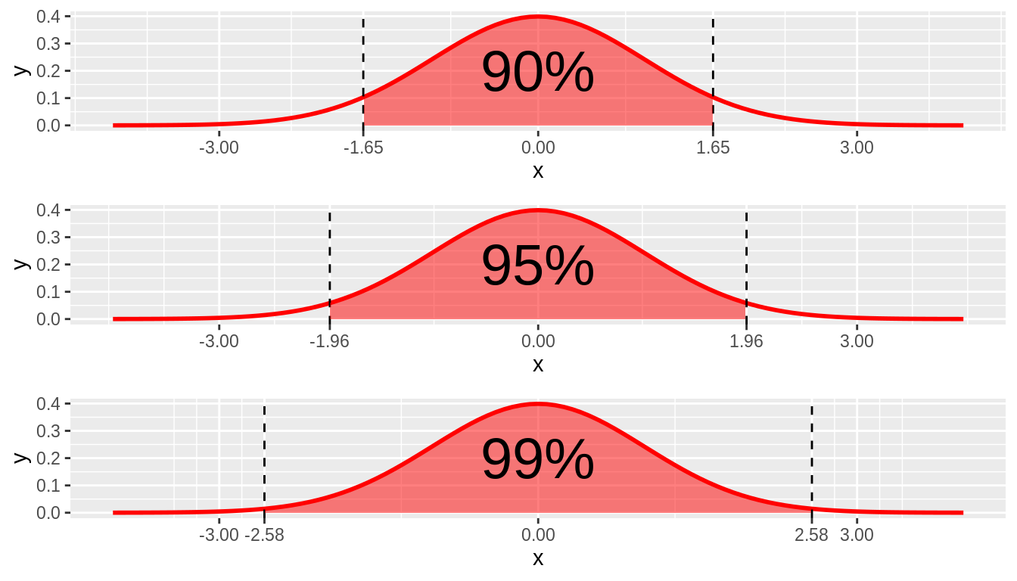

Slide 5
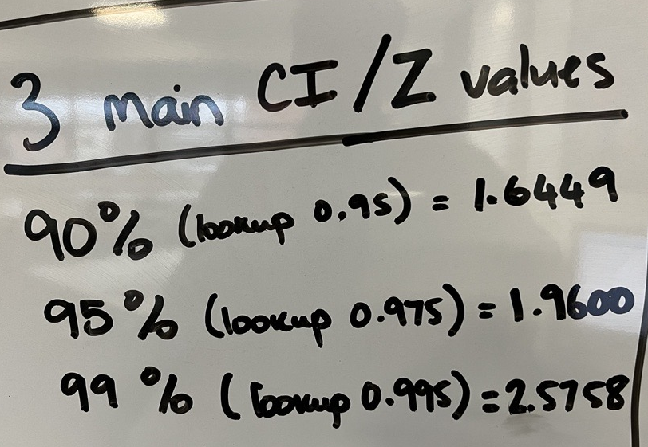
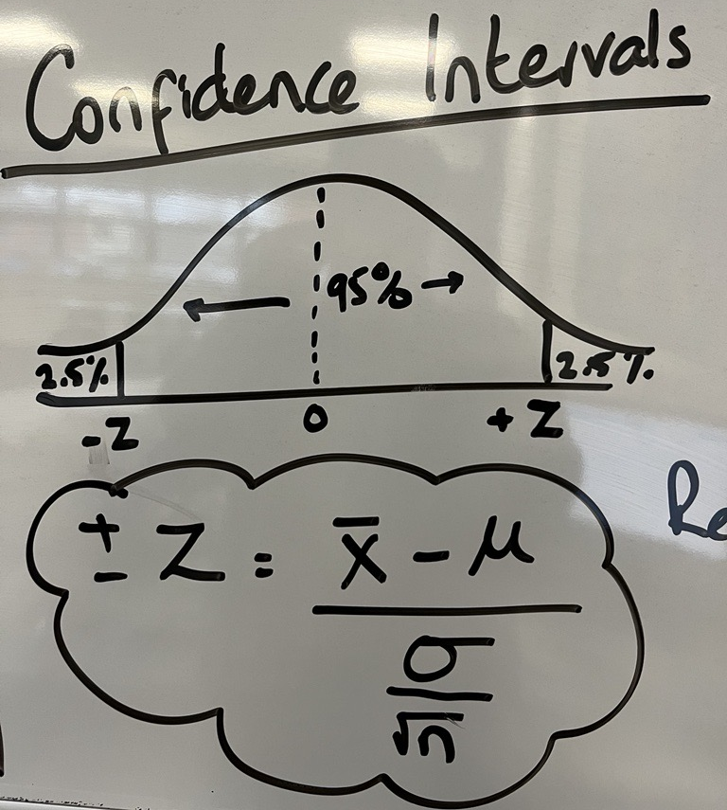

Slide 6
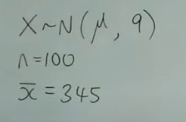
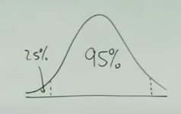
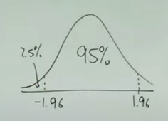

Slide 7
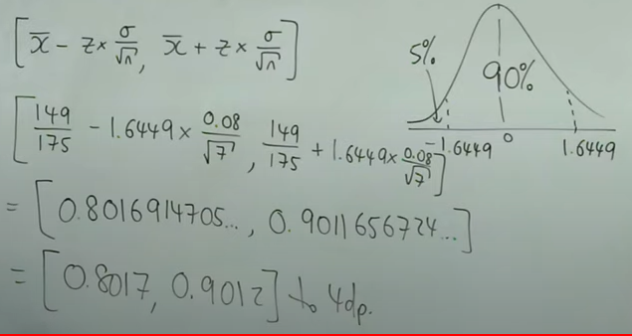
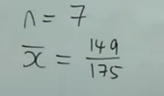

Slide 8
Revision videos:
Worded Question
AQA Mathematical Studies 2A: Confidence Intervals 04: Backwards - YouTube
Working backwards
AQA Mathematical Studies 2A: Confidence Intervals 04: Backwards - YouTube

