Slide 1
Instructions
Each of the slides has audio on it. If you are in slideshow view, it should play automatically. If it doesn’t, just hover over the slide and you should see a play button
There are a few tasks in the PowerPoint. You will need some paper and something to write with
I look forward to seeing you next week!

Slide 2
Thursday, 09 January 2025
The Marketing Mix
Learning Objective: Today, I will complete a number of questionnaires and continue with my assignment
List the four elements of the marketing mix
Describe the marketing mix of a product
Explain why the marketing mix is important

Slide 3
Title: The Marketing Mix
These are four things that need to be right for a product to be a success
We call these the 4 Ps

Slide 4
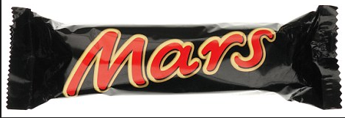
How much do you think it cost? Price
Where might I get it from? Place
Do they ever advertise it? Promotion
What is it like to eat? Product
Notes:
10

Slide 5
Notes:
20

Slide 7
Notes from the lesson
What is the marketing mix?
Why is it important to get the marketing mix right?
3 marker: Explain one advantage to Mars of choosing the right price for its chocolate bars
Lucere aude: convert this into a 6 marker

