Slide 1
Creative Media Production
Answering the Longer Questions RECORDED INSTRUCTIONS ON NEXT SLIDE

Slide 2
Initial Planning 10 mark Question = 5 mins / 20 mark = 10 mins
Pick out the key words in the question
Consider appropriate case studies (texts)
Consider appropriate Theorists
Make rough notes – no particular order
Put the work in order and plan your paragraphs
Introduction & conclusion
Write 'However'!

Slide 3
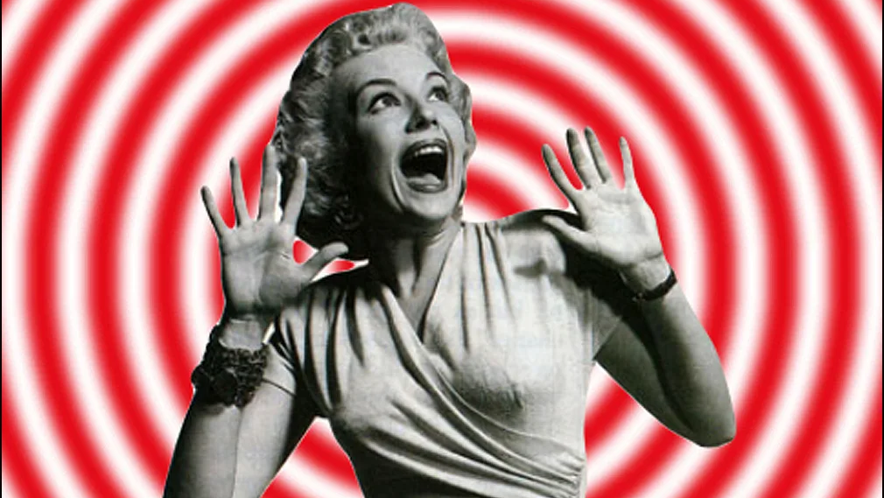
10 Mark Questions & Answers

Slide 4
Example: 10 mark question
Analyse how masculinity is represented in any media texts that you have studied. (10)

Slide 5
Analyse how masculinity is represented in any media texts that you have studied. (10)
1. Pick out the key words in the question:
Masculinity / Represented
2. Consider appropriate case studies (texts). Choose different product areas
Mainstream: Bond / Jason Statham / Action Movies
Alternative: Sarah Connor (Terminator) / The Rock (Jumanji) / 'the new man'
3. Consider appropriate Theorists
Hall – representation
Dyer – stereotyping
Butler – Gender Performativity
...any others?

Slide 6
Planning paragraphs
1. Point
2. Denotation – accurate terminology
3. Connotation – possible meanings (Hall's readings) / polysemy. Repetition (to show it is mainstream). Always discuss choices made.
4. Audience positioning
Alternatives / changes over time, and effect on the audience
Use of theorists to help the analysis throughout

Slide 7
1. Make your point:
Women are objectified in superhero films
2. Denotation (but on it’s own this is only feature spotting). Correct and accurate terminology ​
Natasha Romanov (Black Widow) is dressed in figure-hugging outfits, and is objectified by Tony Stark who looks at her and says “I want one”. In her first scene she is seen in long shot to show her whole body.
3. Connotation - what does it mean? Consider polysemic (or multiple) meanings where appropriate
Choice: consider the question “why did they choose to do that?” if you are struggling for meanings ​
The director chose to use a long shot so that we are invited to ‘look’ at her figure, as Tony Stark does (this is seen in reaction close-up shots of his face)

Slide 8
4. Audience positioning – physical (what can we see? Where is the camera positioned and why?) ​and psychological (what is our emotional response?)
5. Theories – only use where relevant, and when they add something to your analysis
We are physically positioned with Tony and invited to look at Natasha as he does. This psychologically makes us side with him, and [according to Hall’s readings theory] are encouraged to agree with him – the preferred or dominant reading. [Mulvey would say] that this objectifies her through the [Male Gaze, where the camera behaves as a heterosexual man would] and ….
6. Effect – what does it do to us? ​
…potentially demeans women and through a repetition of this kind of representation – from Tomb Raider to Wonder Woman – puts pressures on girls and young women to conform to a particular look and ‘performance’ [according to Butler]

Slide 9
Sample 10-mark marks scheme
1-4​​ | Some appropriate media terminology is used. Mostly appropriate examples are described.​​ ​​ The topics chosen lack detail and there is little, or no analysis of the possible readings / interpretations being constructed​​
5-7​​ | Appropriate media terminology is used throughout​​ ​​ A range of relevant examples are analysed​​ ​​ Each example describes the readings / interpretations accurately and offers some analysis​​
8-10​​ | The use of media terminology is fluent, confident and accurate throughout​​

Slide 10
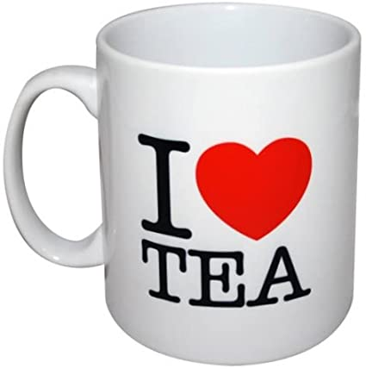
TEA – what the examiners look for
Terminology (including Theories)– accurate and detailed
Examples – a range, including alternatives, fully detailed
Analysis – breaking down media languages, and effects

Slide 11
20 Mark Questions & Answers

Slide 12
Example 20 mark question
The media is often said to offer ‘a window on the world’.
Evaluate how media texts represent reality using example(s) from media texts you have studied (20)

Slide 13
Initial Planning 10 mark Question = 5 mins / 20 mark = 10 mins
Pick out the key words in the question
Consider appropriate case studies (texts)
Consider appropriate Theorists
*New: consider competing arguments
*New: plan your evaluative comments (see the next slide)
Make rough notes – no particular order
Put the work in order and plan your paragraphs
Introduction & conclusion

Slide 14
Required Content (spot the difference)
Terminology – Fluent, confident and accurate
Theorists - Accurate and thorough knowledge and understanding
Reasoning (*new) - Developed reasoning throughout
Textual references / examples - Detailed
Specific topic - Sophisticated (*new) analysis
Competing debates, ideas & theories (*new)
Consideration is given to competing factors
a balanced response
leading to an effective conclusion

Slide 15
Evaluation – beyond a 10 mark question
Meaning: to place a value judgement on something – to closely analyse the effectiveness of something

Slide 16
A | Terminology | 2 | Appropriate
 |  | 3 | Fluent, confident and accurate
 |  | 4 | Fluent, confident and accurate
B | Theories | 2 | Appropriate references
 |  | 3 | Accurate knowledge and understanding
 |  | 4 | Accurate and thorough knowledge and understanding
C | Reasoning | 2 | Appropriate arguments and ideas
 |  | 3 | Developed reasoning throughout
 |  | 4 | Developed reasoning throughout
D | Textual references | 2 | References
 |  | 3 | Relevant
 |  | 4 | Detailed

Slide 17
E | Specific topic | 2 | Underdeveloped analysis
 |  | 3 | Analysis
 |  | 4 | Sophisticated analysis
F | Arguments | 2 | Question is directly addressed
 |  | 3 | Arguments are well developed
 |  | 4 | Sophisticated arguments are well developed
G | Competing debates, ideas & theories | 2 | Superficial evaluative comments
 |  | 3 | Sound judgements
 |  | 4 | Consideration is given to competing factors; a balanced response; leading to an effective conclusion
 | Levels |  | 2) 6-10; 3) 11-15; 4) 16-20

Slide 18
How to write analysis paragraphs

Slide 19
1. Make your point
2. Denotation
3. Connotation
4. Audience positioning
5. Theories
6. Effect

Slide 20
1. Make your point:
Women are objectified in superhero films
2. Denotation (but on it’s own this is only feature spotting). Correct and accurate terminology ​
Natasha Romanov (Black Widow) is dressed in figure-hugging outfits, and is objectified by Tony Stark who looks at her and says “I want one”. In her first scene she is seen in long shot to show her whole body.
3. Connotation - what does it mean? Consider polysemic (or multiple) meanings where appropriate
Choice: consider the question “why did they choose to do that?” if you are struggling for meanings ​
The director chose to use a long shot so that we are invited to ‘look’ at her figure, as Tony Stark does (this is seen in reaction close-up shots of his face)

Slide 21
4. Audience positioning – physical (what can we see? Where is the camera positioned and why?) ​and psychological (what is our emotional response?)
5. Theories – only use where relevant, and when they add something to your analysis
We are physically positioned with Tony and invited to look at Natasha as he does. This psychologically makes us side with him, and [according to Hall’s readings theory] are encouraged to agree with him – the preferred or dominant reading. [Mulvey would say] that this objectifies her through the [Male Gaze, where the camera behaves as a heterosexual man would] and ….
6. Effect – what does it do to us? ​
…potentially demeans women and through a repetition of this kind of representation – from Tomb Raider to Wonder Woman – puts pressures on girls and young women to conform to a particular look and ‘performance’ [according to Butler]

Slide 22
All together now…
Women are objectified in superhero films. Natasha Romanov (Black Widow) is dressed in figure-hugging outfits, and is objectified by Tony Stark who looks at her and says “I want one”. In her first scene she is seen in long shot to show her whole body. The director chose to use a long shot so that we are invited to ‘look’ at her figure, as Tony Stark does (this is seen in reaction close-up shots of his face).
We are physically positioned with Tony and invited to look at Natasha as he does. This psychologically makes us side with him, and [according to Hall’s readings theory] are encouraged to agree with him – the preferred or dominant reading. [Mulvey would say] that this objectifies her through the [Male Gaze, where the camera behaves as a heterosexual man would] and potentially demeans women and through a repetition of this kind of representation – from Tomb Raider to Wonder Woman – puts pressures on girls and young women to conform to a particular look and ‘performance’ [according to Butler]

Slide 23
Q12 The media can have an impact on individuals, groups and society. Evaluate how the media can affect changes in the behaviour or attitudes of the audience. Use any of the clips provided and/or any other media texts you have studied

Slide 24
The audience is the people in which view, interpret and analyses a media text. Encoding is the process in which the producer(s) construct a media text to create meaning for an audience. On the other hand, decoding is the process in which the audience view, interpret and analyses a media text. There are also two types of audiences, passive, who blindly accept what they are being told and active, those who openly engage with media texts. Representation is the portrayal of a person, place or thing, which can either be done in a positive or negative way.
Stereotypes are typically used in media texts so that people or places can be represented in a much easier way. Stereotypes are an over generalization of a person or place that has been exaggerated throughout the media so that everyone/thing can be categorized and identified in a simpler way. 21 However, the hypodermic syringe theory suggests that passive audiences blindly accept what they are being told by the media, even though not everything is particularly true. As a result, the medias stereotypes can manipulate the way in which people view other people or places. For example, as seen in the TV show skins and various other media products, teens are portrayed as rebellious, loud and rude. This stereotype as been overly exaggerated, which may cause some people, typically the older generation to view younger people in a negative way. This also goes both ways, as as seen in clip 3, the elderly are stereotyped as slow and sleepy all of the time. With this in mind, sometimes a media text can subvert from typical standards to create new and powerful messages for the audience to understand
Subversion is the action of diverting from a set and traditional way of something or in terms of film, the conventions of particular genres are tested. For example, in the Hunger Games, Katniss Everdeen is seen as a strong and brave woman who possesses survival and archery skills. This film challenges the typical action genre conventions as a muscular man usually saves the day. From media texts doing this, this can challenge the way in which certain types of people are looked at or the way we act in a society. Having the Katniss Everdeen in mind, the film has empowered women and changed societies views on how capable women actually are. Moreover, when an audience consumes a media text there are various readings that an audience can carry out as suggested by Stuart Hall. These readings are, preferred, aberrant, oppositional and negotiated.
This reading can manipulate the way an audience behave or view a text from the message that they understand. Preferred reading is the typical meaning or way in which producers hope the audience will interpret a media text, such as The Sun newspaper article stating that Ed Miliband is telling 'porkies' and that he is bad for the country. Aberrant reading is when the audience does not get the intended message, such as a person thinking the 'save our bacon' article on Ed Milliband is about him banning bacon, when it is about him being a bad politician. Oppositional reading is when the audience go against the intended message, such as them disagreeing that Ed will be bad for the country.
Lastly, Negotiated reading is when the audience apply their own values and beliefs to a text. For example, in the same article previously mentioned, some of the audience may understand that others think he is a bad politician, but they themselves think he will be good for the country. Objectification is the action of degrading someone to the status of a mere object and it is used quite regularly. Theorist, Laura Mulvey, introduced the idea of 'the male gaze' in which is the way in which women are looked at by men in the media. She suggested that media texts are created for the idea that they will be viewed through the eyes of a heterosexual man. As a result of this, views on women are made to seem more negative as they are portrayed as objects. Objectification in particular is seen in transformers with actress Megan Fox as she is wearing very 22 little item clothings that show off her assets. Additionally, in clip 3, the singer is dressed in red,having the connotations of being sexy and therefore highlighting the text being made in the view of a heterosexual male. Furthermore, Stanley Cohen said that media over exaggerates certain situations that cause mass hysteria- the moral panic. This then makes certain people act worried, even if some of what is shown is not true (passive audiences in particular) Additionally, Jaqueas Lacan talks about the mirror stage. The mirror stage is a point in a child's development where they start to see themselves reflected in certain media texts and identify with them. The social learning theory in particular demonstrates how children observe and imitate behavior. In the Jamie Bugler case, it was mentioned that the killers copied the style of killing from the 'Chucky, child's play' movie. This infers that the media can have an affect on the behavior of those in real-life,either positively or negatively.

