Slide 1


Threshold – Entrance - Teacher to stand on door threshold
Title: Early atmosphere (page 38)
Date: 9 January, 2025
At the start of the lesson:
Greet at the classroom door
Wear your uniform with pride
Enter the classroom in silence
Books distributed calmly
Complete your do now in silence
Place your equipment on the desk
Do Now:
What are the products of complete combustion?
What are the products of incomplete combustion?
When nitrous oxides are formed in burning hydrocarbons where does the nitrogen and oxygen come from?
Sit Up & Focus - Highest Quality Work - Interruption Free - Neat Work - Equipment

Slide 2
Threshold – Entrance - Teacher to stand on door threshold
Title: Early atmosphere (page 38)
Date: 9 January, 2025
At the start of the lesson:
Greet at the classroom door
Wear your uniform with pride
Enter the classroom in silence
Books distributed calmly
Complete your do now in silence
Place your equipment on the desk
Do Now:
What are the products of complete combustion?
Carbon dioxide and water
2) What are the products of incomplete combustion?
Carbon monoxide, Carbon (soot), Water
3) When nitrous oxides are formed in burning hydrocarbons where does the nitrogen and oxygen come from?
The air
Sit Up & Focus - Highest Quality Work - Interruption Free - Neat Work - Equipment

Slide 3
Year 11- C16
Prior Learning:
This Topic covers:
Future learning links:
Year 7 - atoms, elements and compounds
Year 8 - Combustion and chemical reactions
The early atmosphere
Atmosphere today
Climate change
KS5 – Organic chemistry, naming compounds, synthetic routes and mechanisms
Careers:
Chemist, science teacher, pharmacist, Lab assistant, chemical analyst, clinical analyst, engineer.

Slide 4
In this topic we will focus on using the word explain.
When asked to explain, you need to give a scientific reason why or how. Here, you need to use the word ‘because’. E.g., The girl has brown hair and brown eyes because she has inherited the alleles/genes for these characteristics from her parents.
Example:
Explain one advantage of using an electron microscope to observe plant cells.
(2)
.............................................................................................................................................
.............................................................................................................................................
.............................................................................................................................................
.............................................................................................................................................

Slide 5
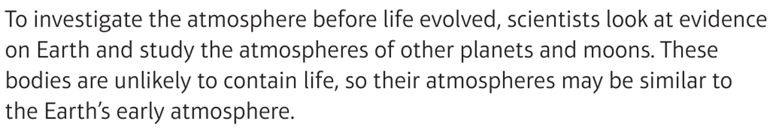
4.5 billion years…..
Our Earth…it’s atmosphere is 4.5 billion years old!
More recent changes are all due to living organisms…which is a problem for us scientists…how do we study what our EARLY atmosphere was like before the evolution of living organisms..?

Slide 6
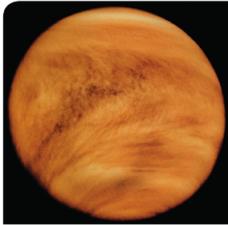
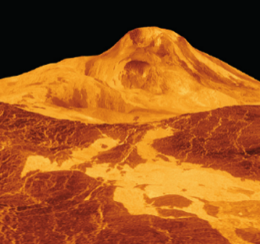
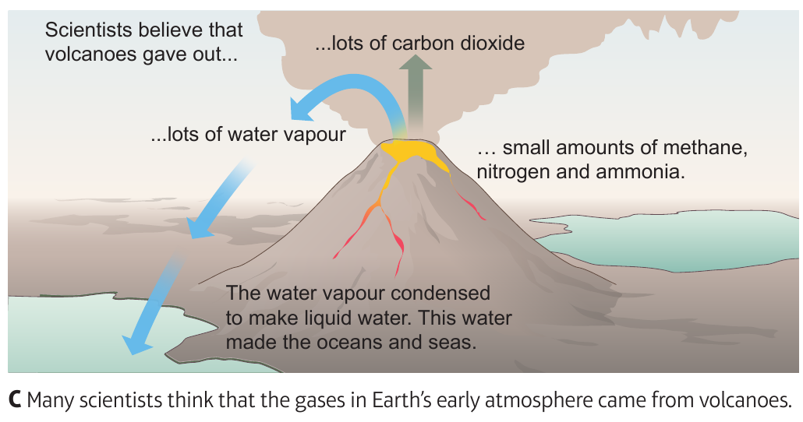
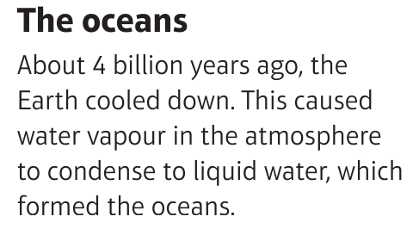
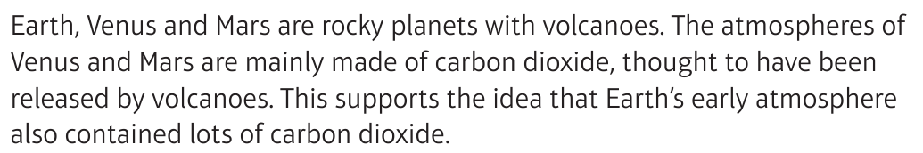
After the volcanic eruptions…

Slide 7
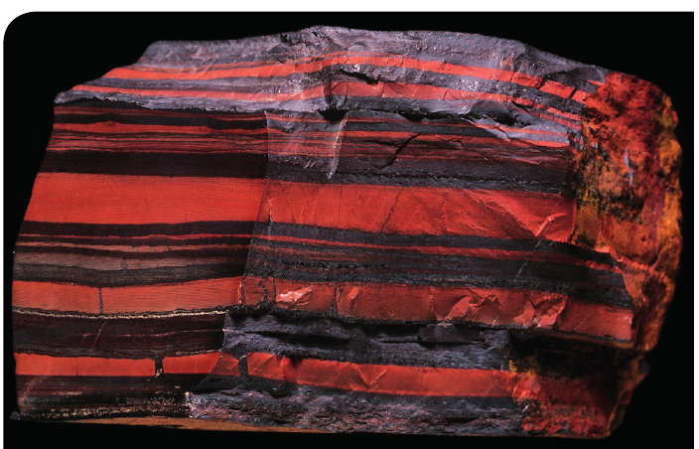
Was there any oxygen in the early atmosphere?
There is two pieces of evidence to support that little or no oxygen was around.
Oxygen is not produced by volcanoes.
Iron pyrite (a compound that is broken down by oxygen) is found in very ancient rock.

Slide 8
1) Why does iron pyrite support the idea that oxygen was not present in the early atmosphere?
Hinge questions
Iron pyrite contains oxygen
Iron pyrite is broken down by oxygen
Iron pyrite is not broken down by oxygen

Slide 9
2. What were the two main gases produced by volcanoes?
Hinge questions
CO₂ and O₂
CO₂ and CH₄
CH₄ and H₂O
CO₂ and H₂O

Slide 10
Independent practice – answer these questions using full sentences
Where did the gases forming the earth’s early atmosphere come from?
Explain why scientists think that the early Earth has an atmosphere similar to Venus
Describe how the earth’s oceans formed
Explain the evidence that supports the idea that oxygen was not present in the early atmosphere on earth
Explain why scientists are more certain about the oxygen content compared to other gases

Slide 11
Independent practice – answer these questions using full sentences
Where did the gases forming the earth’s early atmosphere come from?
Explain why scientists think that the early Earth has an atmosphere similar to Venus
Describe how the earth’s oceans formed
Explain the evidence that supports the idea that oxygen was not present in the early atmosphere on earth
Explain why scientists are more certain about the oxygen content compared to other gases
Volcanoes
The geology of Venus is very similar to Earth with lots of volcanic activity
Water vapour condensed to form the oceans
Iron pyrite is present in very ancient rock, iron pyrite is broken down by oxygen. If it is present there was no oxygen in the atmosphere
Evidence in rocks

Slide 12
Transfer Questions– answer these questions using full sentences
Describe two pieces of evidence that suggest that the composition of the Earth’s early atmosphere was mainly carbon dioxide, with little or no oxygen
Explain why many scientists think that the Earth’s early atmosphere was similar to that of Mars today (which is 95.3% carbon dioxide, 2.7% nitrogen, 1.6% argon and 0.13% oxygen)
Discuss the evidence available for the composition of the Earth’s early atmosphere

Slide 13
Transfer Questions– answer these questions using full sentences
Describe two pieces of evidence that suggest that the composition of the Earth’s early atmosphere was mainly carbon dioxide, with little or no oxygen
Explain why many scientists think that the Earth’s early atmosphere was similar to that of Mars today (which is 95.3% carbon dioxide, 2.7% nitrogen, 1.6% argon and 0.13% oxygen)
Discuss the evidence available for the composition of the Earth’s early atmosphere
Samples of iron pyrite present in ancient rock, prove there was no oxygen. The atmosphere of other planets such as Venus prove it was mainly carbon dioxide
Both are thought to have been formed by volcanic activity, which primarily releases carbon dioxide as a gas, leading to a dominant presence of CO2 in the atmosphere, with very little oxygen, much like the current Martian atmosphere
Evidence from other planets atmosphere like Mars and Venus that has also been produced by volcanic activity
Evidence of iron pyrite in rock which proves oxygen was not present

Slide 14
Extension activity
Create an information leaflet that explains the structure of the early atmosphere, what caused it and how it has changed.

