Slide 1
Threshold – Entrance - Teacher to stand on door threshold
Title: River Erosion and Depositional Landforms
Date: 9 January, 2025
At the start of the lesson:
Greet at the classroom door
Wear your uniform with pride
Enter the classroom in silence
Complete your do now in silence
Place your equipment on the desk
Do Now:
What is found at the base of a waterfall?
Define traction
Name two measures of development
Name one opportunity in hot deserts
Sit up & Focus Have Pride in your Work IS this your best work? No Interruptions Equipment

Slide 2
Do now answers
1. What is found at the base of a waterfall?
A plunge pool is found at the base of a waterfall.
2. Define traction
Traction is when large boulders roll along the river bed.
3. Name two measures of development
Two measures of development are Gross Domestic Product and infant mortality rate.
4.Name one opportunity in hot deserts
One opportunity in hot deserts is mining.

Slide 3
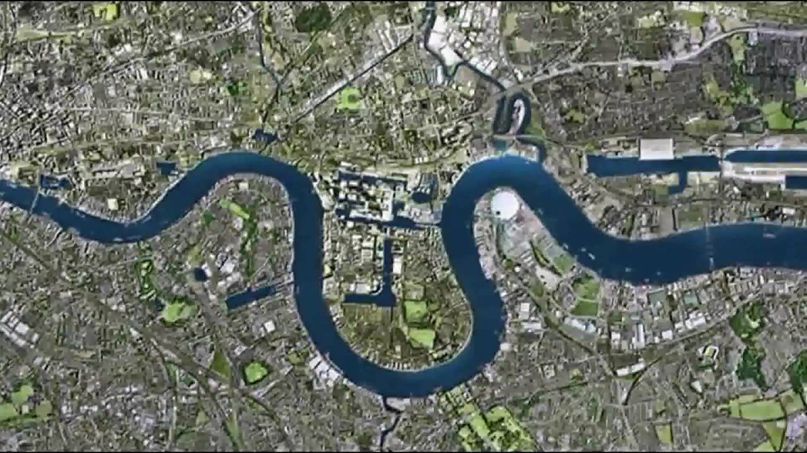
Erosional and Depositional Landforms: Meanders and Ox-bow Lakes
What’s the name of this river?
Where is it located?
Why is it this shape?
Which course of the river is this image?

Slide 4
Erosional and Depositional Landforms: Meanders and Ox-bow Lakes
What’s the name of this river?
Thames
Where is it located?
London
Why is it this shape?
Erosion and deposition
Which course of the river is this image?
Middle/lower

Slide 5
What is a meander?
A meander is a bend in a river. They are found mainly in lowland areas and are extremely common in the middle course of a river.
What are the conditions needed for a meander to form?
In the early stages of meander formation, water flows slowly over shallow areas (riffles) in the riverbed and faster through deeper sections (pools). This makes way for a motion called helicoidal flow that corkscrews across from one bank to another. This starts the erosion and deposition process which continuously shape a meander.

Slide 6
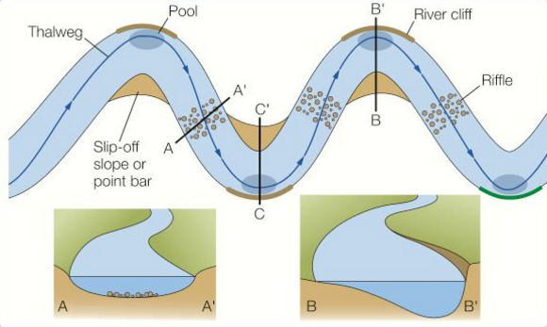
The formation of a meander
1. Fast flowing water on the outside of the bank causes lateral erosion through abrasion and hydraulic action, which undercuts the banks and forms a river cliff.
2. Helicoidal flow is a corkscrew movement. The top part of the flow hits the outside of the bank and erodes it. The flow then ‘corkscrews’ down to the next inside bend where it deposits its load due to friction slowing down the flow.
3. Fast flow causes vertical erosion on the outside bend, this deepens the river bed, resulting in an asymmetrical cross-profile.
4. Sand and pebbles are deposited on the inside bank where the current is slower, forming a gentle slip off slope.

Slide 7
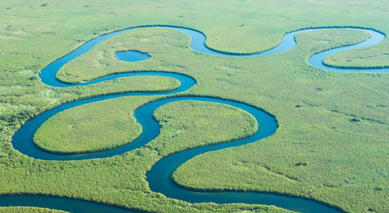
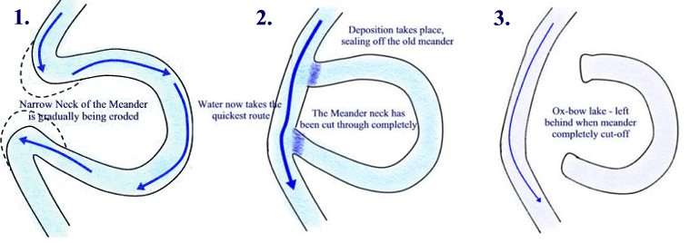
An ox-bow lake
A river with many meanders is called a sinuous river. The loops increase is size as erosion continues on the outside bank and deposition continues on the inside bank. As meanders grow, they migrate over the floodplain.
As they migrate they may start to erode towards each other.
Gradually the neck of the meander narrows until it is completely broken through (usually during a flood) to form a new straighter channel.
The old meander loop is cut off by deposition from subsequent flooding to form an ox-bow lake.
Task: Explain how an oxbow lake is formed.

Slide 8
Question Time
A meander is…
A bend in the river.
When the bend is cut off to form a straight channel.
Meanders and ox-bow lakes are found in the upper course of the river.
True OR False
What is the name of the flow that has a corkscrew effect?
Thalweg
Helicoidal flow

Slide 9
Question Time
A meander is…
A bend in the river.
When the bend is cut off to form a straight channel.
Meanders and ox-bow lakes are found in the upper course of the river.
True OR False
What is the name of the flow that has a corkscrew effect?
Thalweg
Helicoidal flow

Slide 10
Explain how an ox-bow lake could form on the river shown in Figure 1. (6)
SUCCESS CRITERIA:
L1 (1-2) There is a basic explanation of the formation of an ox-bow lake.
L2 (3-4) There is a clear explanation of the formation of an ox-bow lake.
L3 (5-6) There is a detailed explanation of the formation of an ox-bow lake.
Figure 1

Slide 11
Explain how an ox-bow lake could form on the river shown in Figure 1. (6)
There are many meanders shown in figure 1. The current is fastest at the outside bend of a meander because the channel is deeper (1). This means that hydraulic action and abrasion erode the outside bank of the river (1). Overtime erosion causes meanders to migrate across flood plains and get closer together (1). The outside bends continue to get closer until there is only a small bit of land left between two outside bends of a meander (1). This is called the neck. The river breaks through the neck usually during a flood to create a straight channel (1). Material is deposited across the shallow parts of the channel which eventually cuts the meander off and creates and ox-bow lake (1).

Slide 12
Threshold – Exit - Teacher to stand on door threshold
At the end of the lesson:
Stand behind your chair
Make sure your desk area is neat & tidy
Nominated student to collect books & return
Wear your uniform with pride
Exit the classroom calmly & follow the one way system

