Slide 1
Threshold – Entrance - Teacher to stand on door threshold
Title: The Local Water Budget
Date: 8 January, 2025
Do Now:
Write down the following definitions:
Field capacity
the maximum capacity of moisture that a soil can hold
2. River regime
the annual pattern of flow within a river – influenced by climatic conditions and the characteristics of the drainage basin (physical factors and human interventions)
3. Effective rainfall
the amount of precipitation remaining after evaporation
4. Recharge
when soil moisture levels increase as a result of precipitation following a dry period
5. Water balance equation
a way of expressing the water budget. It balances precipitation (P), runoff/river discharge (Q), potential evapotranspiration (E) and soil moisture and groundwater storage (S).
At the start of the lesson:
Greet at the classroom door
Ensure lanyards are worn
Take coats off on entering the classroom
Complete your do now
Place your equipment/folders on the desk
Phones should remain away for the duration of the lesson
Sit Up & Focus - Highest Quality Work - Interruption Free - Neat Work - Equipment

Slide 2
The Water Budget
Take notes
The annual balance between inputs and outputs.
Precipitation (P) =
Channel discharge (Q) + evapotranspiration (E) +/- Change in storage (S)
P = Q + E +/- S
It allows us to understand the difference between natural supply and demand and allow us to identify when precipitation exceeds evapotranspiration and vice versa.
What is discharge?
What is evapotranspiration?
What changes in storage might occur?

Slide 3
The Water Budget
Take notes
Precipitation (P) =
Channel discharge (Q) + evapotranspiration (E) +/- Change in storage (S)
P = Q + E +/- S
What is discharge?
The volume of water passing a certain point in the channel over a certain amount of time. It is measured in cumecs.
What is evapotranspiration?
The combined effect of evaporation and transpiration
What changes in storage might occur?
The amount of moisture in the soil. The amount of groundwater.

Slide 4
The Water Budget
Take notes

Slide 5
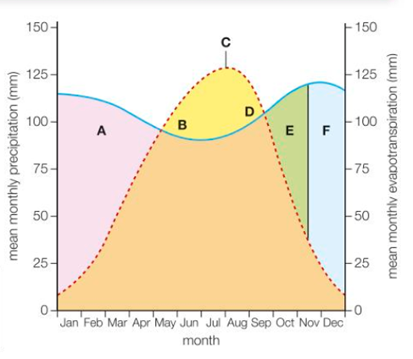
The Water Budget
Take notes
Either copy and paste the graph of the water budget on to word document or draw it out on a piece of paper and add the labels on the next slide to each of the letters, A-F.

Slide 6
The Water Budget

Slide 7
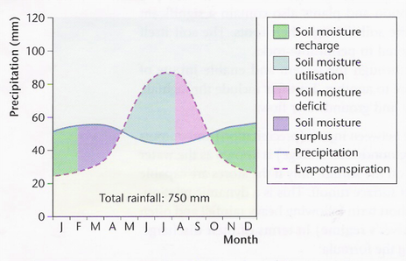
Seasons
Take notes
In the summer…
Potential evapotranspiration (PE) exceeds precipitation leading to lower water levels in rivers, lakes and ponds.
The soil moisture content declines and vegetation may wilt.
By August, there is a deficit.

Slide 8
Seasons
Take notes
In the winter…
The UK’s ‘water year’ begins in October, when rainfall exceeds evaporation.
Storage areas are usually recharged by January, after which there is a surplus – which raises the flood risk.

Slide 9
River Regimes
Take notes
The annual pattern of a river’s flow is known as a river regime. At a local level, this can be shown on a storm hydrograph.
Simple regimes – When a river experiences a period of seasonally high discharge, followed by low discharge. Typical of rivers in mountainous areas, where summer snowmelt occurs. EG. The Rhone and the Arve, in the Alps.
Complex regimes – These occur when a river crosses several different relief and climatic zones. Human factors contribute and the longer the river, the more complex the regime tends to be. EG: The Yukon in Alaska, the Amazon in Brazil, and the Murray Darling in Australia.

Slide 10
Named Examples Complex River Regimes
On a piece of paper draw the table on the right. Complete the first two columns on your table, using the graph below:
See larger version of graph on next slide

Slide 12
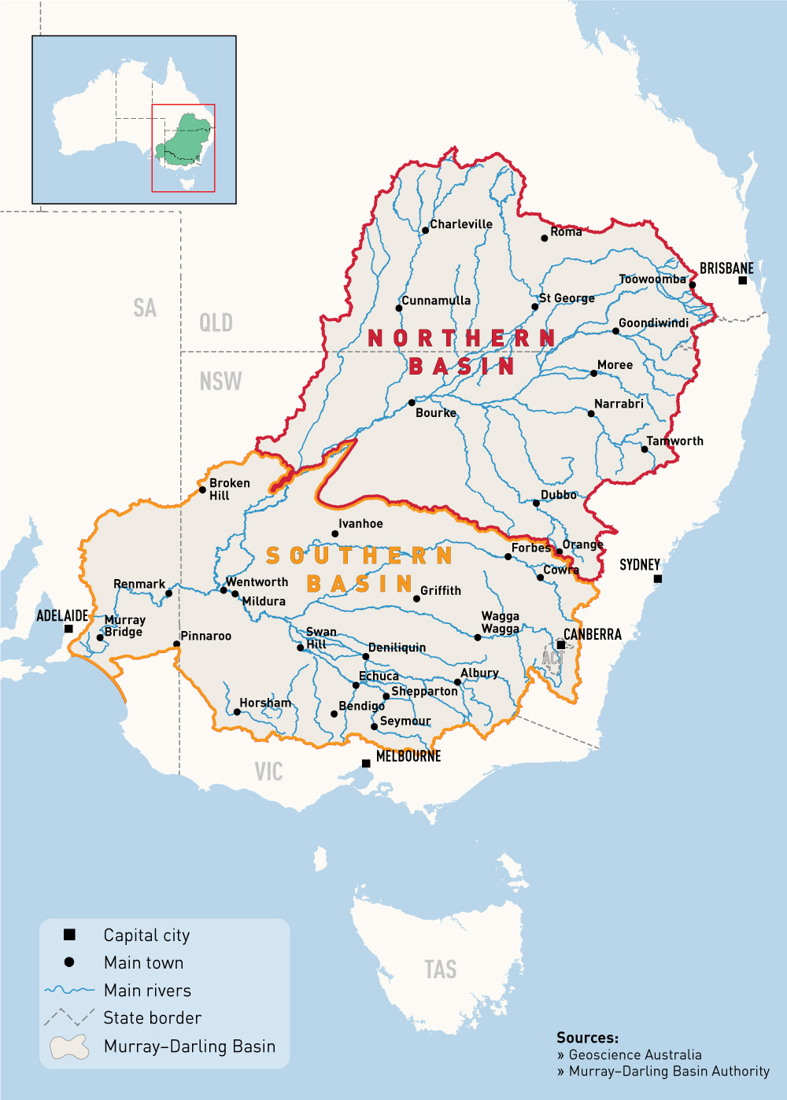
Murray Darling EXTRA INFO
The range in climate across the Murray–Darling Basin reflects it size, of more than 1 million square kilometres, and its diverse geography ─ from rugged mountains to flat semi-arid plains.
The climate of the Basin is sub-tropical in the north, semi-arid in the west and mostly temperate in the south. Rainfall graduates from summer dominant to winter dominant, from north to south. The eastern side of the Basin has high average annual rainfall, up to 1,500 mm and in the south, snow falls for several months each winter on the peaks of the Great Dividing Range. The western side of the Basin is typically hot and dry, and average annual rainfall is generally less than 300 mm.
Evaporation rates in the Basin are high, with 94% of the rainfall that falls in the Basin being used by plants (transpired) or evaporating from the land and surface water. The low-lying topography of the Basin ─ warm to hot semi-arid conditions in most regions ─ and the meandering and slow-flowing nature of the creeks and rivers, all combine to make an environment characterised by high evaporation.

Slide 13
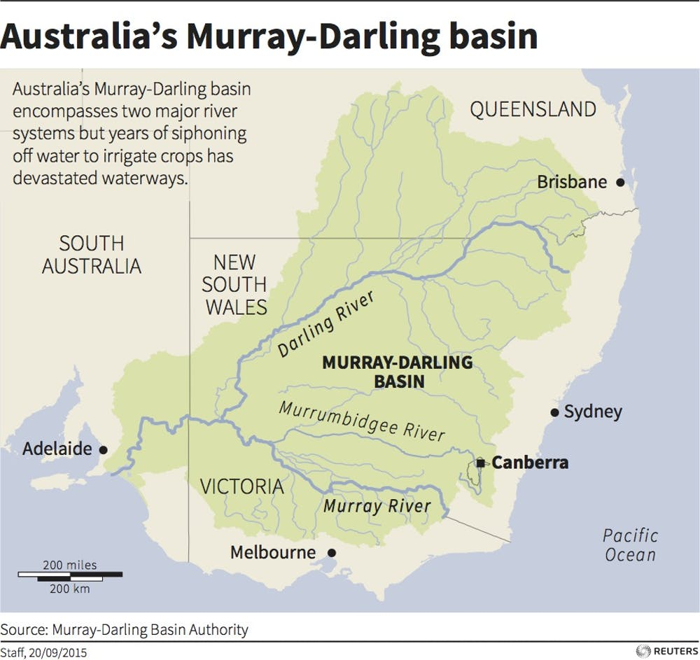

Slide 14
Named Examples of River Regimes
Complete the final column, using this table.

Slide 15
Answers

Slide 16
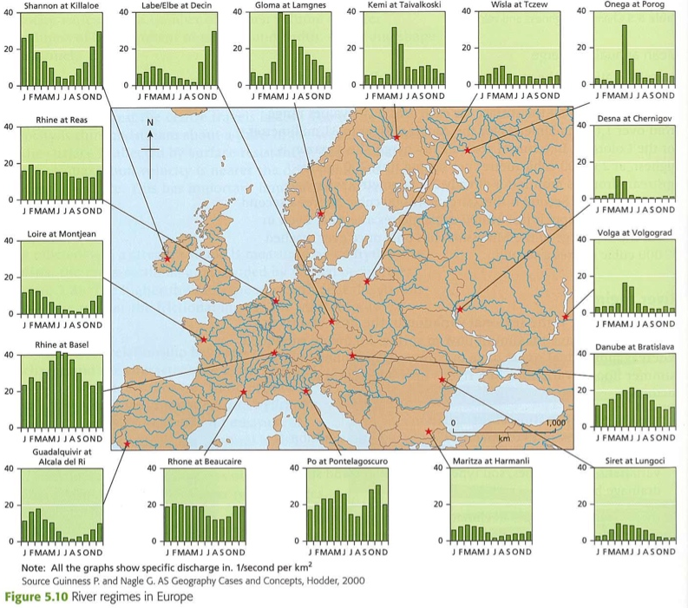

Slide 17
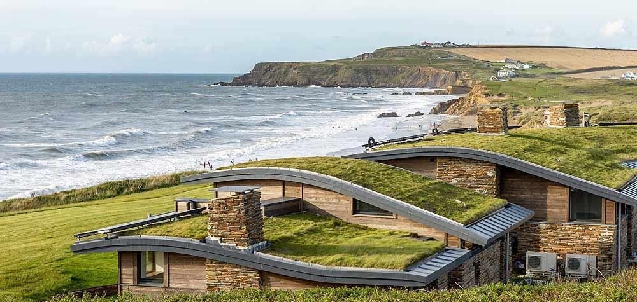
SuDS
Take notes
SustainableUrban Drainage Systems (SuDS) have been introduced to reduce runoff produced from rainfall.
These green roofs on holiday homes at Widemouth Bay in Cornwall store water.
Rain gardens are designed to store water in urban areas.

Slide 18
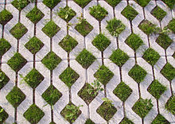
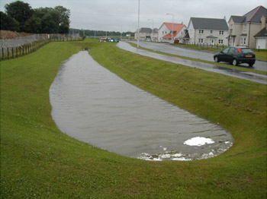
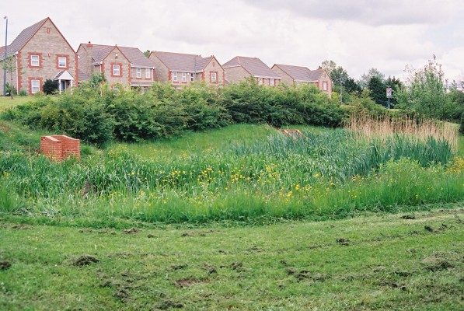
Other SuDS
Take notes
Permeable paving
Detention basin
Wetlands
Players in the Water Cycle
Within the UK, planners are required to determine whether any proposed development (eg. housing estate or industrial use) will influence flood risk.

Slide 19
Answer the following question
How far should planners insist on the universal use of SuDS measures?
Key arguments might include:
• Benefits of SuDS to preventing flooding.
• The expense and cost of implementing SuDS.
• The ability of the implementation of SuDS to be monitored.
• The appropriateness of SuDS in all built environments.
• The appropriateness of SuDS for 100-year floods.

Slide 20
Summary

