Slide 1


Threshold – Entrance - Teacher to stand on door threshold
Title: Erosional Landforms
Date: 8 January, 2025
At the start of the lesson:
Greet at the classroom door
Wear your uniform with pride
Enter the classroom in silence
Complete your do now in silence
Place your equipment on the desk
Do Now:
Name the four processes of transportation
Define abrasion
Name one impact of the Nepal 2015 earthquake
Sit up & Focus Have Pride in your Work IS this your best work? No Interruptions Equipment

Slide 2
Do now answers
Name the four processes of transportation
Saltation, Solution, Suspension and Traction.
Define abrasion
Abrasion is when pebbles grind together and act like sandpaper making the rocks rounder and smoother.
Name one impact of the Nepal 2015 earthquake
8,962 people were killed.

Slide 3
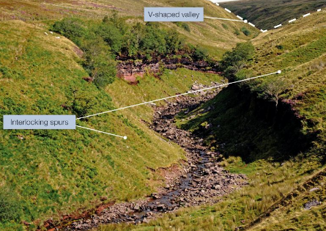
Interlocking Spurs
Interlocking spurs are projections of high land that alternate from either side of a V-shaped valley. They are formed by fluvial erosion and are found in the upper course of a river where rocks are hard. The river is not powerful enough to cut through the spurs of land and so has to flow around them.
Notes:
Scree is a collection of loose pieces of rock found on the sides of hills and mountains.
Vertical rather than lateral erosion dominates in the upper course of the river. This deepens the valley by hydraulic action and abrasion but does not erode sideways into the interlocking spurs.

Slide 4
Waterfalls

Slide 5
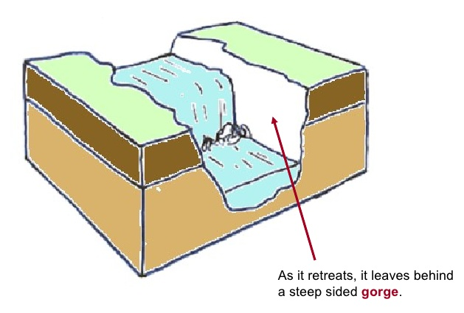
Gorge
A gorge is a vertical narrow steep sided valley that is usually found immediately downstream of a waterfall.
It is formed by the gradual retreat of waterfalls over hundreds, sometimes thousands of years.

Slide 6
Question Time
1. Which erosional landform retreats upstream?
Gorge B) Waterfall C) Interlocking Spurs
2. Where would you find interlocking spurs?
Upper Profile B) Middle Profile C) Lower Profile
D) Source E) A and D
3. What processes of erosion undercut a waterfall?
Hydraulic Action and Abrasion
Hydraulic Action and Attrition

Slide 7
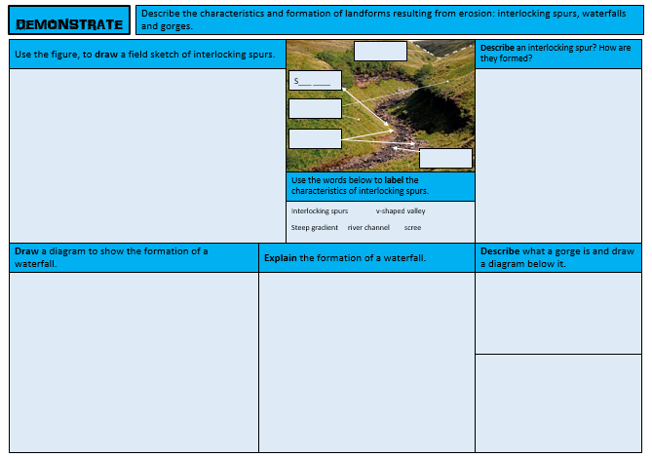
Study the characteristics and formation of interlocking spurs, waterfalls and gorges.
Task: You are going to be given an exam question on one of the features we have studied today.

Slide 8
Explain why a waterfall is only a temporary feature on a river’s course (4 marks)
SUCCESS CRITERIA:
Level 1 (1-2) Demonstrates some knowledge of river processes and environments. Shows limited geographical understanding of the interrelationships between river environments and processes.
Level 2 (3-4) Demonstrates specific and accurate knowledge of river processes and environments. Shows thorough geographical understanding of the interrelationships between river environments and processes.

Slide 9


Model answer
The river will try to develop a smooth long profile. A waterfall is formed where the river flows over a band of more resistant rock (1). This represents an irregularity in the river’s long profile that it will try to remove. Where the more resistant rock overlays less resistant rock, different rates of erosion take place as the less resistant rock is eroded faster than the overlying harder rock by abrasion and hydraulic action (1). Over time the less resistant rock is removed leaving a shelf of more resistant rock overhanging. Eventually this overhang will collapse and the waterfall will retreat further upstream (1). This process continues until all the more resistant rock has been removed, the waterfall disappears and the river’s long profile is smoothed out, therefore a waterfall is only a temporary feature (1).

Slide 10
Threshold – Exit - Teacher to stand on door threshold
At the end of the lesson:
Stand behind your chair
Make sure your desk area is neat & tidy
Nominated student to collect books & return
Wear your uniform with pride
Exit the classroom calmly & follow the one way system

