Slide 1


Threshold – Entrance - Teacher to stand on door threshold
Title: Acids and Alkalis
Date: 9 January, 2025
At the start of the lesson:
Greet at the classroom door
Wear your uniform with pride
Enter the classroom in silence
Books distributed calmly
Complete your do now in silence
Place your equipment on the desk
Do Now:
Define the word ‘atom’
The formula for water is H₂O. Is it an atom or a compound? Why?
In saltwater solution, which is the solvent and which is the solute?
Define the word ‘insoluble’
Describe a separating technique that would separate salt water.
Sit Up & Focus - Highest Quality Work - Interruption Free - Neat Work - Equipment

Slide 2
Acid and Alkalis – Do Now Answers
Mark your own purple pen:
Define the word ‘atom’
The formula for water is H₂O. Is it an atom or a compound? Why?
In salt water solution, which is the solvent and which is the solute?
Define the word ‘insoluble’
Describe a separating technique that would separate salt water.
The smallest part of an element
Compound because it is made from two different elements, hydrogen and oxygen
The solvent = water. The solute = salt.
A substance that cannot dissolve to form a solution
Crystallisation or evaporation - place the salt water in an evaporating dish and heat to cause the water to evaporate, leaving the salt in the dish. (Distillation could also be used)
Notes:
Foundation - If you filter sandy water, what is left in the filter paper?
Stretch - Explain why dry salt would stay in filter paper but salt in a salt water solution would pass through filter paper.
Answers:
Foundation - sand
Stretch - In solution, the grains/crystals/lumps of salt have dissolved so that each particle/molecule of salt is mixed in with particles of water. When dry, the salt compound is in grains/crystals/lumps so is too large to pass through the tiny holes of the filter paper

Slide 3
Acids and Alkalis
Prior Learning:
This Topic covers:
Future learning links:
Year 7-introduction to acids, alkalis and indicators
Year 8-filtration and distillation
Acids, Alkalis and Indicators
Bases and Salts
Preparing copper sulfate
Alkalis and balancing equations
Acids with metals and carbonates
Titration curves
Strong and weak acids
Calculating pH
Careers:
Chemist, science teacher, pharmacist, Lab assistant, chemical analyst, clinical analyst,

Slide 4
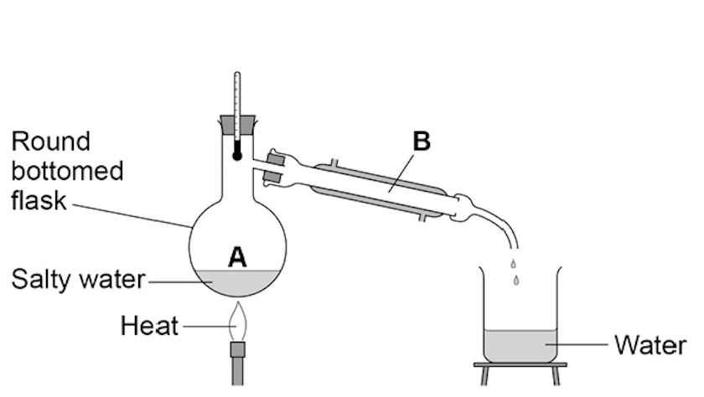
Command words are used in exams to tell you how to answer science exam questions.
In this topic we will focus on using the word describe.
When you are asked to describe something, you should simply ‘say what you see’.
Here’s an example. A student removed water from salty water using the apparatus below. Describe how this technique works by referring to the processes at A and B.

Slide 5
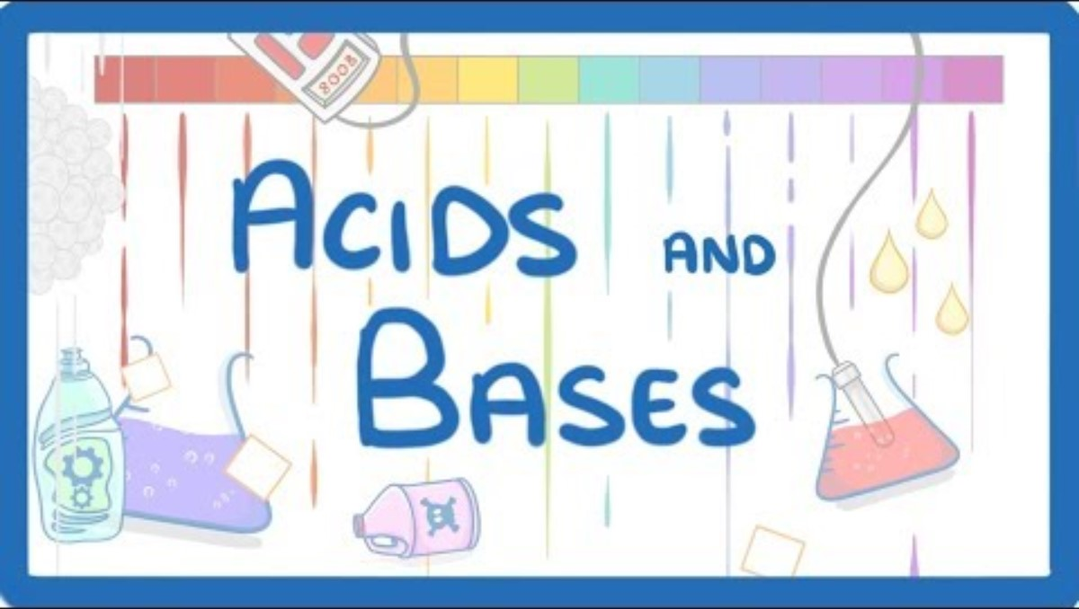
Please watch the video and take notes

Slide 6
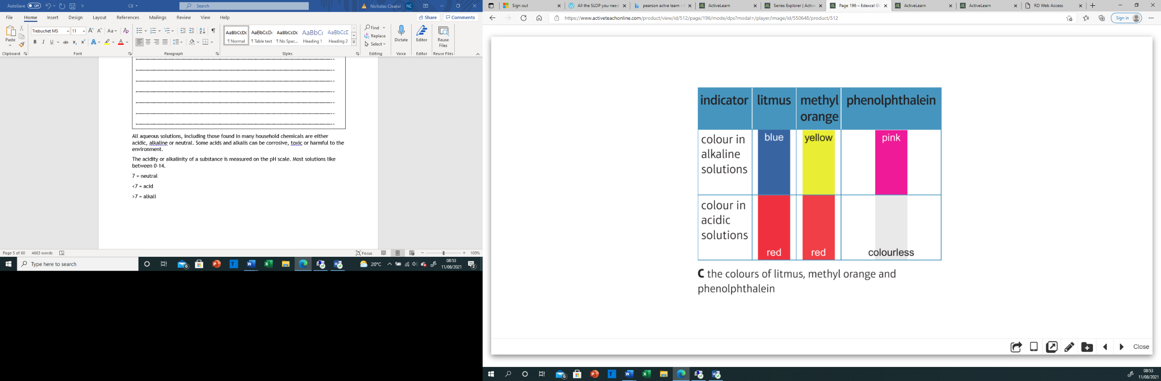
Indicators

Slide 7
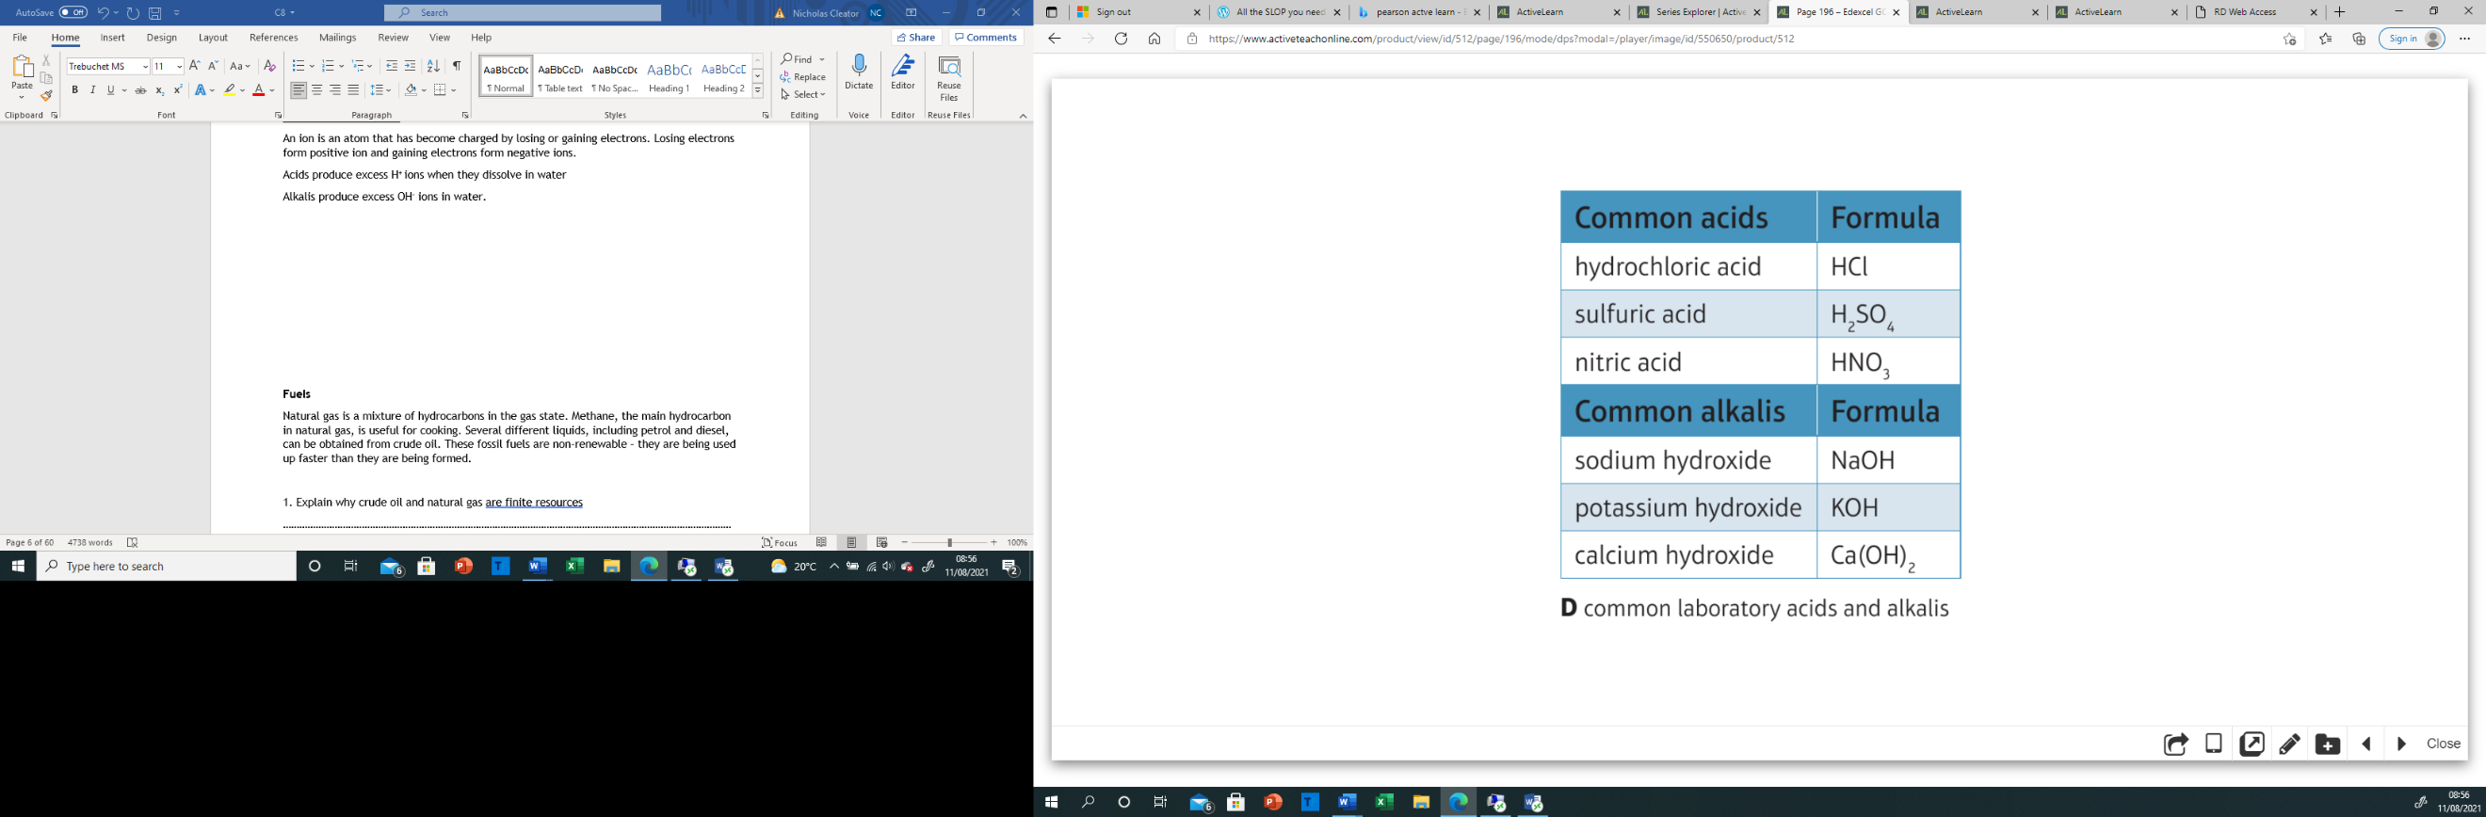
Common acids and alkalis

Slide 8
1. What ion is responsible for acidic solutions
Hinge questions
H
OH
H⁺
H⁻⁻

Slide 9
2. Which of the following is an alkali
Hinge questions
CaO
Ca(OH)₂
CaCO₃
Ca

Slide 10
Independent practice
Use the link to complete the quiz on acids and alkalis
https://cognitoedu.org/courserevise/c2-gcse-edexcel-h-t/c2-gcse-edexcel-h-t_4.01
Extension opportunity
The labels fell off two bottles in the prep room. One was HCl the other NaOH using your knowledge from today plan a test to determine which bottle contained the acid.

