Slide 1

Every time you see this symbol on a slide, please click it to listen to the audio.

Slide 2
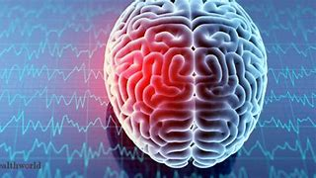
Neurological damage

Slide 3

Learning objectives
To know different types of brain damage and how it occurs.
Investigate real life examples of the impact of neurological damage.
Specification link | A basic understanding of how neurological damage, e.g. stroke or injury can affect motor abilities and behaviour.

Slide 4
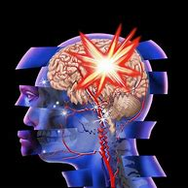
Neurological damage = brain damage
Neurological damage concerns any damage to neurons in the brain which may be permanent or temporary.
We have seen how the brain function is localised - different areas of the brain perform specific functions.
Therefore, way in which neurological damage affects behaviour will depend on which area of the brain has been damaged. Also, the extent and seriousness of the damage will determine whether the effects are mild or severe.

Slide 5
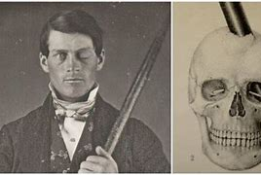
Phineas Gage?
Why Scientists Are Still Fascinated By Phineas Gage (youtube.com)
Notes:
https://www.youtube.com/watch?v=vb8Jg1PAL90

Slide 6
How do strokes happen?
A stroke is an interruption to the blood supply to the brain, either through bleeding or because some blood vessels have become blocked.
Nerve cells can die because of a lack of nutrients carried by the blood, so if the blockage or bleeding continues, it can produce permanent damage.
If the blood supply is restored quickly, damage can be minimised. Therefore, strokes need to be treated quickly, usually with drugs that will thin the blood and remove clots
Symptoms of strokes include slurred speech, dragging muscles on one side of the face, and lessened function of the muscles on one side of the body.

Slide 7
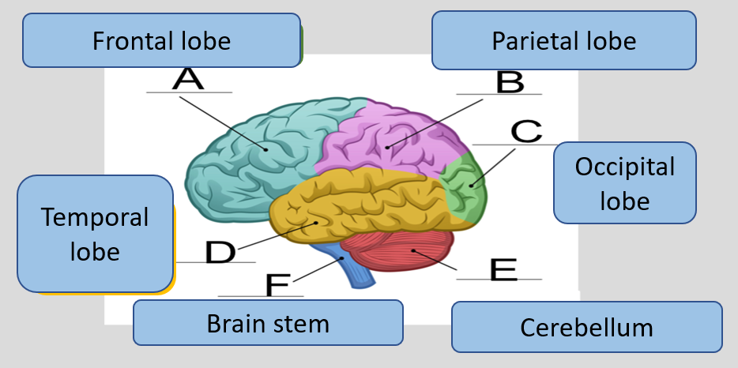
The effects of a stroke
The area the damage occurs will affect the impact
Notes:
Areas of the Brain Affected by Stroke: Location Matters (flintrehab.com)
https://www.youtube.com/watch?v=6zNKz7YoUao
https://www.youtube.com/watch?v=3oef68YabD0

Slide 8
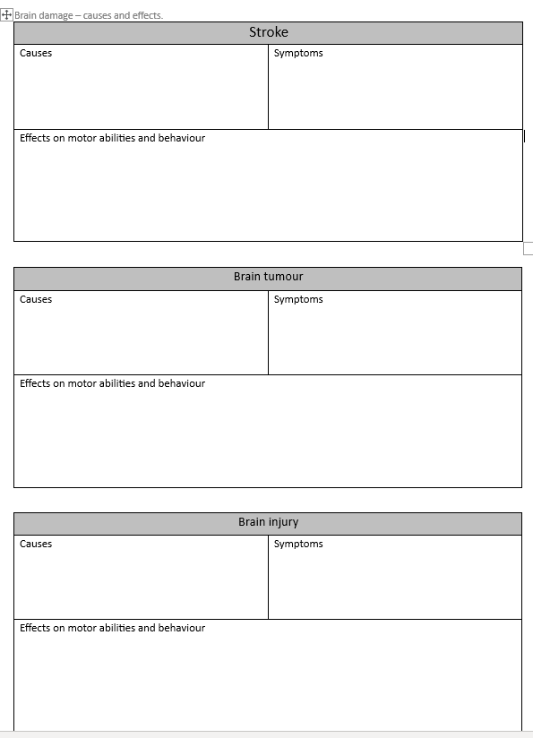
Please complete this research sheet.

Slide 9
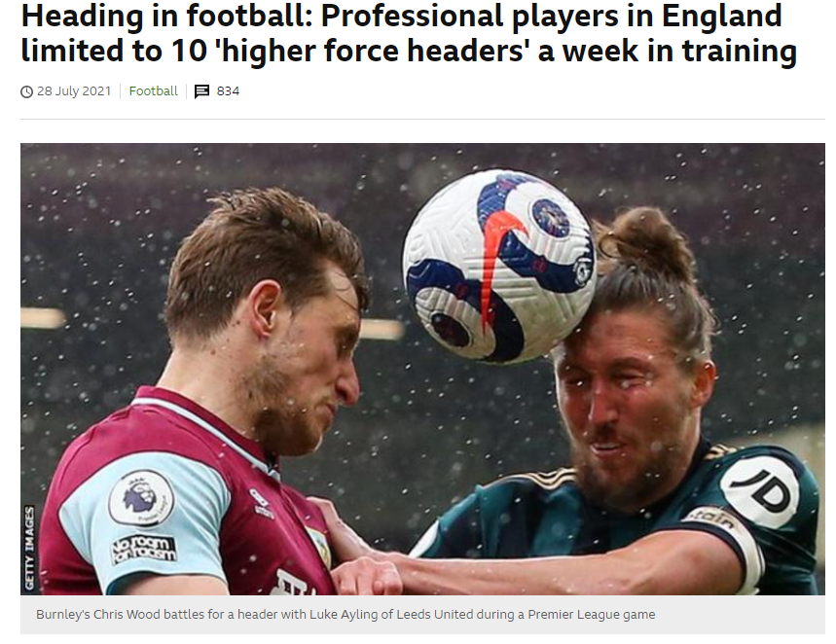
Can heading a football cause damage to the brain?
Heading a ball can impact a person’s memory.
Too early to suggest permanent brain damage may happen – but the bottom line is heading the hall is not good for the brain!
https://www.bbc.co.uk/sport/football/57996593
Notes:
Heading in football: Professional players in England limited to 10 'higher force headers' a week in training - BBC Sport

