Slide 1


Learning outcomes:
To know how to approach component 2 writing questions
To be able explain what you must include in component 2 answers (writing section)
8 January, 2025
Component 2 Writing: Guide
Do Now
List as many persuasive language techniques as you can.
Write a sentence starting with an adverb.
Write a sentence that uses both were and where correctly.
What can a writer use to reveal / present a character?
What tense and person should you narrative be written in?

Slide 2
Learning outcomes:
To know the features / conventions of a guide.
To be able to plan and write own guide.
8 January, 2025
Component 2 Writing – Guide Writing
What is a guide?
A guide gives a reader a ‘tour’ through a topic. It is normally quite informative but can be entertaining.
A guide has a strong personal viewpoint throughout.
A guide usually tries to get the reader to share the writer’s views.

Slide 3
Learning outcomes:
To know the features / conventions of a guide.
To be able to plan and write own guide.
8 January, 2025
Component 2 Writing – Guide Writing
Example Tasks
Writing a guide– exam tasks:
2020
Write a lively guide to surviving the teenage years for a school/college magazine. [20]
Writing a guide– sample tasks:
Write an informative guide for new students who plan to join your school or college. [20]
Write a lively guide for visitors to your local area. [20]
Write a guide for other GCSE students giving advice and information on how to survive their GCSE year. [20]

Slide 4
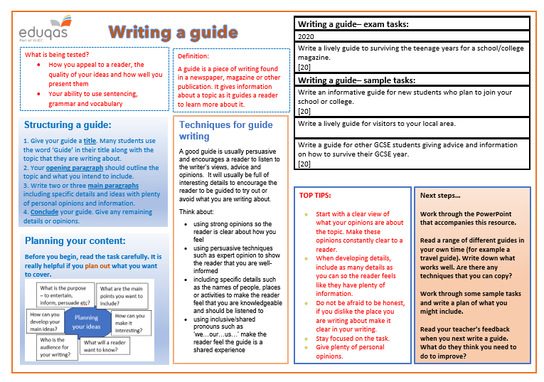
Learning outcomes:
To know how to approach component 2 writing questions
To be able explain what you must include in component 2 answers (writing section)
8 January, 2025
Component 2 Writing: Guide

Slide 5
Features of guide writing
The Rough Guide to Sidmouth
This delightful Regency seaside town has for a long time now claimed the title as one of the south west’s most popular tourist resorts. The question is, ‘Why?’ Naturally the immediate response is to say the beach. Yes, I can see the attraction of a stony beach complete with promenade and overpriced ice-cream kiosks to those from large, built-up cities but for those who have experienced the clear turquoise water of the beach at St Ives or the golden sands of the Lizard peninsular, this is nothing special.
Perhaps it is the lush and leafy Connaught Gardens? I think not. In comparison to the Lost Gardens of Helligan or the Eden Project they seem more like someone’s back garden than a slice of paradise.
Is it then that Sidmouth is home to a vast variety of shops and cafes or even historical and cultural sites? No, sadly, this is not the case. I have searched high and low yet I still cannot find anything to particularly recommend Sidmouth over any other small seaside town with an overinflated opinion of itself. Yes, Sidmouth is really nothing special.
Yet year after year the tourists return in their droves to mill around the town and sit around on deck chairs. My only advice is to ensure that if your heart is set on going to Sidmouth, wait until August when the folk festival arrives. This at least brings a little vibrancy and variety to a town which seems stuck in a time warp.
If it’s sitting in hotels with Devon’s answer to the cream tea or strolling down the promenade with hundreds of other tourists (and the elderly population who seem so attached to the area) then Sidmouth is the place for you. Sadly, I entered the town with high expectations, but will not be going again.
Include a heading. Make it clear what you are writing about.
Appeal to your reader. Ask questions that will encourage them to think of the answers.
Always organise your writing
into paragraphs. Paragraphs will help you to make your ideas clear and easy to follow.
Compare what you are writing about to other familiar things/places. This will help the reader to build up a picture of it.
Repeat the topic that you are writing about so the reader has it in their mind at all times.
Use suitable language to appeal to the reader. This guide is negative, so the language is negative too.
Use punctuation effectively – these brackets have been used to add extra information.

Slide 6
Learning outcomes:
To know how to approach component 2 writing questions
To be able explain what you must include in component 2 answers (writing section)
8 January, 2025
Component 2 Writing: Guide
Task: Write a guide aimed at older people giving information and advice on how to take care in severe weather conditions.
Purpose =
Audience =
Form =

Slide 7
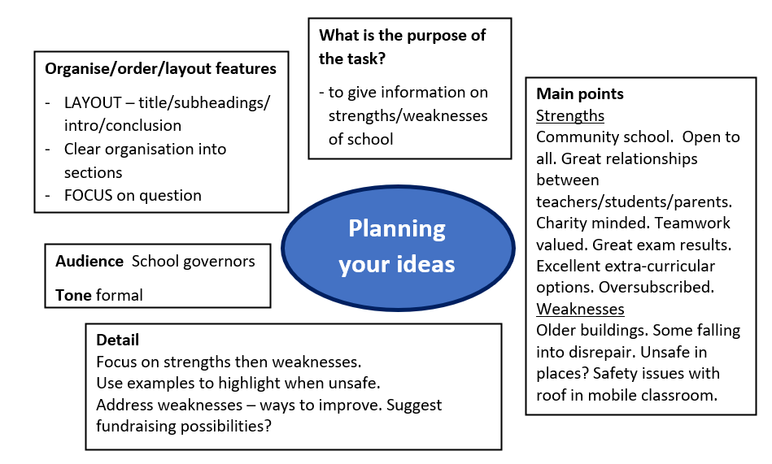
Learning outcomes:
To know how to approach component 2 writing questions
To be able explain what you must include in component 2 answers (writing section)
8 January, 2025
Component 2 Writing: Guide
Guide writing – Planning
Write a guide aimed at older people giving information and advice on how to take care in severe weather conditions. [20]
…
…
…
Audience:
Tone:
…

Slide 8
Learning outcomes:
To know how to approach component 2 writing questions
To be able explain what you must include in component 2 answers (writing section)
8 January, 2025
Component 2 Writing: Guide
Write a guide aimed at older people giving information and advice on how to take care in severe weather conditions.
Write your guide
Timed write: 30 mins
Headline/ Title
Strapline
Intro
Subtitle for point 1
Paragraph
Subtitle for point 2
Paragraph
Subtitle for point 3
Paragraph
Conclusion

