Slide 1
Instructions – Please read
I have narrated each slide. If you view this in slideshow view, my narration should start automatically on each slide.
If not, if you hover over the slide there should be a play button
There is no narration on the next slide (the title slide) but every other slide has narration on
You may either handwrite your work to hand in or type it and email it to me. If you handwrite it, please submit it to Mr Fenner next Tuesday.
Note that this lesson starts with a recap of the content from last lesson. Even if you were at the lesson, I would recommend going over the recap

Slide 2
Wednesday, 08 January 2025
Global marketing
Learning Objective: Today, I will learn about the different methods businesses use to sell their products to customers around the world
Define ethnocentric, geocentric and polycentric approaches
Link this theory to Ansoff’s Matrix
Lucere Aude – Dare to shine!
Can you evaluate each method in a business situation, comparing it with another?
Why are we learning this?
Businesses need to take an approach that will work with their customers to achieve success

Slide 3
Global marketing approaches
Ethnocentric approach – Goods/services are sold without adaptation (assumes what was a success story in own market can be replicated e.g. Apple iPhone)
Geocentric approach – Maintain and promote global brand name, but tailor products to local markets (Think global, act local)
Economies of scale! BUT will the product sell everywhere?
Higher cost of development BUT probably would sell well due to consistent strong brand?

Slide 4
Global marketing approaches
Polycentric approach – Goods/services are sold adapted to countries
Very high cost of development and time consuming, but if researched well then should maximize sales in each country

Slide 5
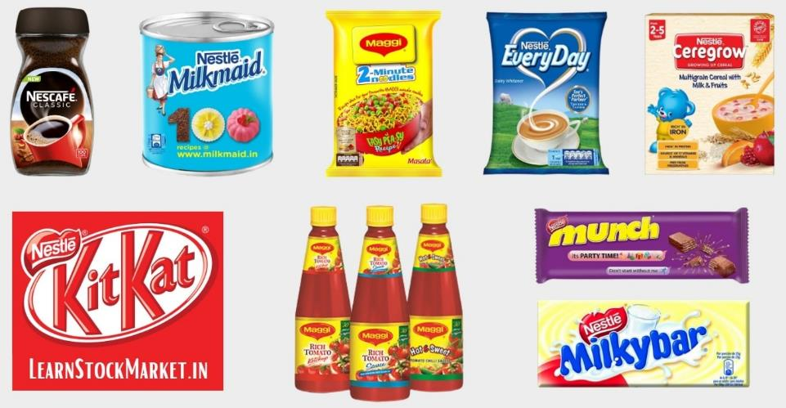
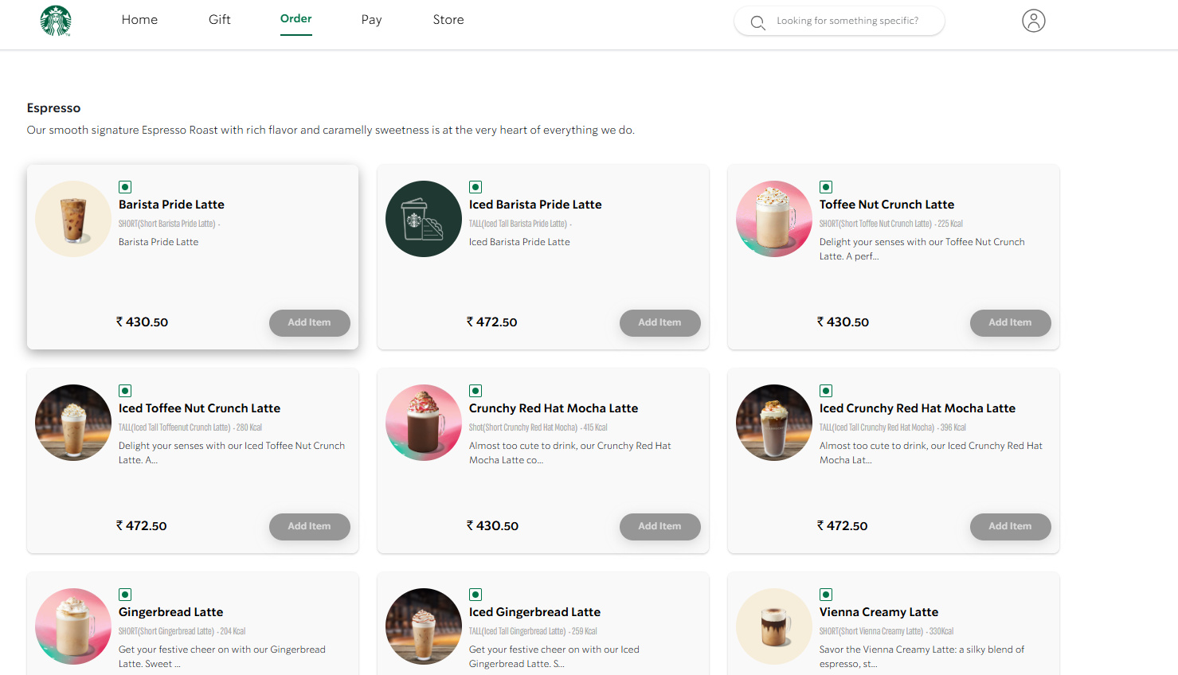
Examples
Ethnocentric:
Apple iPhone
Geocentric:
Nestle
Polycentric:
Starbucks

Slide 6
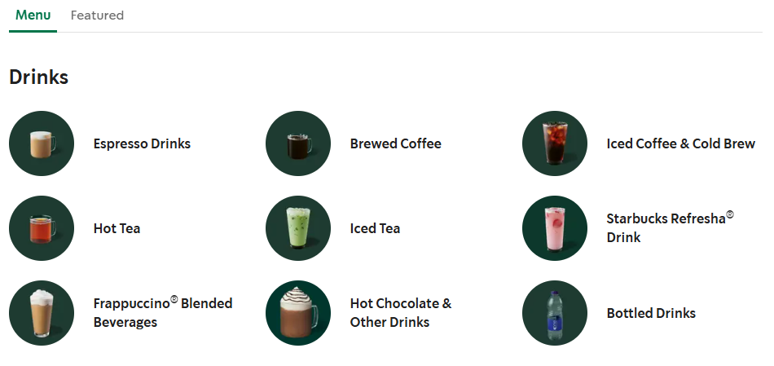
UK

Slide 7
Malaysia

Slide 8
China

Slide 9
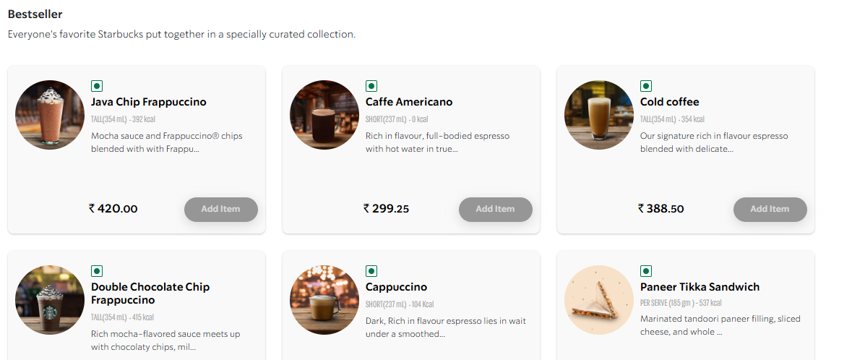
India

Slide 10
Task: McDonald’s
Which of the three approaches does McDonald’s use and how do you know?
What are the negatives to this approach?
Would another approach work better?

Slide 11
To do
Write a summary sheet of today’s lesson. Include
What ethnocentric, geocentric and polycentric mean
Give examples and explain your examples
The advantages and disadvantages of each of these
Complete the work sheet
Answer the Case Study questions

