Slide 1
Btec Level 2 Tech Award Performing Arts Dance
C3 Preparation Work- Year 11
Ms Power

Slide 2
Learning objectives….
To source movement ideas to aid with the creation and generation of movement for Component 3
To explore appropriate themes

Slide 3
Task…
Included in this PowerPoint are video extracts
Watch each of them and answer the questions on the slides that follow
You should write or type your responses in full sentences, using dance appropriate vocabulary and in as much detail as possible
Explain your examples in detail

Slide 4
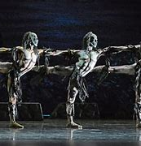
Ghost Dances, Christopher Bruce
Watch the link
Ghost Dances 1
** please be aware the first part of the dance is in silence
Ghost Dances explores the idea of civil war and how innocent people lose their homes and are often murdered. The three ghost like figures in the opening scene of Ghost Dances represent the Chilean government who murdered individuals and their families who opposed their political views
This is similar to Message In A Bottle but Christopher Bruce approaches this in a different way

Slide 5
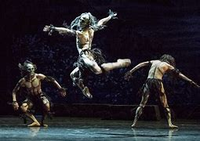
Questions…..
How is the idea of war, murder and fear shown through the actions and the costume in the piece?
Why do you think the cast is all male? Can you link this to the chorographic intention?
Why do you think the performers are dressed as they are?
What is the purpose of the piece and why do you think this? (raise awareness, educate, challenge viewpoints, inform, entertain)
Describe TWO movements that you think clearly show the choreographic idea. You can rewatch the link to find these. As well as describing the movements you might also want to state at what time in the video they can be seen

Slide 6
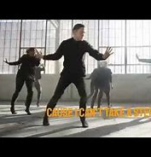
Cry Me A River, Andrew Winghart
CRY ME A RIVER - Justin Timberlake - Dance Video
Watch the video a number of times
I LOVE THIS DANCE!!!
Like yesterday think about what you think the story or theme of this dance is and why you think that?

Slide 7
Questions….
What do think this dance is about? Think about themes
What mood and atmosphere do you think the music and the lyrics create? How does this make you feel?
Why is there a one male dancer and a large ensemble of female dancers? What do you think they represent?
What is the purpose of the piece and why do you think this? (raise awareness, educate, challenge viewpoints, inform, entertain)
Describe TWO movements that you think clearly show one of the themes that you have identified. You can rewatch the link to find these. As well as describing the movements you might also want to state at what time in the video they can be seen
These questions are about your interpretation- justify what you think

Slide 8
Pause For Thought….
How will this task now help you with our exam question??

