Slide 1
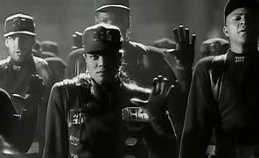
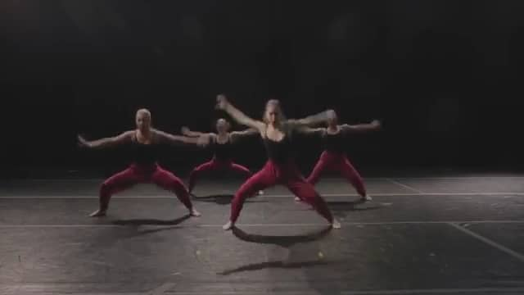
Btec Level 2 Tech Award Performing Arts Dance
C2- Preparation Work
Year 10 PSA
Theme- Equality
Ms Power

Slide 2
Learning Objective
To link Rhythm Nation and Kaaris Charge to the theme of equality

Slide 3
Context…
Our exam period has now started
We will learn 2 pieces of repertoire and select one to be examined on
Create coursework to track your progress and show how you have linked your repertoire to the theme of Equality
Write an evaluation at the end of your project

Slide 4
Rhythm Nation, Anthony Thomas
Review the video
Janet Jackson - Rhythm Nation
Watch the video a number of times and focus on the following topics:
Movement
Dynamics
Space
Formations
Costume
Lights
Set
Dancers

Slide 5
Task…
Now pick TWO topics from the list
Describe what that the topic looks or sounds like in as much detail as possible
Next, explain how you think this topic links to the idea of Equality. This could be because of how it looks, the atmosphere it creates, what it suggests to the audience etc
Remember dance is subjective. If you can explain why you think something there is no wrong answer!!
You can write or type your responses. If you type your responses, then please email to me at the end of our lesson. If you handwrite your responses, please bring with to our lesson next week

Slide 6
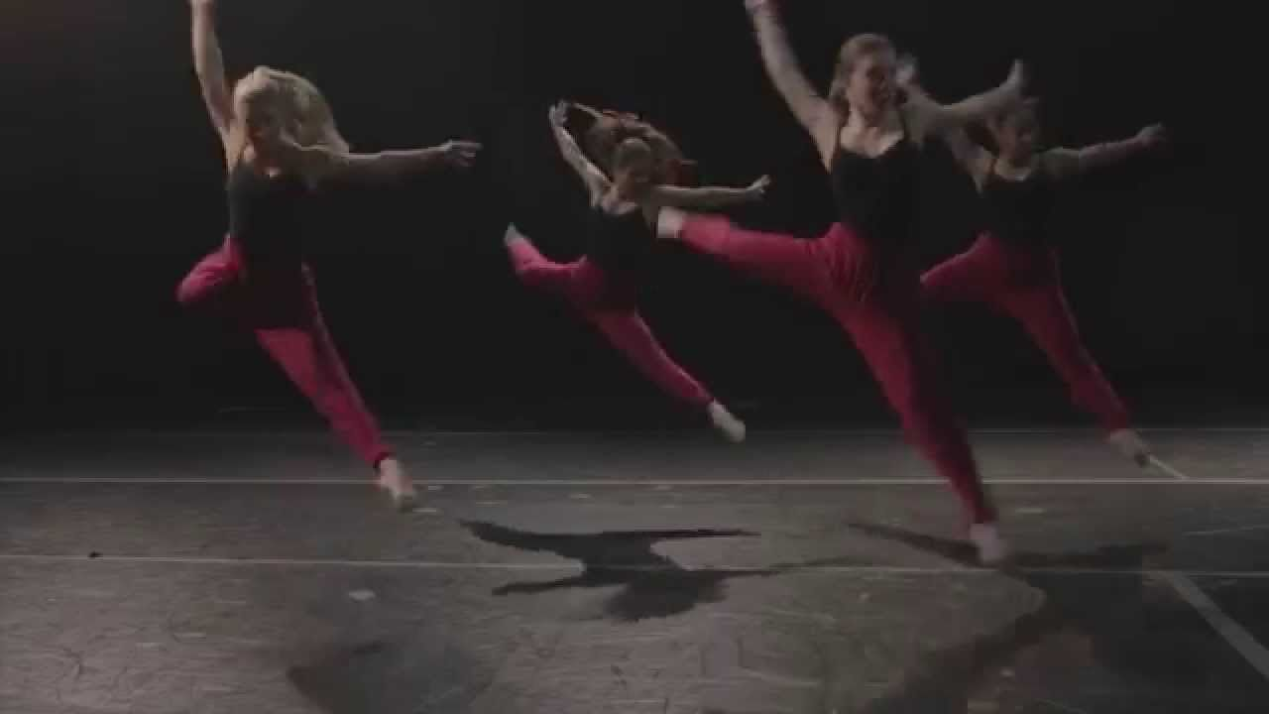
Kaaris Charge, Andrew Winghart
Kaaris- Charge (Mr. Carmack Remix)
Watch the video
Watch the video a number of times and focus on the following topics:
Movement
Dynamics
Space
Formations
Costume
Lights
Set
Dancers

Slide 7
Task…
Kaaris Charge is an abstract piece of repertoire as opposed to a narrative like Rhythm Nation
Rhythm Nation has a clear choreographic intention, and the lyrics of the song help to tell the story. Kaaris Charge does not have this. This means that you have to work a bit harder to find the links to the theme of Equality
This does not mean that the links to the theme do not exist!
Now pick TWO topics from the list
Describe what that the topic looks or sounds like in as much detail as possible
Next, explain how you think this topic links to the idea of Equality. This could be because of how it looks, the atmosphere it creates, what it suggests to the audience etc
Remember dance is subjective. If you can explain WHY you think something, there is no wrong answer!!

Slide 8
Key Vocabulary….
Repertoire
Abstract
Narrative
Mood and atmosphere
Choreographic Intention

Slide 9
Pause For Thought….
What will be your biggest challenge in learning these two pieces of repertoire? Be prepared to share this answer with me next week!

