Slide 1

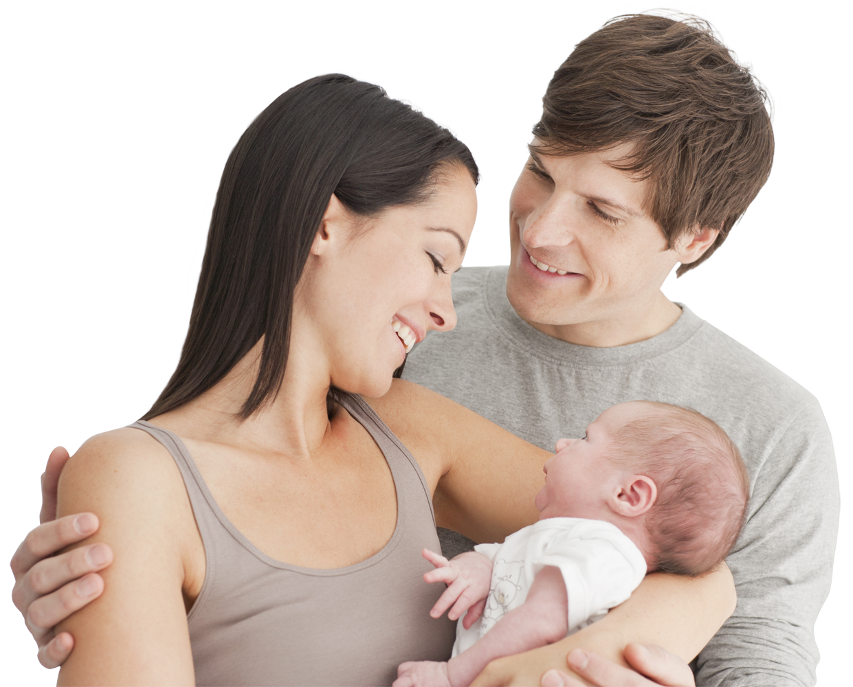
Thursday, 09 January 2025
Attachment Topic
SCHAFFER & EMERSON’S STAGES OF ATTACHMENT
DO NOW:
Define the key terms below
Secondary attachment (2)
Reciprocity (2)
Internal synchrony (2)
EXT: Explain why it might be difficult to research the long-term effects of early attachment?

Slide 2
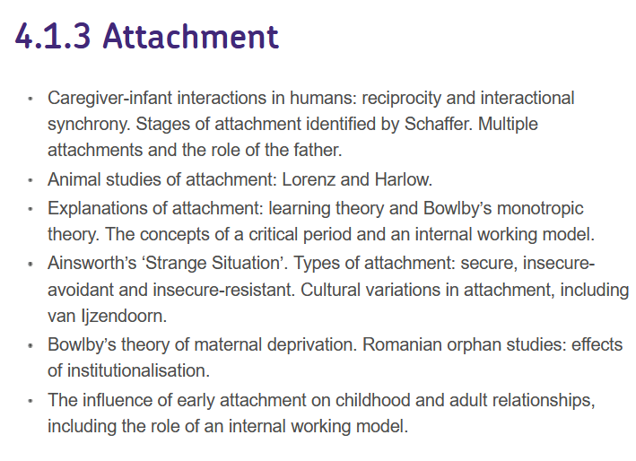
SPEC CHECK:

Slide 3
Thursday, 09 January 2025
Attachment Topic
SCHAFFER & EMERSON’S STAGES OF ATTACHMENT
KEY QUESTIONS:
What were Schaffer and Emerson’s key findings?
What are the four stages of attachment according to Schaffer and Emerson?
When does each stage occur and what are the key features of each stage?

Slide 4
VIDEO QUESTIONS:
What kind of study did Schaffer and Emerson conduct in 1964?
Which attachment behaviours did they measure in this study?
How did they measure these attachment behaviours?
What did they find about infant attachments?
Use the table below to briefly describe each of the four stages:
Do all babies go through the same attachment stages as described by Schaffer and Emerson (1964)
How do we know Schaffer and Emerson’s findings are reliable?
https://youtu.be/WRQiCcH351E
Stage 1 | Stage 2 | Stage 3 | Stage 4

Slide 5

ACTIVITY: Watch the video below and complete the video question sheet given.

Slide 6
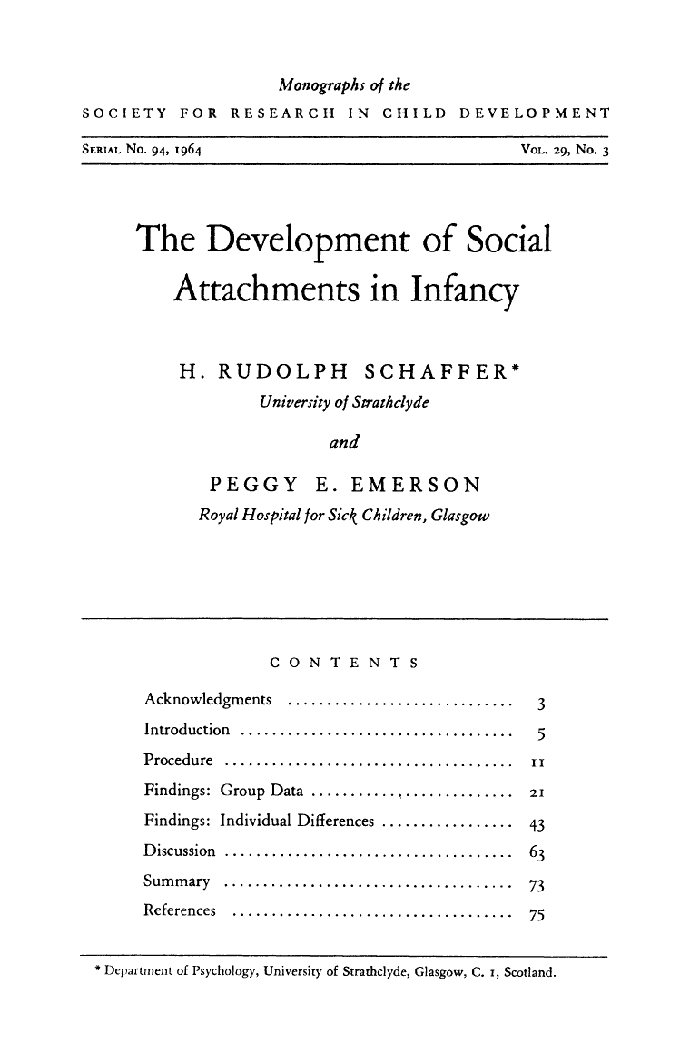
Shaffer and Emerson’s Research (1964)
Schaffer’s Stages of Attachment
AIM:
Schaffer & Emerson (1964) aimed to investigate how early attachments were formed, in particular at which age they developed, their emotional intensity and to whom they were directed to.

Slide 7
Shaffer and Emerson’s Research (1964)
Schaffer’s Stages of Attachment
METHOD:
The study involved 60 babies (31 male and 29 females) from Glasgow with the majority from skilled working-class families.
The babies and their mothers were visited at home every month for the first year and again at 18 months.
The researchers asked the mothers questions about the kind of protest the babies showed in seven everyday separations e.g. adult leaving the room: a measure of separation anxiety. This was designed to measure the infant’s attachment.
The researchers also assessed stranger anxiety: the infant’s anxiety response to unfamiliar adults.

Slide 8
Shaffer and Emerson’s Research (1964)
Schaffer’s Stages of Attachment
FINDINGS:
Between 25 – 32 weeks of age, about 50% of babies showed signs of separation anxiety towards a particular adult, usually the mother (this is called specific attachment).
Attachment tended to be the caregiver who was most interactive and sensitive to infant signals and facial expressions (i.e. reciprocity) – this was not necessarily the person who spent the most time with the infant.
By the age of 40 weeks, 80% of babies had a specific attachment and almost 30% displayed multiple attachments.
THINK, PAIR, SHARE: Evaluate Schaffer & Emerson’s research (1964).

Slide 9
Development of Attachment
Stages of Attachment - Shaffer and Emerson (1964)
Stage | Age | Response
Asocial | 0-6 weeks | Smiling and crying is not directed in any way.
Indiscriminate attachment | 6 weeks - 7 months | Attention is sought from different people.
Specific attachment The first true attachment | 7 - 9 months | Strong attachment to one individual.
Multiple attachment | 10 months + | Strong attachments to two or more people.

Slide 10
 | Stages of Attachment (Schaffer & Emerson)
 | Stage 1 | Stage 2 | Stage 3 | Stage 4
What is this stage called?
When does this stage occur?
What are the key features of this stage?

Slide 11
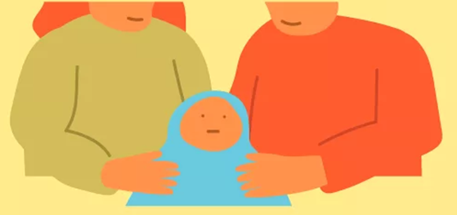
Stages of Attachment
Schaffer’s Stages of Attachment
Stage 1: The Asocial stage (first few weeks)
This stage is not really an ‘asocial’ stage (despite Schaffer and Emerson using that term) as the baby is recognising and forming bonds with its carers.
However, the baby’s behaviour towards non-human objects and humans is quite similar. Babies show some preference for familiar adults in that those individuals find it easier to calm them. Babies are also happier when in the presence of humans.

Slide 12
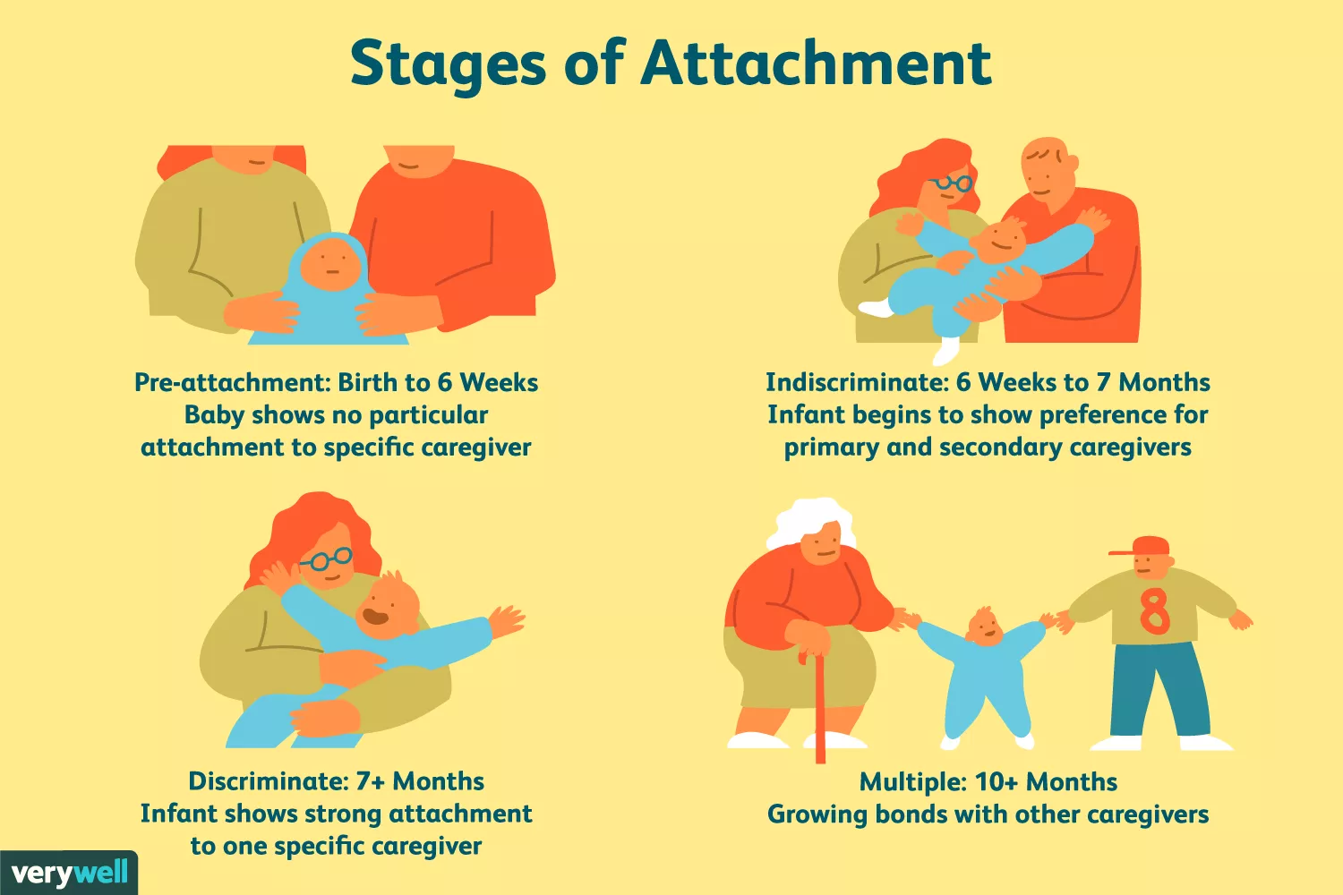
Stages of Attachment
Schaffer’s Stages of Attachment
Stage 2: Indiscriminate attachment
From 2-7 months babies display more observable social behaviour. They show a preference for people rather than inanimate objects, and recognise and prefer familiar adults.
At this stage babies usually accept cuddles and comfort from any adult, and they do not usually show separation anxiety or stranger anxiety. Their attachment behaviour is there said to be indiscriminate because it is not different towards an one person.

Slide 13
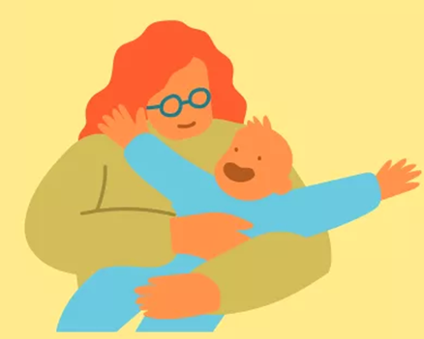
Stages of Attachment
Schaffer’s Stages of Attachment
Stage 3: Specific attachment
From around 7 months the majority of babies start to display anxiety towards strangers and to become anxious when separated from one particular adult (the biological mother in 65% of cases).
At this point the baby is said to have formed a specific attachment. This adult is termed the primary attachment figure. This person is not necessarily the person the child spends most time with but the one who offers the most interaction and responds to the baby’s ‘signals’ with the most skill.

Slide 14
Stages of Attachment
Schaffer’s Stages of Attachment
Stage 4: Multiple attachments
Shortly after (at around 10 months) babies start to show attachment behaviour towards one adult, they usually extend this attachment behaviour to multiple attachments. These relationships are called secondary attachments.
In Schaffer and Emerson’s study, 29% of the child had secondary attachments within a month of forming a primary attachment. By the age of about one year, the majority of infants had developed multiple attachments.

Slide 15
Task 1
Complete 3 exam questions on the next slides

Slide 16
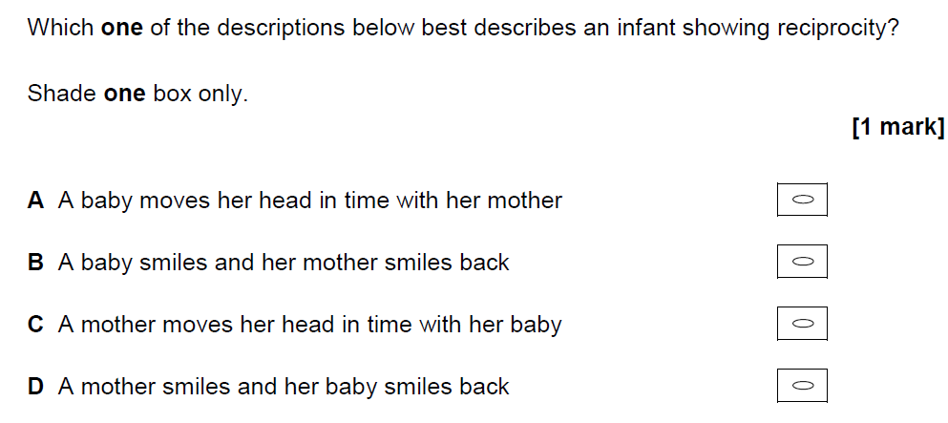
Exam Practice: MCQ
✓
Question 1:
✓

Slide 17
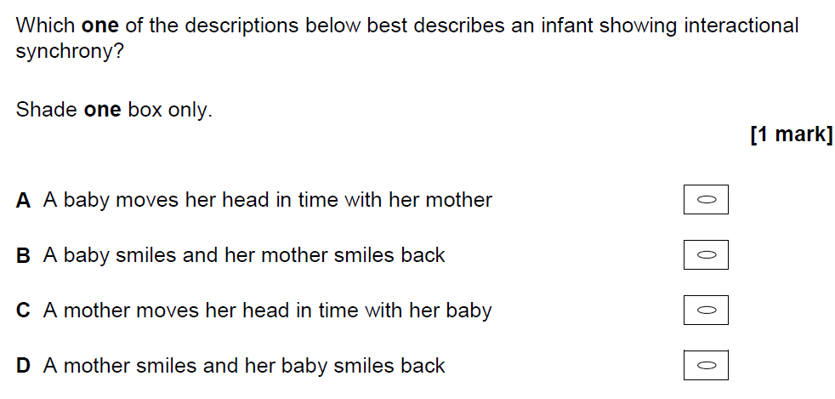
Exam Practice: MCQ
✓
Question 2:
✓

Slide 18
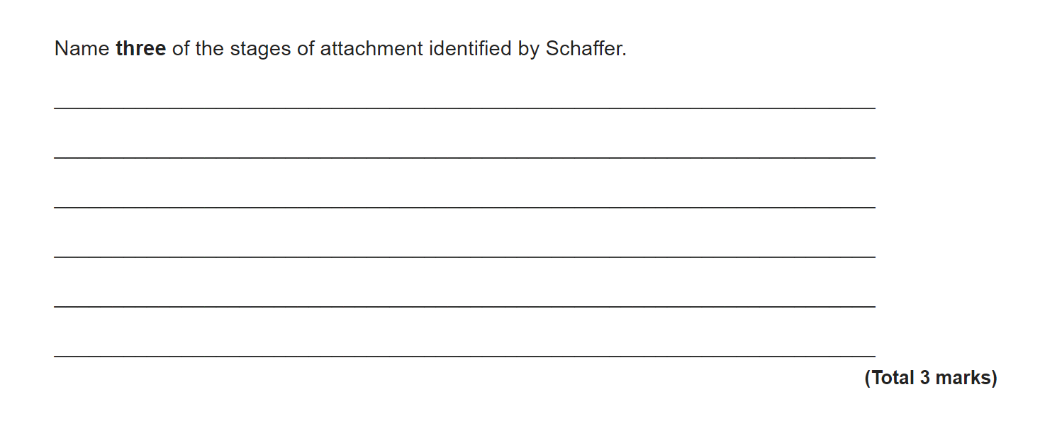

Slide 19
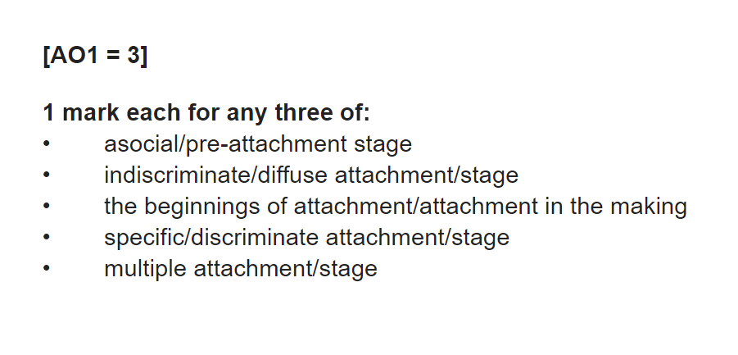

Slide 20

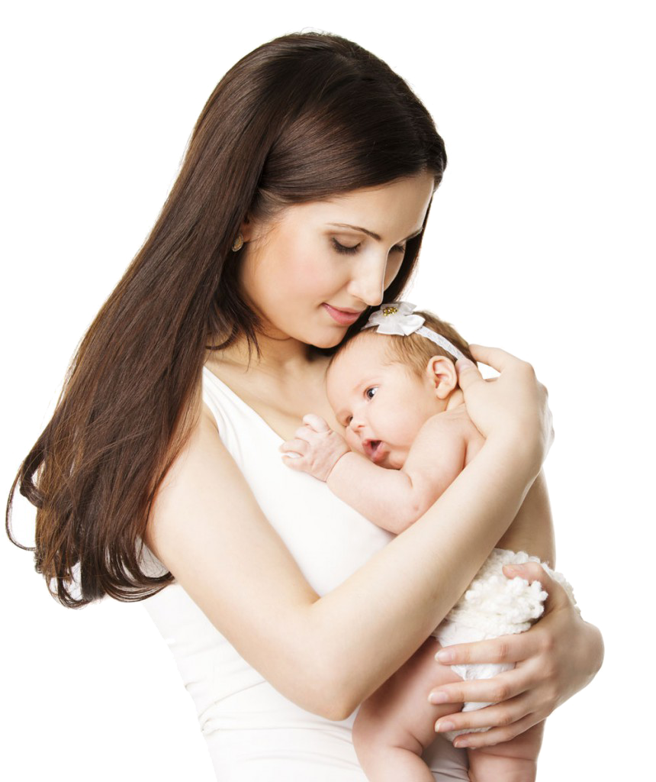
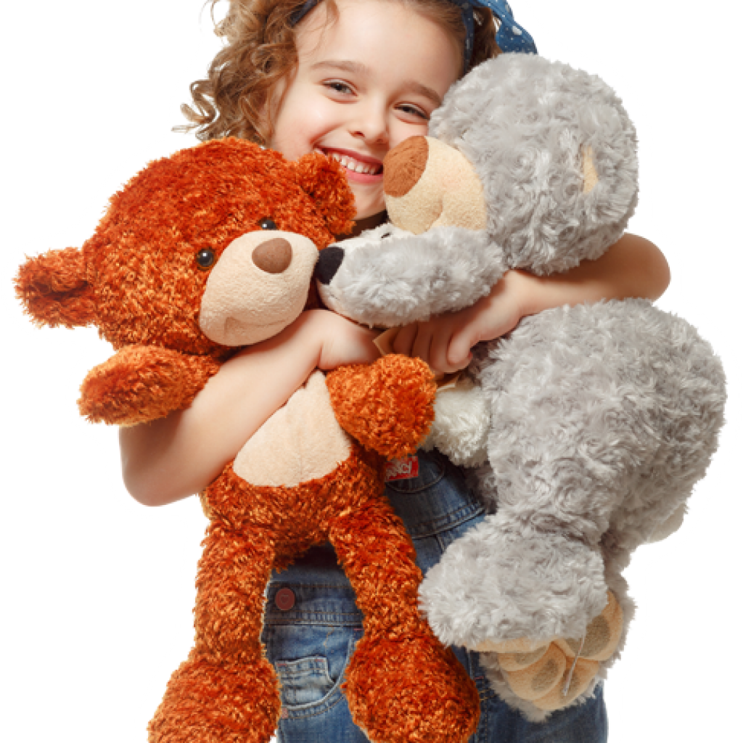
Task 2
For each of the following children, decide which stage of attachment they are at. Justify your answer.
I’m baby Michelle, and I’m only happy if my mum picks me up and plays with me. If it’s anyone else, I cry!
I’m baby Graham, and I’m attached to my teddy bear, although I do find something fascinating about my mummy’s face.
I’m baby Ruth, and I’m happy around everyone. I’m comforted by my mum, dad, grandparents and even by big sister.
Notes:
Michelle – Discriminate stage - Michelle is showing a preference for one caregiver (her mum) and if anyone else picks her up she demonstrates separation strange anxiety.
Ruth – Multiple - Ruth is showing attachment behaviours towards several different people.
Graham – Asocial - Graham shows a similar response towards objects (his teddy bear) and people. He also shows a preference for faces.

Slide 21
Task 3
Create your third “Egg baby” diary entry including:
Description of Schaffer & Emersons stages of attachment & the behaviours seen at each stage.
Give examples of how your egg baby could have shown attachment to people at each stage (e.g.when did they attach to you, are they attached to others – how do you know?)
Remember you can be as creative as you like with photos etc ☺

