Slide 1
Threshold – Entrance - Teacher to stand on door threshold
Title: Ecosystems
Date: Friday 10th January
At the start of the lesson:
Greet at the classroom door
Wear your uniform with pride
Enter the classroom in silence
Books distributed calmly
Complete your do now in silence
Place your equipment on the desk
Do Now:
What is an ecosystem?
Draw a food web
Sit Up & Focus - Highest Quality Work - Interruption Free - Neat Work - Equipment

Slide 2
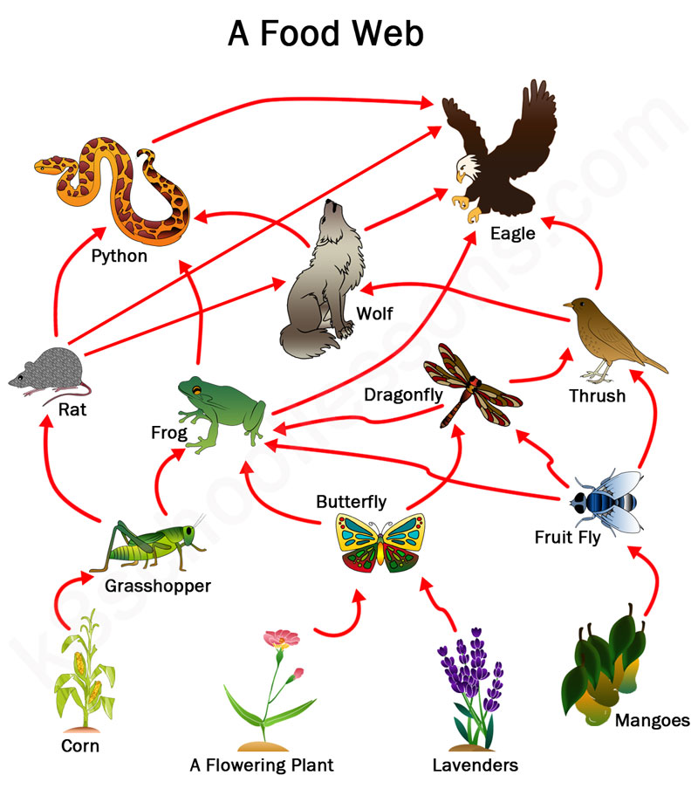
Threshold – Entrance - Teacher to stand on door threshold
Title: Ecosystems
Date: Friday 10th January
At the start of the lesson:
Greet at the classroom door
Wear your uniform with pride
Enter the classroom in silence
Books distributed calmly
Complete your do now in silence
Place your equipment on the desk
Do Now:
What is an ecosystem?
Draw a food web
Sit Up & Focus - Highest Quality Work - Interruption Free - Neat Work - Equipment

Slide 3
Year 11- B9
Prior Learning:
This Topic covers:
Future learning links:
Year 7- introduction to adaptations and natural selection
Year 8- Introduction to sampling techniques
Ecosystems
Energy transfer
Abiotic Factors and communities
Sampling- core practical
Biotic Factors and communities
Assessing pollution (H tier only)
Parasites and mutualists
Biodiversity and humans
Preserving biodiversity
Food security
The water cycle
The carbon cycle
The nitrogen cycle
Rates of decomposition
KS5- Recycling of materials in an ecosystem, sampling methods to determine population size, conservation of biological species
Careers:
Cellular biologist, microbiologist, doctor, nurse, vet, lab assistant, science teacher

Slide 4
Organisms needs resources to stay alive.
Plants need:
Light
Water
Carbon dioxide
Oxygen
Food
Water
Animals need:
Oxygen
Food
Water
Shelter

Slide 5
Groups of the same species of animal form populations within an ecosystem.
All the organisms and the environment in which they live form an ecosystem.
All the populations of organisms that live and interact in an ecosystem form a community.
Each population lives in a particular habitat within the ecosystem.

Slide 6
The animals and plants within an ecosystem all interact with each other and depend on each other for resources - they are interdependent.

Slide 7
Food Webs
We can show the feeding / interdependent relationships within a community using food webs.

Slide 8
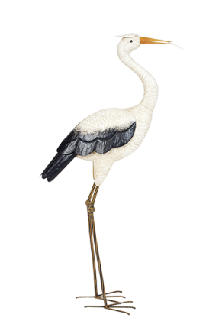
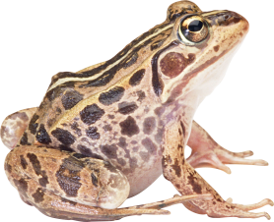
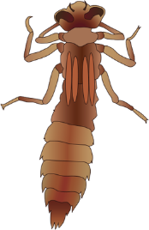
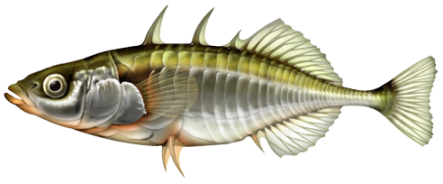
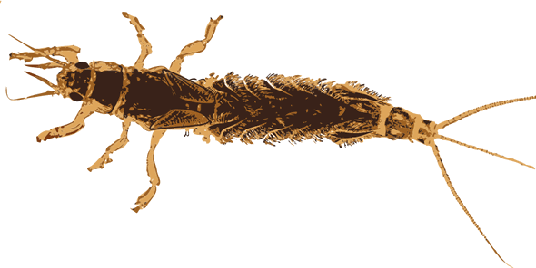
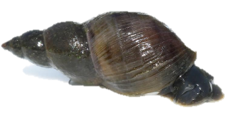
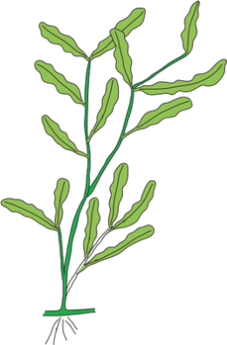
What are the producers in this food chain?
Heron
Common frog
Dragonfly larva
Stickleback
Mayfly larva
Pond snail
Microscopic animals and protists
Microscopic plants
Pondweed

Slide 9
What are the primary consumers / herbivores in this food chain?
Heron
Common frog
Dragonfly larva
Stickleback
Mayfly larva
Pond snail
Microscopic animals and protists
Microscopic plants
Pondweed

Slide 10
What are the secondary consumers / carnivores / predators in this food chain?
Heron
Common frog
Dragonfly larva
Stickleback
Mayfly larva
Pond snail
Microscopic animals and protists
Microscopic plants
Pondweed

Slide 11
What are the tertiary consumers / carnivores / predators in this food chain?
Heron
Common frog
Dragonfly larva
Stickleback
Mayfly larva
Pond snail
Microscopic animals and protists
Microscopic plants
Pondweed

Slide 12
What is the top predator in this food chain?
Heron
Common frog
Dragonfly larva
Stickleback
Mayfly larva
Pond snail
Microscopic animals and protists
Microscopic plants
Pondweed

Slide 13
Hinge Question
Groups of the same species of animal form a what?
Ecosystem
Community
Species
Population

Slide 14
Hinge Question
All the organisms and the environment in which they live form what?
Ecosystem
Community
Species
Population

Slide 15
Hinge Question
All the populations of organisms that live and interact in an ecosystem form a what?
Ecosystem
Community
Species
Population

Slide 16
1. What is an ecosystem?
2. What are biotic factors in an ecosystem?
3. What are abiotic factors in an ecosystem?
4. What is a food chain?
5. What is a food web?
6. What is the role of producers in an ecosystem?
7. What is the role of consumers in an ecosystem?
8. What is a decomposer?
9. What is the carbon cycle?
10. What is the nitrogen cycle?
11. What is biodiversity?
12. How do abiotic factors affect an ecosystem?
13. What is the energy flow in an ecosystem?
14. What is a trophic level?
15. What is the difference between a habitat and a niche?
16. How do invasive species affect ecosystems?
17. What is an example of a mutualistic relationship in an ecosystem?
18. What is the role of plants in an ecosystem?
19. What is an example of a carnivorous plant?
20. How does deforestation affect ecosystems?

Slide 17
1. What is an ecosystem?
Answer: An ecosystem is a community of living organisms interacting with each other and their physical environment (such as air, water, and soil) in a specific area.
2. What are biotic factors in an ecosystem?
Answer: Biotic factors are the living components of an ecosystem, such as plants, animals, bacteria, and fungi.
3. What are abiotic factors in an ecosystem?
Answer: Abiotic factors are the non-living components of an ecosystem, such as temperature, sunlight, water, soil, and air.
4. What is a food chain?
Answer: A food chain is a sequence of organisms, each of which is eaten by the next one in the chain. It shows the flow of energy through an ecosystem.
5. What is a food web?
Answer: A food web is a network of interconnected food chains, showing the complex feeding relationships within an ecosystem.
6. What is the role of producers in an ecosystem?
Answer: Producers (mainly plants and algae) use sunlight to make their own food through photosynthesis, forming the base of the food chain.
7. What is the role of consumers in an ecosystem?
Answer: Consumers are organisms that eat other organisms for energy. They can be herbivores (eat plants), carnivores (eat animals), or omnivores (eat both).
8. What is a decomposer?
Answer: A decomposer, like bacteria and fungi, breaks down dead organisms and waste products, recycling nutrients back into the ecosystem.
9. What is the carbon cycle?
Answer: The carbon cycle is the process by which carbon is exchanged between the atmosphere, oceans, soil, and living organisms. It involves processes like photosynthesis, respiration, and decomposition.
10. What is the nitrogen cycle?
Answer: The nitrogen cycle describes how nitrogen is converted into various chemical forms, moving between the atmosphere, soil, plants, and animals, involving processes like nitrogen fixation and denitrification.

Slide 18
11. What is biodiversity?
Answer: Biodiversity refers to the variety of living organisms in an ecosystem, including different species, genes, and ecosystems themselves.
12. How do abiotic factors affect an ecosystem?
Answer: Abiotic factors such as temperature, light, and water availability influence the types of organisms that can live in an ecosystem and their distribution.
13. What is the energy flow in an ecosystem?
Answer: Energy flows through an ecosystem in one direction, starting with producers (plants) and moving through consumers and decomposers. Energy is lost at each trophic level, mostly as heat.
14. What is a trophic level?
Answer: A trophic level is a position in the food chain or food web, such as primary producer, primary consumer, secondary consumer, etc.
15. What is the difference between a habitat and a niche?
Answer: A habitat is the physical place where an organism lives, while a niche is the role or function an organism performs in an ecosystem, including how it gets food and interacts with other organisms.
16. How do invasive species affect ecosystems?
Answer: Invasive species can disrupt ecosystems by outcompeting native species for resources, spreading diseases, or causing changes in the habitat, often leading to a decline in biodiversity.
17. What is an example of a mutualistic relationship in an ecosystem?
Answer: An example of mutualism is the relationship between bees and flowers. Bees get nectar from flowers, while flowers get pollinated by bees.
18. What is the role of plants in an ecosystem?
Answer: Plants are producers that capture solar energy through photosynthesis, provide oxygen, and form the base of the food chain, supporting herbivores and other organisms.
19. What is an example of a carnivorous plant?
Answer: An example of a carnivorous plant is the Venus flytrap, which captures and digests insects to obtain nutrients.
20. How does deforestation affect ecosystems?
Answer: Deforestation can destroy habitats, reduce biodiversity, increase carbon dioxide levels, and disrupt the balance of ecosystems by removing plants and animals that depend on forests.
These questions cover a broad range of topics related to ecosystems, making them ideal for GCSE revision or assessment.

