Slide 1
Threshold – Entrance - Teacher to stand on door threshold
Title: What was the Cuban Revolution?
Date: 9 January, 2025
At the start of the lesson:
Greet at the classroom door
Wear your uniform with pride
Enter the classroom in silence
Books distributed calmly
Complete your do now in silence
Place your equipment on the desk
The name of the speech made by Winston Churchill claiming the Soviet Union were dividing the word.
The plan that offered small European countries money to not turn to communism.
The Soviet Union's version of financial aid which also offered money to countries to turn them to communism.
The capitalist alliance created by USA in 1949
The Communist alliance created by the Soviet Union in 1955
Sit Up & Focus - Highest Quality Work - Interruption Free - Neat Work - Equipment

Slide 2
Threshold – Entrance - Teacher to stand on door threshold
Title: What was the Cuban Revolution?
Date: 9 January, 2025
At the start of the lesson:
Greet at the classroom door
Wear your uniform with pride
Enter the classroom in silence
Books distributed calmly
Complete your do now in silence
Place your equipment on the desk
The name of the speech made by Winston Churchill claiming the Soviet Union were dividing the world: Iron Curtain Speech.
The plan that offered small European countries money to not turn to communism: Marshall Plan.
The Soviet Union's version of financial aid which also offered money to countries to turn them to communism: Molotov Plan.
The capitalist alliance created by the USA in 1949: NATO (North Atlantic Treaty Organization).
The Communist alliance created by the Soviet Union in 1955: Warsaw Pact.
Sit Up & Focus - Highest Quality Work - Interruption Free - Neat Work - Equipment

Slide 3
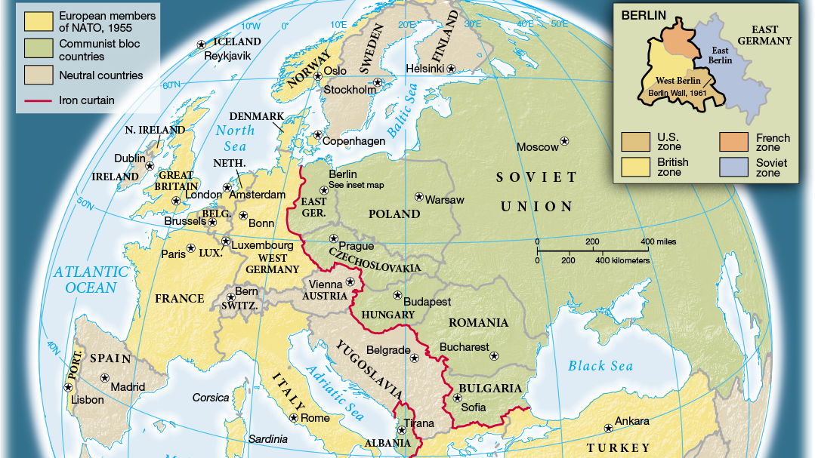

Slide 4
Why would USA and capitalism be concerned about Cuba?

Slide 5
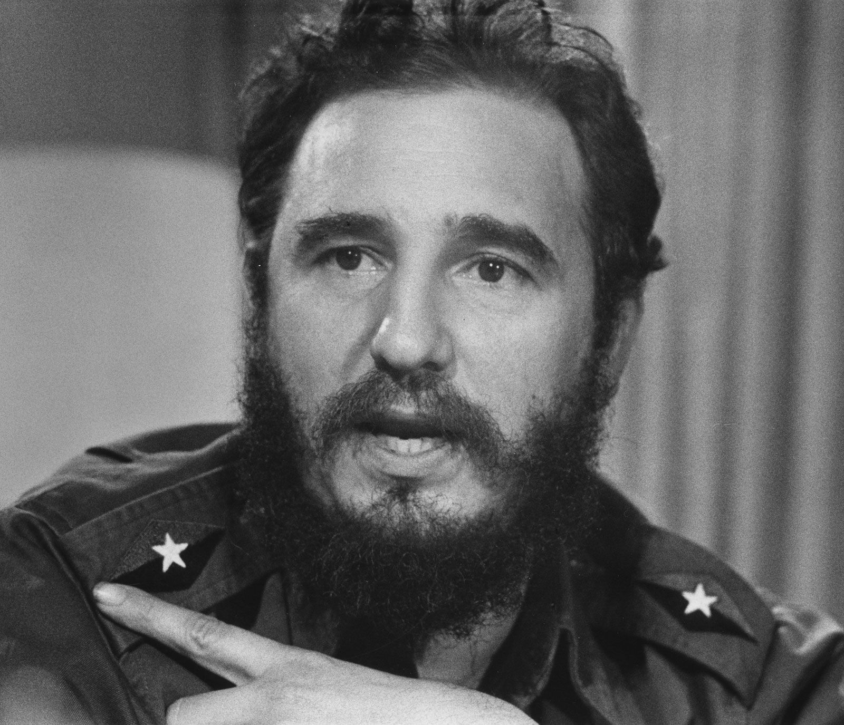
What happened in the Cuban Revolution?
The Cuban Revolution, led by Fidel Castro, saw him and his followers overthrow the dictator Fulgencio Batista in 1959 after a long struggle. After taking power, Castro's government turned to communism, which created tension with the United States, especially since Cuba was only 145 kilometers away. In response, the U.S. refused to buy Cuban sugar, a key part of the country's economy, which pushed Castro to seek help from the Soviet Union. Russia stepped in and began buying Cuban sugar, helping to support the island’s economy. This further deepened the divide between Cuba and the U.S., leading to years of tension between the two nations.

Slide 6
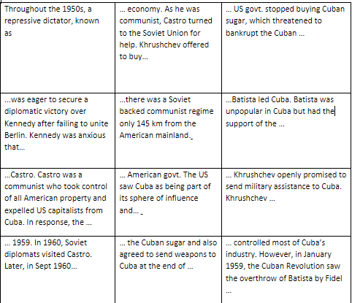
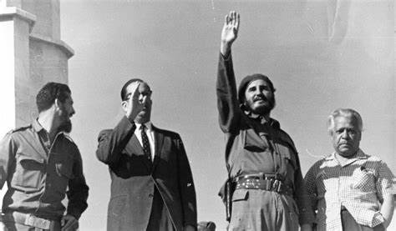
Number each card in the correct order to show the events of the Cuban Revolution
1
12
Lucere Aude
Turn to the back of your book. Can you create a timeline of events without the information sheet?
How would the world react to this event?
Compare this revolution to other events we have learned about. Is this the most significant moment? Explain why.

Slide 7
Number each card in the correct order to show the events of the Cuban Revolution
1
7
6
2
11
12
Lucere Aude
Turn to the back of your book. Can you create a timeline of events without the information sheet?
How would the world react to this event?
Compare this revolution to other events we have learned about. Is this the most significant moment? Explain why.
5
3
10
9
8
4

Slide 8
In 3 sentences, describe the events of the Cuban Revolution. Try to use the words below.
1
7
6
2
11
12
Batista
Overthrow
Castro
145Km
Kennedy
Sugar
Military assistance
Capitalism
Tension
5
3
10
9
8
4

Slide 9
Which of the statements below best describes the impact of the Cuban Revolution?
Batista had become ruler of Cuba after the revolution so USA felt threatened that a Communist leader was so close to its own country. USA feared the Soviet Union could use Cuba to invade USA and communism had successfully spread.
The Cuban people supported a Communist revolution and would likely try to invade USA, USA would have to act immediately and potentially increase its arms.
Fidel Castro could now act as a puppet for Khrushchev and the Soviet Union potentially giving them access to the USA for an invasion. USA felt highly threatened as Communism had spread further than Eastern Europe

Slide 10
Was the Cuban Revolution significant to the development of the Cold War?
Hugely Significant
Insignificant
1 2 3 4 5 6 7 8 9 10
Describe the events of the Cuban Revolution.
Analyse how the USA retaliated to the revolution.
Evaluate how important the Cuban revolution and the Bay of Pigs was to development of the cold war.

