Slide 1

Component 1:Devising
Question One

Slide 2
Component 1: Devising
40% of qualification - 60 marks for performance(15marks) and portfolio (45marks)
There are 6 portfolio questions in total and we are going to focus on Question 1 today
Q1: What was your initial response to the stimuli and what were the intentions of the piece?

Slide 3
Q1: What was your initial response to the stimuli and what were the intentions of the piece?
Sentence starters below for each paragraph:
-The first stimulus I explored was...
-Stimulus one was...
-Initially I explored stimulus one which was...
You would use a different sentence starter then when discussing Stiumlus 2 & 3.
Each paragraph should be detailed & explore each stimulus in depth. Your thoughts, ideas, emotions/how it made you feel, what techniques you could use/ what impact it would have on the audience and how it links with your artistic intention.

Slide 4
Mrs Quinn's Example:
The first stimulus that I explored in lesson was a collage of 3 images that I believe, all somehow were referring to mental health and how many external factors can lead to poor mental health. One image was an umbrella with a neurodiversity tag written along the top which suggested to me that there are a multitude of needs every person could have which may lead to them needing specialist support with learning at school or actioning daily tasks in everyday life but that the umbrella is symbolic of the recognition of those neurodiverse needs and that everyone is not left out and is kept safe & 'dry' with support that is out there through schools, local authorities and GPs.

Slide 5
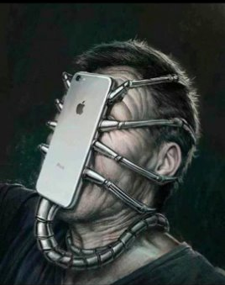
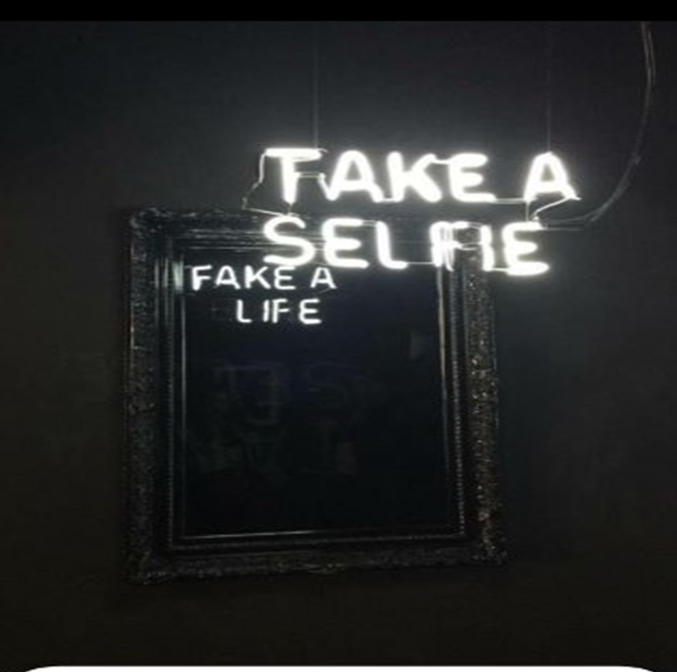

Stimuli 1: Images

Slide 6
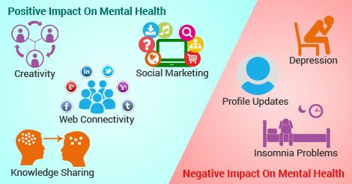

Stimuli 2: Social Media

Slide 7
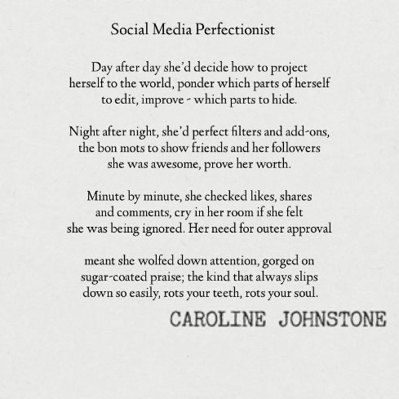
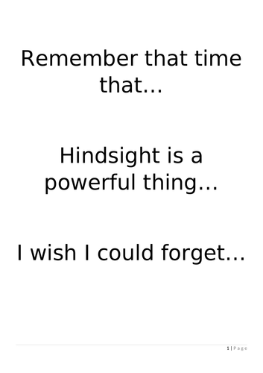
Stimuli 3: Poem

Slide 8
Task: To complete Question 1 for your devised piece
Using Mrs Quinn's example please write up your answer for question one individual and speak in the first person when doing so (I, me)
Write about all 3 stimuli you explored and your response to it commenting on how you came to the final decision of your current piece.
If you have any questions, drop me or Mrs Foulder an email :)

