Slide 1


Lesson 17:
Area and perimeter of rectilinear and compound shapes
Level 2
Objectives
Explore the area and perimeter of squares, rectangles, triangles and compound shapes
Understand the concepts of area and perimeter and use them in a range of problem-solving situations

Slide 2



Three gardens
Handout
available
A farmer has three rectangular vegetable gardens.
Garden A
15 m × 7 m
Garden B
15 m × 8 m
Garden C
16 m × 7 m
Ruby
Garden A is the smallest because it has the smallest length and width.
Garden C is the biggest as it is the longest. 16 m is longer than 15 m.
Dev
Discuss their reasoning without calculating the area of the gardens.
Notes:
Ask learners to work in pairs. Give learners the ‘Three gardens’ handout to help them visualise.
Give learners a few minutes to discuss Dev and Ruby’s statements. Learners should not use a calculator and should not work out the area of each garden but should consider the effect of increasing the width and the length respectively.
The purpose of the task is to get the learners to understand that area of rectangles is two-dimensional and that changes to each dimension can change the area. The handout reinforces this idea and deepens understanding as the learners can see the number of squares in the rows and columns.

Slide 3
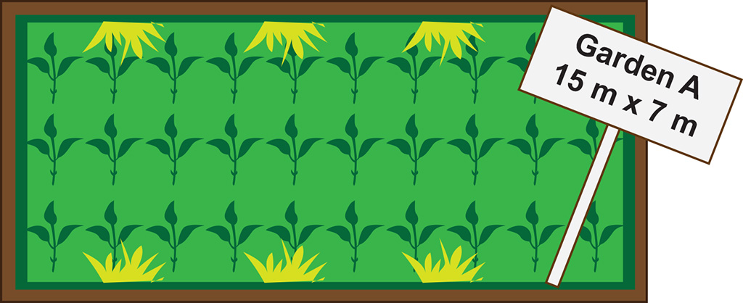
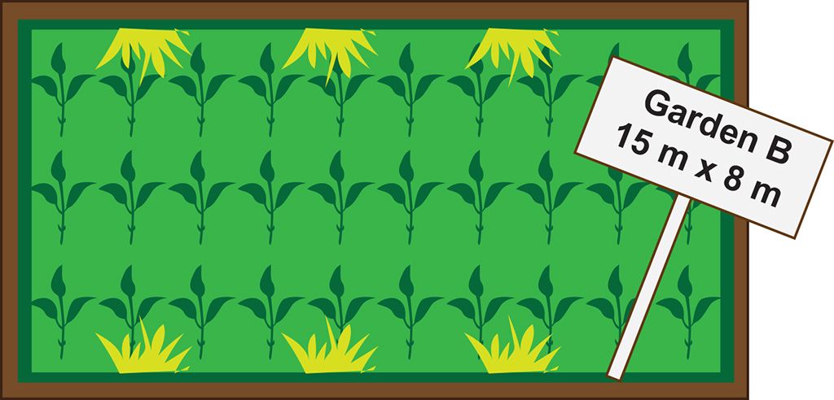
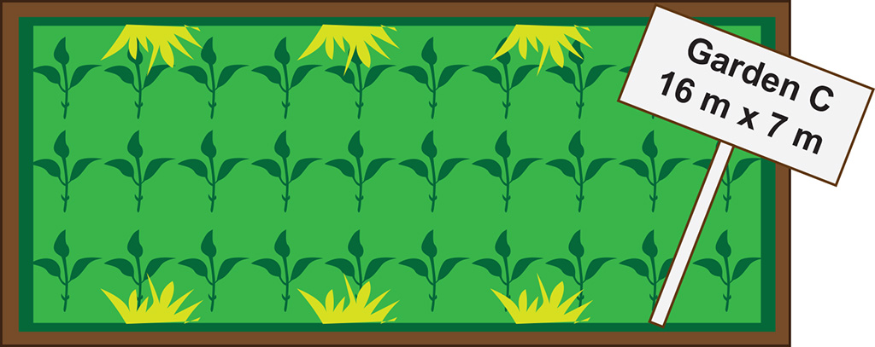
Three gardens (answers)
Garden A has the smallest length and width.
Garden B is 1 metre wider than Garden A. It is 15 m² bigger than Garden A.
1 x 15
1 x 7
Garden C is 1 metre longer than Garden A. It is only 7 m² bigger than A. It is smaller than Garden B.
Notes:
Ask a few pairs to suggest whether Ruby and Dev are correct and share what methods they use to decide.
Use the slide to show a visual of how changing the length and the width by one meter will affect the area.
The part shaded green helps to show how area is measured, reinforcing that it is the area inside a shape and for rectangles is made up of columns/rows (hence counting squares is a method of working out the area of a rectangle).

Slide 4

Area and factors
DISCUSS
Handout
available
Use dot paper to draw as many different rectangles as you can with an area of 24 units.
What is the length and width of each rectangle?
The factors of 24 are 1, 2, 3, 4, 6, 8, 12 and 24.
The side lengths are factor pairs of 24.
24 × 1
12 × 2
6 × 4
8 × 3
Dev
Notes:
Ask learners to work individually to draw as many rectangles as they can with an area of 24 units.
Get learners to share how many rectangles they could draw and what they noticed about the rectangles and their dimensions.
Prompt the learners to think about the dimensions of the rectangles.
Use the slide to show some factor pairs that give an area of 24 units.
It is important to use the term ‘factors’ and make the link between factor pairs and dimensions clear.
Note that some learners may have drawn their rectangles in the vertical orientation. Emphasise that these give the same area and have the same dimensions.
Mention perimeter again and highlight the difference between the perimeter and area of a rectangle.
The purpose of this activity is for the learners to understand that a rectangle with a constant area can be made using rectangles with different dimensions (pairs of factors).

Slide 5
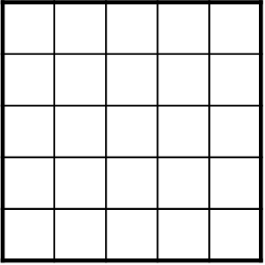
Area and square numbers
DISCUSS
What are the dimensions of a square with an area of 25 cm²?
Square numbers:
1, 4, 9, 16, 25, 36, 49, 64, 81, 100 ...
5
5
25 is the fifth square number.
The square root of 25 is 5.
The length of the square’s side is 5 cm.
Area = 5²
Area = 25
Ruby
Notes:
Remind learners about the concept of square numbers. Explain how they can find the dimensions of a square by finding the square root of its area.

Slide 6
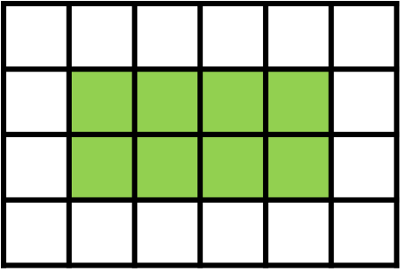
DISCUSS
Finding perimeter by counting
1 cm
Dev thinks the perimeter of the green shaded shape is 16 cm.
1 cm
1
2
3
4
12
5
11
6
Ruby thinks the perimeter of the green shaded shape is 12 cm.

10
9
8
7
Perimeter = 12 cm
Carlos thinks the perimeter of the green shaded shape is 8 cm.
Who is correct?
What do you think the others did wrong?
Notes:
Ask learners to consider the statements and decide who is correct and what the others did wrong.
Ask learners to explain their reasoning and state the misconceptions that Dev and Carlos held.
Dev has made the common mistake of counting the squares around the rectangle (including those 4 extra corner squares).
Carlos has worked out the area instead of the perimeter.

Slide 7

Perimeter
KEY IDEA
The perimeter of a shape is the sum of the lengths of each side.
P = 3 + 4 + 3 + 4
= 14
The perimeter of the rectangle is 14 cm.
3 cm
4 cm
Notes:
Highlight the method for finding perimeter. Remind learners it is something they will need to memorise. Use the slide to demonstrate how to calculate perimeter.

Slide 8
Area
KEY IDEA
Area of a rectangle = base × height
height (h)
base (b)
Notes:
Highlight the formula for the area of a rectangle. Remind learners it is something they will need to memorise. Some tutors or learners may use the terms ‘length’ and ‘width’. Make it clear that ‘base’ and ‘width’ refer to the same thing and the terminology is not what is important. Base and height were used so they correlated with the terminology in the formula for the area of a triangle.

Slide 9
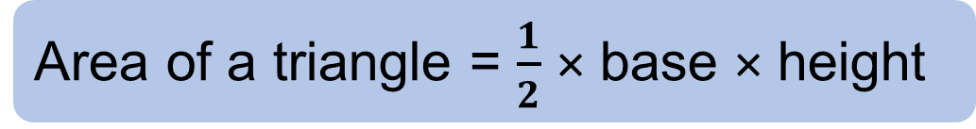
Rectangles and triangles
Area of a rectangle = base × height
The diagonal of a rectangle splits the rectangle into two congruent triangles.
Compare the area of each triangle to the area of the rectangle. What do you notice?
How can we use this to find the formula for the area of a triangle?
height
base
Area of a triangle = $\frac{1}{2}$ × base × height
Notes:
Use the slide to show a rectangle split into two triangles. Use prompts to guide learners to figure out that the area of each triangle is half the area of the rectangle. They can use this to derive the area of a triangle.

Slide 10
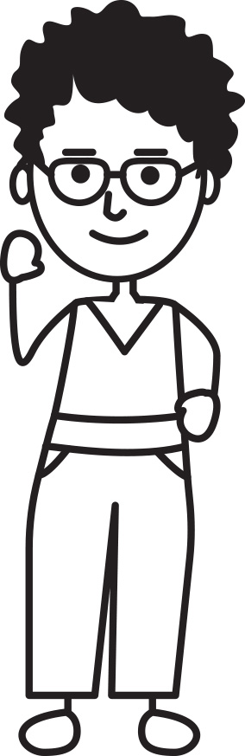

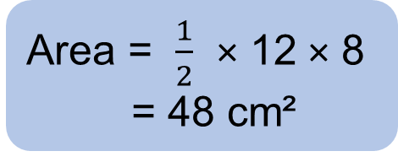
DISCUSS
What is the area of the triangle?
I think the area is 96 cm².
I think the area is 60 cm².
Ruby
10 cm
8 cm
Dev
I think the area is 960 cm².
I think the area is 48 cm².

Zac
12 cm
Florence
Area = $\frac{1}{2}$ × 12 × 8
= 48 cm²
Who is correct?
What do you think the others did wrong?
Notes:
Ask learners to check each character’s answer. Ask learners to work out what mistakes were made by the characters who gave incorrect answer. Discuss the misconceptions in each of the incorrect answers.
Ruby – forgot to halve.
Dev – used a side length which was not the height.
Zac – multiplied all sides together. May have mixed in an incorrect perimeter method.

Slide 11

Area of a triangle
KEY IDEA
The area of a triangle = $\frac{1}{2}$ × base × height
height (h)
height (h)
base (b)
base (b)
Notes:
Teacher to highlight the formula for the area of a triangle, remind students it is something they will need to remember. Highlight that the height needs to be the perpendicular height, from the vertex to the opposite side.

Slide 12
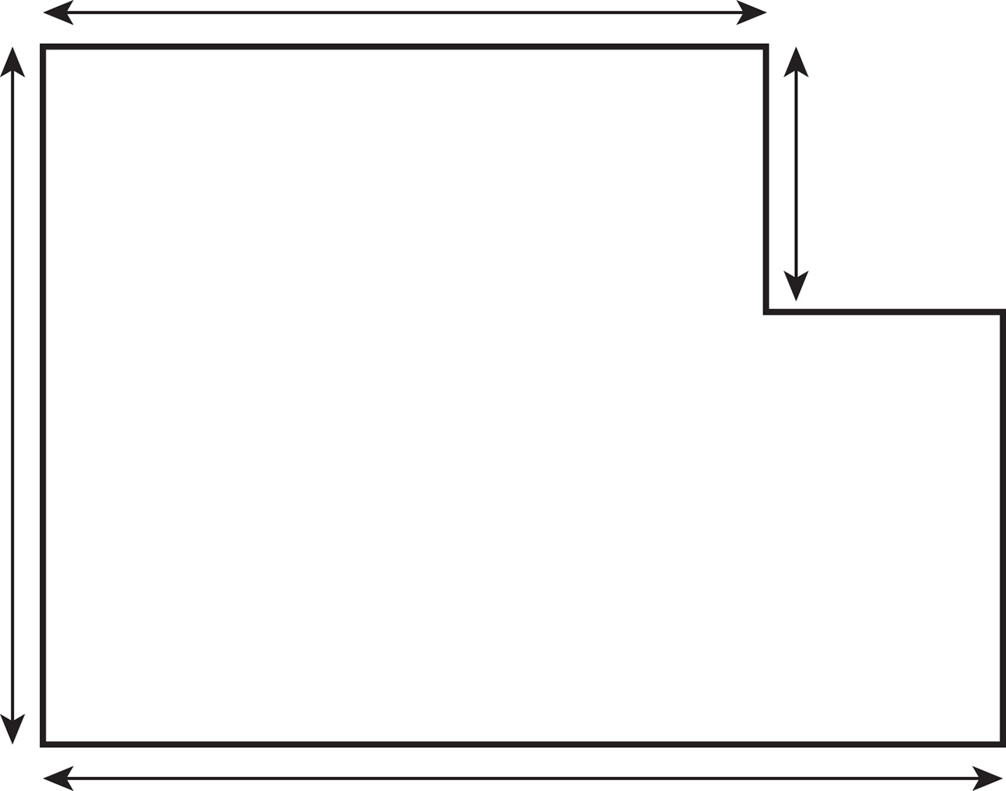
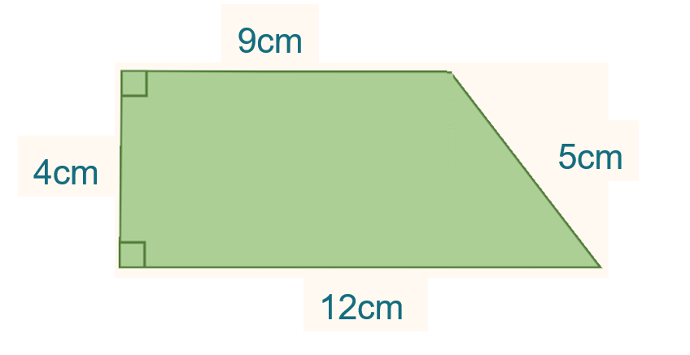
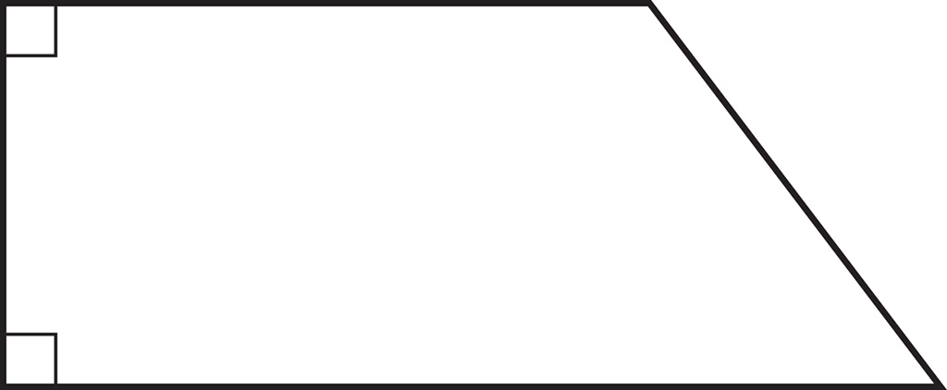
Area of compound shapes
EXPLORE
Handout
available
Find the area of the compound shapes.
a)
b)
9 cm
9 cm
4 cm
4 cm
5 cm
10 cm
12 cm
12 cm
Notes:
Ask learners to work in pairs to work out the area of each shape. Some may not know how to calculate the area of a triangle but encourage them to try, focusing on what they can do. For example, could they split the shape? Remind learners that these questions will be worth a few marks and that they can get some marks for correct steps, even if they don’t answer the whole question.
Tell learners that they will be discussing methods so make sure they have worked together and have drawn the shapes.
Ask pairs to come to the board to show how they found the area of the shape.
Ask a pair who used a different method to come up and show their method. Try to find responses using all 3 methods for the first shape. Once a method has been shown, check which other pairs used the same method.
Repeat for the second shape. For the second shape learners could use the formula for the area of the trapezium but the aim is to give them tools to answer questions on compound shapes rather than remember formulae.

Slide 13
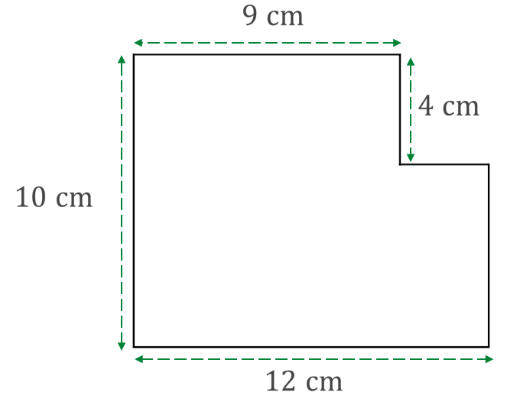
Methods 1 and 2 for (a)
EXPLORE
Handout
available
Method 1
Method 2
9 cm
9 cm
A₁ = 9 × 4
A₁ = 36 cm²
Or
4 cm
4 cm
A₁ = 9 × 10
A₁ = 90 cm²
10 cm
10 cm
A₂ = 12 × 6
A₂ = 72 cm²
A₂ = 3 × 6
A₂ = 18 cm²
12 cm
12 cm
Total area
= 36 cm² + 72 cm²
= 108 cm²
Total area
= 90 cm² + 18 cm²
= 108 cm²
Notes:
This is an optional slide to review two of the three different methods, step by step.

Slide 14
Method 3 for (a)
EXPLORE
Handout
available
Or
Method 3
9 cm
A₂ = 3 × 4
A₂ = 12 cm²
A₂
4 cm
A₁ = 12 × 10
A₁ = 120 cm²
10 cm
Total area
= 120 cm² – 12 cm²
= 108 cm²
12 cm
Notes:
This is an optional slide to review two of the three different methods, step by step.

Slide 15
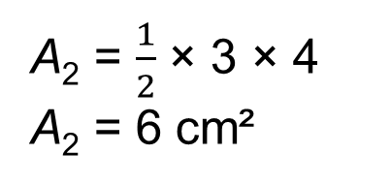
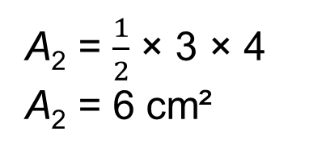
Methods 1 and 2 for (b)
EXPLORE
Handout
available
Method 1
Method 2
9 cm
9 cm
A₁ = 9 × 4
A₁ = 36 cm²
A₂
5 cm
A₁ = 12 × 4
A₁ = 48 cm²
4 cm
4 cm
A₂
12 cm
3 cm
12 cm
A₂ = $\frac{1}{2}$3 × × 4
A₂ = 6 cm²
Total area
= 36 cm² + 6 cm²
= 42 cm²
A₂ = $\frac{1}{2}$ × 3 × 4
A₂ = 6 cm²
Total Area
= 48 cm² – 6 cm²
= 42 cm²

Slide 16
Area of compound shapes
KEY IDEA
To find the area of a compound shape:
split the shape into smaller shapes that you are familiar with
calculate the area of each smaller shape
add the areas of all the smaller shapes
Notes:
Reinforce the process of finding the area of a compound shape. Explain that ‘familiar’ shapes can be rectangles, squares, triangles, circles or part of a circle.

Slide 17

Crowd capacity
EXPLORE
Handout
available
An event company is looking for a venue for a music event.
Each venue can safely fit a maximum of 3 people per 1 m².
Tickets for the event are £30 each.
The company wants to make as much money as possible while ensuring safety.
Notes:
Guide learners to see that the crowd capacity is affected by the area of venue. Give other types of common problems about area in exams: ‘How many tins of paint are required to paint the wall…’, ‘How many tiles…’. Highlight that these types of questions often involve finding an area or perimeter and then using that measure to work out something practical like how much of a material is needed, costs, etc.

Slide 18
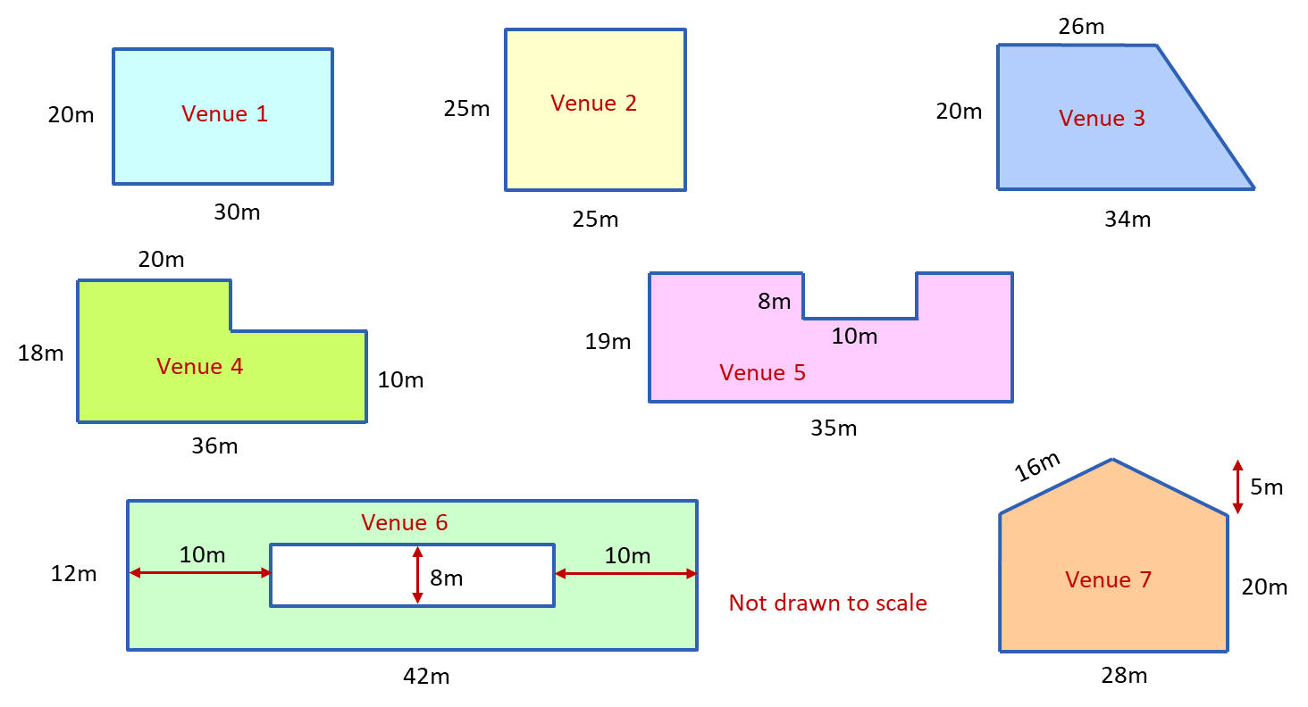
Which venue?
YOUR TURN
Handout
available
To make the greatest amount of money possible, which venue should the company choose? How much will the company earn?
Notes:
Ask learners to work in pairs to calculate the area of each venue and complete the table in the handout.
Some potential prompts:
Can you split the shapes?
Can you find any missing lengths or dimensions?
What do you need to find the area of a square / rectangle / triangle? Check the formula if you have forgotten.
Once learners have worked out the area of each venue, they should choose the venue with the largest area and work out how much income the company will get from that venue.
Ask one pair to share their method for finding the area of each shape. Ask the pair to explain how they found any ‘missing’ dimensions.
Emphasise that these questions are multi-mark questions and reinforce the importance of trying to do at least some of the steps for each of the questions to get as many marks as possible.

Slide 19
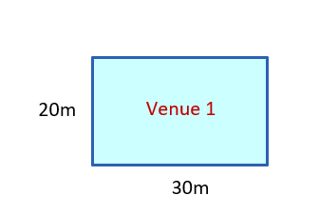
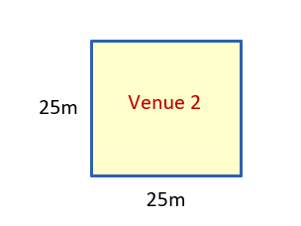


Area of Venue 1 and Venue 2
REVIEW
Venue 1
Venue 2
Area of Venue 1
= 20 × 30
= 600 m²
Area of Venue 2
= 25 × 25
= 625 m²

Slide 20
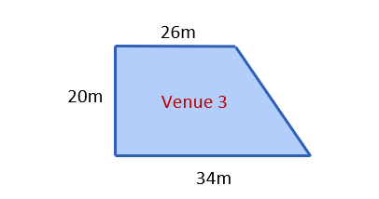
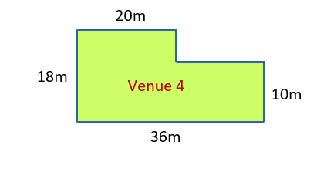


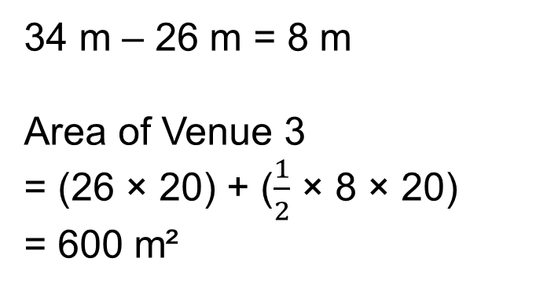
Area of Venue 3 and Venue 4
REVIEW
Venue 3
Venue 4
34 m – 26 m = 8 m
Area of Venue 3
= (26 × 20) + ($\frac{1}{2}$ × 8 × 20)
= 600 m²
36 m – 20 m = 16 m
Area of Venue 4
= (20 × 18) + (16 × 10)
= 520 m²

Slide 21
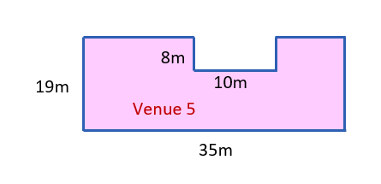
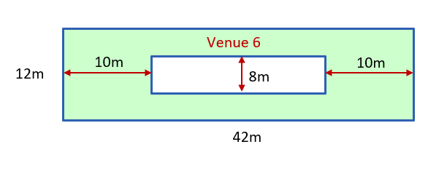

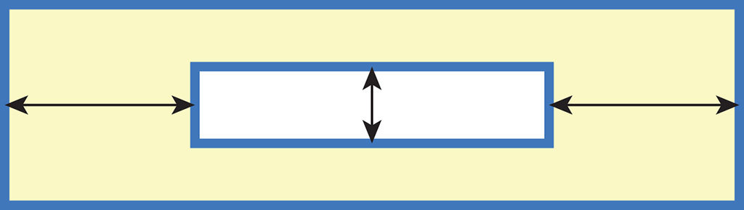
Area of Venue 5 and Venue 6
REVIEW
8m
10m
10m
10m
8m
Venue 5
Venue 6
42 m – 10 m – 10 m = 22 m
Area of Venue 6
= (42 × 12) – (8 × 22)
= 328 m²
Area of Venue 5
= (35 × 19) – (10 × 8)
= 585 m²
Notes:
There are alternatives to the calculation methods shown on the slide – most notably adding up the areas of composite rectangles. Make sure these methods are discussed and validated.

Slide 22
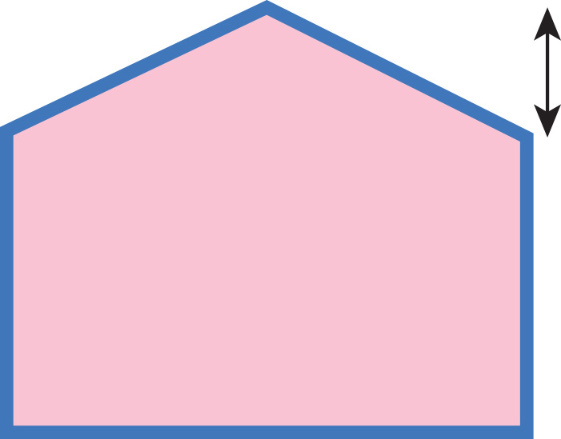
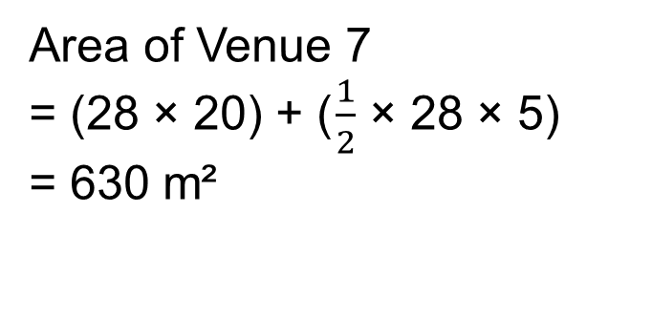
Area of Venue 7
REVIEW
Venue 7 has the biggest area.
Therefore, it can fit the greatest number of people and give the greatest income.
There can be 3 people per 1 m².
630 × 3 = 1890
Tickets are £30 each.
1890 × £30 = £56 700
The company can earn £56 700.
16m
16 m
5 m
Venue 7
Venue 7
20 m
28 m
Area of Venue 7
= (28 × 20) + ( $\frac{1}{2}$ × 28 × 5)
= 630 m²

Slide 23
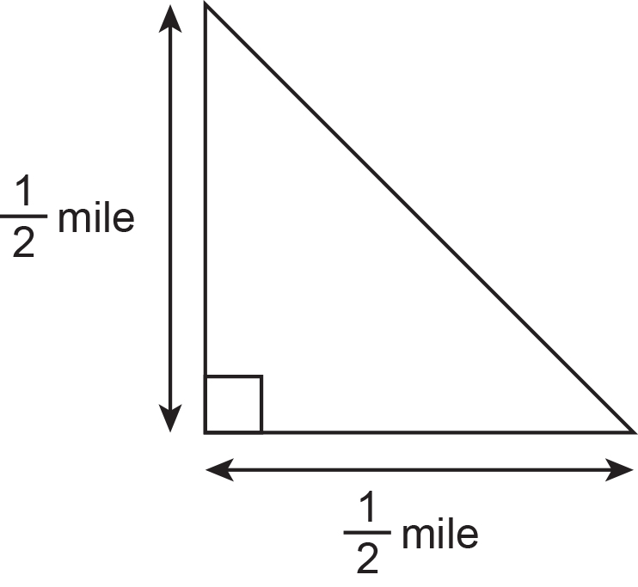
FS exam question guidance/tips
Worksheet
available
Underline key words
Usha is a local councillor.
She wants to write about a new housing development.
The diagram shows the space for the new development.
Remember units!
Usha thinks that the area of the development will be greater than the total area of 50 football pitches.
Usha knows
• a football pitch is rectangular 100 m by 50 m
• 1 mile = 1600 m
Would a sketch help?
Have you answered the question?
Is your answer realistic? Check it.
Will the area of the development be greater than the total area of 50 football pitches?
(5 marks)
Use reverse calculations to show a check for your answer.
(1 mark)
Look at the marks – gives an indication of how many steps are required.
Notes:
Tutor to go through tips and exam guidance pointing out stages when these could be applied.

Slide 24
FS exam guidance: Reverse calculations
Reverse calculations are used in functional skills maths to check answers.
This can be either carrying out reverse operation or estimating your answer.
Reverse calculation example:
Calculation could be 12 × 8 = 96
Reverse check would be 96 ÷ 8 = 12
Look out for checks. They come at the end of the question.
You need to do the opposite/inverse.
Notes:
Tutor to go through the tips and exam guidance pointing out stages when these could be applied.

Slide 25
Practice question 1
PRACTICE QUESTION
Worksheet
available
Usha is a local councillor.
She wants to write about a new housing development.
The diagram shows the space for the new development.
Usha thinks that the area of the development will be greater than the total area of 50 football pitches.
Usha knows
• a football pitch is rectangular 100 m by 50 m
• 1 mile = 1600 m
Will the area of the development be greater than the total area of 50 football pitches?
Use reverse calculations to show a check for your answer.
Notes:
Tutor to give learners the choice of 2 questions to answer from the 3 (or all 3 if time allows). The questions are of varying difficulty.
Tutor to highlight exam tips:
Underline key information (mainly mathematical words – area, volume, percentage, etc.)
Can you use your calculator to help you? Do you know how to use your calculator?
Look at marks awarded – could link to the number of steps needed in the answer.
Check work – is it asking for reverse check or estimation?
Look at units in the question, as they give clues if it is asking for area, perimeter or volume.
Make sure you answer the question (Yes or no, possibly with a sentence. E.g. ‘Yes, she has enough money to buy…’)
Emphasise how important it is to look at the units used in a question and explain that full marks will not be awarded if units are missing.

Slide 26
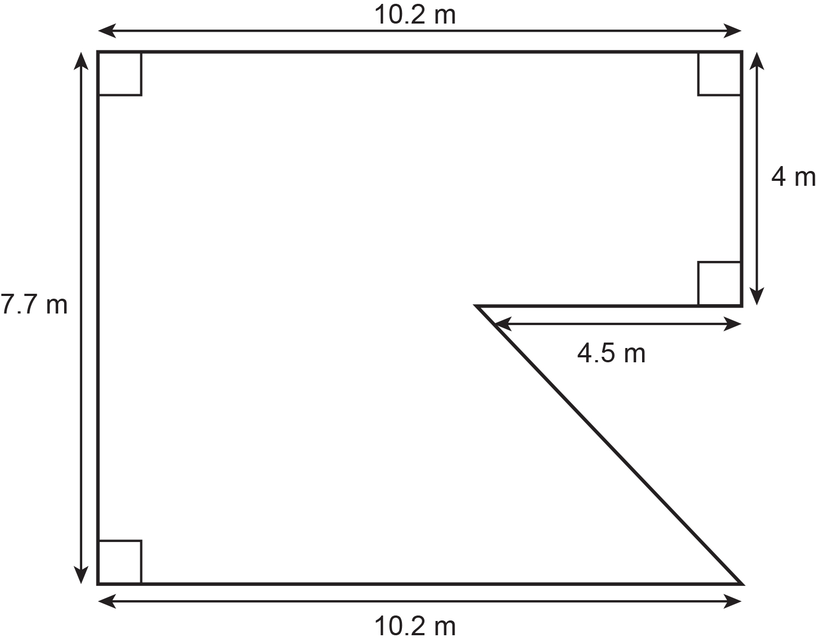
Practice question 2
PRACTICE QUESTION
Worksheet
available
Maninder is the manager of a restaurant.
She wants to cover the floor of the restaurant with tiles.
This is a plan of the floor of the restaurant.
Maninder will buy the tiles in packs.
Each pack covers an area of 0.945 m².
One pack of tiles costs £16.15
Tiles can be cut and joined.
Work out the total cost of the packs of tiles Maninder will buy.
Notes:
Tutor to reinforce to the class that this question is a 6-mark question so there are various opportunities to get marks.
Learners to think about all possible ways to get marks: draw sketches, find missing lengths, work out the area of any part of the shape, etc.
Tutor to explain about follow through marks.
FTM enable the Learners to get marks for working done later in the question, even if their first answer is incorrect.
Encourage learners to highlight key words and information in the question so they understand exactly what is being asked.
Make sure you answer the question (Yes or no, possibly with a sentence. E.g. ‘Yes, she has enough money to buy…’)

Slide 27
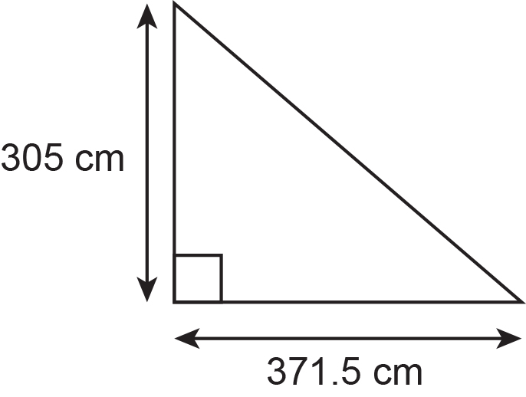
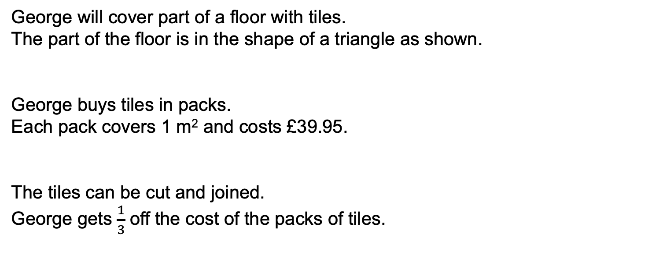
Practice question 3
PRACTICE QUESTION
Worksheet
available
George will cover part of a floor with tiles.
The part of the floor is in the shape of a triangle as shown.
George buys tiles in packs.
Each pack covers 1 m² and costs £39.95.
The tiles can be cut and joined.
George gets $\frac{1}{3}$ off the cost of the packs of tiles.
Work out the lowest cost of the tiles for George.
Notes:
Tutor to reinforce to the class that this question is a 5-mark question so there are various opportunities to get marks.
Learners to think about all possible ways to get marks: draw sketches, find missing lengths, work out the area of any part of the shape, etc. Tutor to explain about follow through marks.
FTM enable the Learners to get marks for working done later in the question, even if their first answer is incorrect. Encourage Learners to highlight key words and information in the question so they understand exactly what is being asked.

Slide 28
Practice question 1 – mark scheme
Worksheet
available
PEARSON EDEXCEL FUNCTIONAL SKILLS MATHEMATICS − SEPTEMBER 2019
MARK SCHEME − LEVEL 2
Question | Process | Mark | Mark Grid | Evidence
Q4(a) | Process to convert to metric Process to work out area of development Process to find area of a football pitch Full process to find figures to compare Valid decisions with accurate figures | 1 1 1 1 or 2 | A B C D DE | e.g. 1600 ÷ 2 (= 800) e.g. × '800' × '800’ (= 320 000) or 0.5 × 0.5 ÷ 2 (= 0.125) 100 × 50 (= 5000) oe e.g. 50 × '5000' (=250 000) OR ‘320 000' ÷ '5000’ (= 64) Yes AND 320 000 (m²) and 250 000 (m²) Yes AND 64
Q4(b) | Valid check | 1 | F | e.g. '250 000' ÷ 50 = 5000 and '320 000' ÷ 800 = 4000
Total marks for question |  | 6

Slide 29


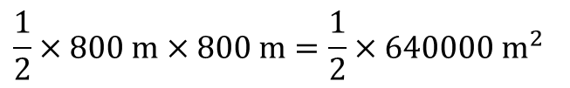
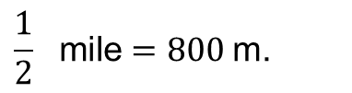
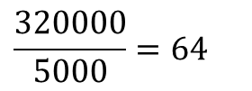
Practice question 1 – answer to (a)
PRACTICE QUESTION
Worksheet
available
Usha is a local councillor.
She wants to write about a new housing development.
The diagram shows the space for the new development.
(a) Will the area of the development be greater than the total area of 50 football pitches?
$$\frac{1}{2} \text{mile}=800 \text{m}\text{.}$$
$$\frac{1}{2}×800 m×800 m=\frac{1}{2}×640000 m^{2}$$
(Area available).
$$=320000{ m}^{2}$$
$$50 m×100 m=5000{ m}^{2}$$
(football pitch).
Usha thinks that the area of the development will be greater than the total area of 50 football pitches.
Usha knows
• a football pitch is rectangular 100 m by 50 m
• 1 mile = 1600 m.
$$\frac{320000}{5000}=64$$
Yes, it will be larger.
Yes.
Notes:
Tutor to give learners the choice of 2 questions to answer from the 3 (or all 3 if time allows). The questions are of varying difficulty.
Tutor to highlight exam tips:
Underline key information (mainly mathematical words – area, volume, percentage, etc.)
Can you use your calculator to help you? Do you know how to use your calculator?
Look at marks awarded – could link to the number of steps needed in the answer.
Check work – is it asking for reverse check or estimation?
Look at units in the question, as they give clues if it is asking for area, perimeter or volume.
Make sure you answer the question (Yes or no, possibly with a sentence. E.g. ‘Yes, she has enough money to buy…’)
Emphasise how important it is to look at the units used in a question and explain that full marks will not be awarded if units are missing.

Slide 30
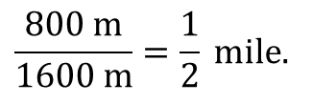



Practice question 1 – answer to (b)
PRACTICE QUESTION
Worksheet
available
Usha is a local councillor.
She wants to write about a new housing development.
The diagram shows the space for the new development.
(b) Use reverse calculations to show a check of your answer.
$$64×50×100=320000$$
$$320000×2=640000$$
$$640000=800 m×800 m$$
$$\frac{800 m}{1600 m}=\frac{1}{2} \text{mile}\text{.}$$
Usha thinks that the area of the development will be greater than the total area of 50 football pitches.
Usha knows
• a football pitch is rectangular 100 m by 50 m
• 1 mile = 1600 m.
Notes:
Tutor to give learners the choice of 2 questions to answer from the 3 (or all 3 if time allows). The questions are of varying difficulty.
Tutor to highlight exam tips:
Underline key information (mainly mathematical words – area, volume, percentage, etc.)
Can you use your calculator to help you? Do you know how to use your calculator?
Look at marks awarded – could link to the number of steps needed in the answer.
Check work – is it asking for reverse check or estimation?
Look at units in the question, as they give clues if it is asking for area, perimeter or volume.
Make sure you answer the question (Yes or no, possibly with a sentence. E.g. ‘Yes, she has enough money to buy…’)
Emphasise how important it is to look at the units used in a question and explain that full marks will not be awarded if units are missing.

Slide 31
Practice question 2 – mark scheme
Worksheet
available
PEARSON EDEXCEL FUNCTIONAL SKILLS MATHEMATICS
MARK SCHEME − LEVEL 2 SET 3
Question | Process | Mark | Mark Grid | Evidence
Q12 | Process to find out a missing length Process to find out one relevant area Full process to work out floor area Process to work out number of packs (allow for a relevant area) Full process to work out total cost using rounded up value (allow ft ‘packs’ provided area is used) Accurate figure | 1 1 or 2 1 or 2 or 3 | A B BC D DE DEF | 10.2 − 4.5 (= 5.7) OR 7.7 − 4 (= 3.7) e.g. 4.5 × 4 (= 18) OR 10.2 × 4 (= 40.8) OR 4.5 × ‘3.7’ ÷ 2 (= 8.325) OR 7.7 × ‘5.7’ (= 43.89) OR ‘3.7’ × ‘5.7’ (= 21.09) OR 10.2 × 7.7 (= 78.54) OR 4 × ‘5.7’ (= 22.8) e.g. ‘18’ + ‘43.89’ + ‘8.325’ (= 70.215) OR ‘40.8’ + ‘21.09’ + ‘8.325’ (= 70.215) OR ‘78.54’ − ‘8.325’ (= 70.215) e.g ‘70.215’ ÷ 0.945 (= 74.30…) oe e.g ‘75’ × 16.15 (= 1211.25) 1211.25
Total marks for question |  | 6
Notes:
Question 2: This multi-stage problem requires learners to demonstrate an ability to work with the area of a Level 2 composite shape, direct proportion and money to find the cost of the packs of the tiles needed to cover a floor. The majority of learners were often awarded at least 3 of the 6 marks available for finding a partial area and using the coverage stated to find the cost of the tiles for a partial area. The most successful approach when calculating the total area of the floor was to find the area of a whole rectangle and subtract the triangular part. Commonly seen errors were to forget to divide by 2 when calculating the area of a triangle, multiplying by the coverage rather than dividing or to not round up to a whole number of packs when finding the total cost.

Slide 32
Practice question 2 – answers
PRACTICE QUESTION
Worksheet
available
Maninder is the manager of a restaurant.
She wants to cover the floor of the restaurant with tiles.
This is a plan of the floor of the restaurant.
Maninder will buy the tiles in packs.
Each pack covers an area of 0.945 m²
One pack of tiles costs £16.15
Tiles can be cut and joined.
Work out the total cost of the packs of tiles Maninder will buy.
The area = 10.2 × 7.7 − 4.5 × (7.7 − 4) ×
= 78.54 − 8.325
= 70.215 m²
packs: 70.215 ÷ 0.945
≈ 75
cost: 75 × 16.15 = £1211.25
Cost: £1211.25
Notes:
Tutor to reinforce to learners that this question is a 6-mark question so there are various opportunities to get marks.
Learners to think about all possible ways to get marks: draw sketches, find missing lengths, work out the area of any part of the shape, etc.
Tutor to explain about follow through marks.
FTM enable the learners to get marks for working done later in the question, even if their first answer is incorrect.
Encourage learners to highlight key words and information in the question so they understand exactly what is being asked.
Make sure you answer the question (Yes or no, possibly with a sentence. E.g. ‘Yes, she has enough money to buy…’)

Slide 33
Practice question 3 – mark scheme
Worksheet
available
Question | Process | Mark | Mark Grid | Evidence
 | Uses consistent units Process to find area Process to work with whole packs Process to work with fractional discount Correct answer | 1 1 1 1 1 | A B C D E | e.g. 3.05(m) and 3.715(m) or 10 000(cm²) May be seen or implied by subsequent working ‘3.05’ × ‘3.715’ ÷ 2 (= 5.66…) ‘6’ × 39.95 (= 239.7) OR ‘26.63…’ × ‘6’ (= 159.8) OR ‘6’ ÷ 3 × 2 (= 4) oe ‘239.7’ ÷ 3 × 2 (= 159.8) oe OR 39.95 ÷ 3 × 2 (= 26.63…) oe OR 39.95 × ‘4’ (= 159.8) 159.80
Total marks for question |  | 5
Notes:
Question 3: Examiner comments not available.

Slide 34


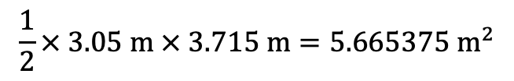
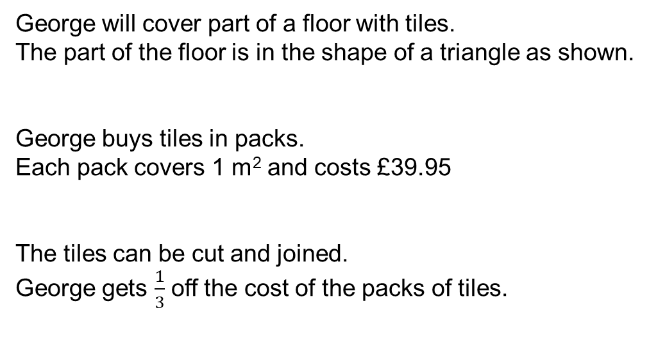
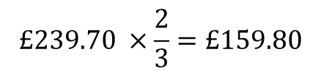
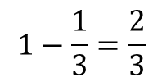
Practice question 3 – answers
PRACTICE QUESTION
Worksheet
available
George will cover part of a floor with tiles.
The part of the floor is in the shape of a triangle as shown.
George buys tiles in packs.
Each pack covers 1 m² and costs £39.95
The tiles can be cut and joined.
George gets $\frac{1}{3}$ off the cost of the packs of tiles.
Work out the lowest cost of the tiles for George.
$$\frac{1}{2}× 3.05 m × 3.715 m=5.665375{ m}^{2}$$
$→$ 6 packs are needed.
$$6 × £39.95=£239.70$$
$$1−\frac{1}{3}=\frac{2}{3}$$
$$£239.70 ×\frac{2}{3}=£159.80$$

