Slide 1
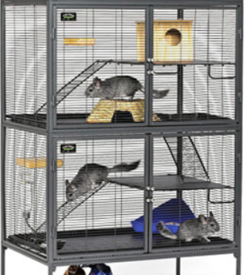
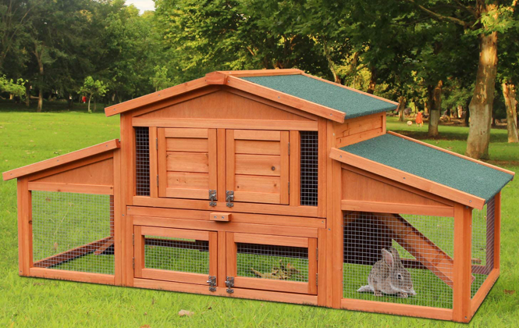

Accommodation

Slide 2
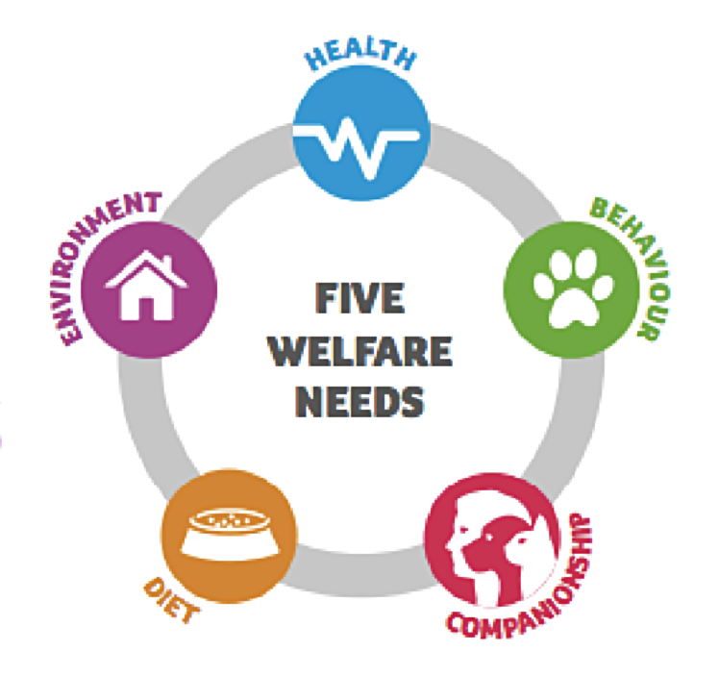
All animals have basic needs. These are known as the 5 welfare needs of all animals.
Animals must be kept in a way that meets the 5 welfare needs:
These are
Environment - All animals should be kept in the right kind home for their species. This accommodation must include the correct shelter with enough space within the area for the animal to get enough exercise to stay healthy. The accommodation should provide a safe place for the animal to rest, hide and sleep in comfort.
Diet - Any animal kept by humans must have access to clean and fresh drinking water at all times. All animals must be given the correct diet for their species and the food be the right amount and type to make sure they are healthy.
Behaviour – Animals all have natural behaviours. They should have enough space, housing, toys and enrichment to be able to exhibit these normal behaviours.
Company – Not all animals are the same. Every animal has to be given the right company if it normally lives with others. This can be from birth or sometimes later on when they are bonded successfully with another. But some animals are better if they are kept on their own. Before getting any animal, make sure research is done so it is kept with the correct company.
Good Health – An animal should always be protected from pain. All animals have the right to good health which means protecting it from any pain, disease and suffering. This includes taking it the vet if it is sick or injured. The accommodation must make sure that the animal stays healthy and happy.

Slide 3
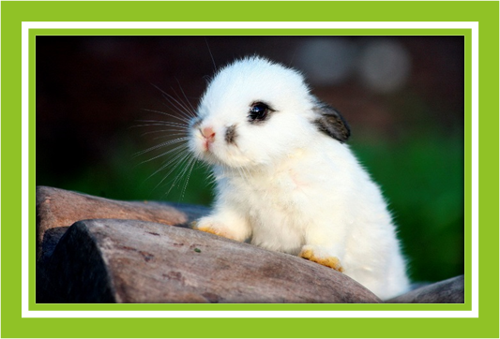
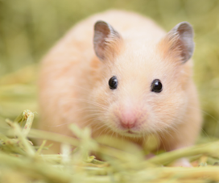
Accommodation for small mammals
Rabbit and Hamster

Slide 4
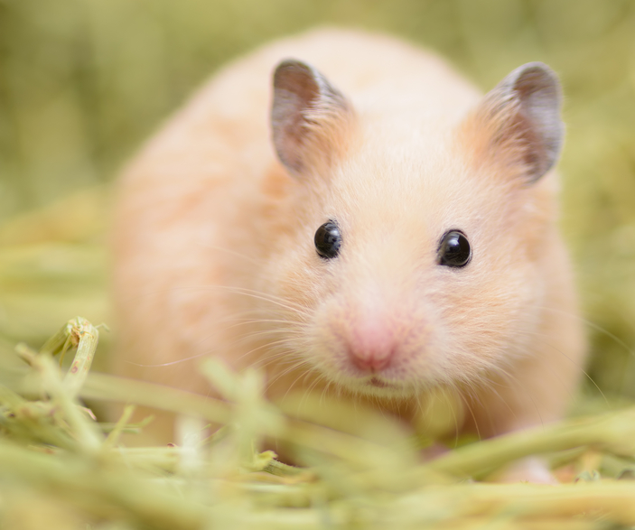
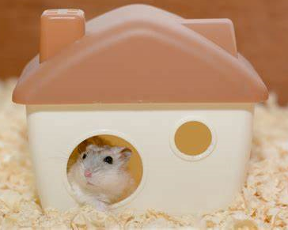


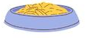
Wire mesh – allows ventilation and social interaction.
Cage size
90 x 60 x 50 cm
Hamster
Hammock- used for resting in.
Tunnels – used to give the hamster more opportunities to display natural behaviours
Nest box – hamsters are nocturnal and need somewhere to sleep and nest
Cage clips – attaches from top part of the mesh cage to the bottom plastic base. Holds the cage together and prevents escape.
Water bottle – Fresh water should always be available. The bottle should be washed and refiled daily.
Toys – hamsters like toys to play with. Things like balls that can be stuffed with treats or hay.
Plastic base – must be deep enough to have plenty of substrate to burrow, dig and nest.
Wheel- good for exercise and enrichment. Usually used at night.
Ladders – used for climbing to higher platforms of the cage.
Sand bath – good for cleaning and natural behaviour.
Food bowl – Fresh food should be available daily. The bowl needs to be washed and clean every day.

Slide 5
Hamster
Accommodation Details
Materials
The cage should be solid and stable in design. Plastic based cages are better than metal, but wooden cages should not be used as they can be chewed through and hold the wetness from any urine. A cage with stainless steel bars with or without a plastic coating or mesh sides is preferable to one with solid sides. This is to allow ventilation, light and heat in. The cage floor should be solid to allow for bedding material to be provided (to absorb the relatively small quantities of urine they produce) as well as natural behaviours.
Structure and Design
Hamsters need a lot of room (especially at night), so as large a cage as possible is best. The design should have suitable enrichment (such as a tunnel system, chewing blocks, ladders and a exercise wheel) whilst still allowing generous space for your hamster to run around. The structure of the cage is usually in a box shape, this is made up from a wire top and a plastic bottom. The cage should be as large as possible. Minimum 70cm x 40cm or 430 square inches for the smaller breeds, depending on the breed you would need to choose the most appropriate size.
Environment and Welfare factors
Hamsters need a comfortable dry and clean cage to live in. It should be kept out of draughts and not near anything that gives out high frequency sounds like TVs or computers. Hamsters are nocturnal so need lots of space to exercise in especially at night.
Types of Fixtures and Fittings
Water Bottle – Water should be fresh, clean and readily available at all times of the day and night. The bottle should be the correct size and shape for a hamster to drink from.
Food Bowl – Food should be offered daily. The bowl needs to be washed and cleaned every day before fresh food is added.
Wheel – A wheel is a great for exercise, hamsters require mental and physical exercise to stay healthy.
Tunnels - Hamsters love tunnels. Some will use them more often, some will use them every now and then. But all hamsters are drawn to small, tight, hidden pockets of space. This is mostly because of the nature of rodents, to always seek a tunnel or hole to hide in. Also, in the wild hamster nests are made of a series of long, interconnected tunnels and galleries. A network of tunnels allows pet hamsters to exhibit natural behaviours. Tunnels create an elevated comfort level by offering an environment closely resembling their natural habitat; something they wouldn’t have otherwise. Tunnels also provide hamsters with more space to roam and explore.
Toys – There are many different toys that can be given to hamsters for enrichment. Some of these could be activity balls, chew blocks, hay balls, salt licks.
Nest box - The hamster needs a nesting box or shelter to sleep in and keep safe if scared. The shelter should be big enough for the hamster to store food, make a nest and move around.
Hammock – A good choice for hamster to rest in. Some prefer these to enclosed nesting boxes, it’s a good idea to have more than one sleeping area if you have more than one hamster in the same cage.
Ladder – These are used for hamster to climb up to different levels of the cage.
Sand Bath - hamsters clean themselves is because of their habitat. Hamsters in the wild live inside burrows, with series of tunnels and nests deep underground. This can make lots of debris like dirt and twigs get stuck in the hamster’s fur. The hamster cleans himself to function properly, and not have his fur matted with dirt. The main reason hamsters would need a sand bath is to absorb the excess oil in their fur. You see, hamster fur has a layer of oils (like our human hair does, the sebum) which helps keep the hair healthy and the skin clean. However too much of that sebum will make the hamster’s fur look bad, and feel bad too. This is where the sand comes in, to help keep the hamster’s fur nice and clean.

Slide 6
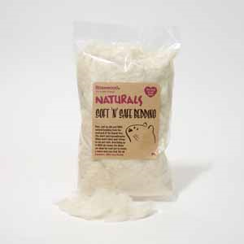
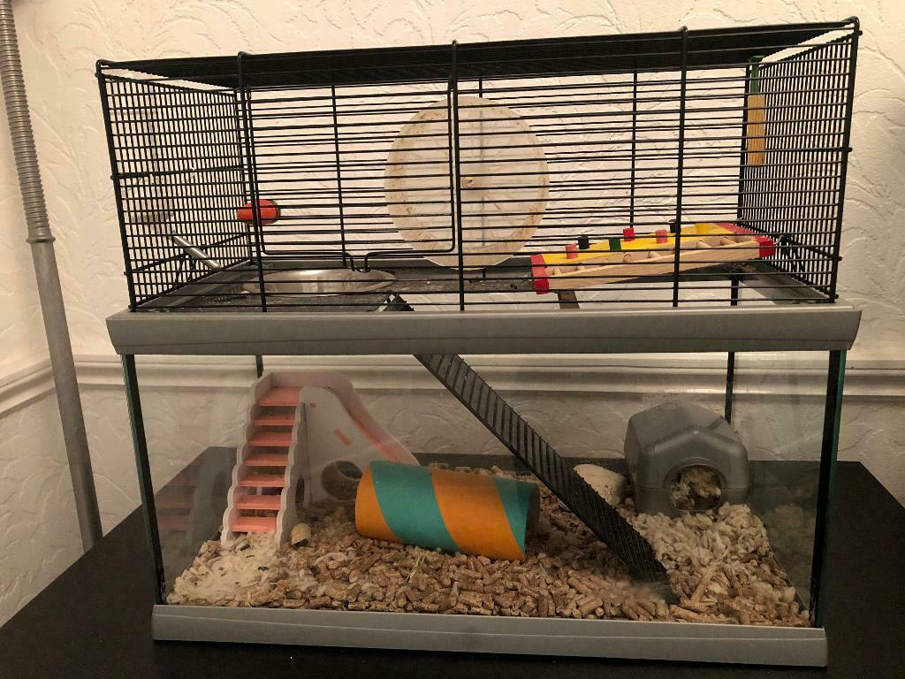
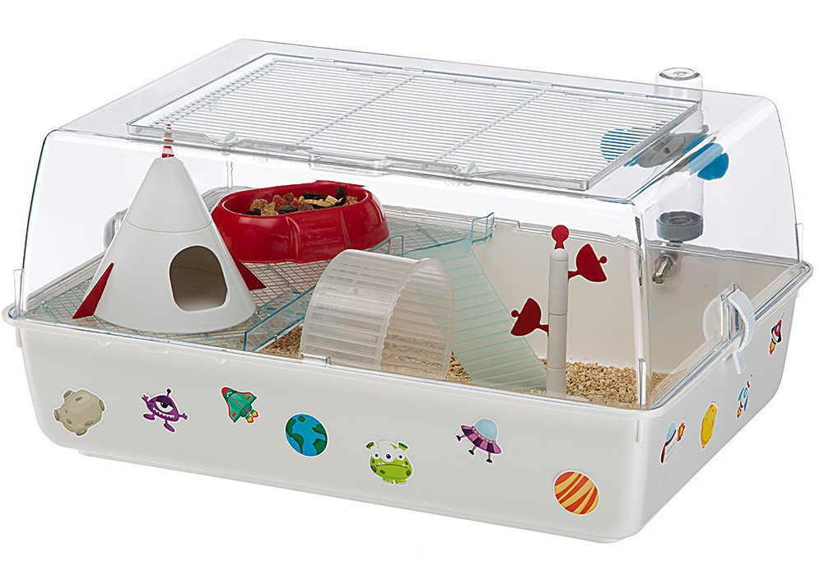
Hamster
Types of substrate
This is the material used to line the bottom of the cage, inside the plastic base to collect all the urine and faeces. It should be deep enough for the hamster to burrow, dig and explore. Ideally a couple of inches thick at least. The most common type of substrate used for hamster is wood shavings, they are soft, comfortable, absorbent and easy to clean.
Types of bedding
Bedding is used for the hamster to nest into. This is different from substrate as it needs to be much softer. Ideally the bedding needs to be made from something like shredded paper or wool bedding materials. Most common type is a soft, easily shred able material like this :
    Soft 'n' Safe Bedding - Pure, soft as silk and 100% natural bedding from the seed pod of the Kapok tree. The short and hypoallergenic fibres will not twist and go into string making it pet safe. Being up to 80% air means the fibres are ideal for your small animal to create a warm and cozy bed.
Alternative Accommodation
The alternative type of accommodation for a hamster would be a glass based or sided tank with a wire top. Or a plastic sided cage with a lid that lifts, usually bars at the top. These are alternatives that should be used if a cheaper (the plastic sided) cage is needed. The glass sided one if good for keeping multiple animals together as they are bigger and give more space.
Alternative Substrate and Bedding
There are different options for substrate in a hamster cage, if wood shavings aren’t an option then recycled paper pellets or wood pellets are a good choice instead. Although they are often more expensive they are better for the rare hamster that has a reaction to shavings. Alternative bedding that can be used are pieces of fleece, fabric hammocks and paper. Never use any paper or bedding with ink on it as hamsters will chew and shred bedding to make a nest, the ink is toxic to hamsters.
Glass based/sided hamster cage.
Plastic sided hamster cage.

Slide 7
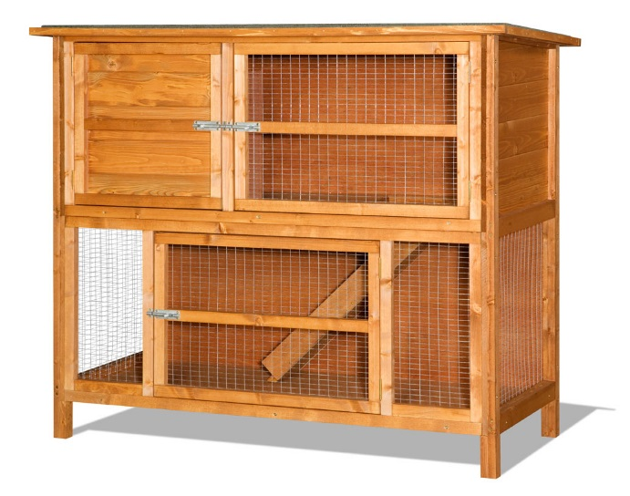
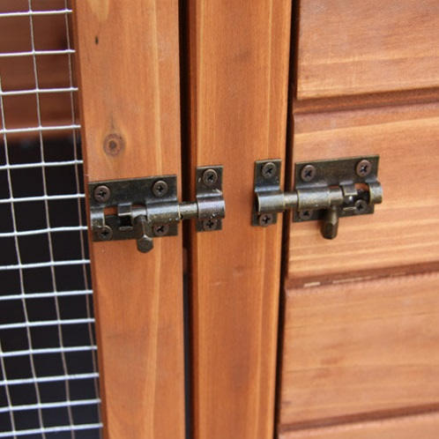
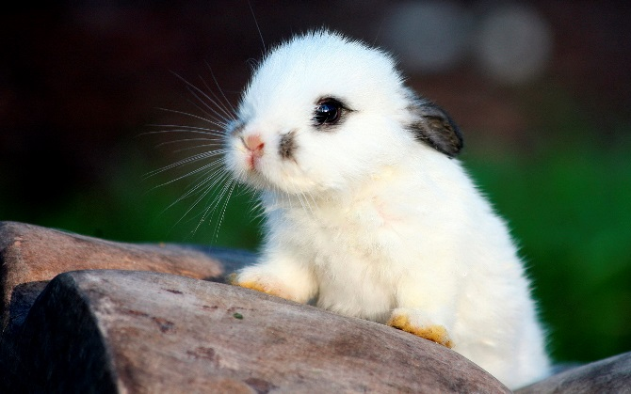
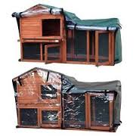
Rabbit
The ideal accommodation for a rabbit would be a hutch. The type of hutch however, depends on the size of the bunny (ideally the minimum height would be if the rabbit can stand up on its back legs but it should be even bigger than this so they have plenty of room). It also depends on how many bunnies you’re storing together and also if you want them outdoors and indoors.
You should make sure there are bolts at the top and bottom of any doors of the rabbit hutch for extra security. You could also have a lock if you wanted to.
Rabbits don’t need a heat source but they could do with some natural light directed on their hutch. They also could do with a shelf in their hutch if it’s large so they can roam about to keep them entertained. They will also need a nest box to sleep in, hutches usually come with them but if not, you can make one out of cardboard and typical rabbit bedding.
Rabbits temperature can go up on down when the weather changes so you need to take precautions to make sure they are always at a nice temperature. If it’s raining and your rabbit is outside, make sure you have a plastic sheet covering the hutch. During the summer the wood of the hutch can heat up very quickly so you should try insulating the roof to keep it cooler or get sun reflectors.
For the owners to have access to the hutch, there should be several doors and also some hutches come with an opening roof which makes it easier to clean and pick up the rabbit.
For areas of privacy, hutches should have a little room inside where the rabbits will usually sleep in, but some may use that as their toilet. The materials you could use to create a rabbit hutch would be smooth wood, gauge galvanized wire, mesh. You will also need a kind of bedding (hay for example).

Slide 8
Rabbit – cleaning routines and schedules
Indoors; cleaning routines
Daily Husbandry Routine;
Firstly, place rabbit in pet carrier and put in safe place away from any other animals or anything that might cause stress to rabbit.
You would firstly remove all the solid substrate, after that get warm water and disinfectant clean the walls, pipes and tubes then rinse thoroughly and dry before replacing. Check all the bedding and replace and necessary, you would need to ensure any soiled bedding is placed in the washing machine ensuring that it is all cleaned. Use the disinfectant to clean the floor, making sure that you get it all into the corners, as the fence can get trapped there. You are going to have to allow time for the floor to dry as it would make it a hazard and finally, you would need to replace the substrate.
Outdoor;
Daily Husbandry Routine: You would first lock the flap to make sure the rabbits can't go outside, after that you would go to the outside area. Then after doing all that that you then go and clean up the faeces from the floor and the shelf. After that you then using the disinfectant and hot water, scrub the floor once again ensuring that you get into all the corners to remove the faeces. You would then rinse with another bucket of hot water to ensure that all then disinfectant has gone, as it can be hazard for the rabbit and for other animals. The floor may need to be swept to get rid of the excess the water. Then you would clean any toys or what bowls and they would to be replaced. You are going to be needing time to allow the floor to dry before letting the rabbits out. You would need to ensure that the cat flap swings open and shut, this is so it doesn't lock the rabbits out of the cold weather.

Slide 9
Rabbits- plans for accommodation
Managing waste
Disposal of Waste- Any soiled cleaning products (that can’t be washed like the brushes can) dirty bedding and substrate needs to be placed in a strong black bin liner and then thrown away in an outside bin. Make sure to dispose of any water directly into a sink or an outside drain to prevent spread of any bacteria or diseases. If possible rabbit waste can be composted which is more environmentally friendly than going to landfill
health and safety considerations – actual accommodation plan shows structural considerations. Other systems relate to regular checks and inspections on the accommodation which are part of the maintenance routine.
Handling contingencies- plan must include temporary accommodation whilst carrying out cleaning and any maintenance. A pet carrier or indoor cage should be available to temporarily house rabbit. If more than one rabbit is kept then facilities to separate and isolate one animal need to be available.

Slide 10
Task 1- Describe suitable accommodation for a small mammal
You need to choose from the following:
Rabbit- can be kept indoors or outdoors so you need to describe suitable accommodation for both
Guinea Pig- same as rabbit-both indoor and outdoor
Hamster-indoor cage
Mouse-indoor cage
Rat-indoor cage

Slide 11
Task 1- Describe suitable accommodation for a small mammal
Describe the 5 animal welfare needs- and relate each to your animal.
Owning animals has responsibilities that are actually written into law. Under the Animal Welfare Act 2006 owners are required to meet the ‘five animal needs these being:
Suitable place to live
Suitable diet
Exhibit normal behaviour patterns
housed with, or apart from, other animals (if applicable)
protected from pain, injury, suffering & disease

Slide 12
Task 1- Describe suitable accommodation for a small mammal
5 welfare needs-Example for a rabbit:-
Exhibit normal behaviour patterns -Jumping, hopping and digging are normal behaviour for a rabbit. Whether kept indoors or out a run for exercise is needed big enough for three hops. To enable a rabbit to dig a large flat container with sand or soil is suitable. Also need items to provide enrichment such as play tunnels and toys. Cardboard tubes from tinfoil are a cheap but good idea.
housed with, or apart from, other animals (if applicable)-Rabbits are social animals in the wild who live in colonies so are better kept in pairs as long as both are neutered
protected from pain, injury, suffering & disease-Daily inspections for signs of illness and disease. Look at eyes, ears and check for parasites e.g. fleas, fly strike. Inspect mouth for tooth problems.

Slide 13
Task 1- Describe suitable accommodation for a small mammal
Factors that need to be considered
Size of accommodation- how big is required?
Type of accommodation- what is it made of- wood, plastic, metal etc- and why is this type of construction the right choice
Example rabbit-
For the rabbit, I will make sure to provide a cage that is tall enough for them to stand up on their hind legs and offer enough space to laze around, jump run and dig. This will depend on the size of the rabbit but the bigger the better. The cage will preferably be made out of either plastic or wood with a solid bottom to it and have a large door, or two, to allow easy access for the owner to the rabbit and to feed and water it too.

Slide 14
Task 1- Describe suitable accommodation for a small mammal
Factors that need to be considered
Fixtures and Fittings-
Example rabbit-
Outdoor hutch- bolts at the top and bottom of any doors of the rabbit hutch for extra security. Water bottle so access to fresh water at all times, feed dish, hay rack so they have clean hay available to eat at all times as they are grazers.
Enrichment- tubes to hide in and chew, sand tray to dig in, chew toys made of safe wood to help gnaw down their teeth.

Slide 15
Task 1- Describe suitable accommodation for a small mammal
Actual accommodation
You need images and descriptions
Example rabbit-
Outdoor hutch- get a picture then describe why that hutch is suitable
Indoor hutch- get a picture and describe why it is suitable for a rabbit

Slide 16
Task 1- Describe suitable accommodation for a small mammal
Very important – you MUST say why your accommodation is suitable and which of the 5 needs it meets.
Example Rabbit- a rabbit hutch should be no smaller than 6ft x 2ft x 2ft especially if they need to be housed with another rabbit. This meets another of the animal welfare needs ‘to be placed with or apart from other animals (if applicable)’. The RSPCA has a three hop rule which states that if a rabbit cannot hop three places in their hutch then it is the wrong size and there is no space for them to ‘display their natural behaviours’ this would be breaking one of the five animal welfare needs.

