Slide 1
Photoshoot
Natural Forms

Slide 2
Why do we need a Photoshoot?
Analyse original sources
Understand the work further
Informs creative process
Adds depth and meaning to your work

Slide 3
What should I do?
Plan a photoshoot based on an element of natural forms – nature.
Write your plan, using the guide on the next slide and email it to me.
Take your photographs and upload them to Teams, OneDrive or email them to me before next lesson (Tuesday 14th).
You can use your phone to take the photographs, you don't need a camera. Remember to upload!

Slide 4
Photoshoot Plan Guidance
Discuss your subject matter – leaves, branches, flowers.
What are you hoping to achieve? Close up images, detail, shapes.
How do you hope to transform these images into drawings? What is the creative process? Will you take your photographs and draw the entire image or will you choose sections from the image?

Slide 5
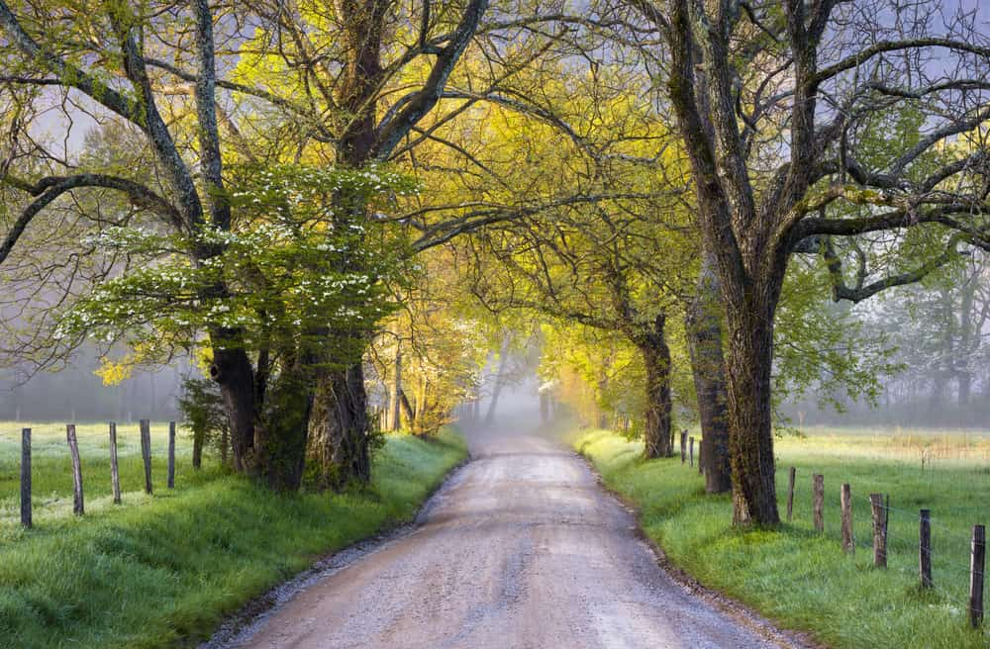
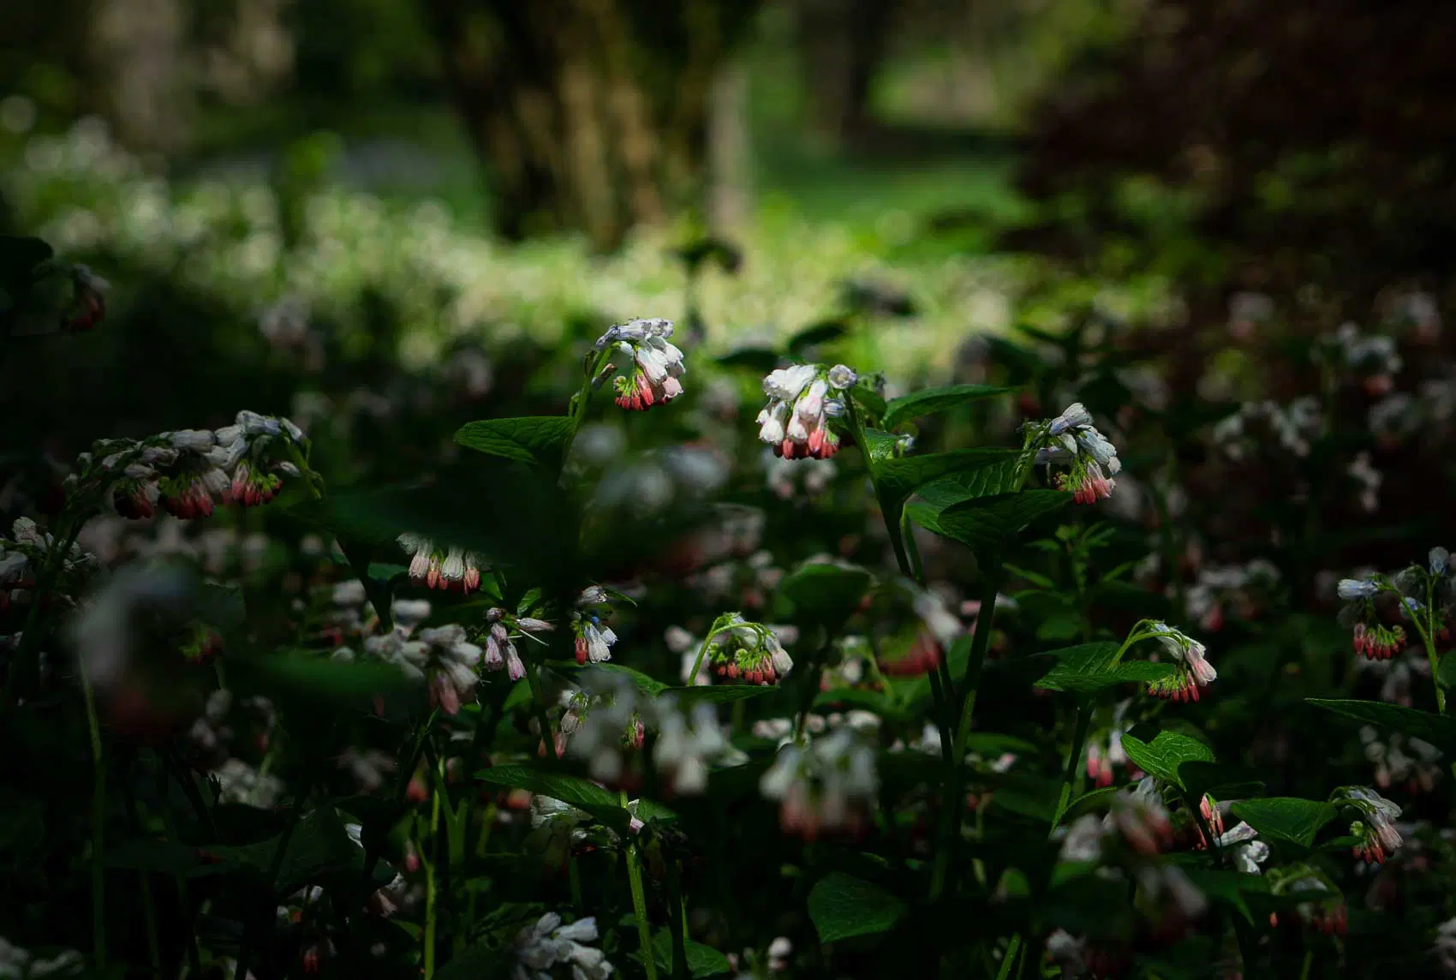
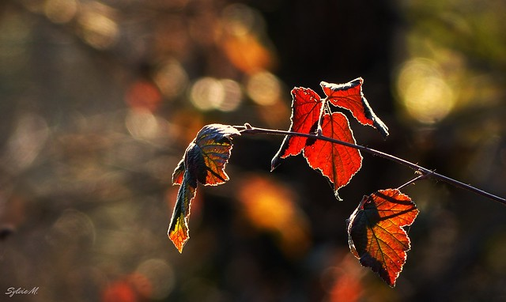
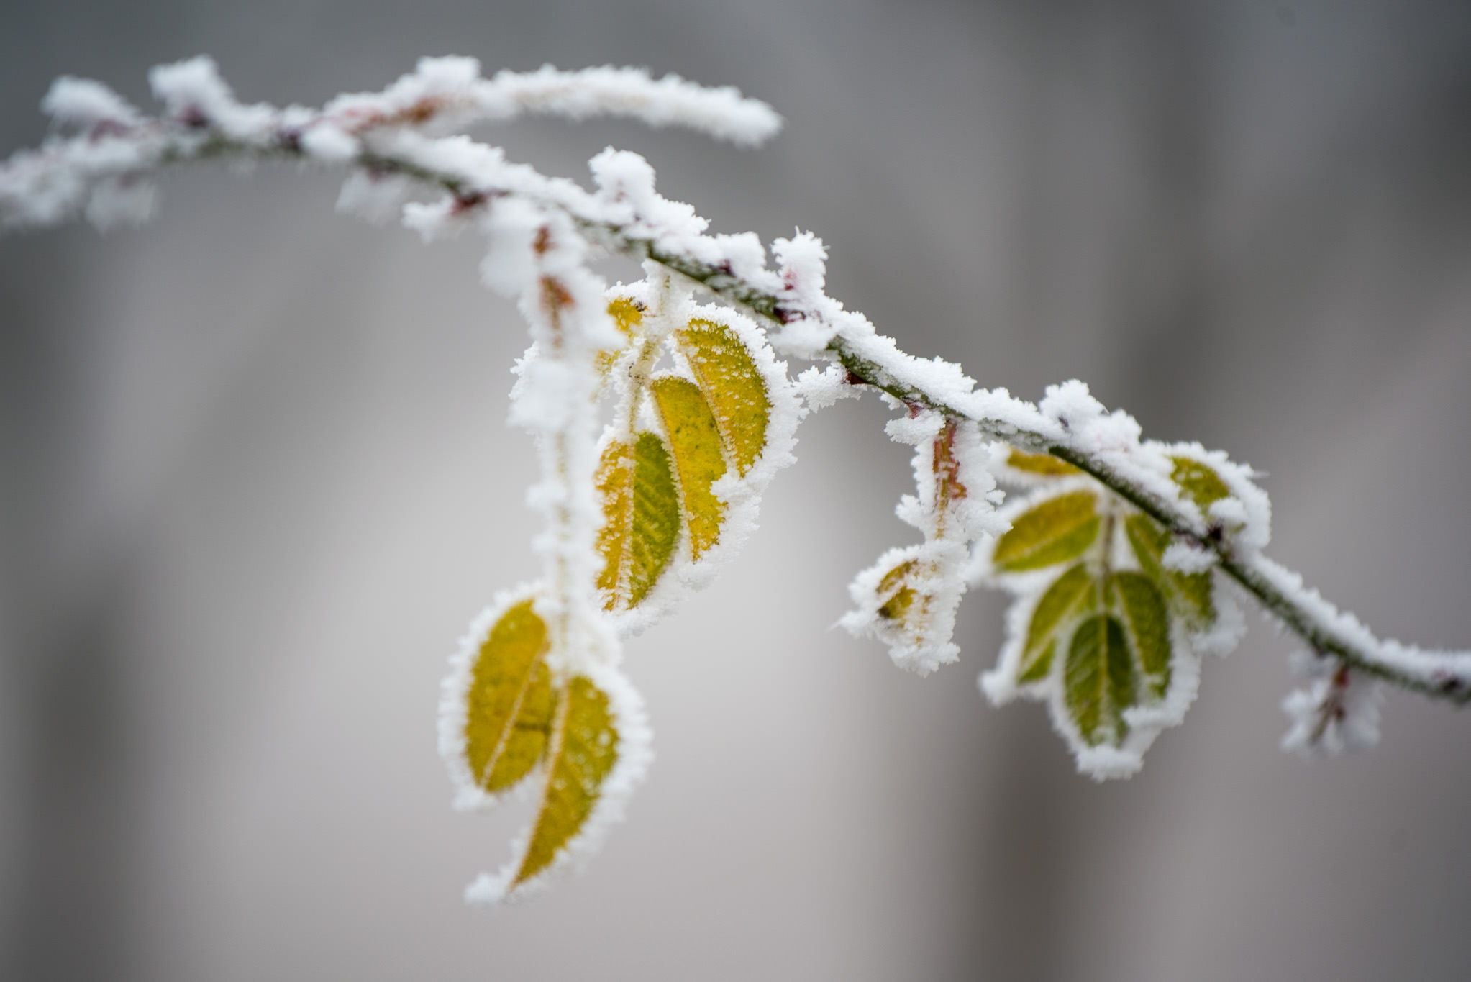
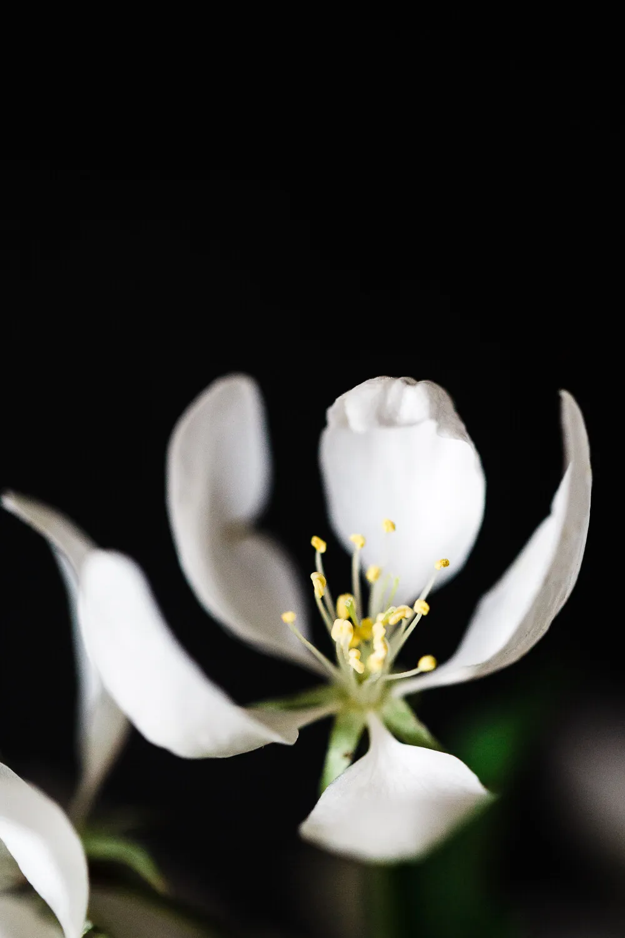
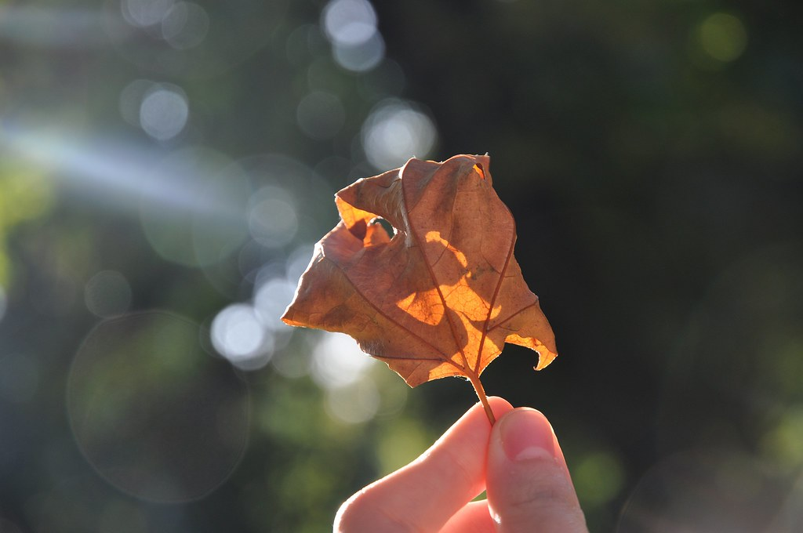
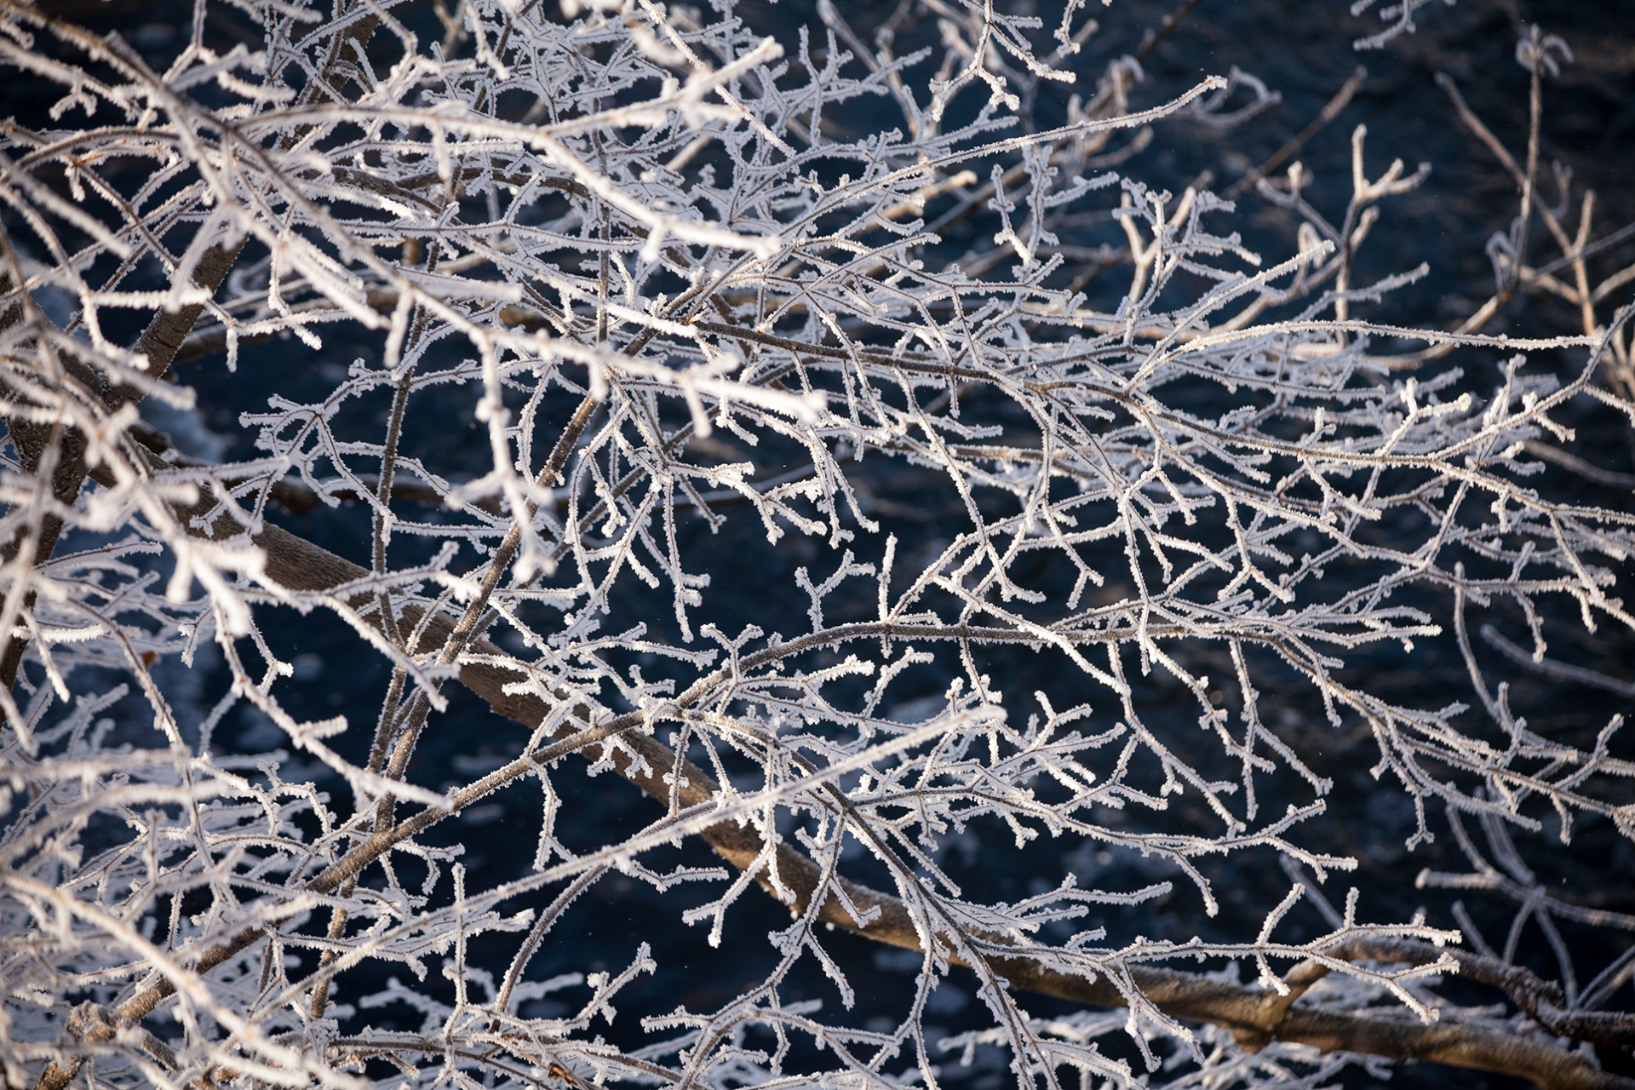
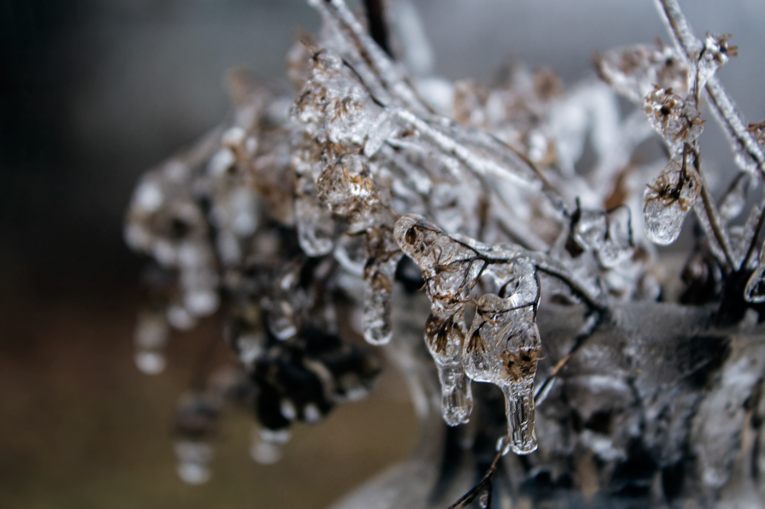
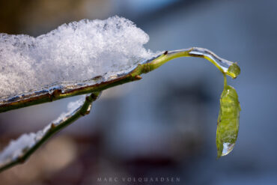
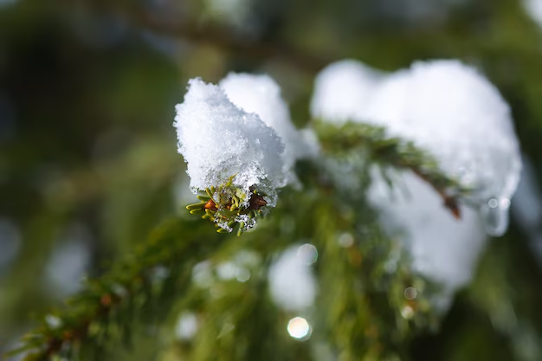
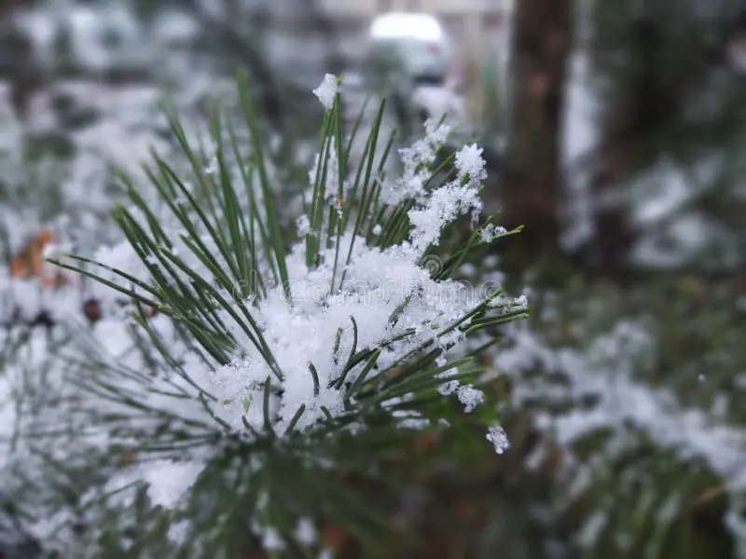
Examples of nature images.

Slide 6
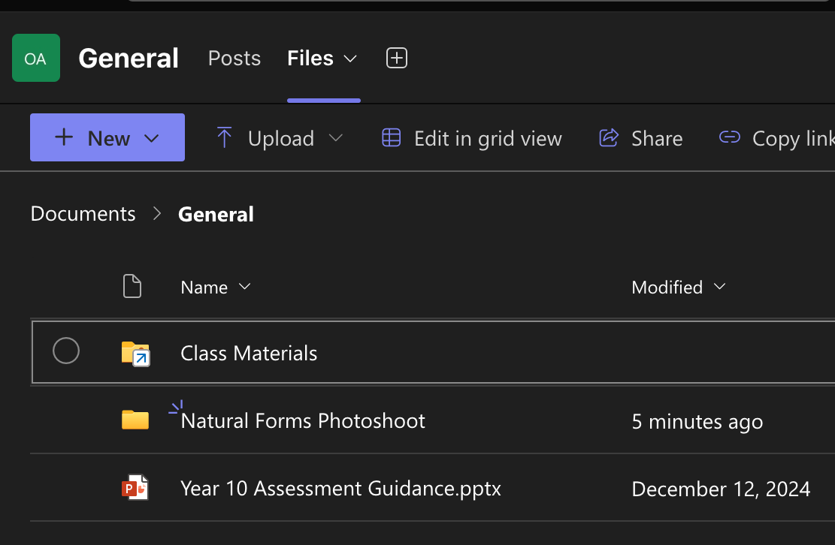
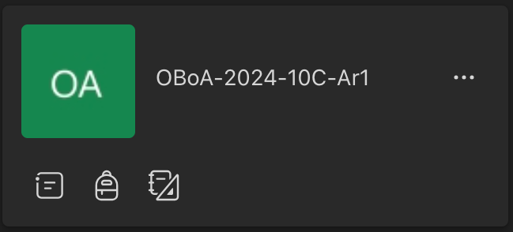
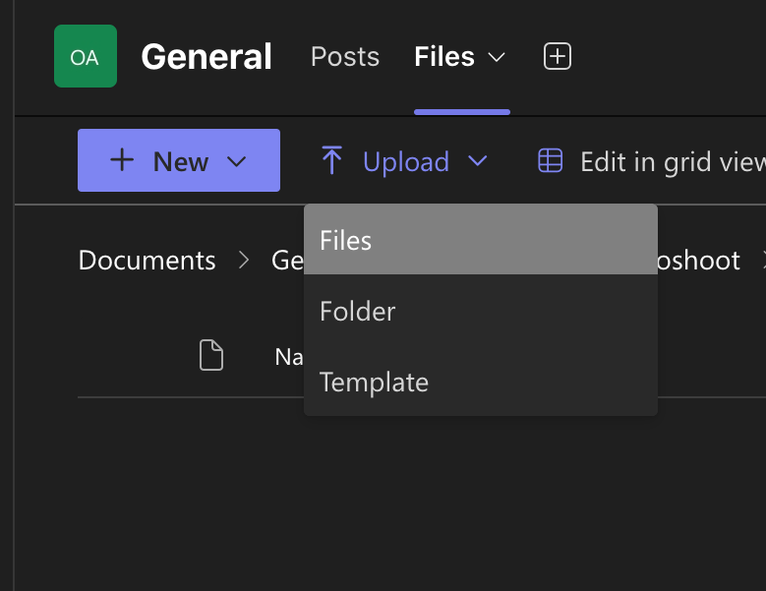
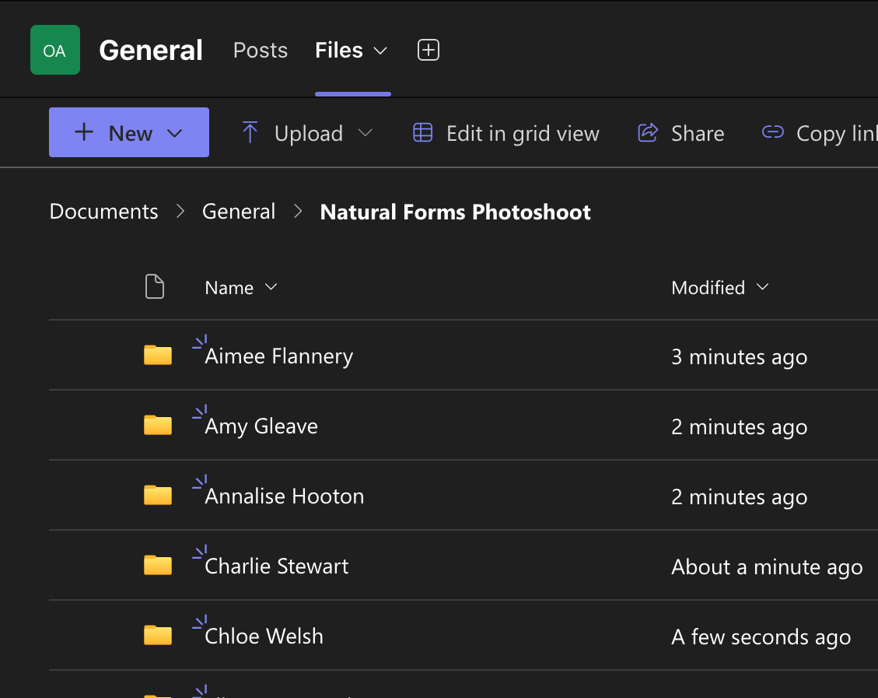
Uploading to Teams
Step 2 – choose files from the top and then natural forms photoshoot.
Step 1 – choose our Teams folder.
Step 4 – click 'upload' then 'files' and then upload all of your images into this folder.
Step 3 – find the folder with your name and open that to upload your photos.

Slide 7
Please email me for support!
l.fenlon@ob-ac.co.uk

