Slide 1
Yr11 Information Evening 2024 cohort
Wednesday 7th June 2023

Slide 2
Context
2020 – Cancellation of summer exams, replaced with Centre Assessed Grades (CAGs).
2021 – Cancellation of summer exams, replaced with Teacher Assessed Grades (TAGs).
2022 – All GCSE examinations due to take place with some subjects having adaptations to content.
2023 - All GCSE examination back to pre-pandemic status, with the exception that formula sheets are given in Maths and Science.
2024 – All exams are back to pre-pandemic status.

Slide 3
What does it all mean!

Slide 4
Key Dates
Mock exams will take place from Wednesday 14th June until Thursday 22nd June 2023.
Next year 2023-24
Summer 2024 GCSE examination – timetable is confirmed in January 2024. Please don’t book holidays during May, June and July.

Slide 5
Preparation in School
All students will meet with Mrs Evans to discuss student progress
Two sets of mock exams next academic year (Autumn and Spring)
Meeting after mock exams with 6th form team and SLT to discuss next steps
Parents evening just after first set of mock exams
Assembly to discuss progress 8 and their current position, early September
Academic mentors assigned for each child
Sessions on how to create a revision calendars in Autumn term
Directed morning interventions starting at 8.30am for targeted students
After school interventions every Tuesday, Wednesday and Thursday (3 -4 pm)
Half term interventions
Study skills sessions in Lessons for Life

Slide 6
Preparation at Home
Complete all homework set – follow homework timetable
Revision calendar – no more excuses, stick to the schedule if something comes up don’t just not do it move the revision to another day.
Space to revise – try and find a calm space to revise at home or in school
No distractions – turn mobile phones and TVs off
Regular breaks – short sharp bursts of revision is better
Exercise – fresh air and exercise is great for your mental health
Eat well and keep hydrated to improve concentration
Good nights sleep – we need at least 8 hours sleep each night.

Slide 7
Head of Sixth Form
Mr Fenner

Slide 8
Head of English
Miss Styles

Slide 9
Our Goal:
For your child to be as good as anyone, anywhere!

Slide 10
Why is English Important?
The majority of courses, jobs and careers will require a Good Pass (5+) in English and Maths.
A study of over 400,000 people shows achieving 5 A* to C (9-5) GCSE grades, including the vital English and Maths subjects, adds £80,000 to a student’s earnings over their lifetime.
A further £60,000 is added to their wages if they go on to achieve at least 2 A Levels, highlighting the economic value of the increased knowledge, confidence and employability that arises from success in school.
Most students who fail to get good GCSEs in English and Maths at 16, also fail to get them by 18. Only 6.5% eventually got the grades in English.

Slide 11
The Course at a Glance:
English Literature | English Language
2 Exam Papers Paper 1 – 2 hours The Merchant of Venice Eduqas Poetry Anthology Paper 2 – 2.5 hours An Inspector Calls A Christmas Carol Unseen Poetry | 2 Exam Papers Paper 1 – 1h 45 mins Unseen Narrative Extract + 5 questions Write a narrative Paper 2 – 2 hours Two non-fiction extracts + 6 questions Write 2 of the following text types: Letter, Article, Report, Review, Speech, Guide

Slide 12
How can you help?
English Literature | English Language
Watch the film version Ask your child what they’ve learned about the text Help them memorise quotations Watch YouTube videos to understand aspects of the texts | Encourage them to read books, newspapers, articles, magazines Make a bank of good words they could use Encourage them to use revision guides Discuss issues in the world and how they can be solved
Help them schedule revision time into the week Encourage them to use revision guides Encourage them to complete Tassomai

Slide 13
Literature: What to revise!
poetic devices, writer’s techniques, language, form, structure
Merchant of Venice quotes and connotations | An Inspector Calls quotes and connotations | A Christmas Carol quotes and connotations | Poetry anthology quotes and connotations
Merchant of Venice Themes | An Inspector Calls Themes | A Christmas Carol Themes | Poetry anthology links between poems
Merchant of Venice characters and relationships | An Inspector Calls characters and relationships | A Christmas Carol characters and relationships | Poetry anthology terminology and effect on reader
Merchant of Venice Context | An Inspector Calls Context – desirable but don’t have to- | A Christmas Carol Context | Poetry anthology context

Slide 14
Make mind maps and diagrams. | Make cue cards and colour code them. | Practice exam answers. | Create a memory game or pairs game with key quotes. | Create mnemonics and flash cards.
Turn key quotes into dingbats. Test yourself to recall it! | Use a catchy rhythm to help you remember key information and facts. | Test a friend. Work together and get twice the results. | Make timelines of each text. | Create a quiz on a topic – creating questions helps you remember the answers.
Create Venn diagrams to compare themes, characters or even poems. | Play ‘just a minute’ –talk for a minute about a theme, character, relationship or poem. 3 strikes and you’re out. No pauses, fillers or repetition! | Rank and justify topics/ themes/ characters. What has the most impact and why? | Mix and Match: Split quotes in half and try and find the matching pair. See how many quotes you can match in a minute. | Find the magic words: Look for single word quotes that appear in multiple poems and memorise them.
Watch YouTube videos on each text. Make a poster or a flow chart of the information provided. | Test yourself. Put key questions around the house. Get into a routine of having to ask yourself a question to get into the fridge! | 30 – 10 – 5 – 1 Start with 30 key words, and condense down until you have one word. | Listen to the audiobook version of the text before bed | Read through and annotate model answers.

Slide 15
Merchant of Venice | An Inspector Calls | Poetry Anthology | A Christmas Carol | Unseen Poetry
YouTube Links to revise with https://www.youtube.com/watch?v=YsXYM7aFyLo literary terms revision song
https://www.youtube.com/watch?v=fipV-Afv6MA 10 key quotes for MoV https://www.youtube.com/watch?v=Tw9q2P2N028 thug notes MoV https://www.youtube.com/watch?v=rNQpmJUKJkg Mr Bruff analysis of each scene https://www.youtube.com/watch?v=th7euZ30wDE Shylock speech https://www.youtube.com/watch?v=HfotcY3iwWQ Antonio analysis | An Inspector Calls: Context And Background – YouTube Inspector Calls in 2 minutes! GCSE Quotes Plot Characters – YouTube The 10 Most Important Quotes in 'An Inspector Calls' – YouTube An Inspector Calls Complete BBC Edition Bernard Hepton 1982 by JB Priestley – YouTube Themes in 'An Inspector Calls': Social Responsibility - GCSE English Literature Revision – YouTube Is This the Best AIC Video Ever Made? Mr Salles – YouTube | https://www.youtube.com/watch?v=6BERjLZzuOg&list=PLcvEcrsF_9zJ0JEEr8Lp9c9_eYQzZBYcR&index=65&t=0s London – Blake https://www.youtube.com/watch?v=tRWbo2x5lnA&list=PLcvEcrsF_9zJ0JEEr8Lp9c9_eYQzZBYcR&index=67&t=0s Ozymandias – Shelley https://www.youtube.com/playlist?list=PL-rK0dB2k__fdfjVyzgmJLIKBIsq221lX poetry anthology playlist of poems https://www.youtube.com/channel/UCzPbeNb4OPKDJ2eCnKMw8EA Miss Dye English – analysis of most poems | Mr Bruff A Christmas Carol YouTube playlist https://www.youtube.com/results?search_query=bbc+teach+a+christmas+carol BBC teach A Christmas Carol https://www.youtube.com/watch?v=M2JFSDbm7cU context revision https://www.youtube.com/watch?v=GFeNZ510uhQ quotation song https://www.youtube.com/watch?v=XABMiDM_VHY audiobook of ACC https://www.youtube.com/watch?v=16vRZYwUUeQ characters BBC Teach https://www.youtube.com/watch?v=1JMcKSp8uto themes BBC Teach | https://www.youtube.com/watch?v=7wghR08CTTA how to analyse unseen poetry – five minute structure https://www.youtube.com/watch?v=6wTVQJwhkMo unseen poetry advice https://www.youtube.com/watch?v=8UvMIldrPtI comparing poems https://www.youtube.com/watch?v=IjFCA5nixNE tutorial on comparing poems https://www.youtube.com/watch?v=SvL1392jLnM how to give a personal response in the unseen poetry exam

Slide 16
Merchant of Venice | An Inspector Calls | Poetry Anthology | A Christmas Carol | Unseen Poetry
Useful Websites
https://www.sparknotes.com/shakespeare/merchant/quiz/ quiz http://www.funtrivia.com/quizzes/literature/shakespeare/merchant_of_venice.html quizzes https://www.shmoop.com/merchant-of-venice/quizzes.html quizzes https://www.shmoop.com/merchant-of-venice/questions.html key questions https://www.sparknotes.com/shakespeare/merchant/ revision site https://www.shmoop.com/merchant-of-venice/ revision site | An Inspector Calls - Themes Overview - Themes - AQA - GCSE English Literature Revision - AQA - BBC Bitesize Useful revision website An Inspector Calls: Full Book Quiz Quiz: Quick Quiz | SparkNotes Quiz An Inspector Calls Revision Flashcards | Quizlet Revision cards The Ultimate An Inspector Calls Quiz | Authors (funtrivia.com) Quiz ‘An Inspector Calls’: Questions – MR HENNEMAN'S ENGLISH LANGUAGE AND LITERATURE Revision questions An Inspector Calls on Apple Podcasts Useful podcasts | https://www.eduqas.co.uk/blogs/five-tips-for-teaching-the-poetry-anthology ways of revising poetry anthology https://getrevising.co.uk/revision-cards/wjeceducas-poetry-anthology flash cards for the poems https://padlet.com/sgilberthome/w671ow7ulvpt lots of revision pages and resources for the anthology poems https://www.audiopi.co.uk/subjects/english-literature/gcse/eduqas/eduqas-poetry-anthology-1789-to-present-day a range of audio links to discuss and analyse each poem. You can listen to these anywhere https://www.sporcle.com/games/Cpt_Comeback/wjec-eduquas-poetry-anthology-revision fill in the blank quote quiz | https://www.bbc.com/bitesize/topics/zwhkxsg BBC bitesize https://www.bbc.com/bitesize/topics/zwhkxsg useful revision booklet https://www.sparknotes.com/lit/christmascarol/ summary and analysis of whole text https://www.sparknotes.com/lit/christmascarol/quiz/ Christmas carol quizzes https://www.yorknotes.com/gcse/english-literature/a-christmas-carol-2017/revision-cards/01_characters revision cards https://getrevising.co.uk/revision-notes/a-christmas-carol-8 flash cards and revision notes https://www.audiopi.co.uk/subjects/english-literature/gcse/aqa/a-christmas-carol podcasts for a Christmas carol | https://www.bbc.com/bitesize/guides/z3gfg82/revision/1 bbc bitesize http://www.dccacademy.org.uk/english_revision/english_literature_paper2/English_Literature_Paper-2_Unseen-Poetry-Booklet-2017.pdf unseen poetry booklet https://missryansgcseenglish.wordpress.com/category/english-literature/unseen-poetry/ a range of resources and revision material https://www.eduqas.co.uk/qualifications/english-literature/gcse/Component-2-Section-C-Unseen-Poetry.pdf range of unseen poems from eduqas https://www.slideshare.net/SaltashnetPeru/unseen-poem-revision-handout helpful guide

Slide 17
SLT Link for Science
Mr. Wynne

Slide 18
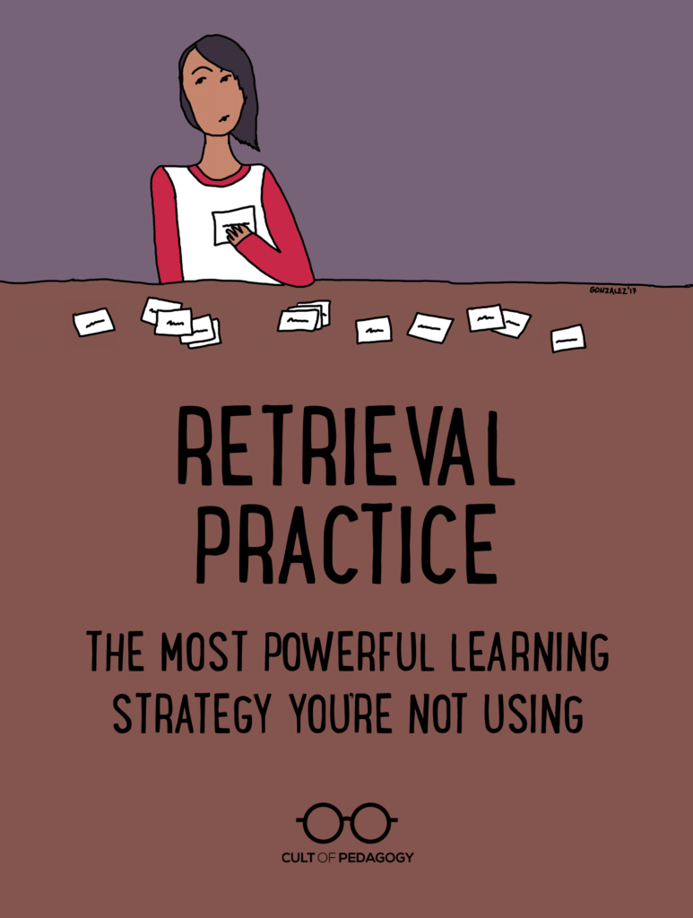
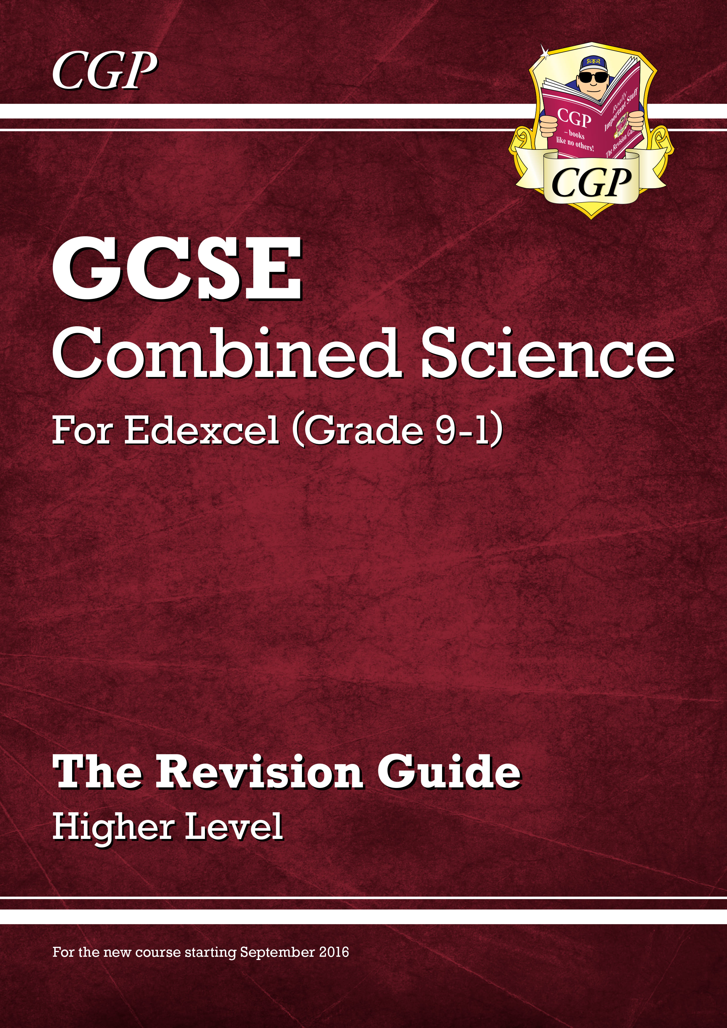
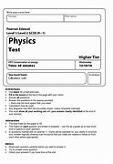
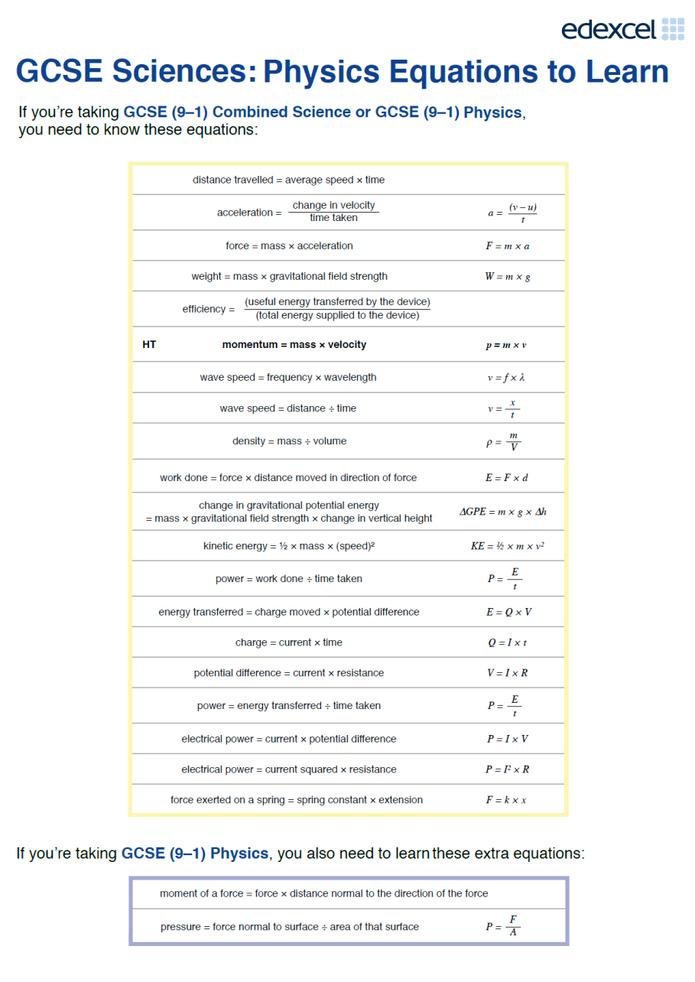
What does effective revision look like?
1. Retrieval
2. Review
3. Practice

Slide 19
8/9
7
6/5
4

Slide 20
What do the exams looks like?
Combined science
(60 marks per paper)
2 x Biology papers
2 x Chemistry papers
2 x Physics papers
Total: 360 marks
Triple science
(100 marks per paper)
2 x Biology papers
2 x Chemistry papers
2 x Physics papers
Total: 200 marks EACH

Slide 21
What do we offer?
Enrichment after school and during half terms.
Morning breakfast enrichment on Friday’s at 8am.
Access to past papers for students.
Each student has access to Tassomai – an online homework which helps embed key science knowledge.

Slide 22
How you can help?
1. Encourage effective revision - retrieve, review and practice.
2. Encourage completion of at least 4 daily goals per week on Tassomai.
3. Encourage them to ask as many questions as possible.

Slide 23
Head of Maths
Mrs Toseland

Slide 24
GCSE Mathematics 9 - 1, Edexcel
3 papers, 90 minutes and 80 marks each
Two tiers: Foundation (Grades 1 – 5) and Higher (Grades 3 – 9)
Paper 1 – Non-Calculator
Paper 2 & Paper 3 – Calculator

Slide 25
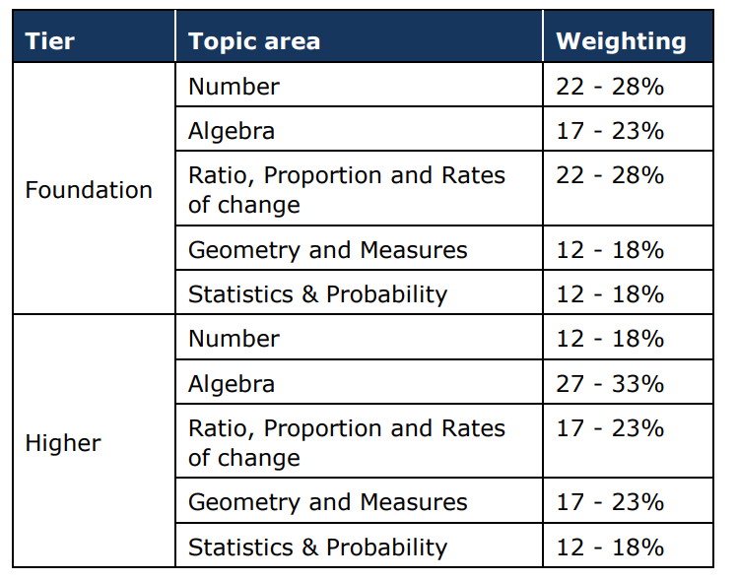

Slide 26
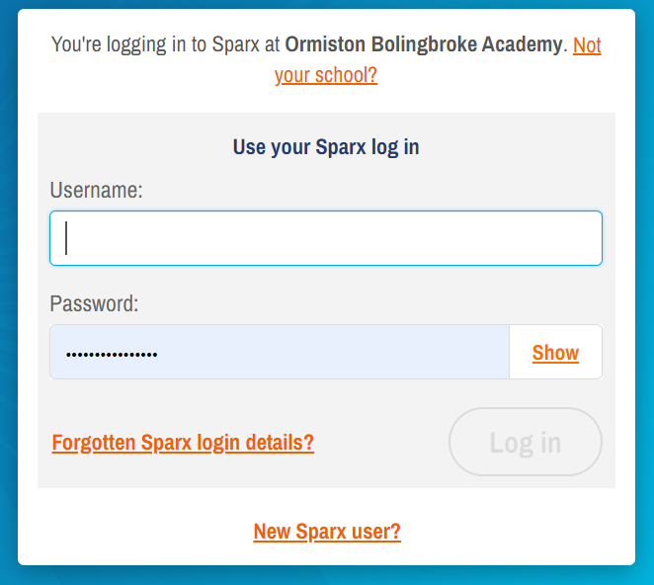
The only way to revise Maths is to do Maths!
Sparx Maths
Joe Bloggs
Username joebloggs
Password – created by student

Slide 27
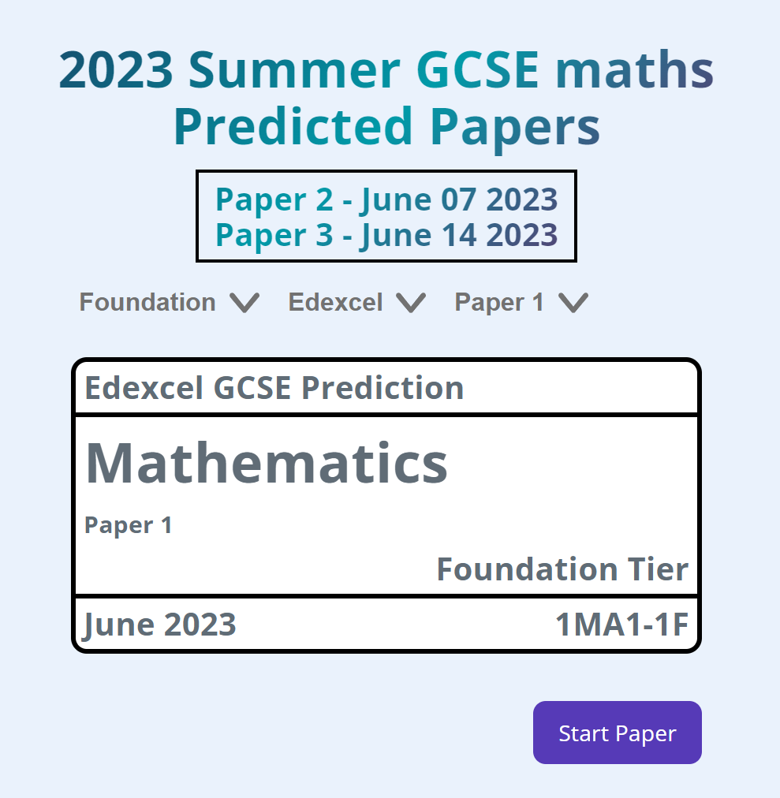
www.onmaths.com

Slide 28
www.onmaths.com

Slide 29
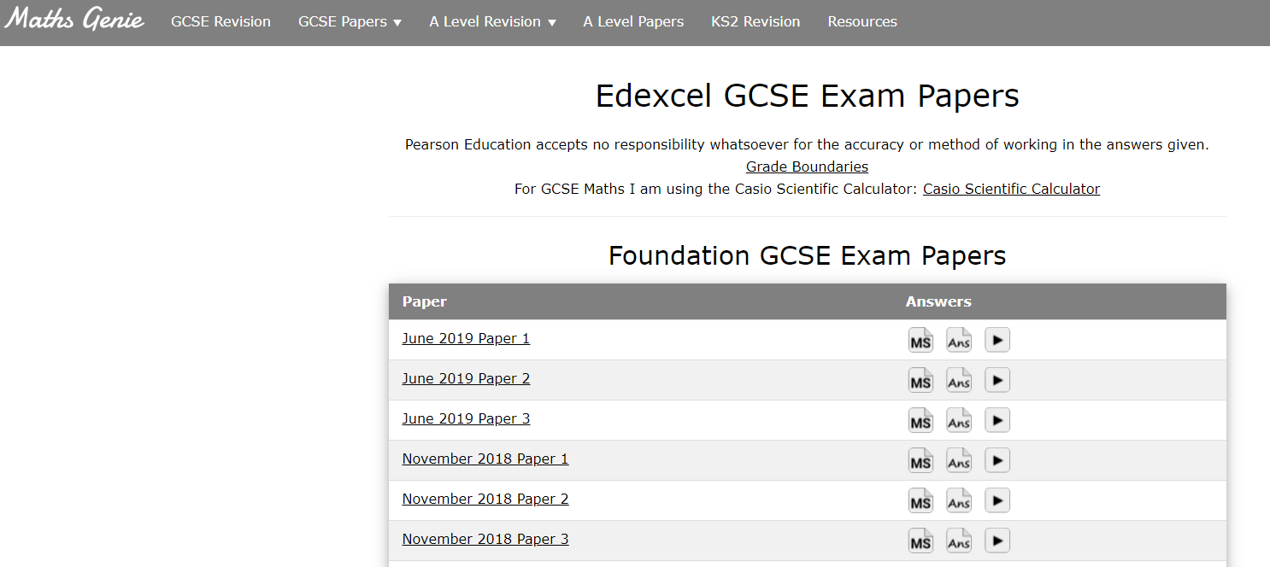
www.mathsgenie.co.uk

Slide 30
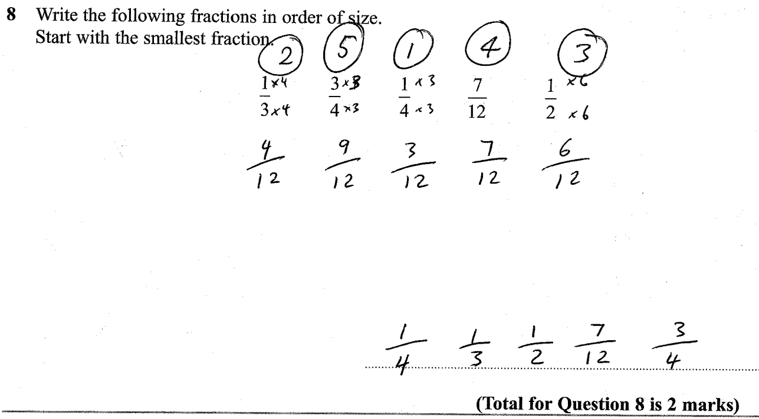

Slide 31
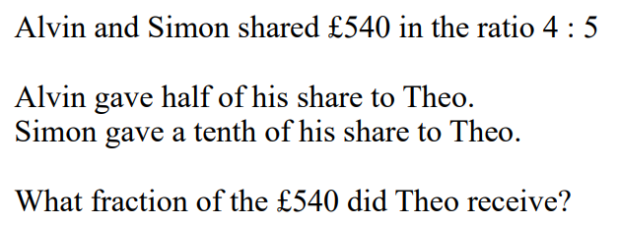
Don’t just read through revision notes; the only way to revise Maths is to do Maths!
Don’t just revise the topics you can do.
When completing past paper questions, ‘some’ marks is better than ‘no’ marks.
Use the line-by-line approach.

Slide 32
Use your calculator!
Always write down your working out.
Check your answers to ensure they make sense.

Slide 33
Head of Humanities
Mr McGlory

Slide 34
The Course
Paper 1 – British Thematic Study with Historic Environment
Written examination:
1 hour and 15 minutes
30% of the qualification
52 marks
Section A: Whitechapel Murders
Section B: Crime and Punishment Through Time (Medieval, Early Modern, 18th/19th Century and Modern)
Paper 2 – Period Study and British Depth Study
Written examination:
1 hour and 45 minutes
40% of the qualification
64 marks
Section A: Cold War
Section B: Elizabethan England
Paper 3 - Modern Depth Study
Written examination:
1 hour and 20 minutes
30% of the qualification
52 marks
Section A: Weimar and Nazi Germany Sources
Section B: Weimar and Nazi Germany Historian Interpretations

Slide 35
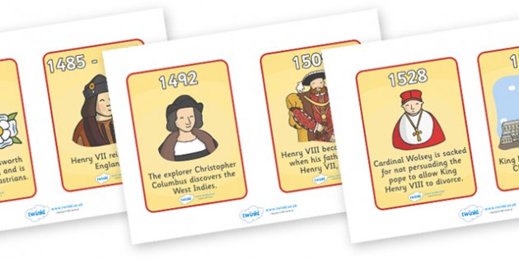
Top Tips to Revise:
Use cards to remember individuals and events
Retrieval Practice
Create your own knowledge quiz
Practice exam questions or plan answers

Slide 36
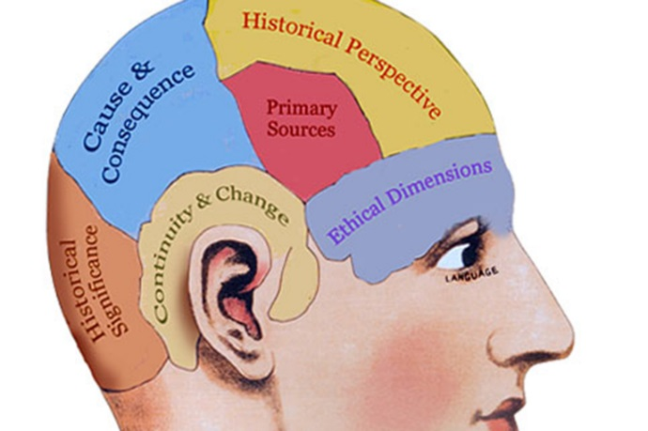
Mastering the content
Consider…
The 4S’
Shrink down - Eliminate the unnecessary, in depth revision comes from revision guides and class books.
Save space- Replace words with symbols, shorten words or use acronyms to cram in the info.
Stand out- Using diagrams and pictures in place of lengthy explanations makes the information stand out.
Secure keywords- When condensing the content, remember that keywords are KEY.
Individuals
Dates
Historical Events
Key Concepts

Slide 37
What do we offer?
Enrichment every Thursday for catching up and closing the gaps.
Access to past papers for students.
Students will be given revision guides for the topics.

Slide 38
How you can help?
1. Encourage revision – the 4S’ and use top tips
2. Encourage completion of all homework.
3. Work with them in retrieving names and events.
4. Encourage them to practice questions at home.

Slide 39
On your way out?
Key figures Cards
Revision guides for the 2 completed topics
Topic Lists

Slide 40
Thank You

